Slide 1

“ESU Gym Check-In”
A Multi-Threaded Networking Project
Prepared By:
Mark Benson, Danny Chen, and John Khan

Slide 2


Presentation Outline
Concept
GUIs
Login
Home Screen
Specific Gym
Flow Chart Diagram
Server/Client
Pseudo Methods

Slide 3
Conceptual Design
2 Gyms on ESU Campus
Mattioli Rec Center (MRC)
Rec B
Approx. 100 Users (Client)
Username/Passwords
Shows users checked at location
GUI is Java Swing based
Network connected socket programs (Server)

Slide 4
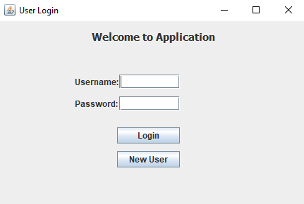
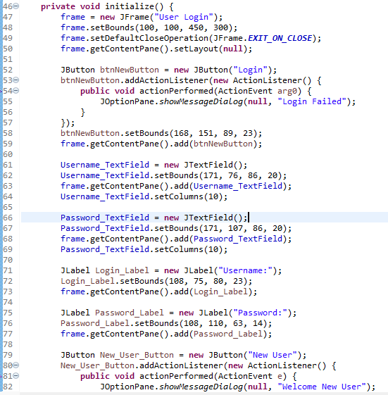
Login GUI

Slide 5






Main “Home” Screen GUI
MRC Users: 08/20
Rec B
Users: 20/20

Slide 6



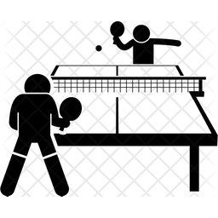
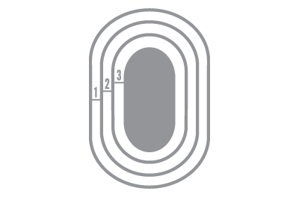

Gym Specific GUI
MRC Users: 08/20
Check - In
Check - Out
Schedule
Session

Slide 7
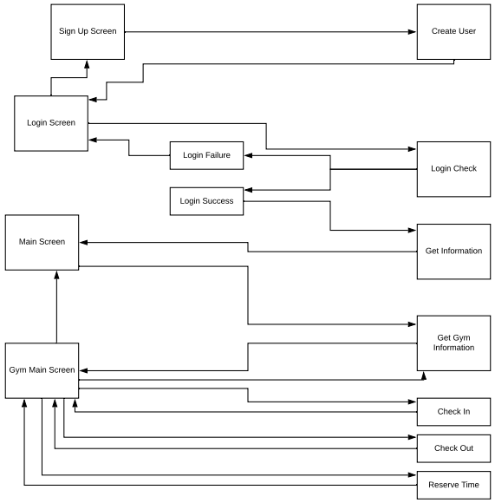
Control Flow
Client
Server
Client Side
Log-In
New Account
Main “Home” Screen
Specific Gym Screen
Server Side
Create User
Log-In
Check-In
Check-Out
Get Information
Schedule Time

Slide 8
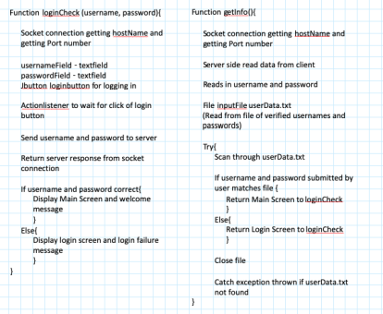
Pseudo Codes/Algorithms

Slide 9
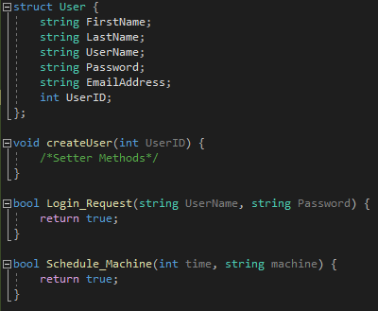
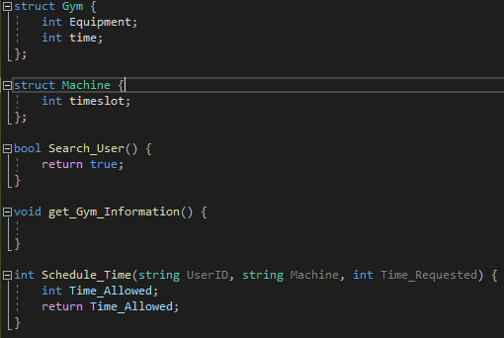
Pseudo Code/Algorithms
Server
Client

