Slide 1
NYSE Data Project
Presented By
Emmanuel Ogomigo
With focus on
Industrials & Information Technology

Slide 2
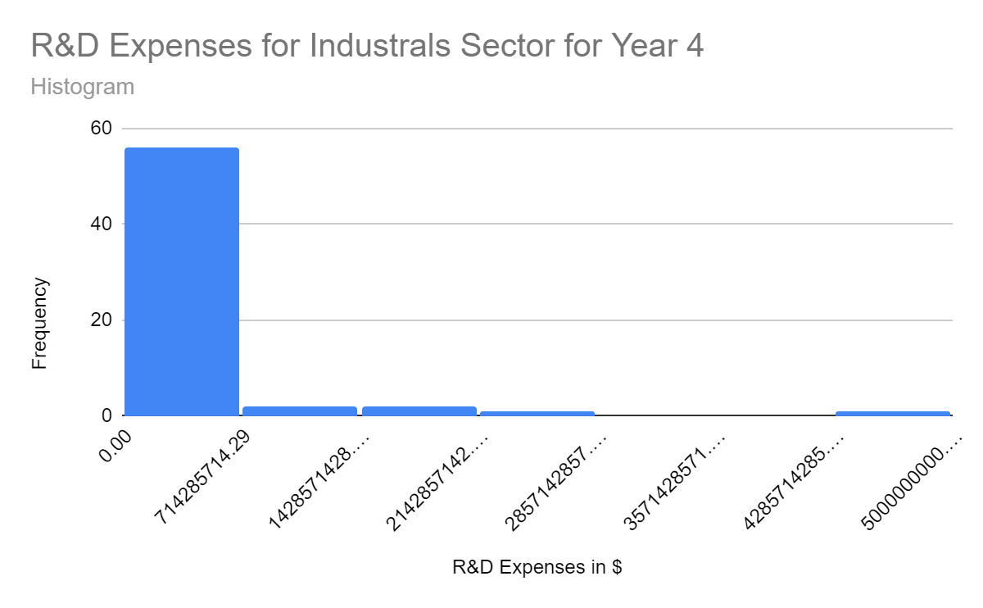
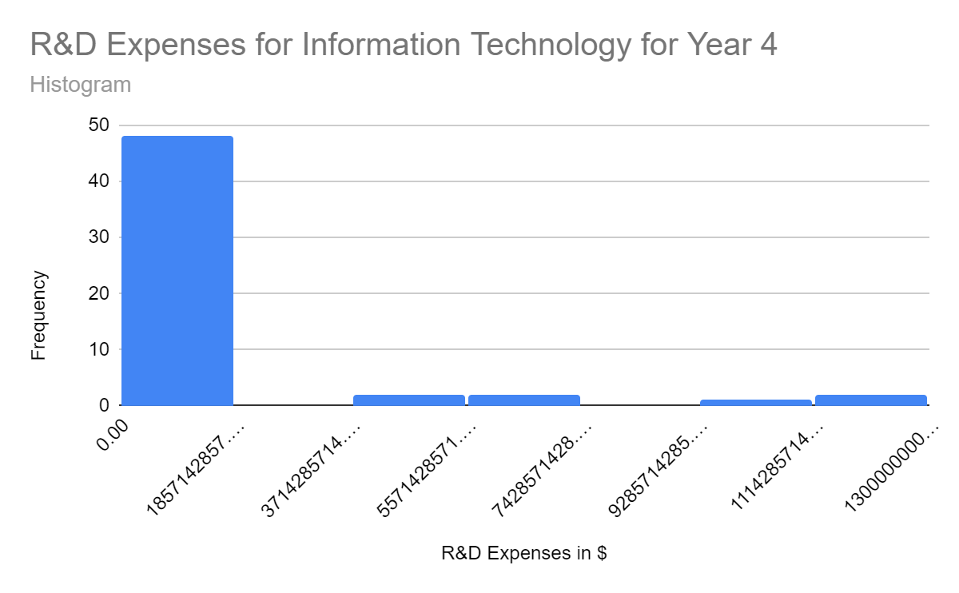
Does the Industrials sector have similar expenditure levels for R&D in comparism to IT sector for Year 4?
Here are the histograms for the annual R&D expenses for Industrials sector and IT sector companies reported for all companies in Year 4.
Both distributions are right-skewed or positively skewed. That means, the mean for each is higher than the median.
The mean for Industrials is about $247 million, and for IT is slightly above $1.5 billion. However the median for Industrials is zero, owing to the fact that fewer compaines invest in R&D and most companies invest $0 in R&D as compared to IT with a median value of a little over $653 million.
The SD for Industrials is way less ($749 million for Industrials and 2.8 billion for IT). That means, the variability in R&D for IT companies is higher, with more companies spending within the range of $12 billion, and more than 50% of the IT companies spending more than $653 million that year on R&D expenses.

Slide 3
Reference
https://docs.google.com/spreadsheets/d/1wxOuVT4ARl1kSdyjH_aKRxNvMReJgUeaf86CF6ljrbs/edit?usp=sharing (link to the google sheet)
Analytics with Spreadsheets (Masterschool) - Udacity

