Slide 1
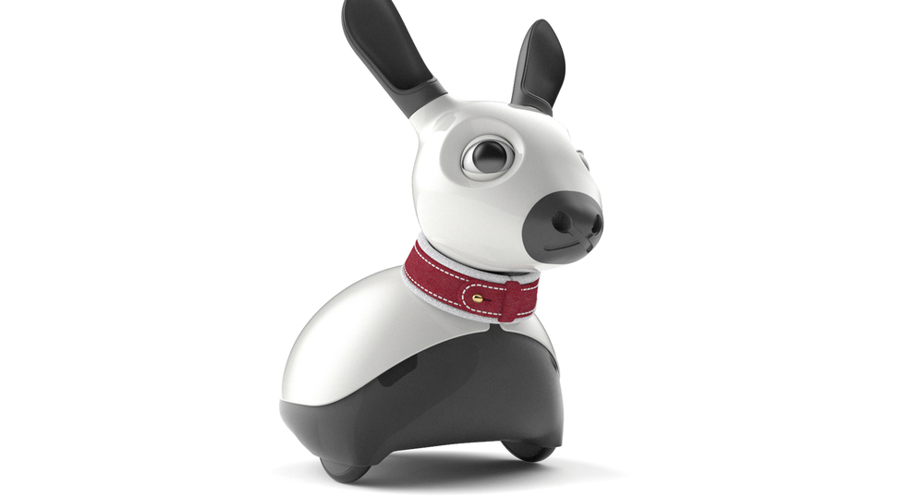

MiRo
bioMimetic Robot

Slide 2
MiRo
Companion robot
Human-Robot interaction (HRI)
Robot assisted therapy
Biomimetic and brain-based robotics

Slide 3
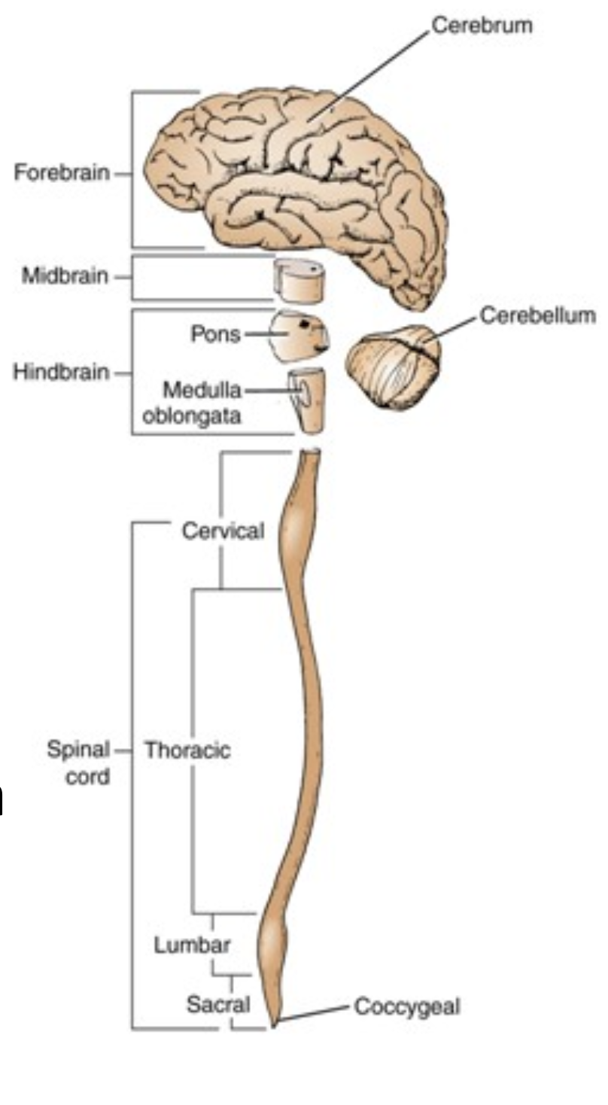
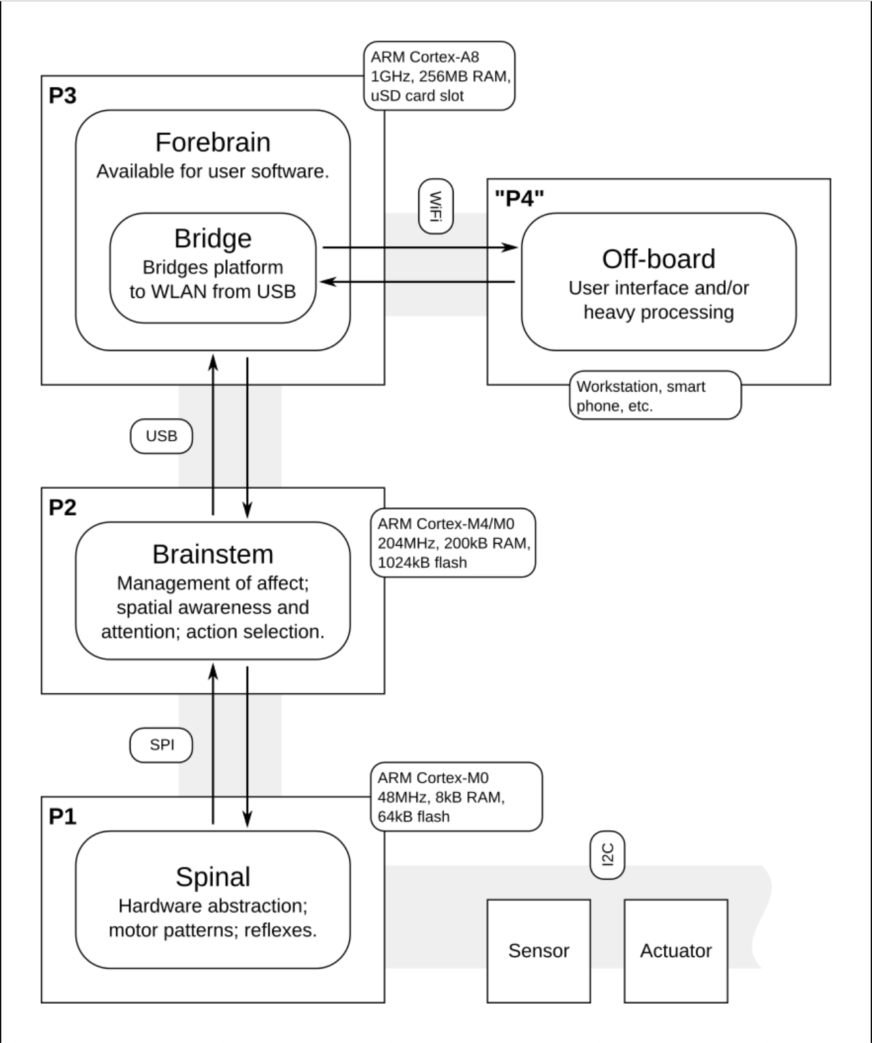
Note

Slide 4
Setup for MiRo
About MiRo: http://consequentialrobotics.com/miro/

Slide 5
Note
The following slides are a quick summary of what is described in detail here: https://consequential.bitbucket.io/
Specifically the ‘developer manual’: https://consequential.bitbucket.io/Developer.html

Slide 6

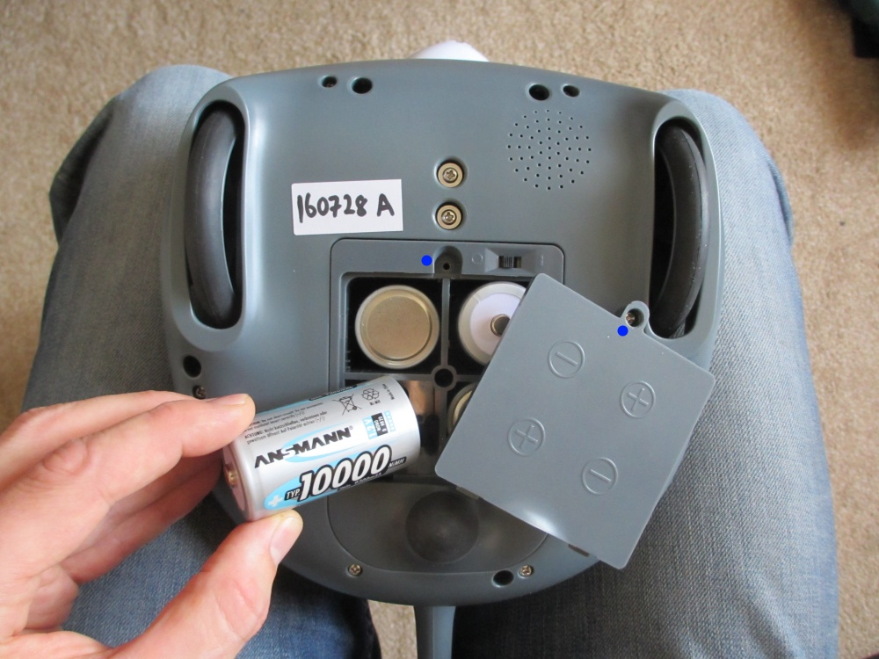
Critical points
Hardware
software
While removing or inserting batteries. Place MiRo as can be seen in the image on the left.
Quick look at this page (related to basic safety): https://consequential.bitbucket.io/Demonstrator_Commissioning_Before_You_Start.html
Quick look at this page (if any technical doubts): https://consequential.bitbucket.io/Technical.html
If you wish to use MIROsim (http://consequentialrobotics.com/mirosim/). It is better to have ubuntu as dualboot on your workstation rather than having ubuntu in virtual machine.
Nonetheless, if you are using virtual machine and MIROsim does not work properly, try again by disabling 3D acceleration (In VirtualMachine settings)

Slide 7
Ros installation
Copy and paste in terminal, one by one, everything after the ‘$’ sign.
$ sudo sh -c 'echo "deb http://packages.ros.org/ros/ubuntu $(lsb_release -sc) main" > /etc/apt/sources.list.d/ros-latest.list’
$ sudo apt-key adv --keyserver hkp://ha.pool.sks-keyservers.net:80 --recv-key 421C365BD9FF1F717815A3895523BAEEB01FA116
$ sudo apt-get update
$ sudo apt-get install ros-kinetic-desktop-full
$ sudo rosdep init
$ rosdep update
$ echo "source /opt/ros/kinetic/setup.bash" >> ~/.bashrc
$ source ~/.bashrc
$ sudo apt-get install python-rosinstall python-rosinstall-generator python-wstool build-essential
$ rosversion ros

Slide 8
MiRo devkit and android app
Download from: http://labs.consequentialrobotics.com/miro/mdk/
The MDK (Complete Edition) onto your workstation
The MIROapp onto your Android mobile device directly
Then, in your workstation:
Make a new directory called ‘lib’ in your ‘home’ directory
Extract the recently downloaded MDK (Complete Edition) in ‘lib’
In the terminal enter into the mdk directory and execute the following command:
$ ln -s ~/lib/mdk-180509 ~/mdk
Continued …

Slide 9
MiRo devkit and android app
Download from: http://labs.consequentialrobotics.com/miro/mdk/
The MDK (Complete Edition) onto your workstation
The MIROapp onto your Android mobile device directly
Then, in your workstation:
Finally, open your bash file by typing in:
Copy and paste lines from https://consequential.bitbucket.io/Developer_Preparation_Prepare_workstation.html
(The lines within white windows) which are basically configure ROS and Gazebo for operating with MiRo.
$ sudo nano ~/.bashrc

Slide 10
Configuring MiRo
In the smartphone: open the MIROapp and check its IP address
In your workstation: open a new terminal window and type in:
$ ssh root@<Put_Here_IP_Of_MIRO_Found_In_Android_App>
MIRO’s SSH entry password is:
$ MIROOpen1
Once inside MIRO’s Terminal, type in:
$ sudo nano ~/.profile
Once inside .profile
Change ROS_MASTER_IP as the IP address of your workstation. To check the IP address of your workstation open a new terminal window and type in:
$ ifconfig

Slide 11
Testing sample codes
(MIRO is going to move, be careful if it is on the table)
To run sample python code
Proceed as shown in the link:
https://consequential.bitbucket.io/Developer_Examples_Python_Command-line_Client.html
To run sample C++ code
Proceed as shown in the link:
https://consequential.bitbucket.io/Developer_Examples_C++_Command-line_Client.html
To run sample python code (GUI for sensors and actuators of MIRO):
Proceed as shown in the link:
https://consequential.bitbucket.io/Developer_Examples_Python_GUI_Client.html

Slide 12
Last but not the least
Take a look at Application Domains for Inspiration.
http://consequentialrobotics.com/domains/

Slide 13
Configuring the workstation: to have static ip
Replace ‘<instruction_stated_inside>’ entirely with the instruction stated inside.
In your workstation:
In (Network Preferences/TCP-IP), change (configure IPV4) to 'Manual' from 'DHCP’
Change IPV4 Address to 130.251.13.<select_any_number_between_87_and_94>
In (Network Preferences/DNS), add 130.251.1.4 and 8.8.8.8
If using a virtual machine with ubuntu, all previous steps must be done on the main OS and after which you must go into the network settings of virtual machine and select “attached to” as 'Bridged Adapter'
CONTINUED…

Slide 14
Copy and paste in terminal, everything after the ‘$’ sign.
Replace ‘<instruction_stated_inside>’ entirely with the instruction stated inside.
In your workstation (ubuntu):
$ ifconfig
Check the IP address next to inet addr for enp___
Copy that IP address (It is now the static IP of your workstation)
$ sudo nano ~/.bashrc
Copy and paste in .bashrc the lines below and modify '<>' parts
# cofiguration
export MIRO_PATH_MDK=~/mdk
export ROS_IP=<Put_Here_StaticIP_Of_WorkStation>
export ROS_MASTER_URI=http://localhost:11311
# make our custom messages available to ROS/python
export ROS_PACKAGE_PATH=$MIRO_PATH_MDK/share:$ROS_PACKAGE_PATH
export PYTHONPATH=$MIRO_PATH_MDK/share:$PYTHONPATH
# usual Gazebo setup
source /usr/share/gazebo/setup.sh
# announce MIRO resources to Gazebo
export GAZEBO_RESOURCE_PATH=$MIRO_PATH_MDK/share:${GAZEBO_RESOURCE_PATH}
Finally
$ roscore

