Slide 1
Influence Limiter Analysis

Slide 2
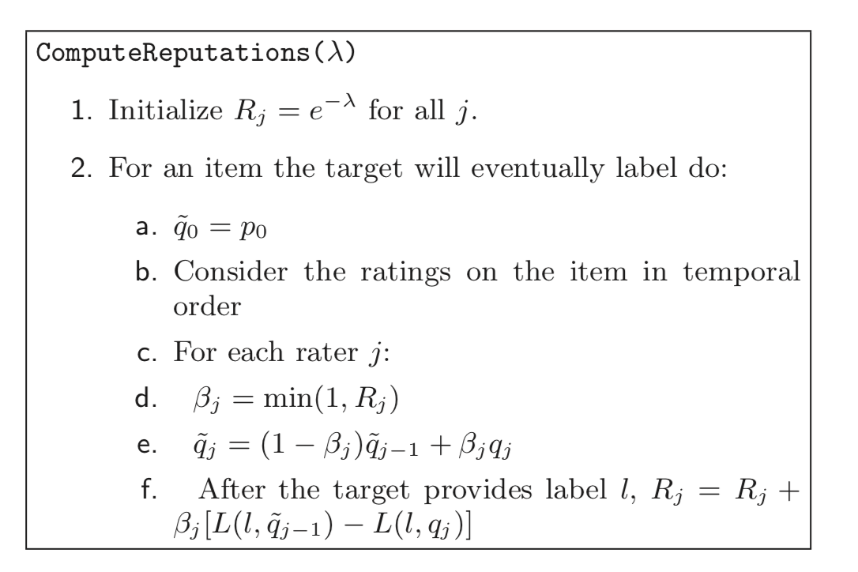
Why not just use loss function as reputation?
So first off, we do L(l,q) and not (l,r_j), because r_j is not a probability distribution but rather simply the rating that rater j provides. The recommender system is able to take user reports and in return come up with some probability distribution over the target user label space. This is what q_j is. If the reputation earned by rater j on item i is simple L(l,q_j), if we pick the quadratic loss function, the reputation of rater j will always increase, regardless of whether rater j is malicious or not. That is, there is no way to penalize a malicious/attacking rater.
“The more that a rating implies a change in the prediction for the target, the greater the potential change in the rater’s reputation score. A rater who simply goes along with the previous change will have no impact and thus get no change in her reputation. “ → cloning attack
“Second, the actual reputation score of any rater is always positive and is bounded above by an information-theoretic measure of the actual improvement that rater has made in the predictions for the target. “
“Our approach thwarts the cloning attack by adding reputation only when a rater improves the prediction made for some target. Unless the rater moves the recommendation from where it was before the rater provided its information, the rater can neither gain nor lose reputation. “
Basically, we want users to provide additional useful information to the system, if a user does not change the recommendation, he or she didn’t provide
Reputation change is proportional to the amount of information given.

Slide 3
Of course we care about accuracy, but in reality, we wont have

Slide 4
Each rater begins with a very low but non-zero reputation score. The current reputation limits the influence she1 can have on the prediction for the next item. Eventually, the target person indicates whether he likes the item and the raters who con- tributed to predicting whether the target would like it gain or lose reputation. The more that a rating implies a change in the prediction for the target, the greater the potential change in the rater’s reputation score. A rater who simply goes along with the previous change will have no impact and thus get no change in her reputation.
the optimal strategy is to induce predictions that accurately reveal that rater’s information about the items. If the underlying recommen- dation algorithm is making optimal use of ratings, this im- plies that entering honest ratings is optimal. An important special case is that a rater who has not interacted with an item, and therefore has no information about the target’s likely response to it, can only lose reputation in expectation by giving a rating.
Second, the actual reputation score of any rater is always positive and is bounded above by an information-theoretic measure of the actual improvement that rater has made in the predictions for the target.
Finally, our algorithm limits the amount of damage that can be done with sybils. For example, if one rater provides bad information about an item in order to increase the repu- tation of another rater who later corrects that bad informa- tion, the expected sum of the reputations of the two raters does not increase. Thus, while it may be possible to trans- fer reputation among sybils, it is not possible to increase the total reputation of the raters that a person controls.
The initial reputation of each rater is set low enough that the total reputation of this bounded number of raters is still relatively small.
Most recommender systems do not take into account the order of ratings, and thus the attacker will have just as much effect on predictions for the last item as the rater who was copied.
Our approach thwarts the cloning attack by adding reputation only when a rater improves the prediction made for some target. Unless the rater moves the recommendation from where it was before the rater provided its information, the rater can neither gain nor lose reputation.
Moreover, any sybil profile that does happen to gain a high credibility score has, by chance, moved the predictions for the target in a useful way, thus compensating for the lost utility from the subsequent manipulation.
The second feature is a scoring function that assigns repu- tation to j based on whether or not the target actually likes the item. The amount of reputation that can be gained is again limited by the current reputation, and is selected so that the reputation will always be positive. It is also tuned so that honest raters reach full credibility after O(log n) rat- ings, to limit the amount information that is discarded in the influence-limiting step before a rater reaches full credibility. If a rater’s entire reputation was risked on each rating, the probability of getting to full credibility from a sequence of ratings the target agrees with would be too small and the expected time to full credibility would be too high. The rate limiter βj threads the needle, allowing the rater to risk more as her reputation rises, but not risk too much, as we prove in section 5. 2
j = min(1, Rj ) determines j’s influence limit; if Rj is above 1, j can move the prediction q ̃j−1 to qj, but if Rj is below 1 she can only move it partway there. The score for rater j on the current item is a fraction βj times the market scoring rule, the difference between the loss function for the prediction q ̃j−1 and the loss function for qj. Note that she is scored on the prediction she would have liked to make, qj , even if the rate limiter only permitted her to move the prediction to q ̃j.
Lemma 1. (Honest Reporting) For any entity j, if j be- lieves (at the time of rating) that the probability of the item being labelled HI is q, j optimizes her expected reputation gain on this item by putting in a rating such that qj = q.
The following critical lemma relates the influence an agent garners to her measured impact on prediction error. Lemma 2. (Reward-performance inequality) The reputa- tion increase ∆Rj of player j on an item i is no more than the impact ∆ij of entity j on this item’s recommendation.
we tie the influence a rater can have to her accumulated reputation in a way that enables informative raters to ramp up exponentially fast, while limiting the total damage at any point to the amount of positive impact already created by each rater.

