Slide 1
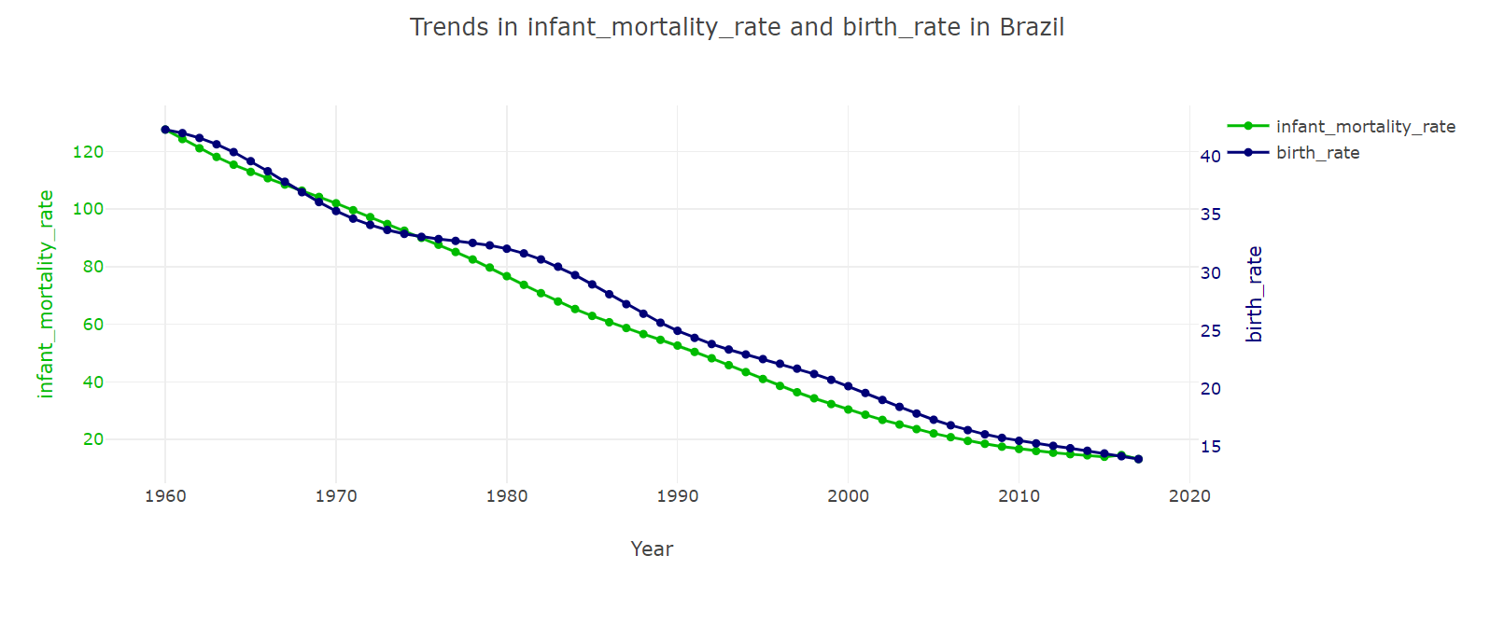
Explore Trends in Different Countries…

