Slide 1
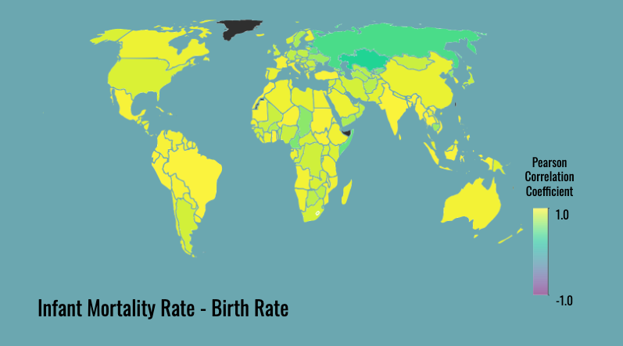
Explore How Healthcare Relates to Outcomes …

