Slide 1
(GAP) Generalized Adaptive Polynomial Window Function
João F. Justo and Wesley Beccaro
Departamento de Sistemas Eletrônicos, Escola Politécnica, Universidade de São Paulo, Brazil
IEEE Access 8, 187584 (2020). DOI: 10.1109/ACCESS.2020.3030903
Notes:
1

Slide 2
Outline
Motivation and state-of-the-art
Proposition
Results: Mimic other window functions
Results: Optimize window functions
Summary
Contact and link to software (MATLAB® and Python)
Notes:
2

Slide 3
Motivation
Discrete Fourier Transform (DFT) is a powerful tool to perform Fourier analysis in discrete data, with several applications, such as astronomy, chemistry, acoustics, geophysics, and digital processing.
The use of window functions affects the analysis in the frequency domain, sometimes introducing unwanted artifacts, such as signal leakage, scalloping loss, and intensity of sidelobes.
Notes:
3

Slide 4
State-of-the-art Window Functions
The current need for better signal processing methods motivates development of improved window functions, to provide superior spectral properties.
Recent research on window functions has focused in improving windows with flexible temporal and spectral characteristics.
There is a demand for a more systematic procedure to develop those functions.
We propose a generalized functional form to describe windows combined with an optimization method to improve their spectral properties.
Notes:
4

Slide 5
Generalized Adaptive Polynomial (GAP)
We present a generalized window function as a non-linear polynomial expansion in which all the current windows could be mimic with the appropriate expansion coefficients.
This functional form is very flexible, which allows searching for sets of expansion coefficients that provide superior properties, considering a reference figure of merit associated to the property to be improved.
This procedure paves the way for optimization and adaptive methods, such as machine learning and genetic algorithms, to adapt window functions to certain data sets and specific applications.
Notes:
5

Slide 6
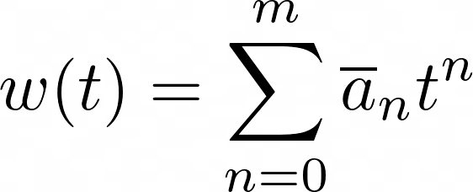
The GAP Window Function
Flexible functional form for a window function, a non-linear polynomial expansion:
where and are the coefficients and the order of the polynomial expansion, respectively.
Notes:
6

Slide 7
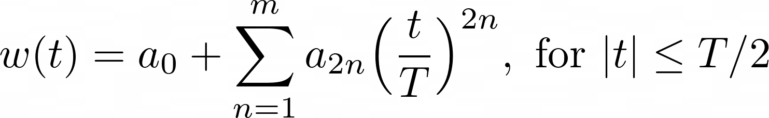



The GAP Window Function
All windows are symmetrically constrained around their center.
Considering the polynomial represented only in the time interval -T/2 to +T/2, we kept the form:
where for .
Here, we developed the window constraining (normalized), but this constrain could be lifted in future developments.
Notes:
7

Slide 8
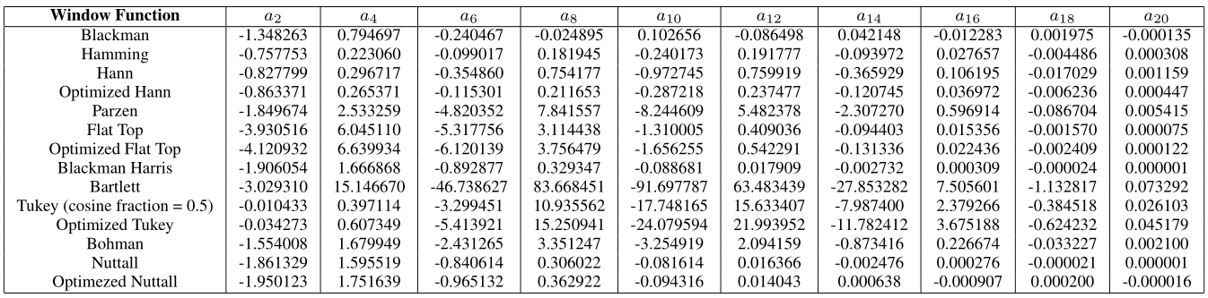
Mimic Other Window Functions
An expansion with m = 10 (only ten coefficients a₂ to a₂₀) can describe well most of the traditional window functions.
The expansion, with coefficients presented in the table, mimic any of the well-established windows and their properties.
Notes:
8

Slide 9
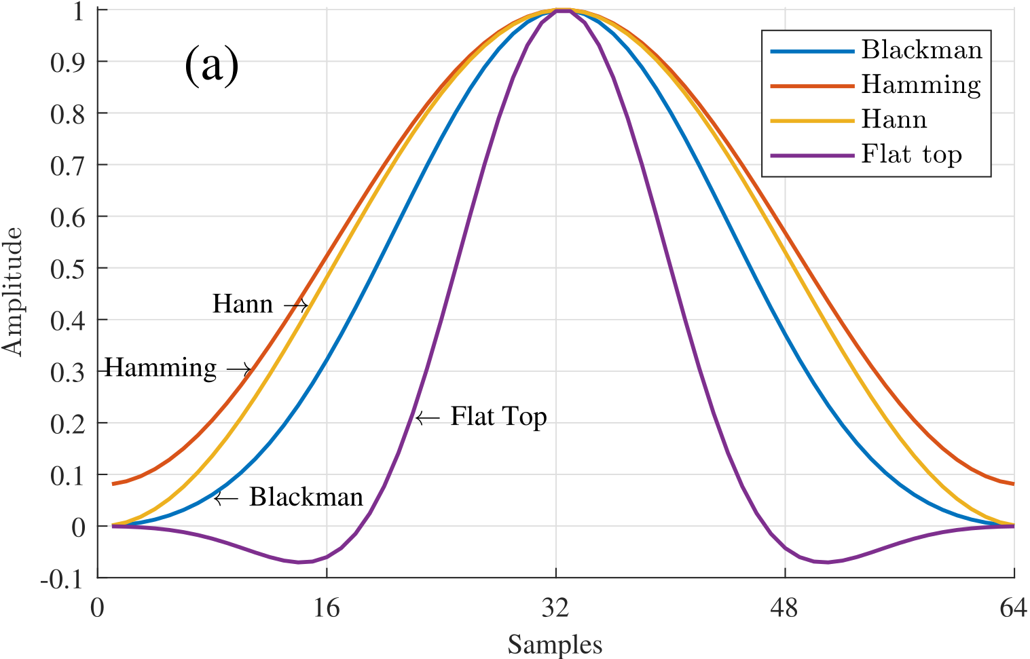
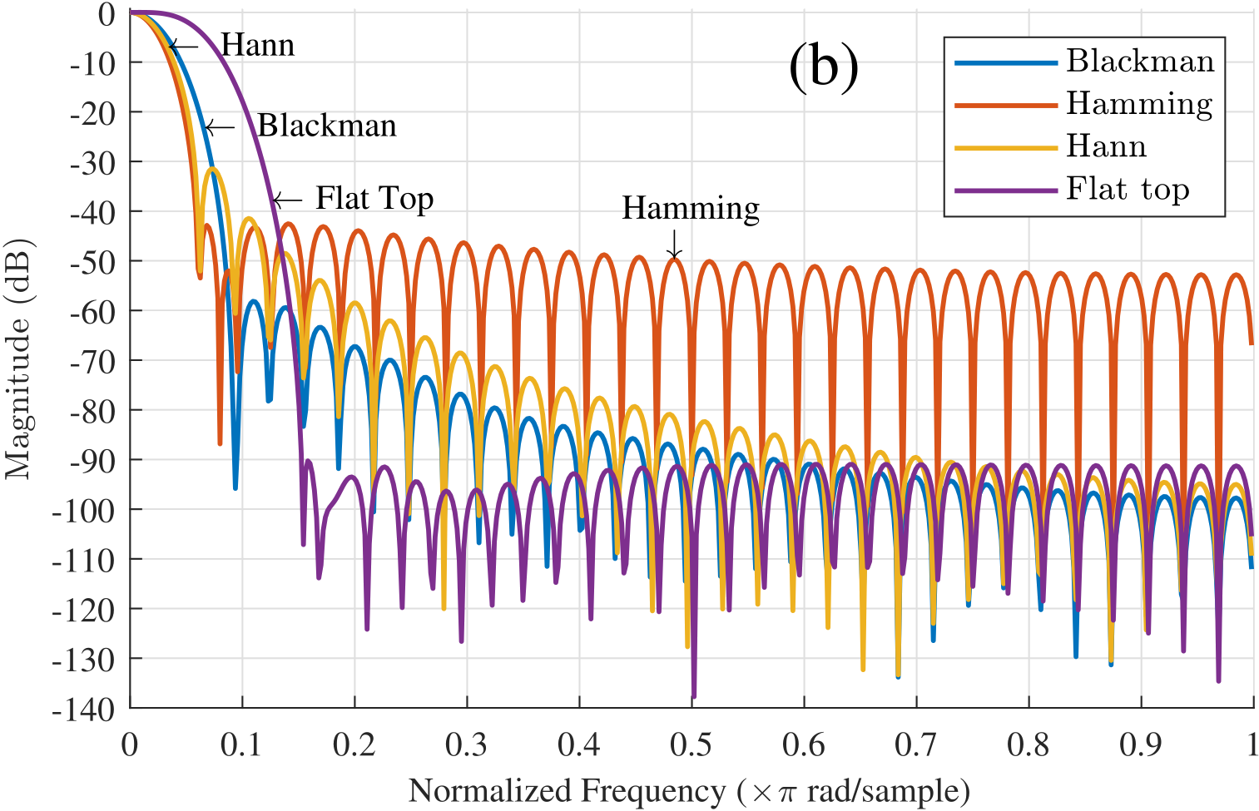
Mimic Other Window Functions (Results)
This generalized window function could mimic (as shown in the figure) any of the well know window functions.
Notes:
9

Slide 10
Optimization Algorithms
Starting with a set of expansion coefficients a_{2n} that mimics a certain window function, one can find a new window by varying those coefficients, searching iteratively to minimize a certain cost function up to a pre-determined convergence value.
Using the a_{2n} variables as input of the Nelder–Mead (NM) algorithm (simplex method), it is possible to find a new set of coefficients that lead to a local minimum of a side lobe measurement function (or other spectral properties).
Notes:
10

Slide 11


Optimization Strategies for GAP Coefficients
The first optimization strategy can be performed in the frequency domain, by varying the coefficients and optimizing the main properties in the frequency response.
Another strategy to optimize the GAP can be performed directly in the time domain. Get a_{2n} coefficients that minimize the window function derivative at its extremities to improve the sidelobe attenuation:
Maximize the second derivative modulus of w(t) at its center to decrease the main lobe width:
Notes:
11

Slide 12
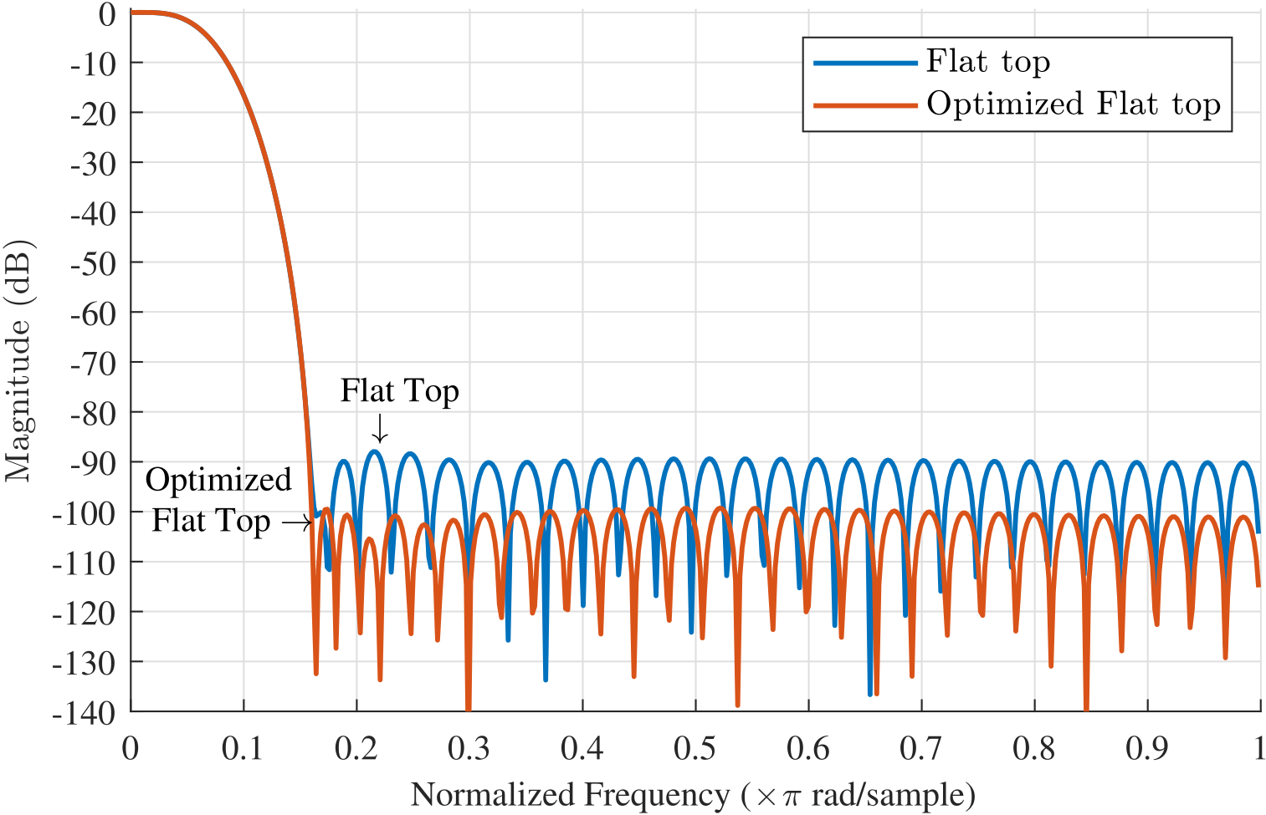
Optimization (Flat Top Window)
Flat Top window is optimized to improve the side lobe attenuation.
Notes:
12

Slide 13
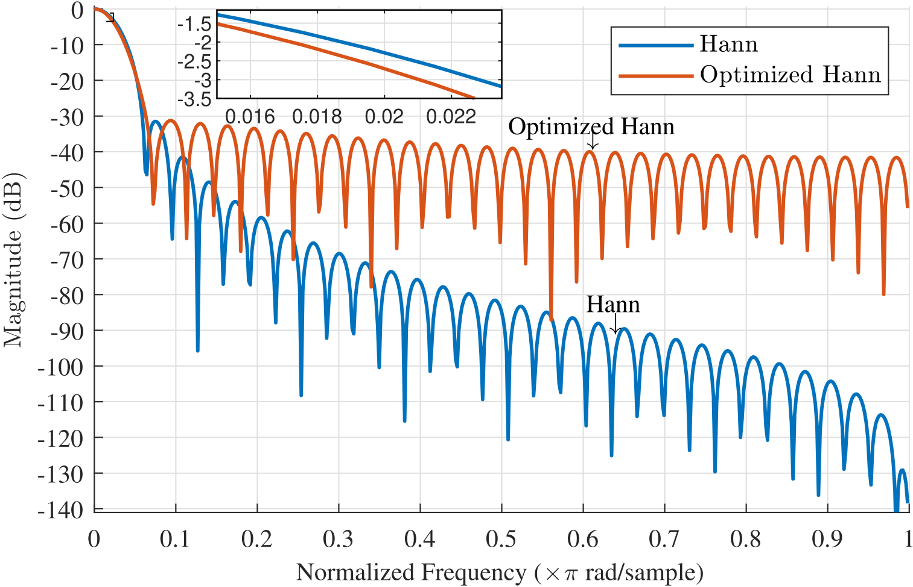
Optimization (Hann Window)
Hann window is optimized to improve the main lobe width.
Notes:
13

Slide 14
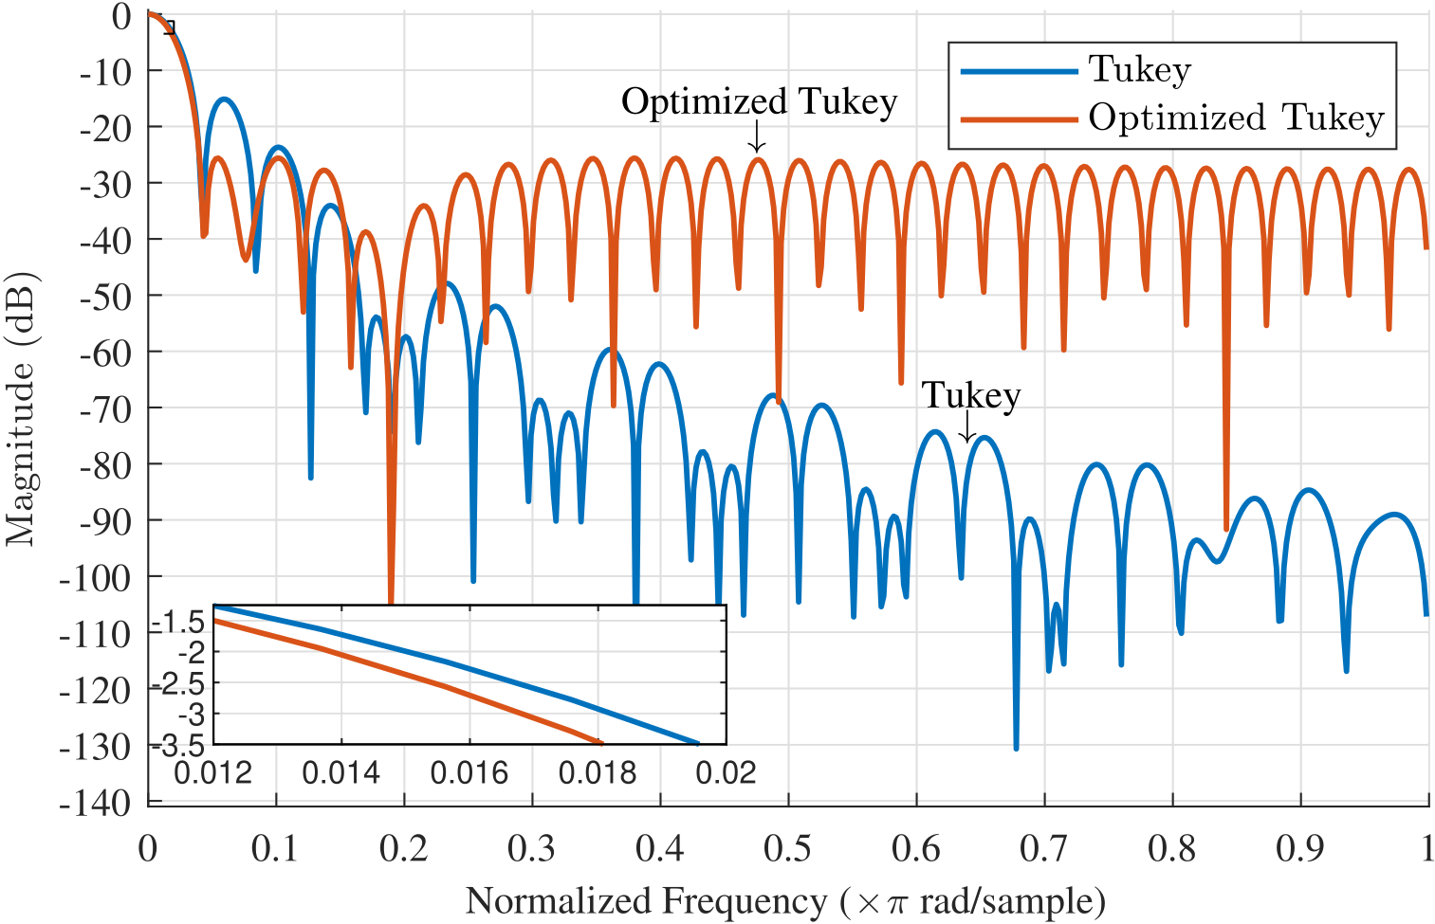
Optimization (Tukey Window)
Tukey window is optimized to improve simultaneously the side lobe attenuation and main lobe width.
Notes:
14

Slide 15
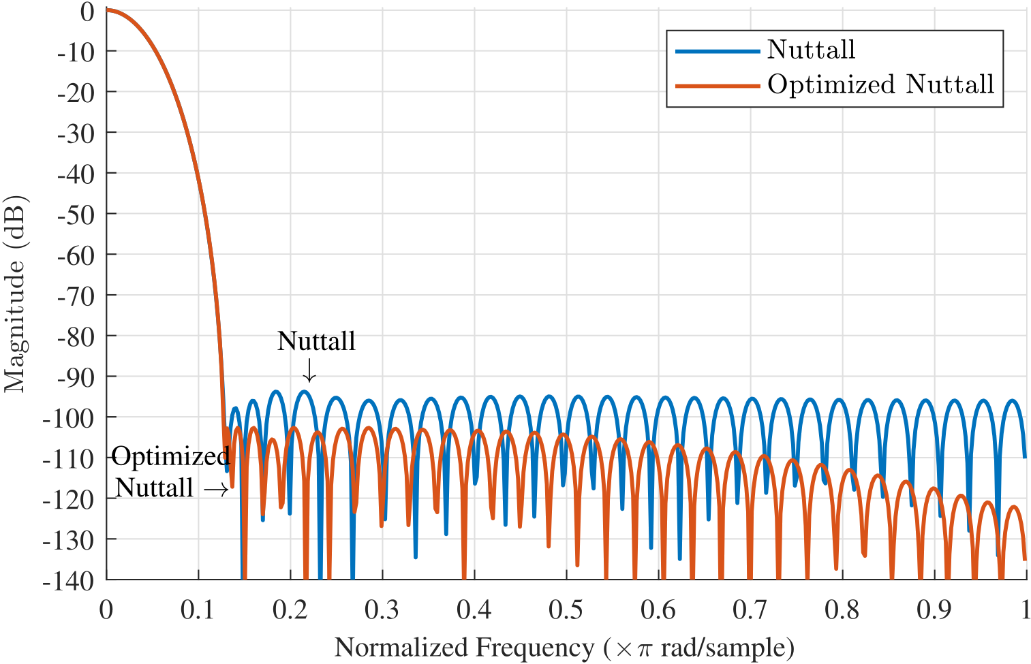
Optimization (Nuttall Window)
Nuttall window is optimized to improve both the side lobe attenuation and main lobe width.
Notes:
15

Slide 16

Optimization Movie (with MATLAB®)
Notes:
16

Slide 17
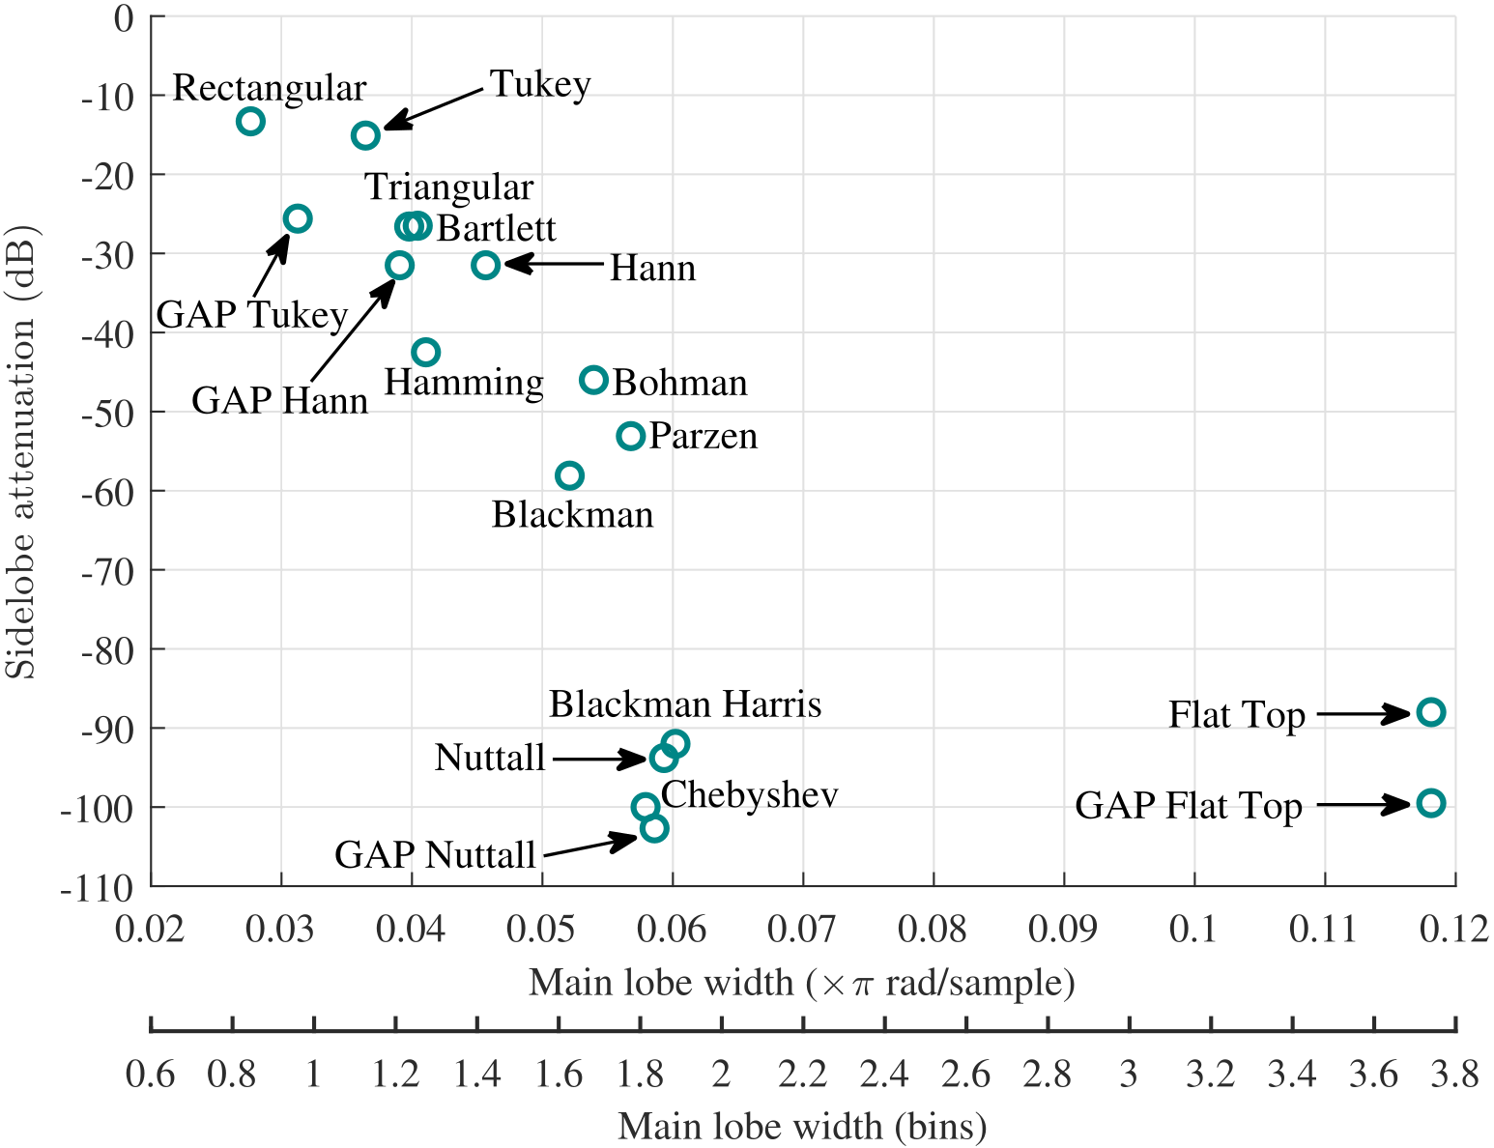
Optimization of Spectral Properties (General Results)
Notes:
17

Slide 18
Summary
This method to obtain windows is quite general, allowing the use of several optimization strategies, such as global optimization (genetic algorithms and simulated annealing) or local optimization (Newton and gradient-based methods) techniques, or even machine learning.
Any new window obtained by optimization represents an improvement of the spectral properties in the frequency domain, when compared to that initial window function guess.
This method allows to improve several spectral properties simultaneously.
Notes:
18

Slide 19



Contact and Link to Software (MATLAB® and Python)
IEEExplore (Paper):
https://ieeexplore.ieee.org/document/9223641
GITHUB:
https://github.com/EmbDSP/GAP/
MATLAB® File Exchange:
https://www.mathworks.com/matlabcentral/fileexchange/81658-gap-generalized-adaptive-polynomial-window-function
Contact: wesley@lme.usp.br
Notes:
No modo Apresentação de Slides, selecione as setas para visitar os links.
19

