Slide 1




Learn Basic SSIS
For Beginners
linkedin.com/in/joeyblue/
github.com/EmbarkBlue/JoeyBlue-SQL-Trainings/
youtube.com/user/SqlTrainingOnline

Slide 2

Overview
Quick Introduction of ETL/SSIS
Prerequisites
Example Setup from Github
Initial ETL
Transformations
Control Flow
Parameters
Publishing
Server Configurations
Scheduling
Advanced API Call

Slide 3

ETL - Definition
Extract, Transform and Load

Slide 4
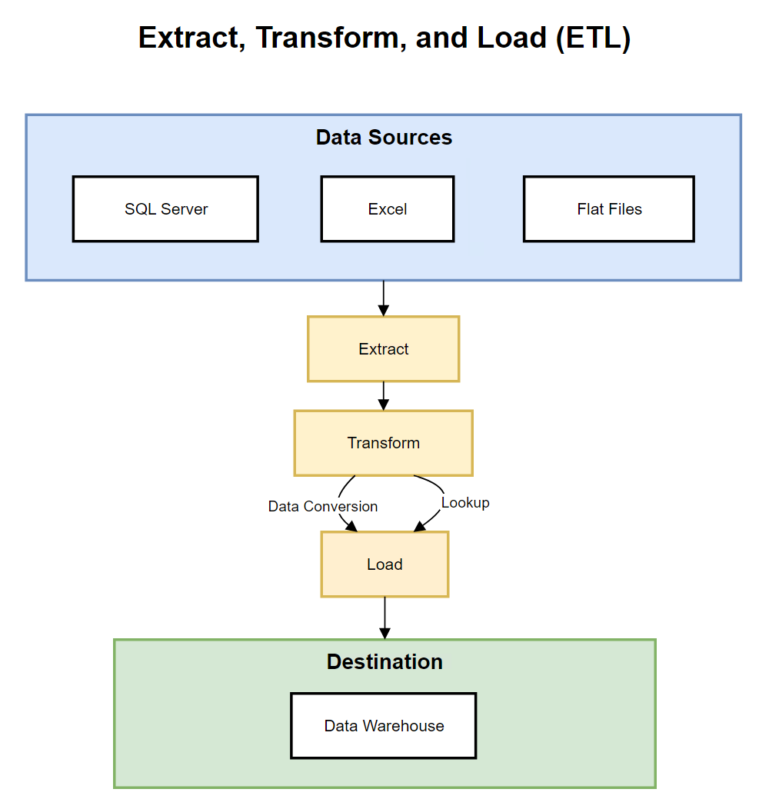

Slide 5

ETL Tools
SQL Server Integration Services (SSIS)
Informatica
AWS Glue
Azure Data Factory
Talend Open Studio
Alteryx
Power Query
Python
C#

Slide 6
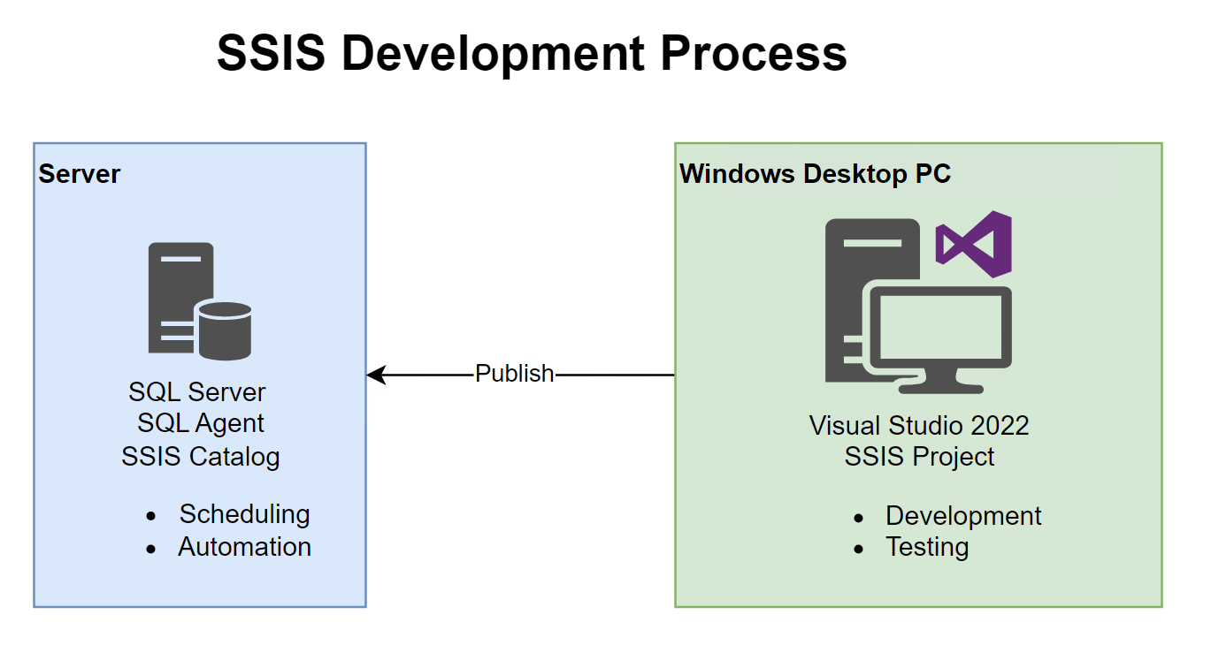

Slide 7
Pre-requisites
Visual Studio 2022 Community
SSIS Project Extension
SQL Server
SQL Server Management Studio
Github Database Scripts

Slide 8

Database Setup

Slide 9

Business Request
The business has customer purchase data in local currency, but needs that data converted and needs the Customer contact information with it.
The purchase data is in SQL Server, the currency conversion data is in Excel, and the customer contact information is in a csv file.
You task is to bring this data together in a new SQL Server database for the business.

Slide 10

Initial ETL

Slide 11

Transformation

Slide 12

Deployment

Slide 13
Server Configuration and Scheduling

Slide 14

API Call for Currency Conversion

