Slide 1
Hailstorm: Disaggregated Compute and Storage for Distributed LSM-based Databases
ASPLOS’20

Slide 2
1 Intro
Distributed database used in cloud applications，such as:
search engines [34, 39], social networks online shopping [1, 41], media services [4], messaging [28], financial services [5, 33], graph analytics [6], and blockchain
Distributed databases shard data across LSM-KV store.
Problems:
Skew occurs naturally. Current LSM-based databases address skew by resharding data across machines -> bulk migration of data
Background operations such as compaction -> significant I/O and CPU bursts
Reason:
storage engines operate independently of each other and thus are unaware of resource usage and background operations on other machines.

Slide 3
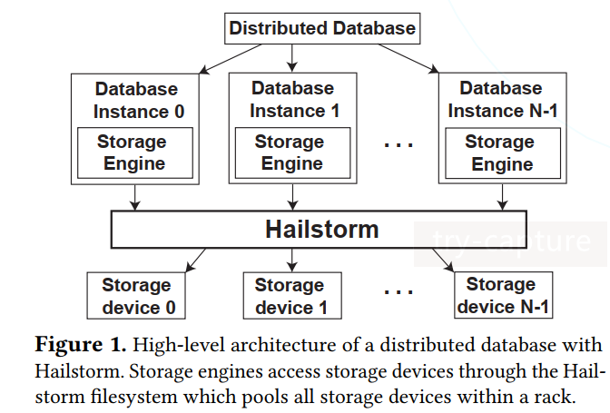
This paper presents Hailstorm, a lightweight distributed filesystem specifically designed to improve load balance and utilization of LSM-based distributed databases.
Key idea: disaggregate compute and storage, allowing each to be load balanced and scaled independently
Pooling and fine-granularity data spreading (in a rack)
Offloading expensive background compaction tasks to other less utilized nodes

Slide 4
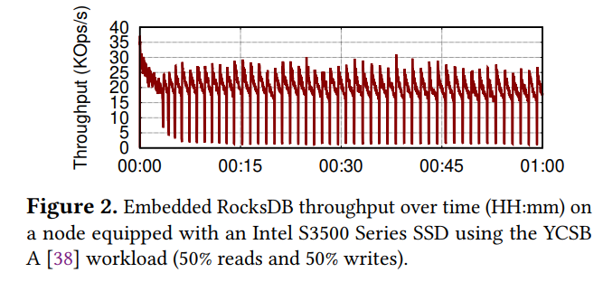
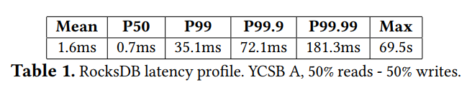
2 Background & Challenges
2.1 Skew in Distributed Databases
Some keys are more popular than others. As a result, sharding inevitably leads to data imbalance across the nodes
2.2 Compaction in LSM KV Stores

Slide 5
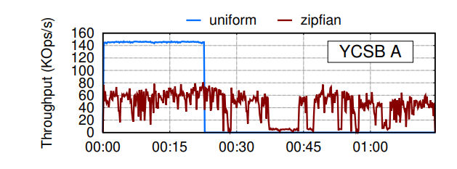
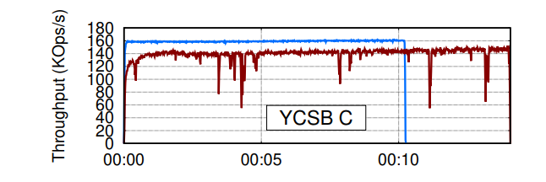
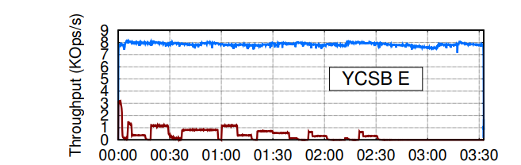
2.3 Distributed Databases with LSM Storage Engines
Both layers(skew in distributed databases, compaction in LSM KV store) interfere with each other
Current approach: MongoDB uses resharing to address skewness
Resharding involves migrating existing data
Resharding decisions are usually taken by the distributed database based on its own load metrics
Preliminary experiment implications
throughput is degraded with Zipfian
rebalancing shards and data migration bring throughput drops
YCSB E: range queries are stalled by compactions competing for I/O bandwidth and CPU resources on overloaded nodes
Only write
range queries
Only read

Slide 6
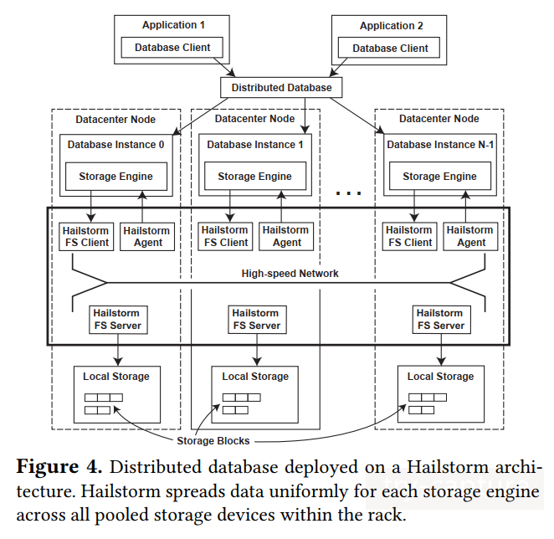
3 The Hailstorm Design
3.1 Hailstorm Design Principles
Resource disaggregation
Storage pooling
Fine-grained spreading of data
Compaction offloading
3.2 Filesystem Architecture
exposes a subset of the standard POSIX filesystem interface as required by storage engines
each client can access and store data on all servers within the same rack

Slide 7
3.3 Storage Architecture
Pooling Storage
stores the data at block granularity on all storage devices，spreading the load and enabling fast data access from any client
as long as the top-of-rack switch provides full bisection bandwidth and the network is fast enough, accessing remote storage incurs virtually no penalty（a few microseconds）
Data Placement and Access
a pseudorandom mapping function, take from file path, follow cyclic order across servers
Prefetch
Metadata
universally unique identifier (uuid) for file
client keeps the mapping between file path and uuid
Uuid -> servers: deterministic mapping function

Slide 8
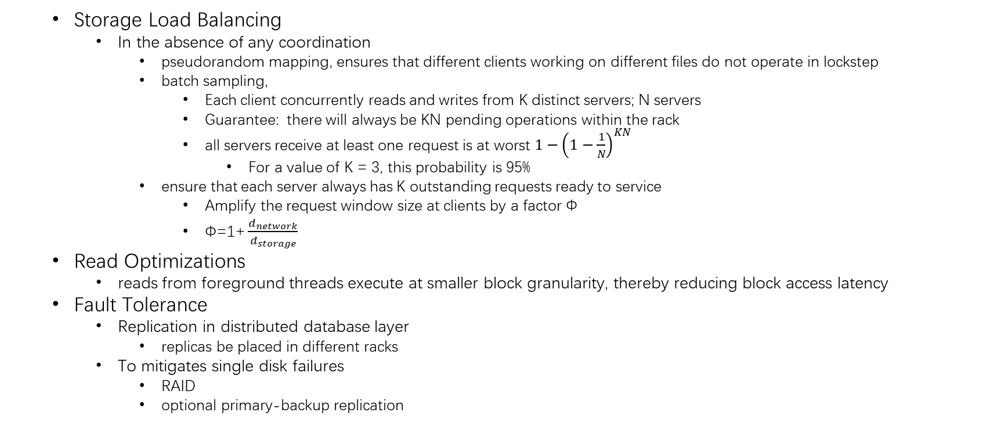
Storage Load Balancing
In the absence of any coordination
pseudorandom mapping, ensures that different clients working on different files do not operate in lockstep
batch sampling,
Each client concurrently reads and writes from K distinct servers; N servers
Guarantee: there will always be KN pending operations within the rack
all servers receive at least one request is at worst $1−{\left(1−\frac{1}{N}\right)}^{KN}$
For a value of K = 3, this probability is 95%
ensure that each server always has K outstanding requests ready to service
Amplify the request window size at clients by a factor Φ
$\text{Φ}\text{=1+}\frac{d_{network}}{d_{storage}}$
Read Optimizations
reads from foreground threads execute at smaller block granularity, thereby reducing block access latency
Fault Tolerance
Replication in distributed database layer
replicas be placed in different racks
To mitigates single disk failures
RAID
optional primary-backup replication

Slide 9
3.4 Compaction Offloading
Agent monitor resource usage
measures CPU utilization periodically, check if the difference between its value and the target node’s is larger than a customizable threshold θ
informs the peer with compaction job and associated file metadata
Remote agent spawns a process for job
notifies the agent on the original node with the list of newly created sstable files and their associated file metadata

Slide 10
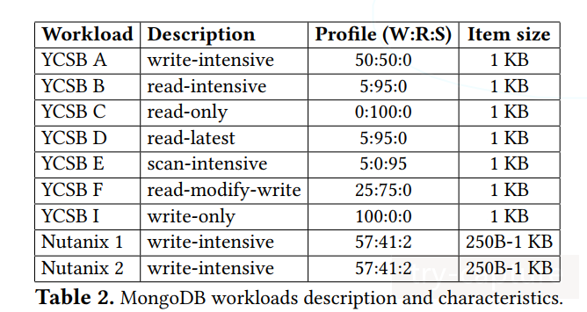
4 Evaluation
Experimental Environment
18 dedicated 16-core machines, 128 GB of DDR3 ECC main memory, an SSD providing a read bandwidth of 420 MB/s and a write bandwidth of 320 MB/s, a 40GigE top-of-rack switch
1 Distributed Database: MongoDB

Slide 11
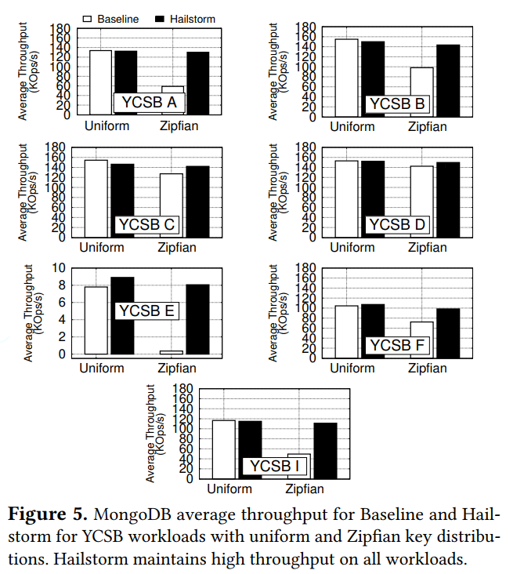
Synthetic Benchmark (YCSB)
Hailstorm allows the database to maintain good throughput even in the presence of high skew
Throughput is better with Hailstorm than with Baseline for write workloads
storage pooling and compaction offloading
network overheads

Slide 12
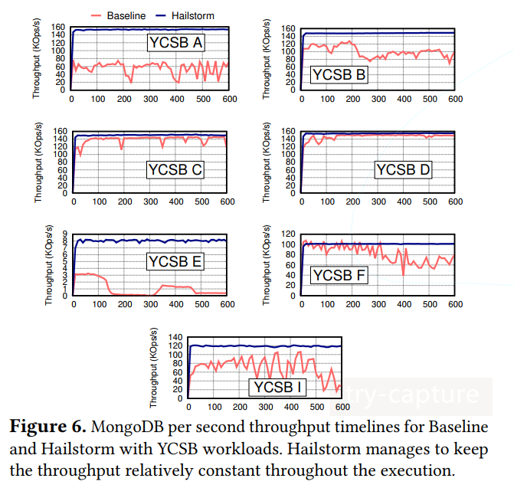
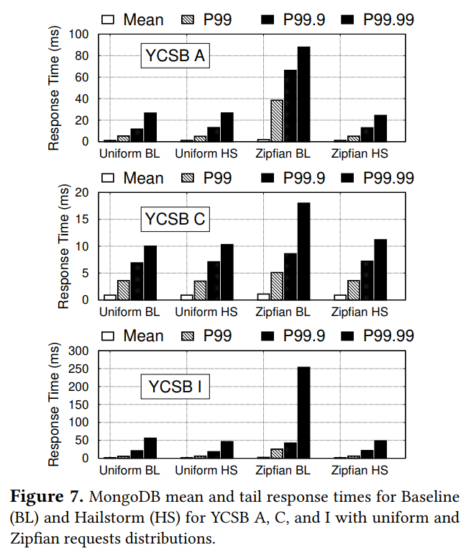
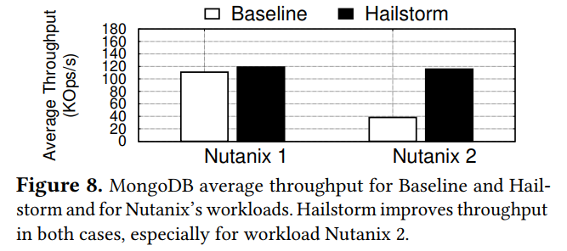
Fig6: Hailstorm maintain high and relatively constant throughput in the presence of skew.
Fig7: Hailstorm significantly improves response times under skew, especially for write workloads.
Fig8: production trace

Slide 13
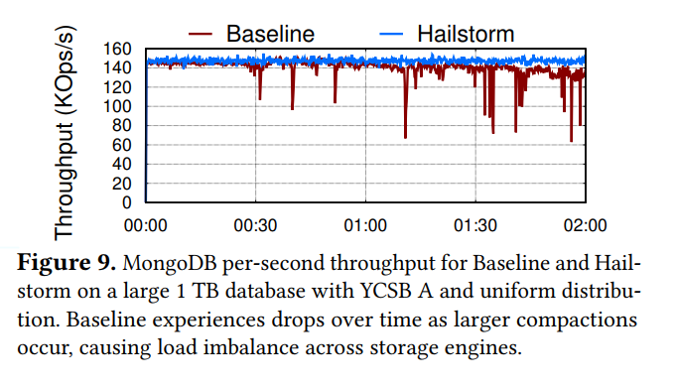
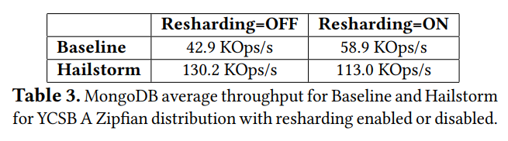
Fig9：Baseline performance suffers from sudden drops that increase over time as a result of larger compactions
Table3: resharding in MongoDB is beneficial in skewed workloads; storage pooling and compaction offloading are more effective than resharding

Slide 14
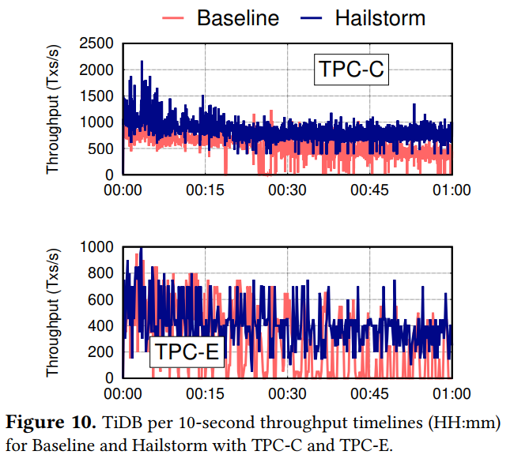
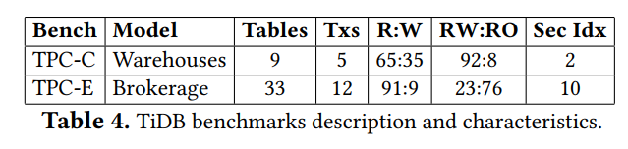
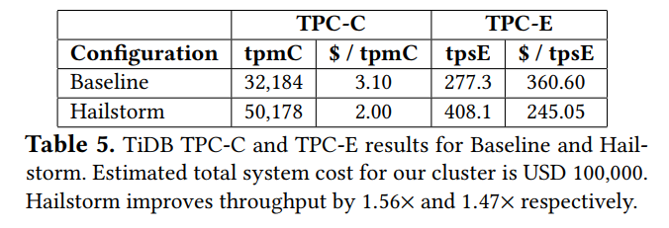
2 Distributed SQL Transactions: TiDB
Table5: Hailstorm provides significant performance improvements and cost reduction for distributed databases
Fig10: Baseline suffers from unstable throughput, due to compactions and resharding. Short bursts of data migration consume as much as 90% of the I/O bandwidth

Slide 15
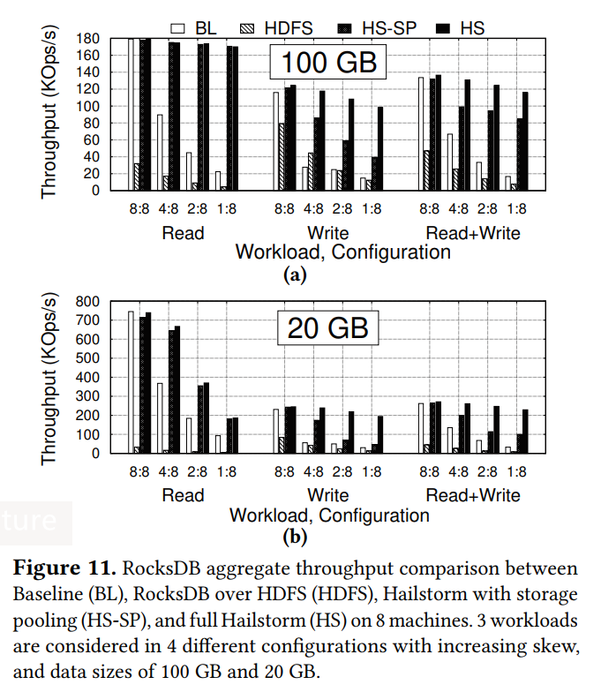
3 Comparison with HDFS
Fig11.a:
Hailstorm performance decreases mildly with increasing skew due to remote reads and writes and increased compaction offloading;
HDFS is lower than the corresponding Baseline case, because of the missing of specialized filesystem design
synchronous calls to the namenode before accessing data, performing I/O one block at a time, and writing blocks preferentially to the local disk
Fig11.b In-memory Workload(CPU bound):
Compaction offloading
Hailstorm read performance goes down with increasing skew
significant times on binary search to find a random key, decompression, and checksums
Notes:
An i:8 configuration represents a scenario where 8 nodes are running a RocksDB database, but only i of them are executing the workload with the other nodes remaining idle.
8:8 corresponds to uniform, 4:8 to mild skew, 2:8 to intermediate skew, and 1:8 to high skew

Slide 16
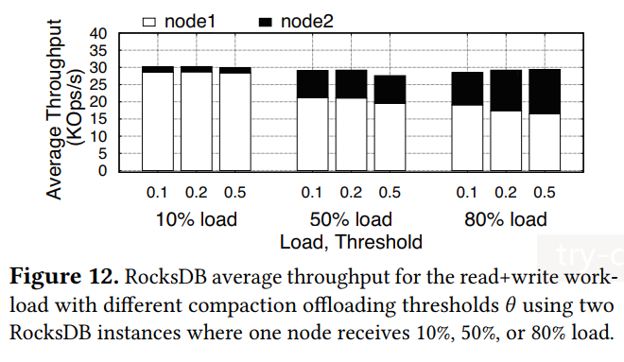
4 Sensitivity Analysis
a sensitivity analysis for the compaction offloading threshold θ using two machines: node1, which receives full load, and node 2, which receives 10%, 50%, or 80% of the full load.
Overall, different θ values have little impact

Slide 17
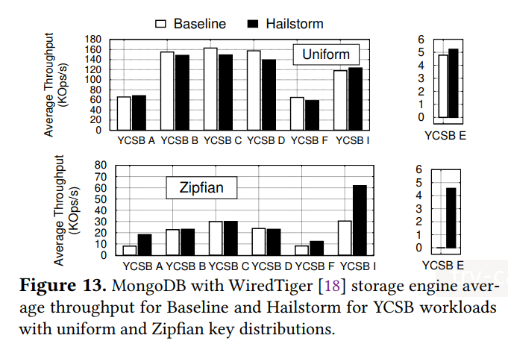
5 Using Hailstorm with B-trees
Hailstorm’s storage pooling provides ∼2× throughput improvements in the Zipfian case for write workloads
Hailstorm also improves performance for range-based queries in YCSB E as it partially relieves the overloaded node that becomes a straggler.
Hailstorm does not improve performance for reads in the presence of skew because the CPU, not the I/O, is the bottleneck.

