Slide 2
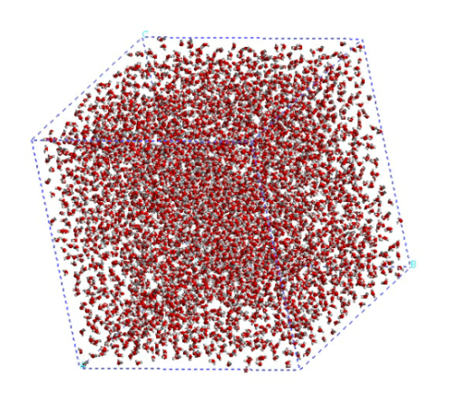
GPUOcelot
NVCC (compiler)
PTX code
Emulator/
Trace Generator
Heterogeneous Architecture
Timing & Power
Simulator
CUDA code (*.cu)
X86 Binaries
Pin
Trace Generator

Slide 3
Input Queue
Cache access flow
Cache access
Fill flow
Fill Queue
Write-back
Cache
Cache miss
Cache fill
Router
From lower-level cache or dram
WB Queue
Output Queue
To lower-level cache or dram

