Slide 1
CAPM Testing
& Alternatives to CAPM
Professor Thomas Chemmanur

Slide 2
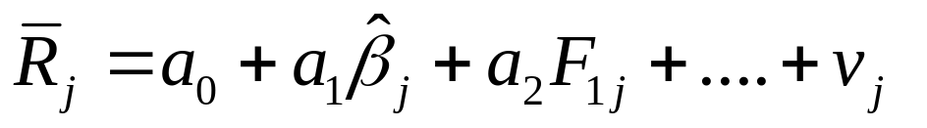

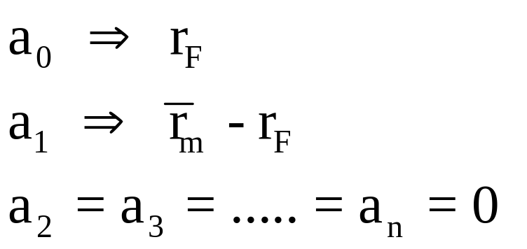

TESTING THE CAPM
RUN A CROSS-SECTIONAL REGRESSION:
ACROSS STOCKS, IN A GIVEN PERIOD.
IF THE CAPM HOLDS, WE SHOULD GET:
THEORETICAL (CAPM) LINE
ACTUAL (EMPIRICAL) LINE
β_{i}

Slide 3
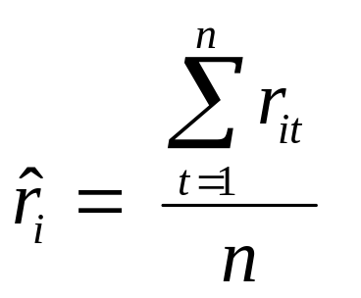

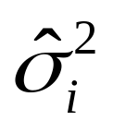
IMPLEMENTING PORTFOLIO THEORY IN PRACTICE
ASSUMING THAT ASSET RETURNS ARE “STATIONARY”, WE CAN USE HISTORICAL DATA; TYPICALLY, USE MONTHLY DATA.
N = NUMBER OF ASSETS
n = NUMBER OF PERIODS OF DATA AVAILABLE
SIMILARLY, WE CAN ESTIMATE THE VARIANCE,

Slide 4
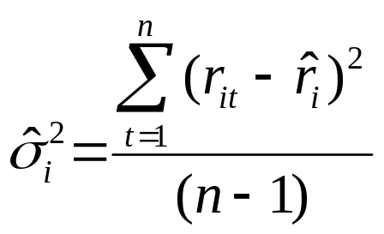
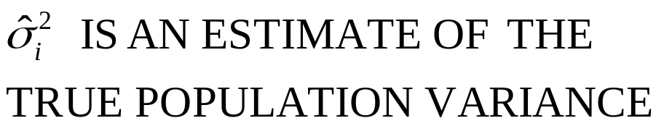
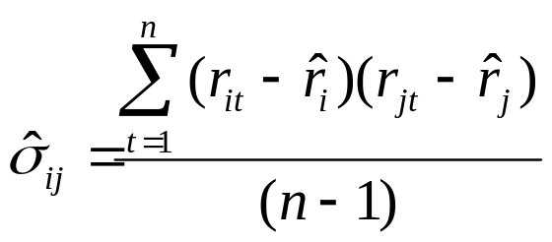
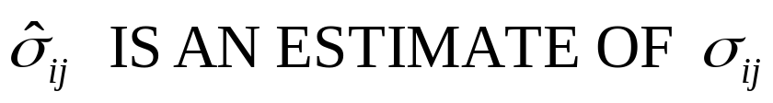
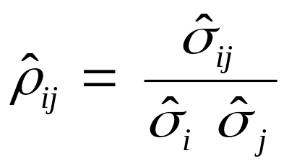
IMPLEMENTING PORTFOLIO THEORY IN PRACTICE
COVARIANCE,
CORRELATION,

Slide 5
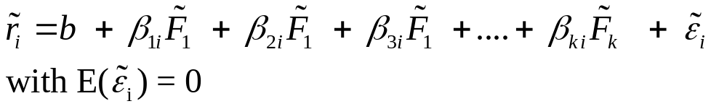
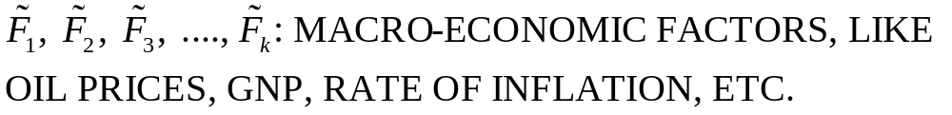
ALTERNATIVES TO CAPM: FACTOR MODELS
FACTOR MODEL 1: ARBITRAGE PRICING THEORY (APT)
THE APT ASSUMES THAT ASSET RETURNS ARE GENERATED BY A k FACTOR EQUATION AS FOLLOWS:
b = CONSTANT

Slide 6
FACTOR MODELS: ARBITRAGE PRICING THEORY
β_{1i}: SENSITIVITY OF ASSET i WITH RESPECT TO FACTOR 1
β_{2i}: SENSITIVITY OF ASSET i WITH RESPECT TO FACTOR 2
ε_{i} : IDIOSYNCRATIC RISK OF ASSET i.
EXAMPLE OF A FACTOR MODEL:
RETURN ON STOCK A (in %)
 | Inflation = 5.4% | Inflation = 6.0% | Inflation = 6.6%
GNP = 176 | 48 | 28 | 8
GNP = 160 | 38 | 18 | -2
GNP = 144 | 28 | 8 | -12

Slide 7
FACTOR MODELS: ARBITRAGE PRICING THEORY
NOTICE THAT STOCK A HAS NEGATIVE BETA WITH RESPECT TO INFLATION AND POSITIVE BETA WITH RESPECT TO PRODUCTION LEVEL.
THE APT STATES THAT, IF:
  (i) THERE ARE ENOUGH ASSETS SUCH THAT IDIOSYNCRATIC RISK CAN BE DIVERSIFIED AWAY.
  (ii) THERE ARE NO ARBITRAGE OPPORTUNITIES
THEN: TWO FACTOR APT

Slide 8
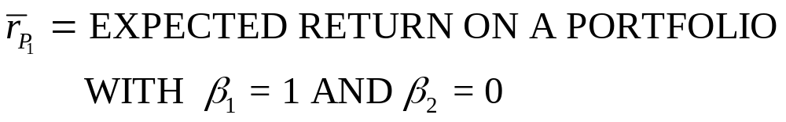
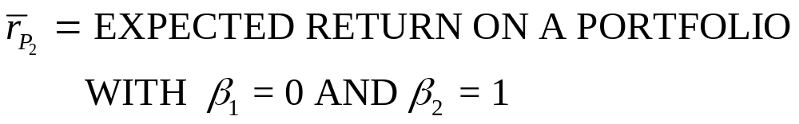
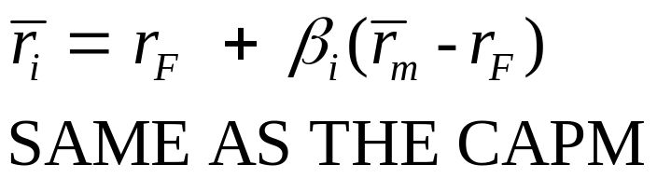
FACTOR MODELS: ARBITRAGE PRICING THEORY
THE ABOVE ARE CALLED “MIMICKING” OR “FACTOR” PORTFOLIOS.
ONE FACTOR APT,
WITH MARKET PORTFOLIO AS FACTOR RETURN

Slide 9
FACTOR MODELS: ARBITRAGE PRICING THEORY
(a) CALL THE NEW PORTFOLIO OF A AND B, PORTFOLIO C
  β_{1C} = 0.5(X_{A}) + 1(X_{B}) = 0
  ⇒ 0.5X_{A} + 1(1-X_{A}) = 0
  ⇒ 0.5 X_{A} – X_{A} + 1 = 0
  ⇒ X_{A} = -1 / -0.5 = 2
  ⇒ X_{B} = 1- X_{A} = 1 – 2 = -1
SHORT SELL ASSET B TO GENERATE AN AMOUNT EQUAL TO YOUR INITIAL WEALTH AND INVEST IN ASSET A, ALONG WITH YOUR INITIAL WEALTH, W.
β_{2C} = 2(β_{2A}) - β_{2B} = 2(2) – 0 = 4

Slide 10
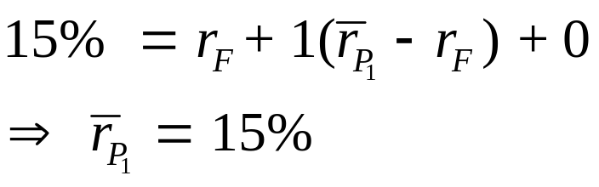
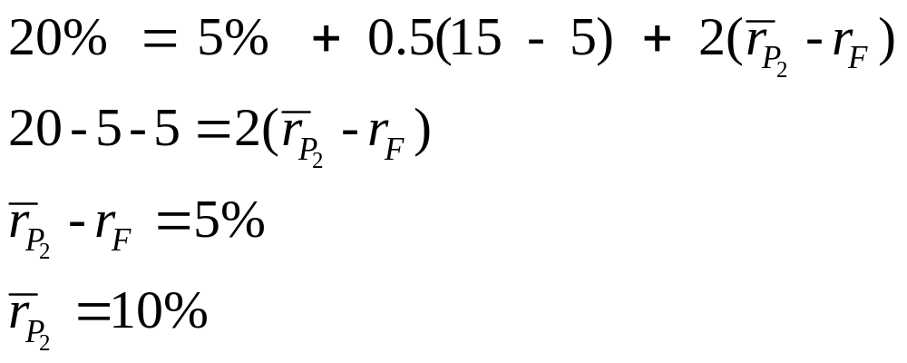
FACTOR MODELS: ARBITRAGE PRICING THEORY
(b) FROM ASSET B (β_{2B} = 0)
NOW, USING THIS IN THE APT EQUATION FOR ASSET A, r_{F} = 5%,

Slide 11
IMPLEMENTING AND USING THE APT
1. USING MULTIPLE REGRESSION, AFTER SPECIFYING THE FACTORS
2. USING FACTOR ANALYSIS (SEE THE ARTICLE ON MY WEBSITE FOR MF807)
  APPLICATIONS OF THE APT
APT IS USEFUL PARTICULARLY IN APPLICATIONS REQUIRING THE SPLITTING UP OF SYSTEMATIC RISK INTO VARIOUS COMPONENTS → INCREASE EXPOSURE TO SOME SOURCE OF RISK, WHILE MINIMIZING EXPOSURE TO OTHERS
  E.g. “RISK STERILIZATION”

Slide 12
ANOTHER FACTOR MODEL
FAMA-FRENCH THREE FACTOR MODEL
IN RECENT RESEARCH, FAMA AND FRENCH FOUND THAT, IN ADDITION TO THE RETURN ON THE MARKET PORTFOLIO, TWO OTHER FACTORS HAVE CONSIDERABLE EXPLANATORY POWER FOR STOCK RETURNS:
  (i) FIRM SIZE (USING MARKET CAPITALIZATION)
    ⇒ CAN PROXY FOR LIQUIDITY OF STOCK
  (ii) BOOK-TO-MARKET RATIO
    ⇒ CAN PROXY FOR RELATIVE DISTRESS
SMALLER SIZE, HIGHER RETURN
HIGHER B/M, HIGHER EXPECTED RETURN

Slide 13
FAMA-FRENCH 3 FACTOR MODEL
BASED ON THE ABOVE EMPIRICAL RESEARCH, THEY POSTULATED A THREE-FACTOR MODEL:
SMB = EXPECTED RETURN ON A PORTFOLIO OF SMALL CAPITALIZATION STOCKS MINUS LARGE CAP STOCKS
s_{j} = SENSITIVITY OF STOCK j TO THE ABOVE PORTFOLIO RETURN (LIKE A FACTOR BETA)
HML = EXP RETURN ON A HIGH B/M STOCK PORTFOLIO MINUS EXP RETURN ON A LOW B/M PORTFOLIO
h_{j} = SENSITIVITY OF STOCK j TO THE ABOVE PORTFOLIO

Slide 14
EXAMPLE: ESTIMATING DELL’S COST OF EQUITY
β_{DELL} = 1.476 s_{DELL} = 0.0634 h_{DELL} = -0.661
RISK PREMIUM ON THE MARKET FACTOR = 7.48%
RETURN ON SIZE FACTOR (SMB) = 2.59%
RETURN ON BOOK-TO-MARKET FACTOR (HML) = 6.13%
RISK PREMIUM ON DELL
= 1.476(7.48) + 0.0634(2.59) –0.661(6.13)
= 7.15%
T-BILL RATE 2.83%
COST OF CAPITAL OF DELL
  = 2.83 + RISK-PREMIUM ON DELL
  = 2.83 + 7.15
  = 9.98%

Slide 15
FAMA-FRENCH 3 FACTOR MODEL - PROBLEMS
IT IS PURELY AN EMPIRICAL MODEL, WHICH HAPPENS TO DO BETTER THAN THE CAPM, CURRENTLY.
NOT BASED ON ECONOMIC AND BEHAVIORAL PRINCIPLES.
NO GUARANTEE IT WILL WORK WELL IN THE FUTURE.

