Slide 1
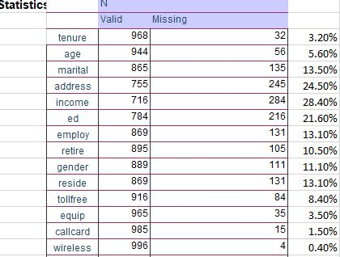
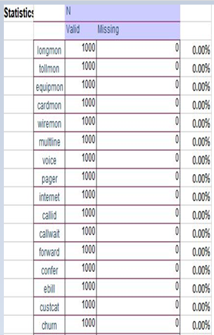
Exploratory Data Analysis (EDA)
Exploratory Data Analysis (EDA)
Opened file telco_missing.sav in IBM-SPSS STATISTISCS 24 app. browsed to analyse-descriptive statistics-frequency Added all variables in spss to find sample size and missing cases for all variables. The tables in the right summarizes the observation made regarding sample size and missing cases for all variables. 11 variables are scalar variables namely tenure,age,address,income,employ,reside,Long distance last month, Toll free last month, Equipment last month,cardmon,Wireless last month. 16 variables are Nominal variables namely marital,retire,gender,tollfree,Equipment rental,Calling card service,Wireless service,Multiple lines, Voice mail, Paging service,internet,Caller ID, Call waiting, Call forwarding,3-way calling, Electronic billing. 2 variables are Ordinal Variables namely Level of education and Customer category.

Slide 2
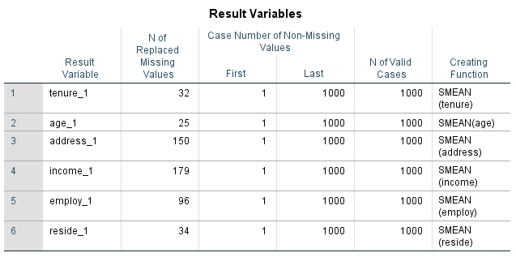
Exploratory Data Analysis (EDA)
1)Opened file telco_missing.sav in IBM-SPSS STATISTISCS 24 app. 2)browsed to transform---replace missing values using series mean as the creating function---only for the scale variables. 3)created all new scale variables in spss to accommodate missing cases for all of them. 4)Attaching the snapshot for the newly added variables to accommodate missing cases.

Slide 3
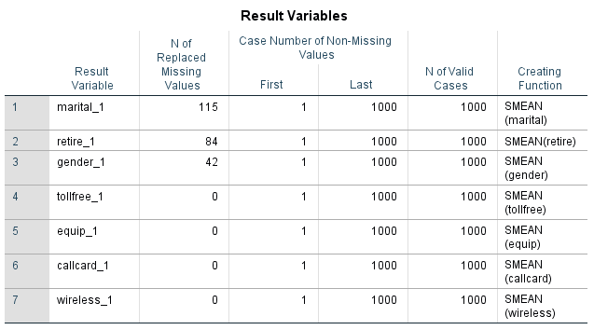
Exploratory Data Analysis (EDA)
1)Opened file telco_missing.sav in IBM-SPSS STATISTISCS 24 app. 2)browsed to transform---replace missing values using Median of nearby points as the creating function---only for the Nominal variables. 3)created all new scale variables in spss to accommodate missing cases for all of them. 4)Attaching the snapshot for the newly added variables to accommodate missing cases.

Slide 4
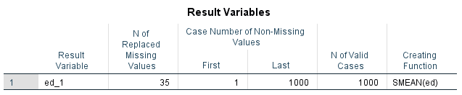
Exploratory Data Analysis (EDA)
1)Opened file telco_missing.sav in IBM-SPSS STATISTISCS 24 app. 2)browsed to transform---replace missing values using Median of nearby points as the creating function---only for the Ordinal variables. 3)created all new scale variables in spss to accommodate missing cases for all of them. 4)Attaching the snapshot for the newly added variables to accommodate missing cases.

Slide 5
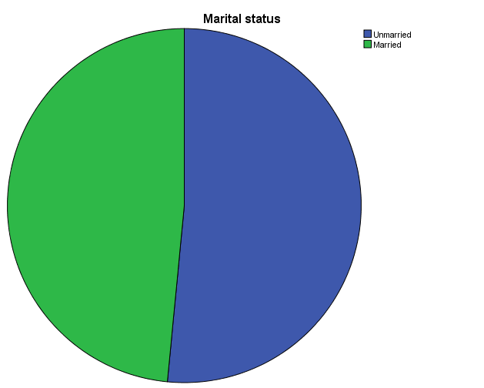
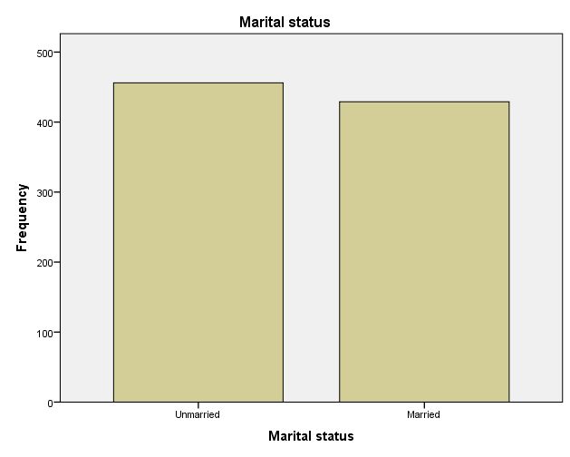
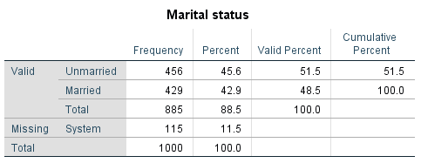
Exploratory Data Analysis (EDA)
1)browsed to analyse-descriptive statistics-frequency 2)Plot bar charts and pie charts for marital. 3)Percentage frequency of unmarried shown is 51.5% whereas that of married shown as 48.5%. 4)We can conclude that marital status doesn’t seems to make too much of a difference.

Slide 6
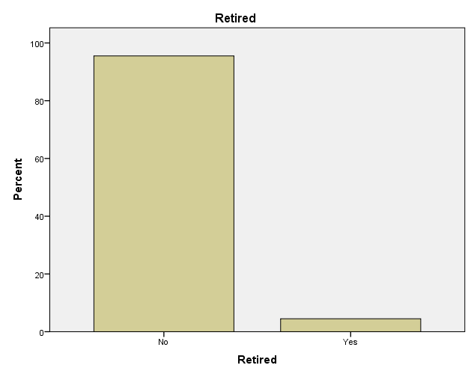
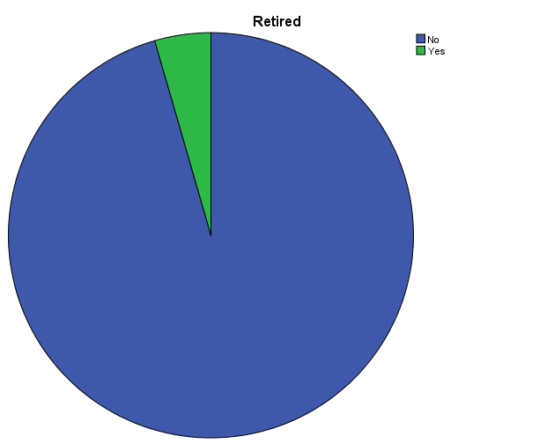
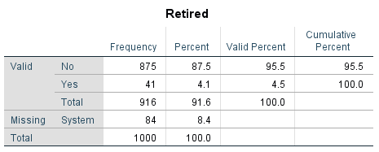
Exploratory Data Analysis (EDA)
Exploratory Data Analysis (EDA)
1)browsed to analyse-descriptive statistics-frequency 2)Plot bar charts and pie charts for retire. 3)Percentage frequency of retired shown is 4.5% whereas that of not retired shown as 95.5%. 4)We can conclude that not retired has highest frequency. | V

Slide 7
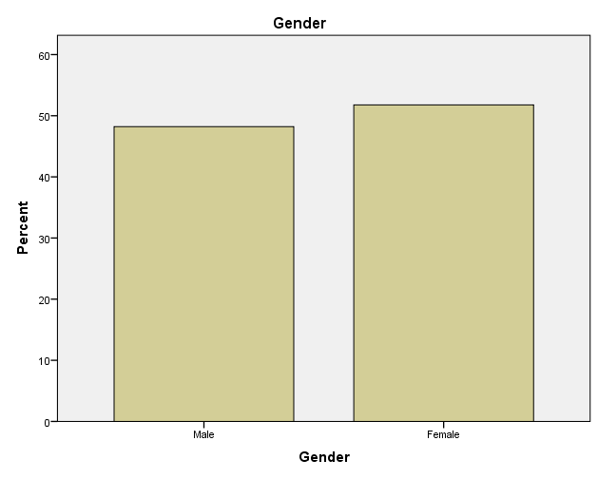
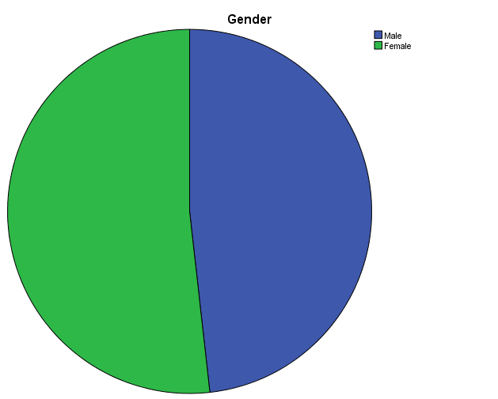
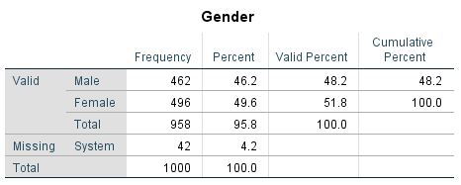
Exploratory Data Analysis (EDA)
1)browsed to analyse-descriptive statistics-frequency 2)Plot bar charts and pie charts for gender. 3)Percentage frequency of male shown is 48.2% whereas that of female shown as 51.8%. 4)We can conclude that gender didn’t make any appreciable changes ...frequency.

Slide 8
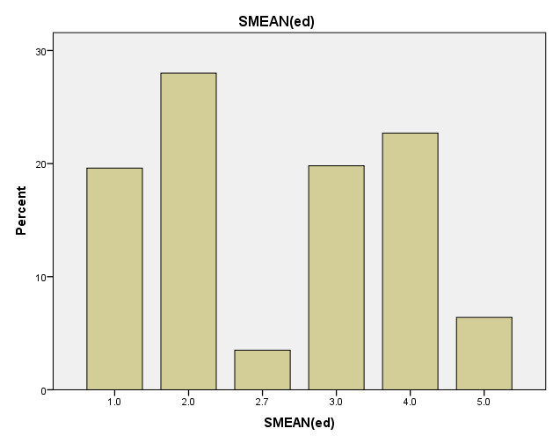
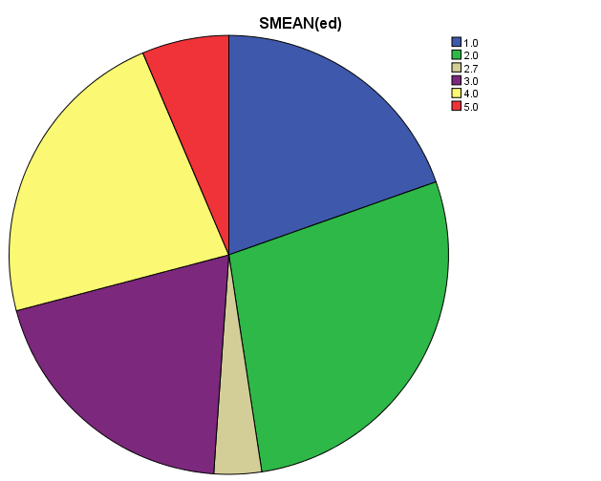
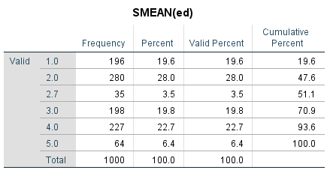
Exploratory Data Analysis (EDA)
1)browsed to analyse-descriptive statistics-frequency 2)Plot bar charts and pie charts for level of education i.e. 1-Did not complete high school , 2-High school degree, 3-Some college, 4-College degree 5-Post-undergraduate degree. 3) it can be observed that frequency is up to 93.6% for 1-4.hoever,there is no significant difference between different levels of education.

Slide 9
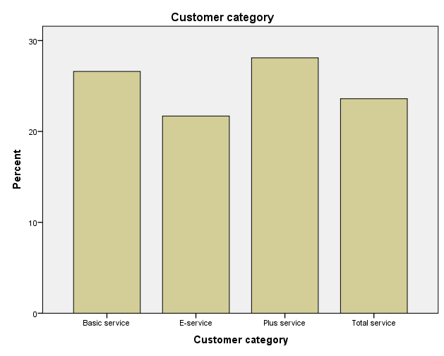
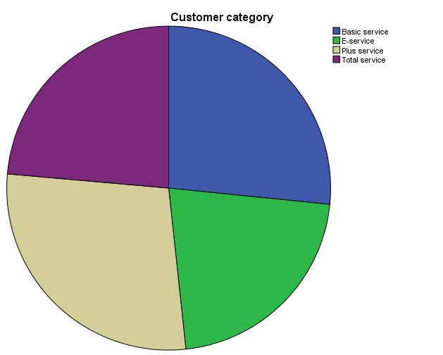
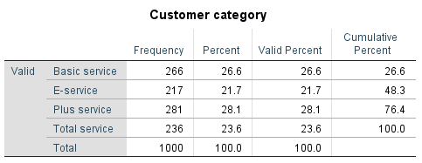
Exploratory Data Analysis (EDA)
1)browsed to analyse-descriptive statistics-frequency 2)Plot bar charts and pie charts for Customer category i.e. 1-Basic service 2-E-service 3-Plus service 4-Total service. 3)it can be observed that frequency is up to 76.4% for 1-3.hoever,there is no significant difference between different customer category. | \

Slide 10
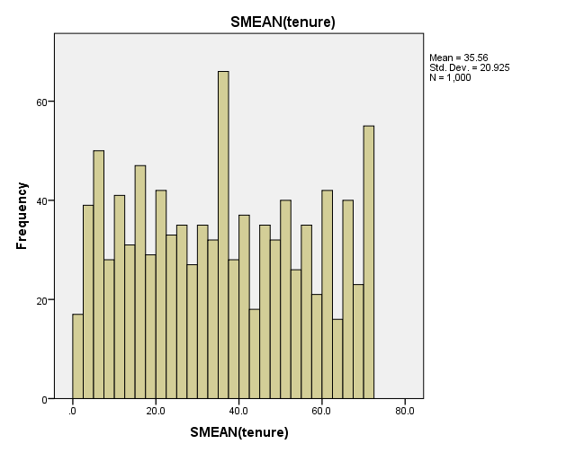
Exploratory Data Analysis (EDA)
1)browsed to analyse-descriptive statistics-frequency 2)Plot Histogram for tenure. 3) People who stayed for 36 and 72 years tenure in a company are the odd ones in the histogram. 4)mean is 35.56.The distribution seems to be more or less normally distributed.

Slide 11
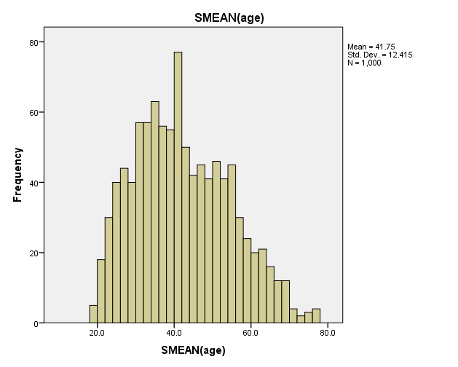
Exploratory Data Analysis (EDA)
1)browsed to analyse-descriptive statistics-frequency 2)Plot Histogram for age. 3)As per histogram, frequency is highest for Age 40.The trend was increasing for age up to 40 years after which it gradually started decreasing. 4)The mean is 41.75.The distribution seems to be more or less normally distributed.

Slide 12
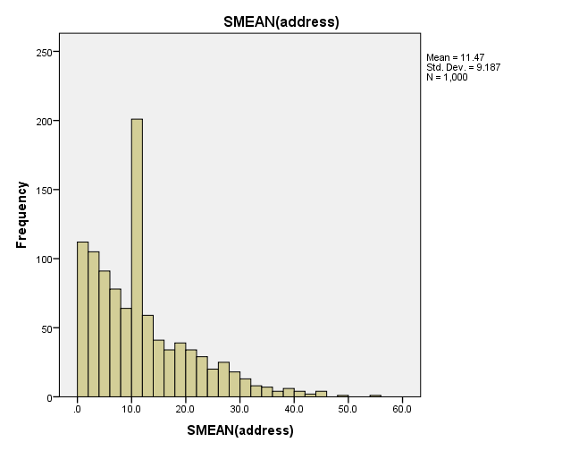
Exploratory Data Analysis (EDA)
1)browsed to analyse-descriptive statistics-frequency 2)Plot Histogram for address. 3)As per Histogram the frequency of data is higher for those whose years at current address were from 0-10 years and it starts gradually declining downwards. 4)The mean is 11.47 and the distribution looks to be positively skewed.

Slide 13
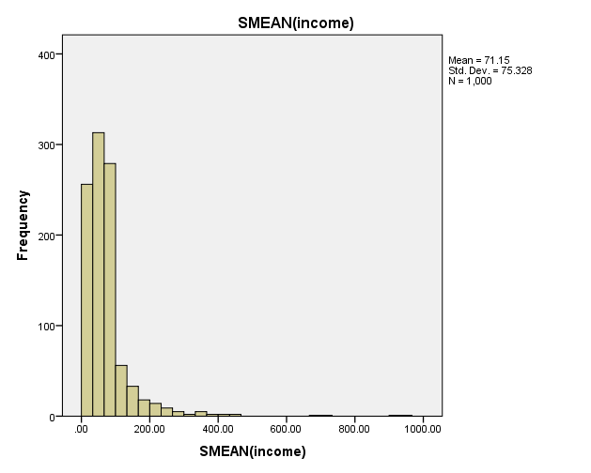
Exploratory Data Analysis (EDA)
1)browsed to analyse-descriptive statistics-frequency 2)Plot Histogram for income. 3)As per Histogram frequency is highest for those in income group of 40000-12000. 4)The mean is around 71.5K.it looks to be highly positively skewed. 5)Frequency continues to gradually decrease for income higher than 120k and become negligible for those having income higher than 200k.

Slide 14
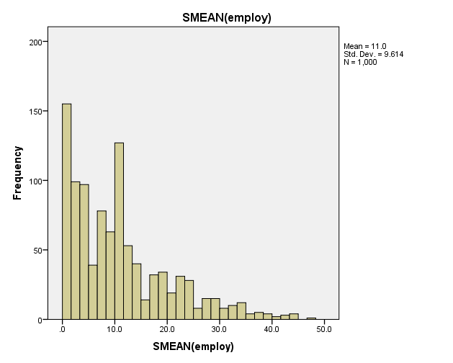
Exploratory Data Analysis (EDA)
1)browsed to analyse-descriptive statistics-frequency 2)Plot Histogram for employ. 3)As per Histogram the frequency is higher for those whose years with current employer were up to 12 years. 4)The mean is 11.0 years. The distribution looks to be positively skewed.

Slide 15
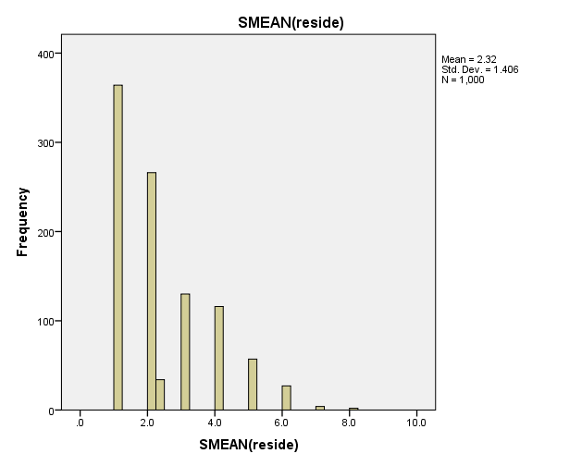
Exploratory Data Analysis (EDA)
1)browsed to analyse-descriptive statistics-frequency 2)Plot Histogram for reside. 3)As per Histogram for reside, we can see the highest frequency for those where number of people residing in household is between 1-4.and then frequency become negligible for occupants more than 4. 4)The mean is 2.32 and the distribution looks to be positively skewed.

Slide 16
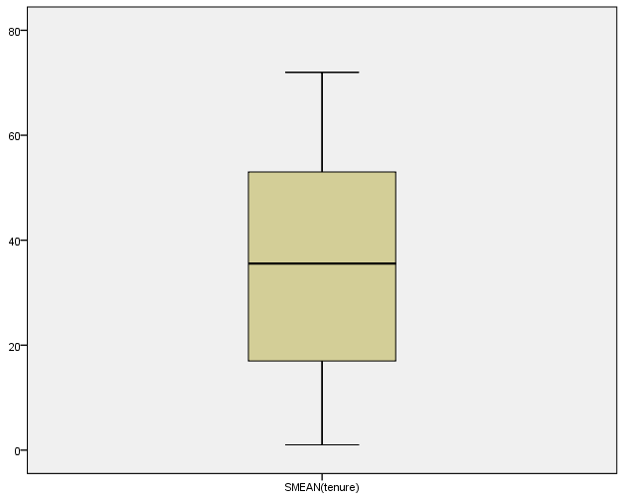
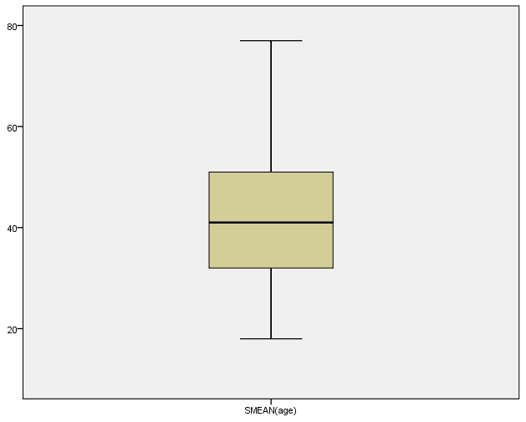
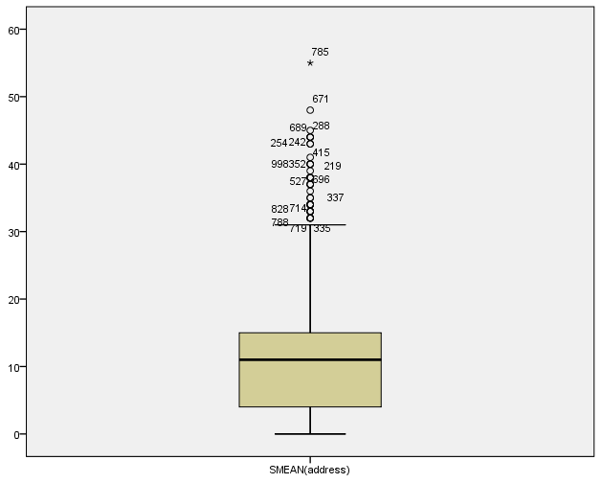
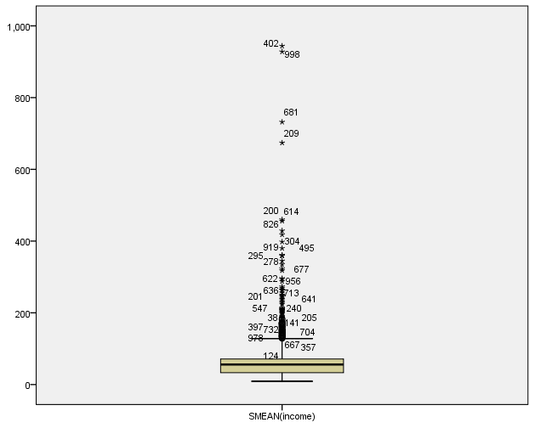
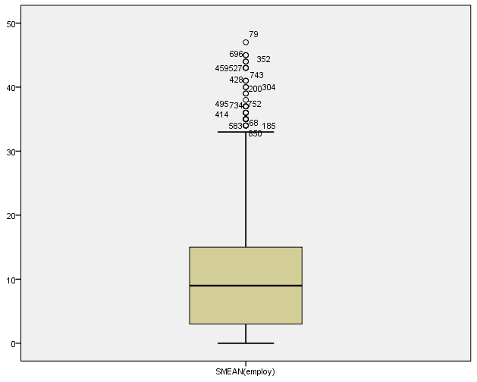
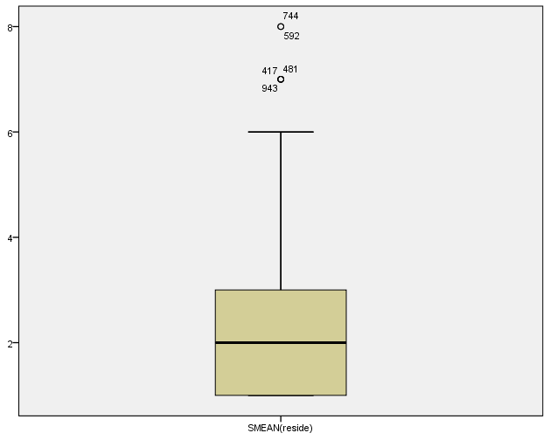
Exploratory Data Analysis (EDA)
1)browsed to analyse-descriptive statistics-explore 2)Plot box plot for tenure, age, address, income,employ,reside. 3)We can see Box plot for tenure,age,income,employ,reside is more or less normally distributed as median lies in middle. 4)Box plot spread is high for tenure, age, employ, reside and so they are more susceptible to high volatility. 5)Box plot for income has the least spread and hence the least volatility. 6)Box plot for address, income , employ has many outliers and all those higher than the uppermost quartile(higher than 100).so the outliers will affect the mean value obtained towards the higher end. Median not impacted by the outliers.

Slide 17
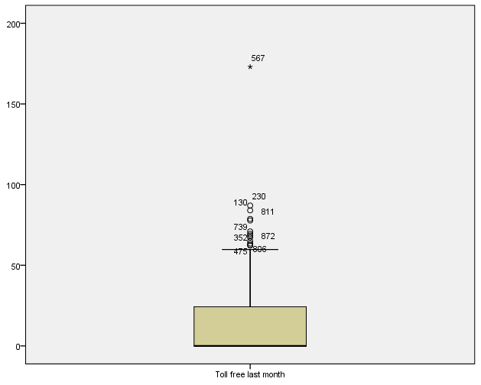
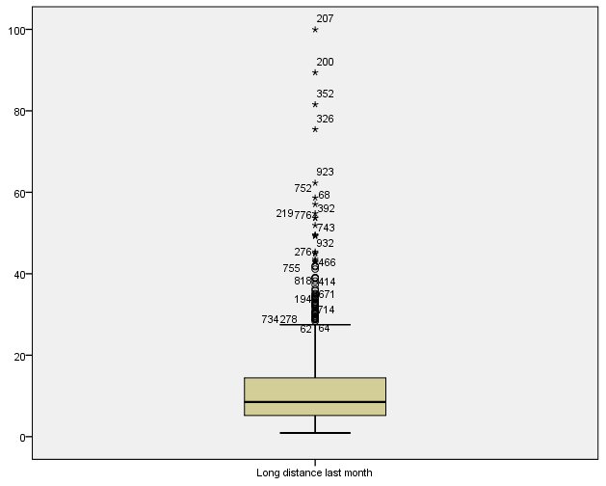
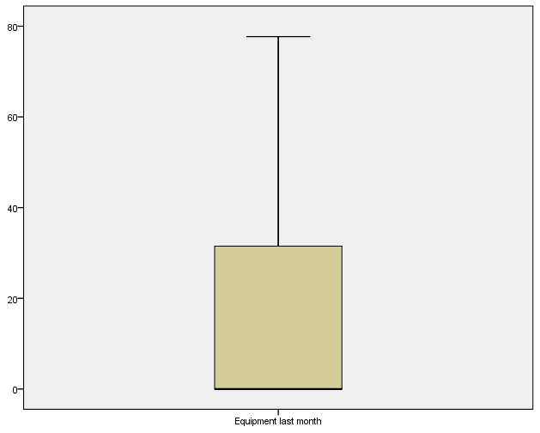
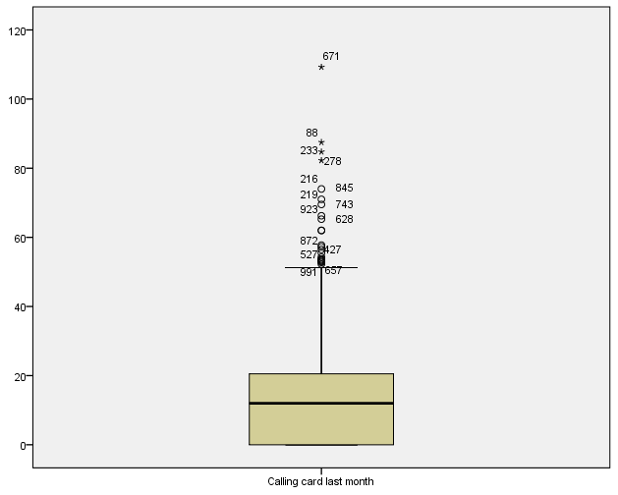
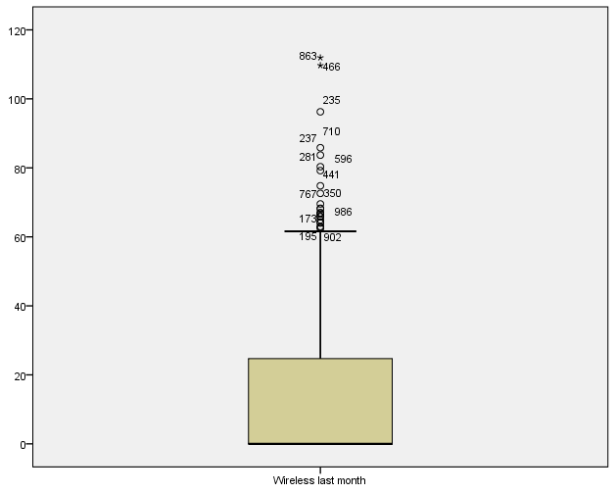
Exploratory Data Analysis (EDA)
1)browsed to analyse-descriptive statistics-explore 2)Plot box plot for Long distance last month, Toll free last month, Equipment last month,cardmon,Wireless last month. 3)Box plot for long distance, equipment last month, wireless month are highly positively skewed as median lies near to the lowermost quartile(0-25). 4)Box plot for toll free has highest spread and hence has highest volatility. Box plot spread for others have less volatility. 5)Box plot for long distance, toll free, cardmon,wireless has outliers towards the upper quartile(100%) and hence mean deviated towards the upper range. Median not impacted by outliers.

Slide 18
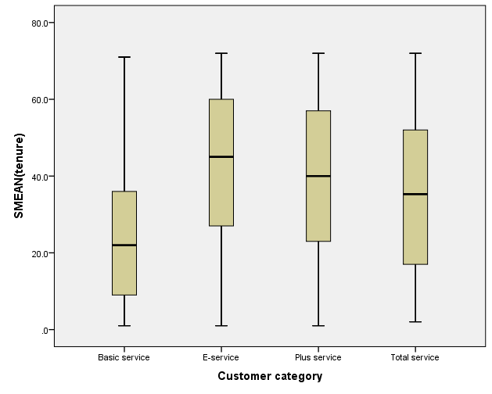
Exploratory Data Analysis (EDA)
1)browsed to analyse-descriptive statistics-explore 2)Put scalar variable in dependent list-tenure 3)Put any categorical variable in factor list-say custcat i.e. 1-Basic service 2-E-service 3-Plus service 4-Total service. 4)Then compute the box plot. 5)We can see that box plot spread is high for all customer category.however,we don’t see any outliers in any customer category. 6)Median lies in middle for all customer category.so distribution is more or less normally distributed.

Slide 19
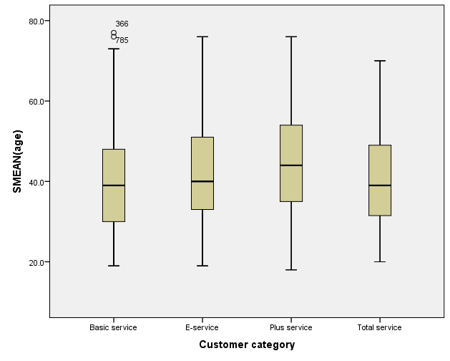
Exploratory Data Analysis (EDA)
1)browsed to analyse-descriptive statistics-explore 2)Put scalar variable in dependent list-age 3)Put any categorical variable in factor list-say custcat i.e. 1-Basic service 2-E-service 3-Plus service 4-Total service. 4)Then compute the box plot. 5)We can see that box plot spread is high for all customer category.however,we don’t see any outliers in any customer category except two outliers in basic service. 6)Median lies in middle for all customer category.so distribution is more or less normally distributed.

Slide 20
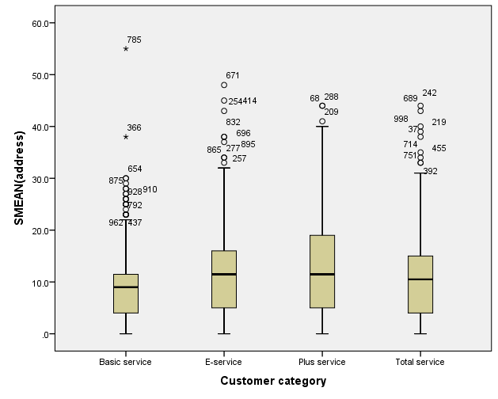
Exploratory Data Analysis (EDA)
1)browsed to analyse-descriptive statistics-explore 2)Put scalar variable in dependent list-address 3)Put any categorical variable in factor list-say custcat i.e. 1-Basic service 2-E-service 3-Plus service 4-Total service. 4)Then compute the box plot. 5)We can see that box plot spread is low for all customer category except plus service.however,we have outliers in all customer category and they deviate the mean towards the upper quartile(100%).Median is not impacted by outliers. 6)Median lies more or less in middle for all except basic service which is negatively schewed.

Slide 21
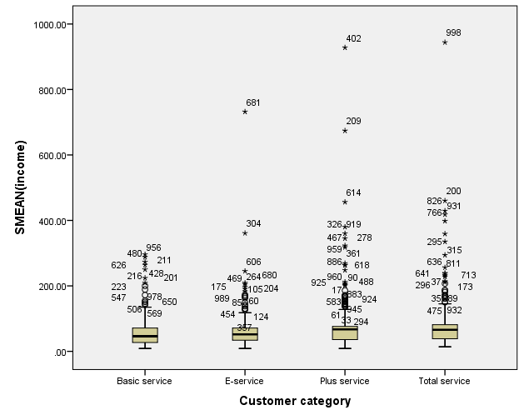
Exploratory Data Analysis (EDA)
1)browsed to analyse-descriptive statistics-explore 2)Put scalar variable in dependent list-income 3)Put any categorical variable in factor list-say custcat i.e. 1-Basic service 2-E-service 3-Plus service 4-Total service. 4)Then compute the box plot. 5)We can see that box plot spread is low for all customer category.however,we have outliers in all customer category. Highest outliers are there in plus services and total services and they deviate the mean towards the upper quartile(100%).Median is not impacted by outliers. 6)Median lies in middle for all except plus service which is negatively schewed.

Slide 22
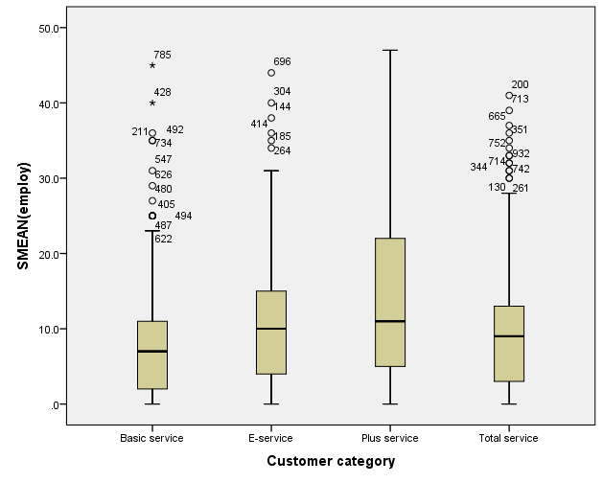
Exploratory Data Analysis (EDA)
1)browsed to analyse-descriptive statistics-explore 2)Put scalar variable in dependent list-employ 3)Put any categorical variable in factor list-say custcat i.e. 1-Basic service 2-E-service 3-Plus service 4-Total service. 4)Then compute the box plot. 5)We can see that box plot spread is low for all customer category except plus service.however,we have outliers in all customer category Except plus service and they deviate the mean towards the upper quartile(100%).Median is not impacted by outliers. 6)Median lies more or less in middle for all except plus service which is negatively schewed.

Slide 23
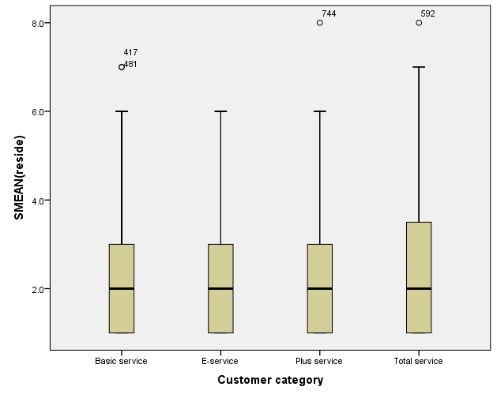
Exploratory Data Analysis (EDA)
1)browsed to analyse-descriptive statistics-explore 2)Put scalar variable in dependent list-reside 3)Put any categorical variable in factor list-say custcat i.e. 1-Basic service 2-E-service 3-Plus service 4-Total service. 4)Then compute the box plot. 5)We can see that box plot spread is high for all customer category.however,we don’t see many outliers in any customer category. 6)Median lies in middle for all customer category.so distribution is more or less normally distributed.

Slide 24
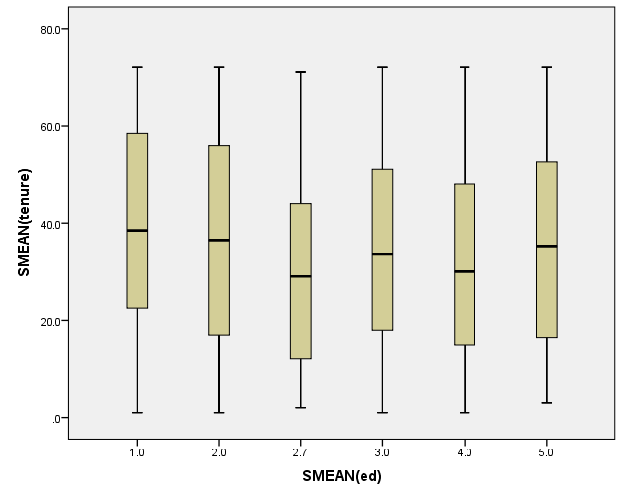
Exploratory Data Analysis (EDA)
1)browsed to analyse-descriptive statistics-explore 2)Put scalar variable in dependent list-tenure 3)Put any categorical variable in factor list-say level of education i.e. 1-Did not complete high school 2-High school degree 3-Some college 4-College degree 5-Post-undergraduate degree 4)Then compute the box plot. 5)We can see that box plot spread is high for all education levels.however,we don’t see any outliers in any education levels. 6)Median lies in middle for all education levels.so distribution is more or less normally distributed.

Slide 25
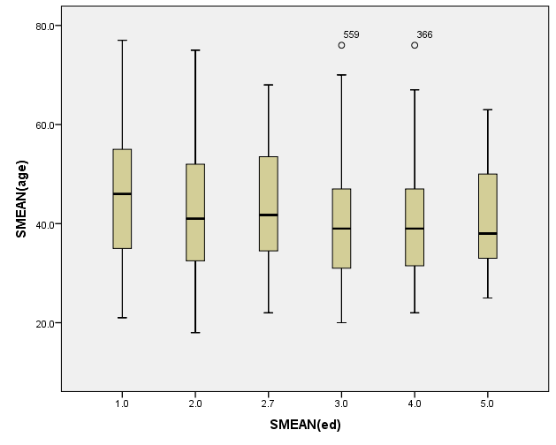
Exploratory Data Analysis (EDA)
1)browsed to analyse-descriptive statistics-explore 2)Put scalar variable in dependent list-age 3)Put any categorical variable in factor list-say level of education i.e. 1-Did not complete high school 2-High school degree 3-Some college 4-College degree 5-Post-undergraduate degree. 4)Then compute the box plot. 5)We can see that box plot spread is high for all education levels.however,we don’t see any outliers in any education levels except two outliers in basic service. 6)Median lies in middle for all education levels.so distribution is more or less normally distributed.

Slide 26
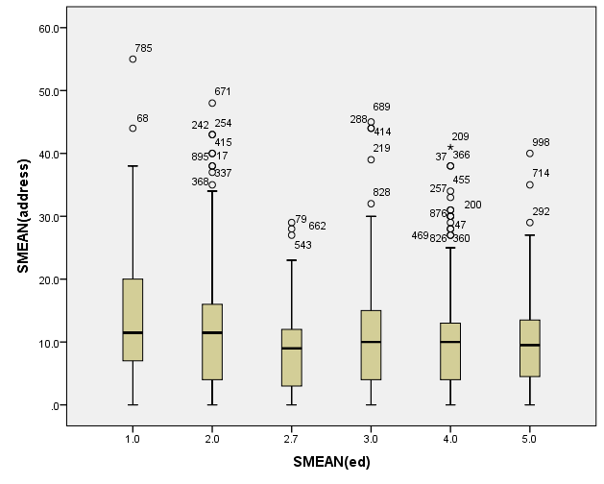
Exploratory Data Analysis (EDA)
1)browsed to analyse-descriptive statistics-explore 2)Put scalar variable in dependent list-address 3)Put any categorical variable in factor list-say level of education i.e. 1-Did not complete high school 2-High school degree 3-Some college 4-College degree 5-Post-undergraduate degree. 4)Then compute the box plot. 5)We can see that box plot spread is low for all education levels except plus service.however,we have outliers in all education levels and they deviate the mean towards the upper quartile(100%).Median is not impacted by outliers. 6)Median lies more or less in middle for 3.

Slide 27
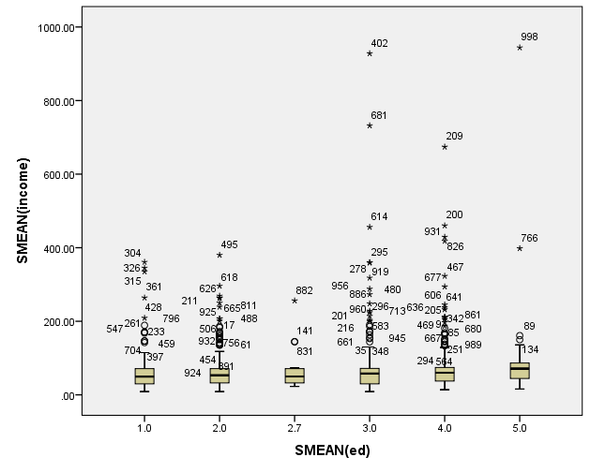
Exploratory Data Analysis (EDA)
1)browsed to analyse-descriptive statistics-explore 2)Put scalar variable in dependent list-income 3)Put any categorical variable in factor list-say level of education i.e. 1-Did not complete high school 2-High school degree 3-Some college 4-College degree 5-Post-undergraduate degree. 4)Then compute the box plot. 5)We can see that box plot spread is low for all education levels.however,we have outliers in all education levels. Highest outliers are there in 1-4 and they deviate the mean towards the upper quartile( 100%). Median is not impacted by outliers. 6)Median lies in middle for all.

Slide 28
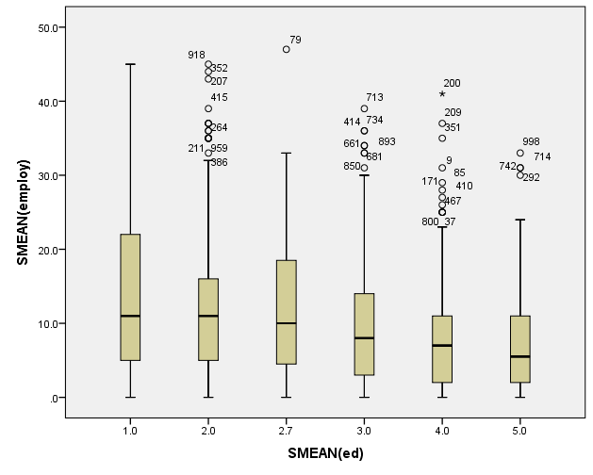
Exploratory Data Analysis (EDA)
1)browsed to analyse-descriptive statistics-explore 2)Put scalar variable in dependent list-employ 3)Put any categorical variable in factor list-say level of education i.e. 1-Did not complete high school 2-High school degree 3-Some college 4-College degree 5-Post-undergraduate degree. 4)Then compute the box plot. 5)We can see that box plot spread is high for all.however,we have outliers in all Except level of education as 1 and they deviate the mean towards the upper quartile(100%). Median is not impacted by outliers. 6)Median lies more or less in middle for all.

Slide 29
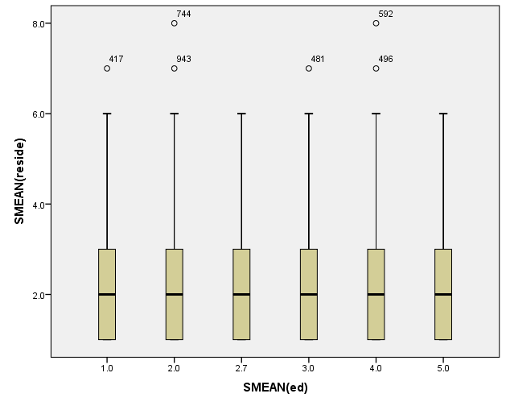
Exploratory Data Analysis (EDA)
1)browsed to analyse-descriptive statistics-explore 2)Put scalar variable in dependent list-reside 3)Put any categorical variable in factor list-say level of education i.e. 1-Did not complete high school 2-High school degree 3-Some college 4-College degree 5-Post-undergraduate degree. 4)Then compute the box plot. 5)We can see that box plot spread is high for all education levels .however, we don’t see many outliers in any education levels. 6)Median lies in middle for all education levels.so distribution is more or less normally distributed.

Slide 30
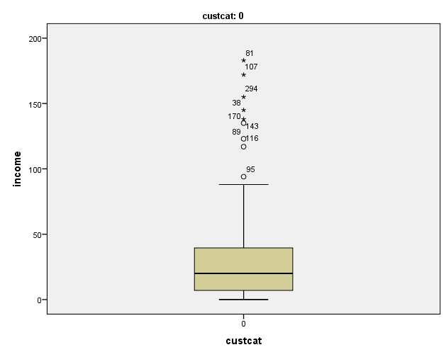




Exploratory Data Analysis (EDA)
1) Go to data 2)Split file—organize data by groups 3)Split file by custcat. 4)Go to analyse-descriptive statistics-explore 5)Put scalar variable in dependent list-income 6)Put any categorical variable in factor list-custcat. 7)Then compute the box plot. 8)We can see that box plot spread is low for all except customer category 0.however,we have outliers in all Except minimal outliers in customer category 2 and they deviate the mean towards the upper quartile(100%). Median is not impacted by outliers. 9)Median lies more or less in middle for customer category 0 and 1 and positively skewed for 2-4.

Slide 31
NULL HYPOTHESIS TESTING
1)Browsed to Analysis—descriptive statistics—crosstabs.
3)Chosen the value In row as marital_1.
4)Chosen the value In column as churn.
Click on statistics---enable chi-square and then see the clustered bar chart.
Go to cells---click on expected and enable it as well in addition to observed already clicked as enabled.

Slide 32



NULL HYPOTHESIS TESTING
As per chi-square test, Null hypothesis is rejected for marital_1 and churn as significant value is <0.05.
We find that p-value is 0.001.since it is less than 0.05 we reject NULL HYPOTHESIS and conclude that there is significant relation between marital_1 and churn.

Slide 33
NULL HYPOTHESIS TESTING
1)Browsed to Analysis—descriptive statistics—crosstabs.
3)Chosen the value In row as gender_1.
4)Chosen the value In column as churn.
Click on statistics---enable chi-square and then see the clustered bar chart.
Go to cells---click on expected and enable it as well in addition to observed already clicked as enabled.

Slide 34



NULL HYPOTHESIS TESTING
As per chi-square test, Null hypothesis is rejected for gender_1 and churn as significant value is <0.05.
We find that p-value is 0.000.since it is less than 0.05 we reject NULL HYPOTHESIS and conclude that there is significant relation between gender_1 and churn.

Slide 35
NULL HYPOTHESIS TESTING
1)Browsed to Analysis—descriptive statistics—crosstabs.
3)Chosen the value In row as custcat.
4)Chosen the value In column as churn.
Click on statistics---enable chi-square and then see the clustered bar chart.
Go to cells---click on expected and enable it as well in addition to observed already clicked as enabled.

Slide 36



NULL HYPOTHESIS TESTING
As per chi-square test, Null hypothesis is rejected for custcat and churn as significant value is <0.05.
We find that p-value is 0.000.since it is less than 0.05 we reject NULL HYPOTHESIS and conclude that there is significant relation between custcat and churn.

Slide 37
NULL HYPOTHESIS TESTING
1)Browsed to Analysis—descriptive statistics—crosstabs.
3)Chosen the value In row as voice.
4)Chosen the value In column as churn.
Click on statistics---enable chi-square and then see the clustered bar chart.
Go to cells---click on expected and enable it as well in addition to observed already clicked as enabled.

Slide 38



NULL HYPOTHESIS TESTING
As per chi-square test, Null hypothesis is rejected for voice and churn as significant value is <0.05.
We find that p-value is 0.000.since it is less than 0.05 we reject NULL HYPOTHESIS and conclude that there is significant relation between custcat and churn.

Slide 39
Decision tree Testing
Multivariate analysis is of two types:---one is unsupervised learning-here we don’t have dependent variable. But we have set of independent variables. We don’t have predefined targets.
other one is Supervised learning----here we have a dependent variable and also an independent variable. One example is decision tree. It is supervised learning where we have predefined target in form of dependent variables.
Decision tree of two types---firstly Classification and secondly it is regression . Classification problems-Eg: churners and non-churners. Regression problems: Here dependent variable is scale variable.it is not ranked data. Decision tree algorithm can handle both classification problems and regression problems.
Characteristics of a decision tree: WE MOVE FROM ENTROPY i.e. complete chaos moving towards system that has a model. When we split parent nodes (also called as root node) into child nodes then it should be in such a way that the nodes should be as homogeneous as possible. Each node should capture the dependent variable to the extent of 100% or more higher the better it will be. I want to maximize adoption of one of the categories of the dependent variable or the target variable. Each thread captures dependent variable to the extent of 100%.
Decision tree involves a family of trees. We don’t need a tree which is very deep. Three or four decision node is fine.as sample reduces with each decision node, deeper the tree the sample diminishes and if sample is reduced to very negligible sample that is not acceptable.

Slide 40
Decision tree Testing
1)Browsed to analyse-classify-tree
2)Then added churn as dependent variables
3)All other variables are independent variables.
4)Growing method is chaid BY DEFAULT---CHI square algorithm.
The output of decision tree can be seen in the following slides.

Slide 41

Decision tree TESTING

Slide 42
Decision tree Testing
We can make inference from the decision tree that the best decision node start from the condition that longmon<=0.900.
Here chi square starts with 695.761 and p-value is 0.000 indicating that there exist significant association between churn and longmon.
As p-value <0.05 ,so Null Hypothesis is rejected. Node 0 has highest probability of 44.8%.
next optimization and similar analysis can be drawn for tollmon followed by voice.
chi square for tollmon is 190.374 and p-value is 0.000 indicating that there exist significant association between churn and tollmon.
chi square for voice is 130 and p-value is 0.000 indicating that there exist significant association between churn and voice.

Slide 43

Decision tree TESTING

Slide 44
Decision tree Testing
We can make inference from the decision tree that the second best decision node start from the condition that longmon is between 0.900 and 1.000.
Here chi square is 200 for tollmon and p-value is 0.000 indicating that there exist significant association between churn and tollmon.
As p-value <0.05 ,so Null Hypothesis is rejected.

Slide 45

Decision tree TESTING

Slide 46
Decision tree Testing
We can make inference from the decision tree that the third best decision node start from the condition that longmon is between 4.2 and 10.0.
Here chi square is 17 for equip and p-value is 0.000 indicating that there exist significant association between churn and equip.
As p-value <0.05 ,so Null Hypothesis is rejected.
Here chi square is 3 for call card and p-value is 0.048 indicating that there exist significant association between churn and equip.
As p-value <0.05 ,so Null Hypothesis is rejected.

Slide 47

Decision tree TESTING
Decision tree

Slide 48

Decision tree TESTING
The risk is .318.means we risk going against 31.8% if we follow the model proposed by the decision tree.

Slide 49

Decision tree TESTING
The confusion matrix is displayed as below and we know that 68.2% is percentage of our correctness in our decision if we follow the model as proposed by the decision tree.

Slide 50

Decision tree TESTING-Correlations
1)Browsed to analyse-correlate-bivariate 2)Then added Long distance last month and Toll free last month as variables to compare correlation between the two. 3)Used Pearson correlation as method for determining correlation coefficients. 4)Null Hypothesis is rejected as significant value is 0.000 which is less than 0.05 indicating that there is significant relation between Long distance last month and Toll free last month . 5)however,correlation coefficient is only .205 .As it is near to 0 and positive .hence, we conclude that both variables are weak positively correlated. 6)Since they are weakly correlated and used as independent variables in our decision tree analysis to determine their relation with Target variable i.e. churn .hence, They won’t result in multi-colinearity problems in decision tree model.

Slide 51

Decision tree TESTING-Correlations
1)Browsed to analyse-correlate-bivariate 2)Then added Long distance last month and Toll free last month and voice mail as variables to compare correlation between each of the two variables. 3)Used Pearson correlation as method for determining correlation coefficients. 4)however,correlation coefficient is not greater than 0.5 or less than -0.5 for either of the correlation coefficients mutually among three variables namely Long distance last month and Toll free last month and voice mail. 5)Since they are weakly correlated and used as independent variables in our decision tree analysis to determine their relation with Target variable i.e. churn .hence, They won’t result in multi-colinearity problems in decision tree model. 6)Also significant value of long distance last month versus voice mail is 0.884.since it is greater than 0.05 so NULL hypothesis is accepted indicating that there is no significant association between Long distance last month and voice mail.However,NULL hypothesis is rejected for all other remaining scenarios.

Slide 52

Decision tree TESTING-Correlations
1)Browsed to analyse-correlate-bivariate 2)Then added call card and equip and long distance last month as variables to compare correlation between each of the two variables. 3)Used Pearson correlation as method for determining correlation coefficients. 4)however,correlation coefficient is not greater than 0.5 or less than -0.5 for either of the correlation coefficients mutually among three variables namely call card and equip and long distance last month . 5)Since they are weakly correlated and used as independent variables in our decision tree analysis to determine their relation with Target variable i.e. churn . Hence, They won’t result in multi-colinearity problems in decision tree model. 6)Also since significant value is less than 0.05 so NULL hypothesis is rejected for all scenarios indicating that there is significant association among all these variables.

Slide 53
STATISTICAL MODELLING ASSIGNMENT
THE END THANK YOU ANAND MOHAN

