Slide 1
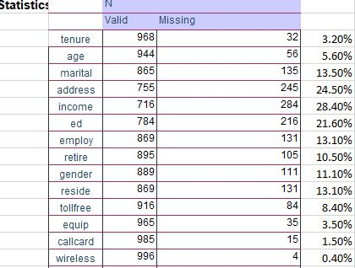
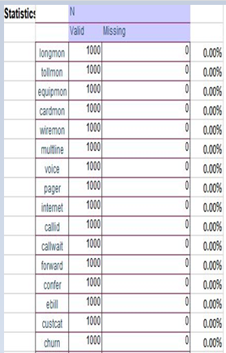
Exploratory Data (EDA)
Exploring sample size and missing values
Opened file telco_missing.sav in IBM-SPSS STATISTISCS 24 app. browsed to analyse-descriptive statistics-frequency Added all variables in spss to find sample size and missing cases for all variables. The tables in the right summarizes the observation made regarding sample size and missing cases for all variables. 11 variables are scalar variables namely tenure,age,address,income,employ,reside,Long distance last month, Toll free last month, Equipment last month,cardmon,Wireless last month. 16 variables are Nominal variables namely marital,retire,gender,tollfree,Equipment rental,Calling card service,Wireless service,Multiple lines, Voice mail, Paging service,internet,Caller ID, Call waiting, Call forwarding,3-way calling, Electronic billing. 2 variables are Ordinal Variables namely Level of education and Customer category.

Slide 2
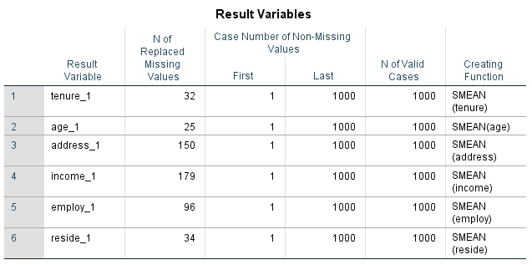
Replacing Missing Values
1)Opened file telco_missing.sav in IBM-SPSS STATISTISCS 24 app. 2)browsed to transform---replace missing values using series mean as the creating function---only for the scale variables. 3)created all new scale variables in spss to accommodate missing cases for all of them. 4)Attaching the snapshot for the newly added variables to accommodate missing cases.

Slide 3
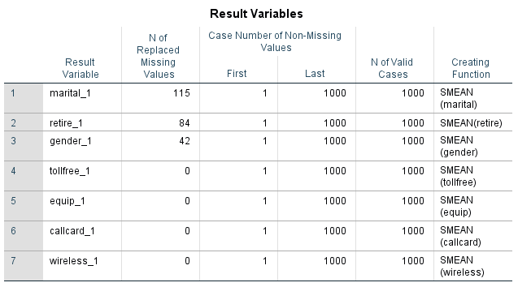
Replacing Missing Values
1)Opened file telco_missing.sav in IBM-SPSS STATISTISCS 24 app. 2)browsed to transform---replace missing values using Median of nearby points as the creating function---only for the Nominal variables. 3)created all new scale variables in spss to accommodate missing cases for all of them. 4)Attaching the snapshot for the newly added variables to accommodate missing cases.

Slide 4
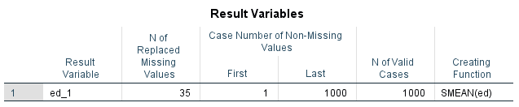
Replacing Missing Values
1)Opened file telco_missing.sav in IBM-SPSS STATISTISCS 24 app. 2)browsed to transform---replace missing values using Median of nearby points as the creating function---only for the Ordinal variables. 3)created all new scale variables in spss to accommodate missing cases for all of them. 4)Attaching the snapshot for the newly added variables to accommodate missing cases.

Slide 5
Linear Regression Used cases
It is used when the relationship is linear.
Linear Regression is used to solve regression type problem. It is supervised technique of building the model where independent variables can be scalar or categorical but Dependent or Target variables must be a scale variable.
Independent variables must be uncorrelated. Otherwise it causes multi-colinearity problems. Building Linear regression when the co-relation coefficients are related, then they do not give reliable predicted output values.
With changes in sample, correlation coefficients are unreliable.
Also mean standard error and Mean absolute error is high when Independent variables are uncorrelated .
however, there can be a situation where there is correlation between dependent and independent variables which is quite acceptable but correlation between two independent variables is not acceptable.in such a situation we drop one of the independent variable which has strong correlation with other independent variable.

Slide 6
Linear Regression Used cases
R-square or co-efficient of determination which lies between 0 and 1 should be nearer to 1 to build a good model.
If R-square is nearer to 0, that won’t build a good model.
Split the data into training and testing.70% of the data sample used to train the model. Then the model built is tested on the remaining 30% of testing samples to ascertain whether the model building was good or bad.
p-value or significant value should also be less than 0.05.if p-value is less than 0.05 then NULL hypothesis is rejected meaning that there is significant association between two variables whether that be between two independent variables or between independent and target or the dependent variable.
For Linear regression variable the dependent variable is scalar and can fluctuate between large positive data and large negative data i.e. range can be between –infinity and +infinity.

Slide 7
Logistic Regression Used cases
Logistic Regression is used to solve classification type problem. It is supervised technique of building the model where independent variables can be scalar or categorical but Dependent or Target variables must be a categorical variable and preferably nominal variable which has two values i.e. either 0 or 1.
If the variable is Binary or nominal, the value can be either 0 or 1 i.e. it fluctuates between 0 and 1.This is classification problem as the output is binary i.e. either 0 or 1.
If you multiply the output obtained by linear regression by (1 divided by (1+e-x)).The value then lies always between 0 and 1.

Slide 8
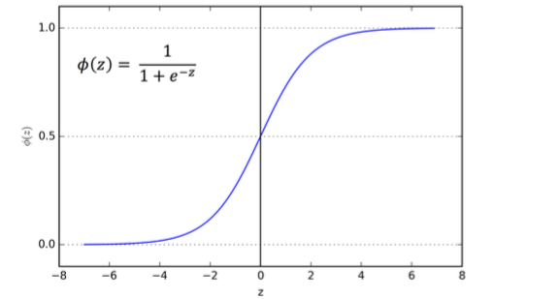
Logistic Regression Used cases
The curve for Logistic regression can be given by the equation as below. Observe that the output value will always lie between 0 and 1.

Slide 9
Logistic Regression Used cases
After getting the output of logistic regression, as it values lies between 0 and 1,if the value is nearer to one it can regarded as 1 and if the value is nearer to 0 ,it can be regarded as 0.
Logistic regression is a supervised model as there is a target or dependent variable and 1 or many independent variables.
Logistic regression can be of two type:
A) Binary LOGISTIC REGRESSION- Here we have only one categorical variable which lies between 0 and 1.
B) Multinomial Logistic Regression--- Here we can have multiple categorical variables.
If we have categorical variable which is ordinal variable whose value lies between 1 and 10.I will split this value as per the business problem.
Say 1-7 is regarded as Binary 0. 8-10 is regarded as Binary 1.Then I can do logistic regression on them which would be binary Logistic regression where value is either 0 or 1.

Slide 10
Building Binary Logistic Regression Model
Opened file telco_missing.sav in IBM-SPSS STATISTISCS 24 app.
As per the dataset, we have 29 independent variables and we need to use Binary Logistic Regression to decide the relationship between Target Variable i.e. churn and the independent variables.
11 variables are scalar variables namely tenure, age, address, income, employ,reside,Long distance last month, Toll free last month, Equipment last month, cardmon, Wireless last month.
16 variables are Nominal variables namely marital, retire, gender, tollfree, Equipment rental,Calling card service,Wireless service,Multiple lines, Voice mail, Paging service,internet,Caller ID, Call waiting, Call forwarding,3-way calling, Electronic billing.
2 variables are Ordinal Variables namely Level of education and Customer category.
Let us initially Build Logistic Regression Model based on all 29 independent variables and Target or dependent variable i.e. churn .

Slide 11
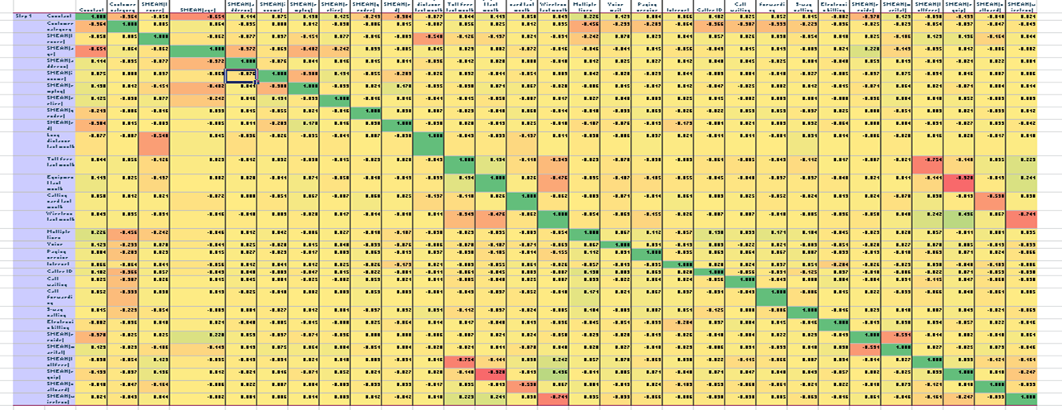
Building Binary Logistic Regression Model
Analyzing the Heat map for correlations we do not find too many dark red and dark green patches indicating there is not too much correlation between independent variables.

Slide 12
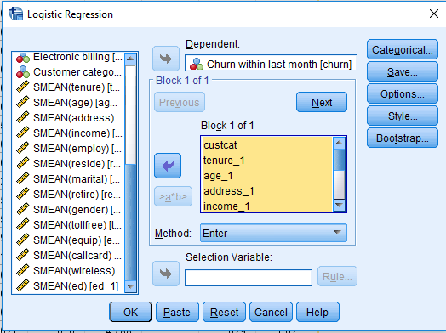
Building Binary Logistic Regression Model
Browse to Analyse-Regression—Binary Logistic Choose Churn within last month as dependent variable. Choose tenure, age, address, income,employ,reside, marital, retire,gender, ed, Customer category as Independent variables. Choose Method as enter Build Binary Logistic regression Model based on above inputs in SPSS.

Slide 13
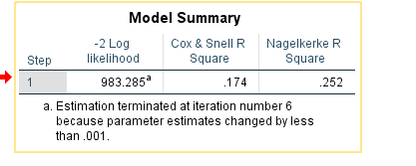
Building Binary Logistic Regression Model
In case of Linear regression if R-square or coefficient of determination tells whether a model is good or bad models as it explains the degree of variation in scale variable .so R-square or coefficient of determination is very important metric to decide whether the model built is a good model or bad model in case of the Linear Regression Model. However, in Binary Logistic regression it is only binary output value which may be either 0 or 1.so R-square or coefficient of determination value is not important in case of Logistic Regression.

Slide 14
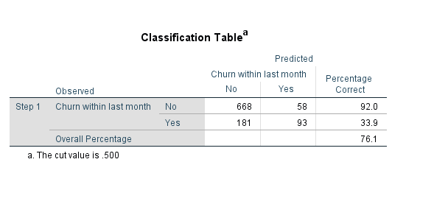
Building Binary Logistic Regression Model
R-square or coefficient of determination value is not important in case of Logistic Regression. But we need to look at confusion Matrix to decide whether the logistic Regression Model built is a good or bad model. As per the confusion Matrix here,Non churners predicted correctly is 668 and predicted wrongly is 58.so percentage of non churners predicted correctly is 92%.since our motive to build the Model is to predict Non churners so we can claim that the model built is a good Model. Also, churners predicted correctly is 93 and predicted wrongly is 181.percentage correct is 33.9%.though churners predicted correctly is not good but we can get high accuracy in predicting Non churners correctly.

Slide 15
Building Binary Logistic Regression Model
Here regression coefficients are not as interpretable as it was in the case of Linear Regression Model.
EXp(Beta) given in last column as below is interpretable.It gives the odds ratio.
Let us say india-pakistan match
India wins 7 out of 10 times
India loses 3 out of 10 times
Taking the ratio of probablity i.e. 0.7/0.3 which is equal to 2.3.
This means odd of india winning is 2.3 times that of pakistan.
This can be called as odds ratio.this is very effective and conveys lot of useful interpretable information.

Slide 16
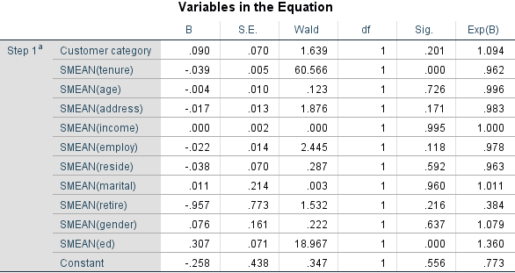
Building Binary Logistic Regression Model
If odds ratio is greater than 1 then odd ratio are better. Those variables with higher odd ratios give higher odds than those variables with lower odd ratios. If odds ratio less than 1 then odds ratio are lesser. As per the Model output those variables with odd ratios greater than 1 or nearer to 1 are customer category,tenure,age,address,income,employ,reside,martial,geneder and levels of education.

Slide 17
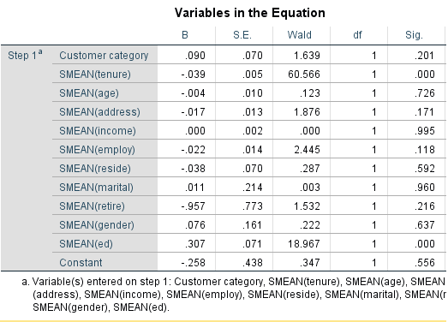
Building Binary Logistic Regression Model
P-value or significant value tells whether there is significant association between two variables or not. If p-value is <0.05 means that there is significant association between two variables and Hence NULL HYPOTHESIS is rejected. If p-value is >0.05 means that there is no significant association between two variables. And we can drop off those variables while building our Logistic regression model. Those variables whose significant value is greater than 0.05 are customer category,age,address,income,employ,reside,marital,retire,gender.However,we will Choose the method as forward conditional later and Build the model to determine p-value.

Slide 18
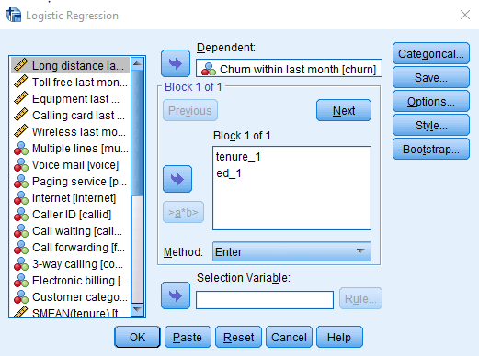
Building Binary Logistic Regression Model
Browse to Analyse-Regression—Binary Logistic Choose Churn within last month as dependent variable. Choose tenure, ed as Independent variables as p-value is less than 0.05 for these two variables indicating there is significant association of these variables with churn. Choose Method as enter Build Binary Logistic regression Model based on above inputs in SPSS.

Slide 19
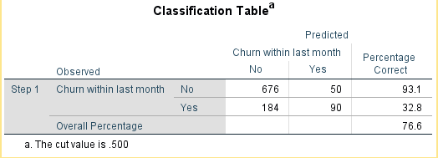
Building Binary Logistic Regression Model
R-square or coefficient of determination value is not important in case of Logistic Regression. But we need to look at confusion Matrix to decide whether the logistic Regression Model built is a good or bad model. As per the confusion Matrix here,Non churners predicted correctly is 676 and predicted wrongly is 50.so percentage of non churners predicted correctly is 93.1%.since our motive to build the Model is to predict Non churners so we can claim that the model built is a good Model. Also, churners predicted correctly is 90 and predicted wrongly is 184.percentage correct is 32.8%.though churners predicted correctly is not good but we can get high accuracy in predicting Non churners correctly.

Slide 20
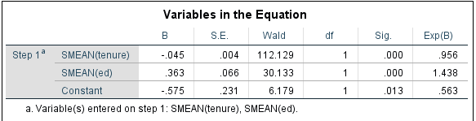
Building Binary Logistic Regression Model
If odds ratio is greater than 1 then odd ratio are better. Those variables with higher odd ratios give higher odds than those variables with lower odd ratios. If odds ratio less than 1 then odds ratio are lesser. As per the Model output those variables with odd ratios greater than 1 or nearer to 1 are tenure and levels of education.

Slide 21
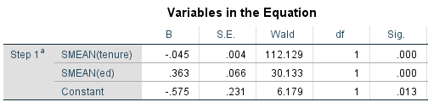
Building Binary Logistic Regression Model
P-value or significant value tells whether there is significant association between two variables or not. If p-value is <0.05 means that there is significant association between two variables and Hence NULL HYPOTHESIS is rejected. If p-value is >0.05 means that there is no significant association between two variables. And we can drop off those variables while building our Logistic regression model. Those variables whose significant value is less than 0.05 are tenure and levels of education indicating that there is significant association between these variables and churn which is the target variable.

Slide 22
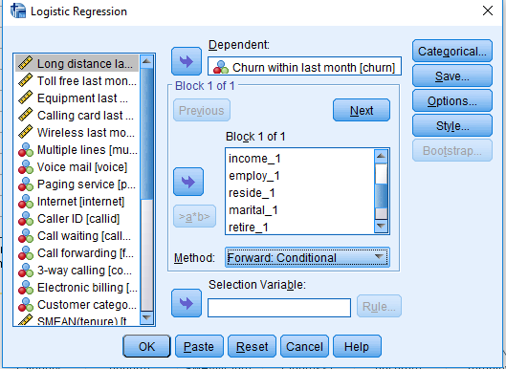
Building Binary Logistic Regression Model
Browse to Analyse-Regression—Binary Logistic Choose Churn within last month as dependent variable. Choose tenure, age, address, income,employ,reside, marital, retire,gender, ed, Customer category as Independent variables. Choose the method as forward conditional . Build Binary Logistic regression Model based on above inputs in SPSS.

Slide 23
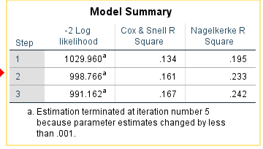
Building Binary Logistic Regression Model
In case of Linear regression if R-square or coefficient of determination tells whether a model is good or bad models as it explains the degree of variation in scale variable .so R-square or coefficient of determination is very important metric to decide whether the model built is a good model or bad model in case of the Linear Regression Model. However, in Binary Logistic regression it is only binary output value which may be either 0 or 1.so R-square or coefficient of determination value is not important in case of Logistic Regression.

Slide 24
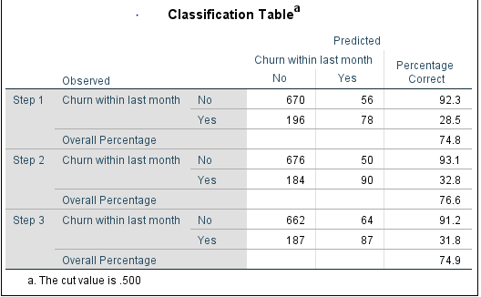
Building Binary Logistic Regression Model
we need to look at confusion Matrix to decide whether the logistic Regression Model built is a good or bad model. As per the confusion Matrix here,Non churners predicted correctly is 662 and predicted wrongly is 64.so percentage of non churners predicted correctly is 91.2%.since our motive to build the Model is to predict Non churners so we can claim that the model built is a good Model. Also, churners predicted correctly is 87 and predicted wrongly is 187. percentage correct is 31.8%.though churners predicted correctly is not good but we can get high accuracy in predicting Non churners correctly.

Slide 25
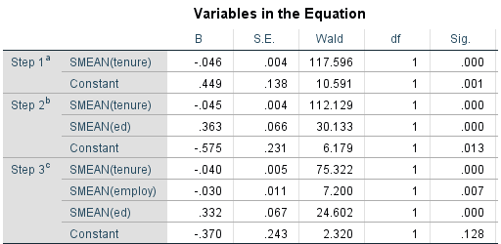
Building Binary Logistic Regression Model
P-value or significant value tells whether there is significant association between two variables or not. If p-value is <0.05 means that there is significant association between two variables and Hence NULL HYPOTHESIS is rejected. If p-value is >0.05 means that there is no significant association between two variables. And we can drop off those variables while building our Logistic regression model. The variables listed have significant value less than 0.05 and hence NULL Hypothesis is rejected and we conclude that there is significant association between tenure,employ,ed and the churn variable which is the target variable.

Slide 26
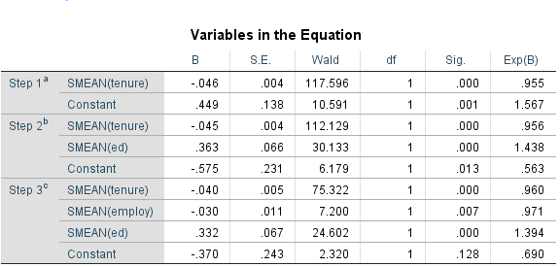
Building Binary Logistic Regression Model
If odds ratio is greater than 1 then odd ratio are better. Those variables with higher odd ratios give higher odds than those variables with lower odd ratios. If odds ratio less than 1 then odds ratio are lesser. As per the Model output those variables with odd ratios greater than 1 or nearer to 1 are tenure, employ and levels of education.

Slide 27
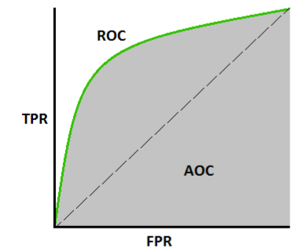
Building Binary Logistic Regression Model
R0C---Receiver operating characteristics: False positive rate predict along the X-axis. True positive rate predict along the Y-axis 45 degree line is formed by Random guessing meaning to see by randomly guessing also 45% chances we may be almost always correct. To decide whether my model is good or bad , it should outperform the Random predicted model. The area between 45 degree line and false positive rate/true positive rate predicted by decision tree model is called ROC curve. AOC is area of curve. If AOC is nearer to zero then model predicted is bad, and If AOC is nearer to one then then model predicted is good.

Slide 28
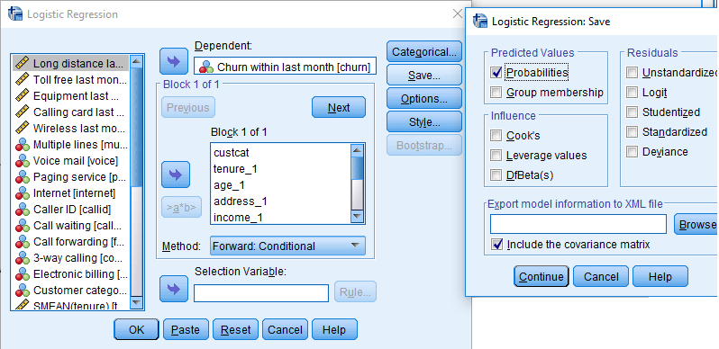
Building Binary Logistic Regression Model
In SPSS go to save ,click on probabilities , Additional columns by this name will be added in sav files. On the sav file do right click and click on sort descending for predicted probabilities.

Slide 29
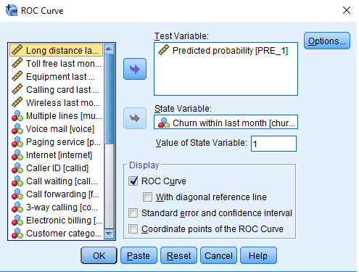
Building Binary Logistic Regression Model
Browse to Analyse-Roc curve. Add details as shown in the snapshot.

Slide 30
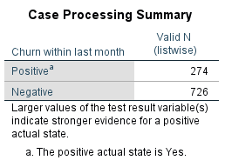
Building Binary Logistic Regression Model
output for ROC Curve computation shown in the snapshot.

Slide 31
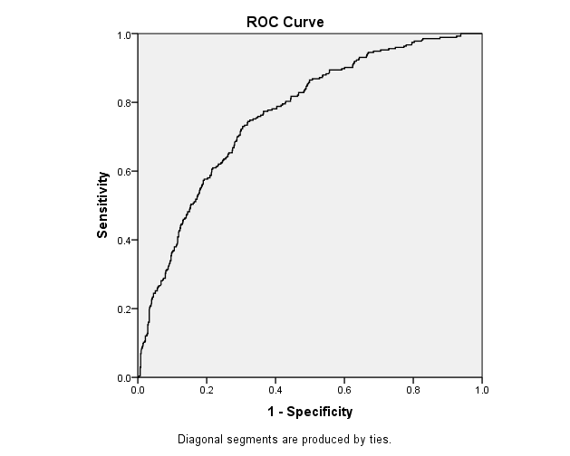
Building Binary Logistic Regression Model
ROC Curve computation shown in the snapshot.

Slide 32
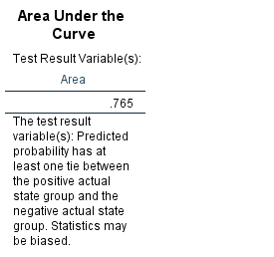
Building Binary Logistic Regression Model
AOC is area of curve. If AOC is nearer to zero then model predicted by the model is bad. Since AOC is nearer to one hence model predicted by the Logistic Regression model is good. TO SUMMARIZE IF WE PREDICTED MODEL USING CHAID,CART AND ALSO USING LOGISTIC REGRESSION then whichever has better ROC Curve, that model is better for building the model. It should be observed that ROC CURVE is used only for modeling where target variable is CATEGORICAL VARIABLE i.e. binary or ordinal variable. Since our Target Variable is churn variable which is Nominal variable whose value can be either 0 or 1.Hence we can use AOC to determine the quality of our model.

Slide 33
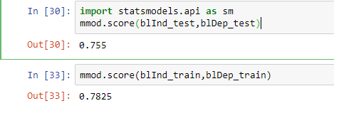
Building Binary Logistic Regression Model
We can also build Logistic Regression Model using python coding. Attaching HTML file on next slide which explains Building Linear Regression Model using python. we have the raw dataset. Golden rule of modeling is that modeling is not applied on the entire dataset. 70% of the dataset is fed to training.30% is fed to testing. 70% of training dataset is fed to Building Logistic regression model. Logistic regression model will generate the output. This model output is used to score the test result. There is slight variation in Model accuracy as for test data our accuracy by which we can predict about the target variable was 75% and for training data it is 78%.

Slide 34
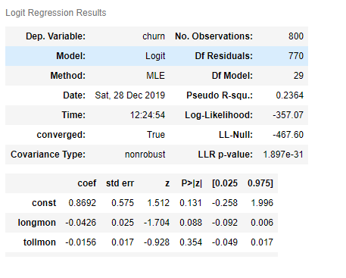
Building Binary Logistic Regression Model
We build Logistic Regression Model using sm.logit as follows: lmod =sm.Logit(blDep_train,blInd_train) mmod = lmod.fit() mmod.summary() 2. We can see the Logit Regression result as shown in the snapshot here. 3.Attaching the HTML FILE for Building LOGISTIC REGRESSION MODEL using PYTHON.

Slide 35
LOGISTIC REGRESSION ASSIGNMENT
THE END THANK YOU ANAND MOHAN

