Slide 1
Rev A0_01
4th April 2017
Secure SD Card
Concept

Slide 2
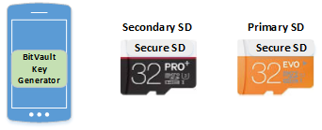
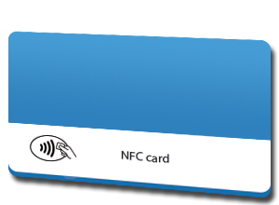
Purchase of new Secure Device
New Purchase comes with a Secure handheld device (SHD), two Secure SD Cards and two NFC cards(Primary and Master)
(Primary / Master Secure SD Card and Secondary / Active Secure SD Card)
SHD – Comes with one time key generator application “BitVault Key Generator”.
After successful generation of BitVault Key, this “BitVault Key Generator” application will be completely erased from the SHD.

Slide 3
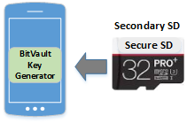
First Power ON
On the First Power ON, Device will prompt for the Secondary Secure SD card insertion.
Device will not boot without a detection of Secure SD card
Once the secure SD is inserted, device will follow the procedure for Secondary (or Primary while recovering the lost SHD device information) SD card key generation

Slide 4
Give the user the option to generate private keys
Delivered to the user(Premium version)
Secure PDF sent with DHL – Need a secure delivery method
Recovery software will only be on a recovery device
Dedicated recovery device – Software for recovery device will not ship on normal device
This process will cost the user more money

Slide 5
New Device First Power On
Enter your recovery email address
Scan user Fingerprint – save to secure zone memory(eMMC Flash – internal to the device)
Scan user Iris – save to secure zone memory(eMMC Flash – internal to the device)
Generate 256 byte random password and write to Primary NFC card, and backup NFC card
Confirm both cards programmed correctly
Read Device UID1
Generate Second UID2 – GenerateUID2(UID1, NFC PW)
Link scanned Fingerprint to UID1
When fingerprint is scanned and matched – UID1 will be assigned
Link scanned iris to UID2
When retina is scanned and matched – UID2 will be generated from UID1 and NFC PW
Write encrypted version of UID1 to Primary and secondary uSD cards
Use UID1, UID2 + the random password stored on the NFC card to generate a root key
Generate 5 bitcoin wallets –
Third parties can not use this process?

Slide 6
New Device First Power On – Recovery
Enter your recovery number that was sent to your recovery email when your original device – Recovery Sever for reading the recovery code
Insert Recovery SD Card and Read UID1
Scan user Fingerprint – save to secure zone memory
Scan user Iris – save to secure zone memory
Read 256 byte random password from backup NFC card
Generate Second UID2 – GenerateUID2(UID1, NFC PW)
Link scanned Fingerprint to UID1
When fingerprint is scanned and matched – UID1 will be assigned
Link scanned iris to UID2
When iris is scanned and matched – UID2 will be generated from UID1 and NFC PW
Use UID1, UID2 + the random password stored on the NFC card and generate a root key1
Recover all wallets

Slide 7
New Device First Power On – Recovery continued
Generate new 256 byte random password and write to Primary NFC card, and backup NFC card
Confirm both cards programmed correctly
Read new Device UID3
Generate Second UID4 – GenerateUID4(UID3, NFC PW2)
Link scanned Fingerprint to UID3
When fingerprint is scanned and matched – UID3 will be assigned
Link scanned retina to UID4
When retina is scanned and matched – UID4 will be generated from UID3 and NFC PW
Write encrypted version of UID3 to new Primary and secondary uSD cards
Use UID3, UID4 + the random password2 stored on the NFC card to generate a new root key2
Scan to see if any contents in recovered wallets and copy to new wallets(Can we transfer all the Funds to one wallet?)
Provide the recovered wallet keys to the user? – Provide the user with the full set of keys of the recovered wallets

Slide 8
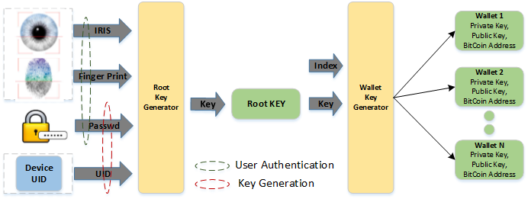
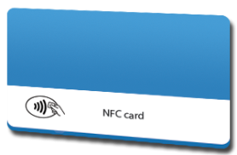
Wallet Key Generation Process – Native Applications only
UID1
UID2
Root Key Generator takes IRIS, FP, NFC as input and creates a Root Key.
Wallet Key Generator take Root Key and Wallet ID as input and creates Wallet keys (Set of private & public keys)

Slide 9
Wallet Key Generation Process – Third Party applications
AppSerial Number
Generated from Serial number and NFC Card
Root Key Generator takes IRIS, FP, NFC as input and creates a Root Key.
Wallet Key Generator take Root Key and Wallet ID as input and creates Wallet keys (Set of private & public keys)
Application store needs to keep track of the Applications every Bitvault installed previously

Slide 10
A different process is required for third party developers
Different root keys will be generated for third party applications
Every third party app will have it’s own unique serial number

Slide 11
Other Applications need a new Root Key
Third party developers will have to generate their own process for generating a root key
New Wallet – Ex. Ethereum wallet
Fingerprint – Linked to 6 Letter password – x1
NFC Card
Iris – GenerateNewUIDx2(x1, NFC PW)

Slide 12
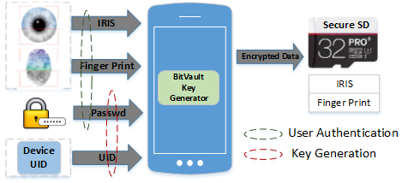
Secondary SD Card Key Generation
SD Card content will be encrypted with the Root Key
(Root key is based on UID and Password).
IRIS, Finger Print will be used for Authentication

Slide 13
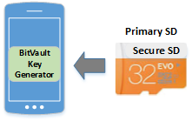
Primary SD insertion
On completion of the secondary SD card, device will prompt for the Primary SD card
Once the secure SD is inserted, device will follow the procedure for Secondary (or Primary while recovering the lost SHD device information) SD card key generation

Slide 14
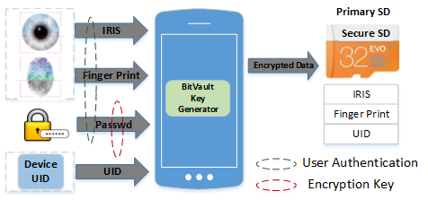
Primary Card Key Generation
Users IRIS, Finger Print, Passphrase, key word will get generated and stored
Primary SD card should encrypt the data using CPU Specific unique ID, so that it will not be used with any other device.

Slide 15

A Partner you can depend on for all dimensions of the Product Development and Manufacturing Lifecycle www.vvdntech.com

