Slide 1
Viper: An Efficient Hybrid PMem-DRAM Key-Value Store
Lawrence Benson, Hendrik Makait, Tilmann Rabl
Hasso Plattner Institute, University of Potsdam
VLDB’21

Slide 2
Introduction
The emergence of persistent memory (a.k.a., PMem, NVRAM, or NVM) promises byte-addressable data persistence with close-to-DRAM speed. It also supports the storage of arbitrary data structures without the need for record de-/serialization, which is required in traditional string-based KVSs.
However, as PMem has only recently become publicly available, the majority of previous PMem research uses simulations to estimate PMem performance in which key characteristics were assumed incorrectly.

Slide 3
Introduction
Recent research shows that Intel’s Optane DIMMs behave differently than DRAM and SSD. Thus, simply replacing disk-based storage with an identical PMem-based one does not yield the best performance.
Benchmarks also show that sequential write latency to PMem is much closer to DRAM’s performance, whereas there is a higher penalty for random reads than expected. This breaks one main assumption previous research built upon, that writes are slow and should be avoided and reads are fast and can be random.

Slide 4
Introduction
To overcome the central performance issues of disk-based KVSs and incorrect assumptions of previous PMem research, we propose three PMem-specific access patterns for efficient data storage, direct PMem writes, DIMM-aligned storage segments, and uniform thread-to-DIMM distribution. We implement these patterns in Viper, a hybrid PMem-DRAM KVS whose persistence is built on Pmem.

Slide 5
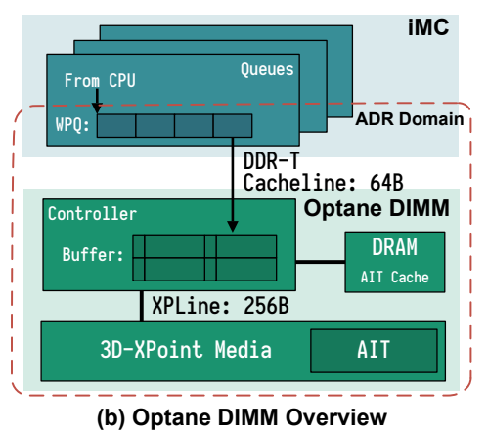
Background
Persistent Memory
These DIMMs are based on 3D XPoint technology and are denser than DRAM DIMMs, offering larger capacities at a lower cost per GB ratio.
integrated memory controller (iMC)
read and write pending queues (RPQs and WPQs)
asynchronous DRAM refresh (ADR)
While the iMC communicates with the DIMM in 64 Byte cache lines, physical media access occurs at 256 Byte granularity.
An on-DIMM controller combines adjacent writes using a write-combining buffer.

Slide 6
Background
Persistent Memory
Running PMem in App Direct Mode gives the user explicit control over access to PMem, whereas Memory Mode uses PMem as a volatile extension of DRAM, in which DRAM acts as an “L4” cache and data is not persistent. To guarantee persistence in Viper, we use the App Direct Mode and map PMem into our application’s virtual memory space via mmap to leverage its byte-addressability.

Slide 7
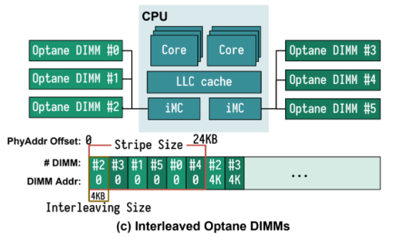
Background
Persistent Memory
PMem also supports interleaving data across DIMMs. Interleaving aims to improve the overall throughput of reads and writes by spreading sequential data accesses over multiple DIMMs in parallel.

Slide 8
Background
Persistent Memory
PMem also supports interleaving data across DIMMs. Interleaving aims to improve the overall throughput of reads and writes by spreading sequential data accesses over multiple DIMMs in parallel.

Slide 9
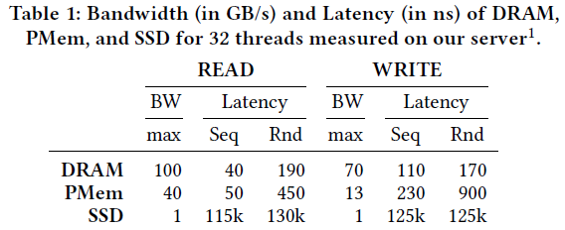
Background
Persistent Memory
Random reads have a 2.5x higher latency than DRAM, caused by a longer delay for accessing the media, but three orders of magnitude lower latency than SSD. At the same time, the latency of sequential persistent writes is almost equal to DRAM, since data only needs to reach the WPQ in the iMC to be persisted. Random writes suffer a 5x higher latency and are impacted heavily by the bandwidth.

Slide 10
VIPER: A HYBRID KEY-VALUE STORE
Hybrid Design
Viper consists of a volatile hash index located in DRAM and persistent data blocks located in PMem.
PMem Access Patterns.
Three core design choices for PMem-specific access patterns that significantly impact its performance on real hardware:
1) Direct PMem writes. Viper writes all data directly to PMem without an intermediate DRAM buffer.
2) Uniform thread-to-DIMM distribution. Viper minimizes the thread-to-DIMM ratio for inserts by assigning threads to different memory regions.
3) DIMM-aligned storage segments. Viper stores data in DIMM-boundary aligned VPages to balance DIMM contention with parallelism.

Slide 11
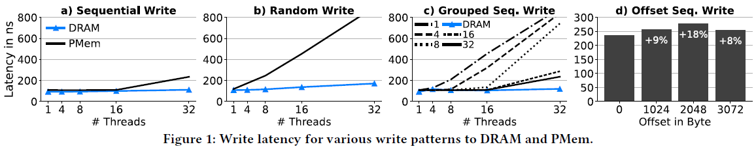
VIPER: A HYBRID KEY-VALUE STORE
PMem Access Patterns.
We perform 64 Byte stores followed by clwb and sfence with a varying number of threads in PMem and DRAM.
Figures 1a and b show that sequential writes have a similar latency for PMem and DRAM (maximum 2x higher for 32 threads), while random writes perform significantly worse on PMem even for low thread counts.

Slide 12
VIPER: A HYBRID KEY-VALUE STORE
PMem Access Patterns.
We distribute the threads across k memory regions (1 GB each), representing log files, to which they write sequentially. Using 1 log file (denoted as 1 in the plot), all threads write adjacent cache lines, i.e., thread 1 writes bytes 0–63, thread 2 writes 64–127, and so on.

Slide 13
VIPER: A HYBRID KEY-VALUE STORE
PMem Access Patterns.
In this benchmark, we let each thread write 4 KB sequentially and alter the alignment of the writes. We see that 4 KB aligned writes (offset = 0) achieve the lowest latency, while a 2 KB offset has an 18% higher latency.

Slide 14
VIPER: A HYBRID KEY-VALUE STORE
Volatile Index.
we avoid (possibly multiple) expensive random operations to the hash index by locating it in DRAM.
For our implementation of Viper, we build on CCEH and use it in DRAM instead of PMem. CCEH uses an extendible hashing approach, thus allowing for dynamic resizing without an expensive full table rehashing. As we use the volatile index to store offsets to PMem locations, we refer to it as Offset Map in the remainder of this work.

Slide 15
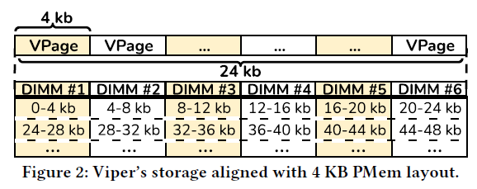
VIPER: A HYBRID KEY-VALUE STORE
Persistent Data.
Viper’s main storage segments are called VPages and contain the individual key-value records as well as some metadata.

Slide 16
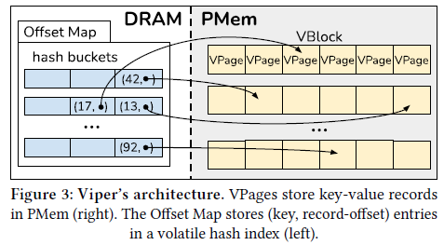
VIPER: A HYBRID KEY-VALUE STORE
Architecture
Each VPage is 4 KB (DIMM-aligned) and contains some metadata plus the actual key-value records stored in slots. They are the actual storage units in Viper.
The offset consists of three parts: the VBlock id, the VPage id, and the record position in the VPage. Viper stores the hash of that key and checks for equality only if the hash matches.
To grow, Viper allocates VBlocks in PMem and maps them into the virtual memory space via mmap. To keep track of the virtual addresses, Viper stores a pointer to each VBlock in a list in DRAM.

Slide 17
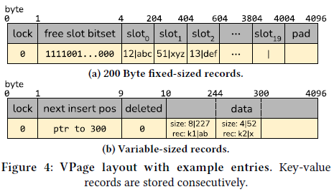
VIPER: A HYBRID KEY-VALUE STORE
Architecture
Both the key and the value are stored together in a single slot.
The metadata is stored in the first few bytes of the VPage. It consists of a version lock byte and a bitset indicating which slots are free or populated. We use a lock byte to handle concurrent access to the VPage, allowing only one thread to concurrently modify its data.
The sizes are stored in a single 32-bit value (15 bits for key, 16 bits for value) to allow for atomic updates. The least significant bit of the value indicates whether the record is set (= 1) or deleted (= 0).

Slide 18
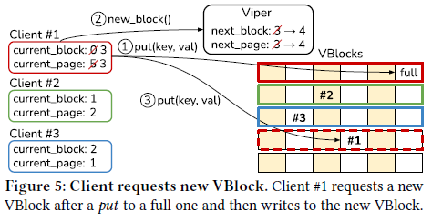
KEY-VALUE STORE OPERATIONS
Viper Client
Each client is initialized with its own VBlock (#1 → VBlock0, #2 → VBlock1, #3 → VBlock2), i.e., no two clients write new records to the same VBlock.

Slide 19
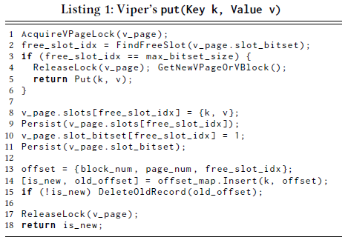
KEY-VALUE STORE OPERATIONS
Put
If a crash occurs between persisting the bitset and the deletion of an old record, Viper contains two values for the same key. To guarantee a deterministic recovery and thus ensure atomic writes, Viper selects the greater ⟨ block_id, page_id, slot_id ⟩ in case of a conflict.

Slide 20
KEY-VALUE STORE OPERATIONS
Get
First, the client searches for the key in the Offset Map and returns an error if not entry was found.
The client then atomically reads the version lock of the VPage that contains the record into 𝑙1.
Before returning the value, it again atomically loads the version lock into 𝑙2. If 𝑙1 = 𝑙2, the VPage was not modified and the value can be safely returned. If 𝑙1 ≠ 𝑙2, the entire read operation is retried, as a conflict might have occurred.

Slide 21
KEY-VALUE STORE OPERATIONS
Update
To avoid partial update anomalies, only atomic updates can be performed. Updating in Viper is similar to get but instead of returning the value if no version
conflict occurred, the client acquires an exclusive lock and applies the UpdateFn to the value. Thus, any subsequent operations are aware that a modification was performed. Recent work shows that in-place modification is preferred over copy-on-write for PMem .

Slide 22
KEY-VALUE STORE OPERATIONS
Delete
In Viper, the actual record is not erased, but the corresponding free slot bit is set to 0 and the bitset is persisted to make the deletion durable. Then, the key is removed from the Offset Map before releasing the page lock and returning a successful deletion.

Slide 23
KEY-VALUE STORE OPERATIONS
Space Reclamation
Viper runs a periodic background space reclamation process.
In this reclamation, Viper scans the bitsets of the VPages to see how many free slots are available. If the number of free slots in a VBlock is higher than a configurable threshold and the VBlock is not currently “owned” by a client, the Vblock is compacted into a new VBlock, marked as free, and added to the free block queue.

Slide 24
KEY-VALUE STORE OPERATIONS
Recovery
Viper stores a small amount of metadata in PMem to keep track of the number of allocated VBlocks, the number of used VBlocks, and the total memory-mapped size.

Slide 25
Evaluation
Other Systems
FASTER: hash-based KVS, a hybrid DRAM-PMem system
Pmem-rocksdb
Dash: PMem-only
Pmemkv: PMem-only, the cmap backend
μTree: hybrid PMem-DRAM systems, hybrid B-Tree implementation
Cross-Referencing Logs(CRL): hybrid PMem-DRAM systems, bridge the gap between volatile and persistent KVSs by persisting cross-referencing logs between two KVSs, one in DRAM and one in PMem.

Slide 26
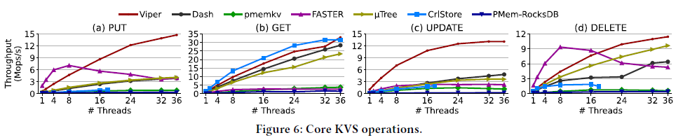
Evaluation
Micro Benchmarks
Key-Value Store Operations.
We initially fill each KVS with 100 million 216 Byte records (16 B key, 200 B value), before performing 50 million individual operations on them.
In (a), we see that Viper’s insert throughput scales well with the number of threads.
(b)FASTER, pmemkv, and RocksDB do not perform well for random get request due to inefficient lookups in PMem.
This shows that get performance heavily depends on the chosen (hash-) index implementation.
In such a workload (c), we see that Viper outperforms all other systems due to its atomic Pmem-aware in-place modification.

Slide 27
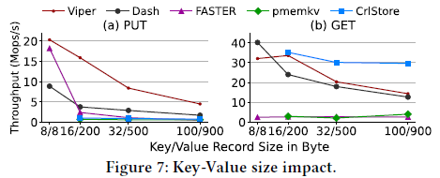
Evaluation
Micro Benchmarks
Key-Value Record Size.
We define a fixed prefill data size of 20 GB, which we divide by the record sizes to get the number of records to prefill each system. We then insert 10 GB in the same manner, i.e., exactly half as many records as the prefill.
Viper decreases linearly with an increasing record size, as it becomes PMem bandwidth-bound.

Slide 28
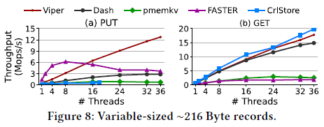
Evaluation
Micro Benchmarks
Variable-sized Records
We prefill 100 million records of about 216 Byte, with a normal distribution around 16 B for the key (N(16, 3.2²)) and 200 B for value size (N(200, 40²)). We then perform each 50 million puts and gets and measure the throughput.

Slide 29
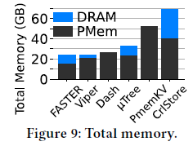
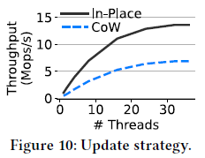
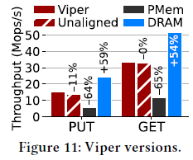
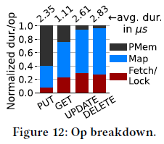
Evaluation
Micro Benchmarks
Memory Consumption. Update Strategy.
Viper Versions Operation Breakdown.

Slide 30
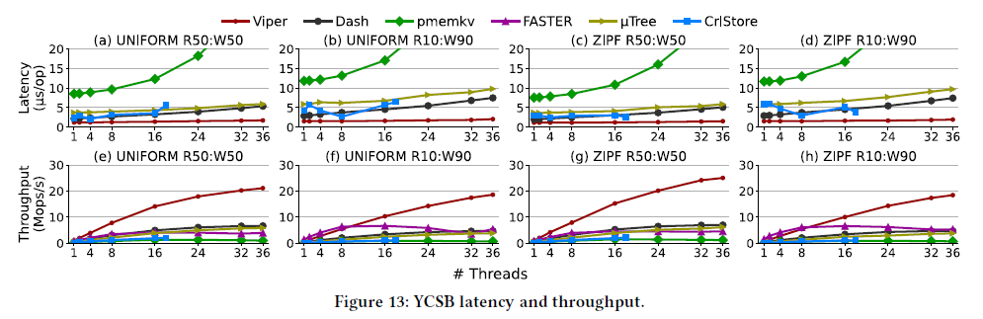
Evaluation
YCSB

Slide 31
Thank you!

