Slide 1
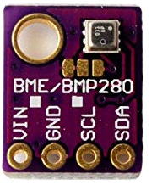
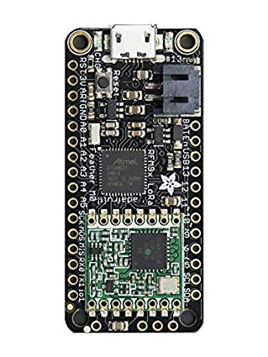
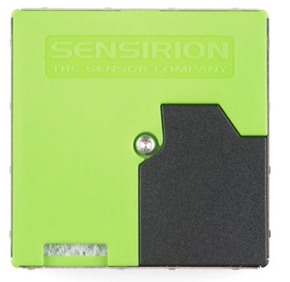
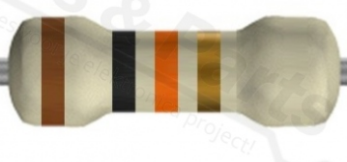
BME280 can handle 5V and Feather input is 5V
GND
Select
SCL
SDA
SPS30
VCC
10K pull resistors are necessary. Some BME280 boards have these already on the board.

Slide 2
BME280 can handle 3V3. The Feather input is 3V3
10K
10K pull resistors to 3V3 are necessary. Some BME280 boards have these already on the board.
GND
Select
SCL
SDA
VCC
SPS30

