Slide 1

FAV Tool Introduction
V1.0
Nancy Yang
2014/08/15

Slide 2
Agenda
Test flow in shop-floor
UI Initial
Main function
FQC Tool
OOB Tool
Shipping OS Tool
VI/P_VI/AOI Tool

Slide 3
Test flow in shop-floor

Slide 4

UI Initial

Slide 5
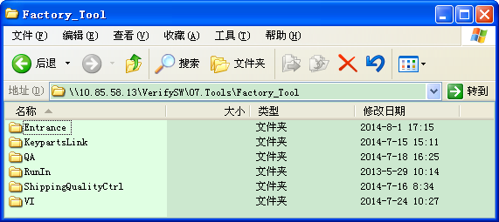
UI Initial: Entrance tool launch
Common tool should be launched by entrance tool.
For FQC/OOB station, Entrance tool will copy QA tool from server, then unzip and run.
For VI/P_VI/SHIPPINGOS/AOI station , Entrance tool will copy VI tool from server, then unzip and run.
Verify version path for example.

Slide 6
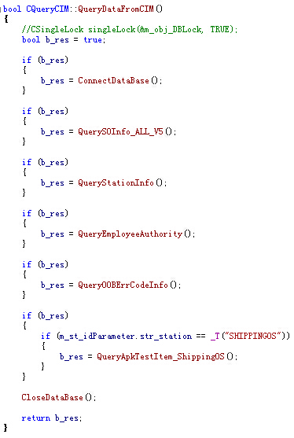
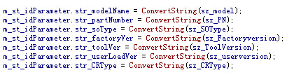

UI Initial: Query Data From PreDB
Query error code from PreDB, and save them in “.\DB\DB_LOG\ErrorInfo.ini“

Slide 7
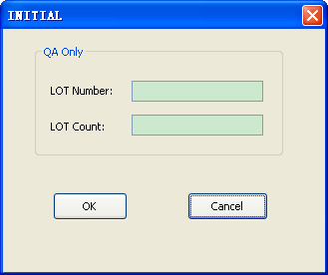
UI Initial : Initial Dialog
If FQC/OOB station, it will launch initial dialog to input lot number and count.

Slide 8
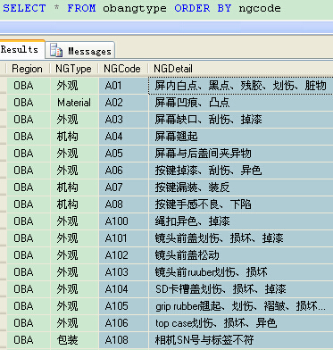
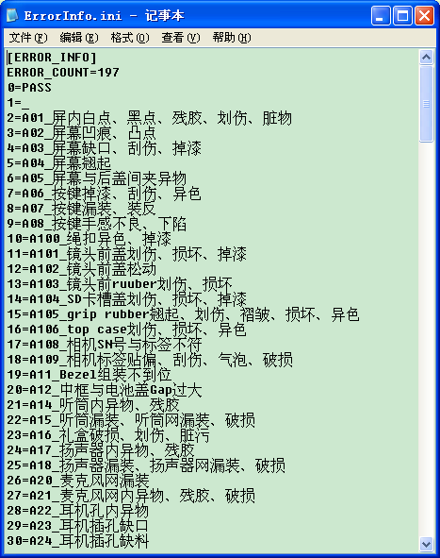
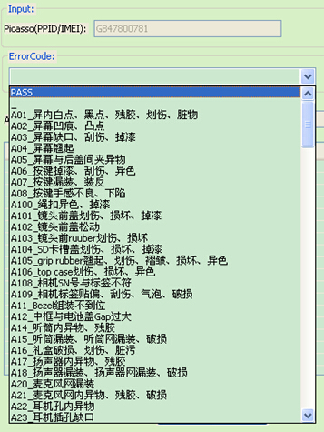
UI Initial : Error Code
When UI initialization, it will do as follow to get error code.
Query error code from PreDB, and save them in “.\DB\DB_LOG\ErrorInfo.ini“
VI/P_VI/AOI station query error code from table ‘picsecd’, FAV/OOB/SHIPPING OS from table ‘obangtype’
Read ErrorInfo.ini, and insert error code to list box of UI.

Slide 9
Main Function

Slide 10
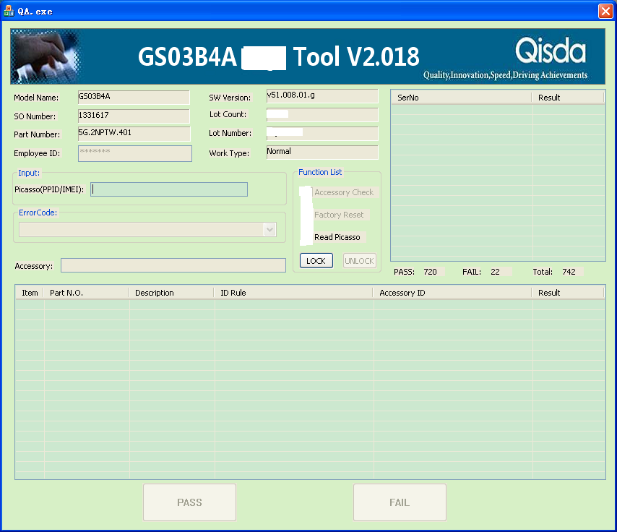
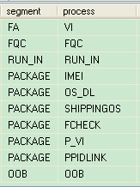
Main Function : UI
Segment is PACKAGE/OOB: Scan ID which type is define in PreDB
Segment is not PACKAGE/OOB: Scan Picasso

Slide 11
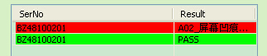
Main Function: general steps
Main Function : Used to record the manual test data to PreDB.
The following is general steps support by all stations.
Visual inspection and function test.
Input id.
Check id rule, if p-line or oob station need Check ID status
Check id hold status
Check routing
If pass, click ‘PASS’ button.
If fail, select an error code, then click ‘FAIL’ button.
Insert a record in PreDB.
Show result in UI, if pass shows green background color or failed red.

Slide 12
Main Function : Check ID status
OOB/SHIPPINGOS/P_VI station, need to check ID status.
‘S’ is not allowed.
In OOB station, if check accessory, ID status must be ‘P’; if not, ID status must be ‘I’ or ‘P’.

Slide 13
Main Function : DB INI
[DB_SET]
ServerName=10.85.68.15
DBName=PREDB
[SETTING]
RetestCount=1

Slide 14
Main Function : DB XML
When test end, it should be insert a test record in PT table for each station.
In OOB/FQC station, it will also insert OOB data to PreDB for QA to get report.
If result is pass, [Pics.xml] use QA.xml and insert the record to oba_accessorycheck table.
If result is fail, then used GetErrCodeDetail_QA to get error detail message, [Pics.xml] use QANG.xml and insert the record to OBACheckNGInfo table.

Slide 15
OOB Tool

Slide 16
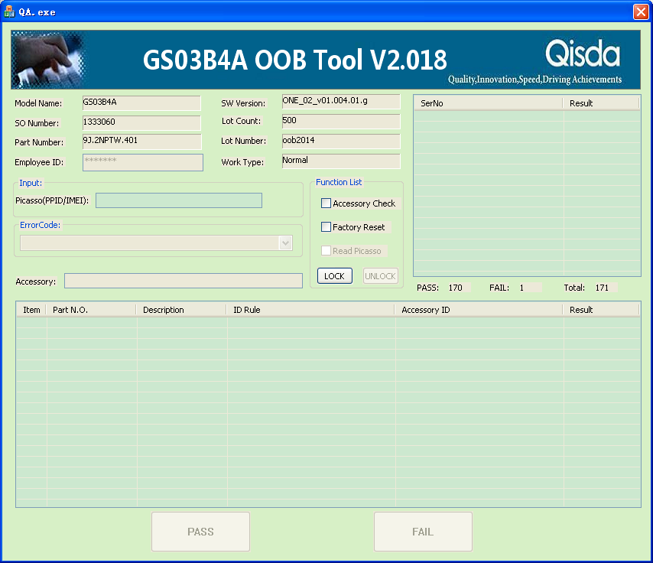
OOB Tool
Support general steps in main function.
Button ‘Accessory Check’ and ‘Factory Reset’ are enable for choose.

Slide 17
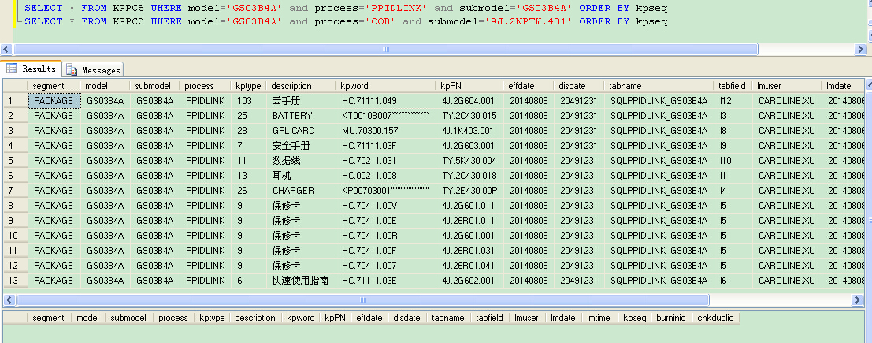
OOB Tool: Accessory Check
Click ‘Accessory Check’ and lock it, there will be list accessories from PreDB.

Slide 18
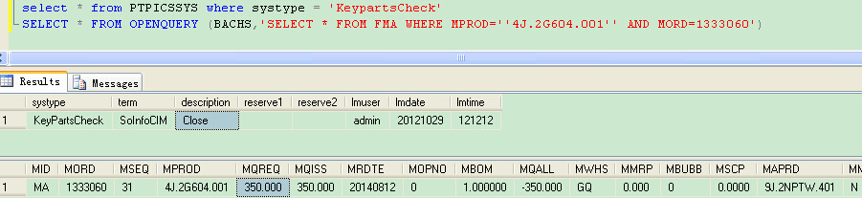

OOB Tool: Accessory Check
Query key parts quantity from BACH/PreDB
description = close will get key parts quantity from BACH
description = open will get key parts quantity from PreDB

Slide 19
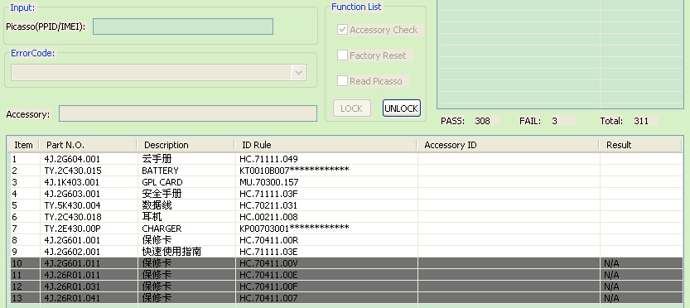
OOB Tool: Accessory Check
Check The Key Part Number if exist in BACH SO BOM,
The non-zero quantity as valid.
Valid: need to check
Invalid: ignore it

Slide 20
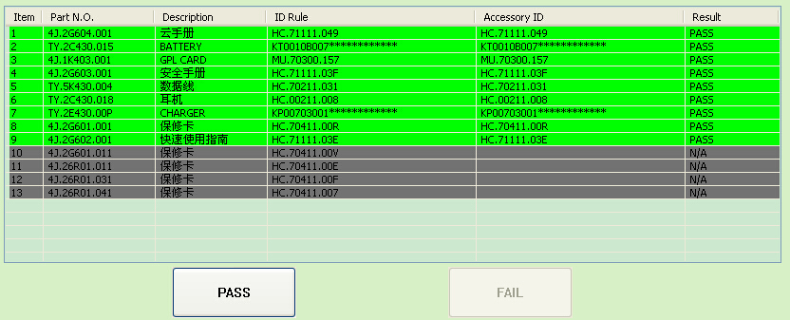
OOB Tool: Accessory Check
Only all accessory checked pass and other function test pass by operator, the PASS button will be activated.

Slide 21

OOB Tool: Factory Reset
Click ‘Factory Reset’ and lock it, when all test pass, And click ‘PASS’ button, it will launch FactoryReset.exe to do factory reset.
EXE Path：

Slide 22
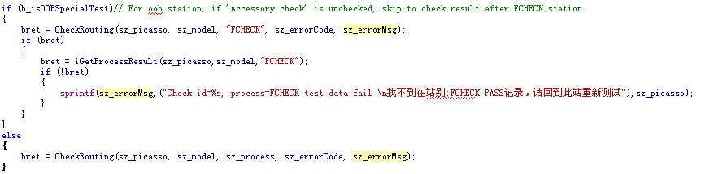
OOB Tool : Check Routing
不勾选附件检查是QA特殊情况的一种做法。只检查FCHECK之前（包含FCHECK站）的测试记录。
勾选附件检查按正常流程check route。

Slide 23
Shipping OS Tool

Slide 24
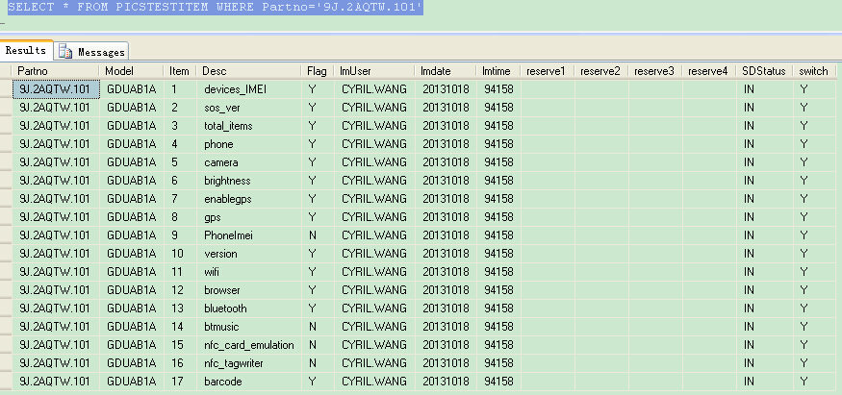
Shipping OS Tool
When UI initial, Query APK test item form PreDB
Switch = Y, ‘ReadIMEI’ button will be enable.
Switch = Y, Tool will check APK test results.
Switch != Y, Tool do not check APK test results.
Support general steps in main function.

Slide 25
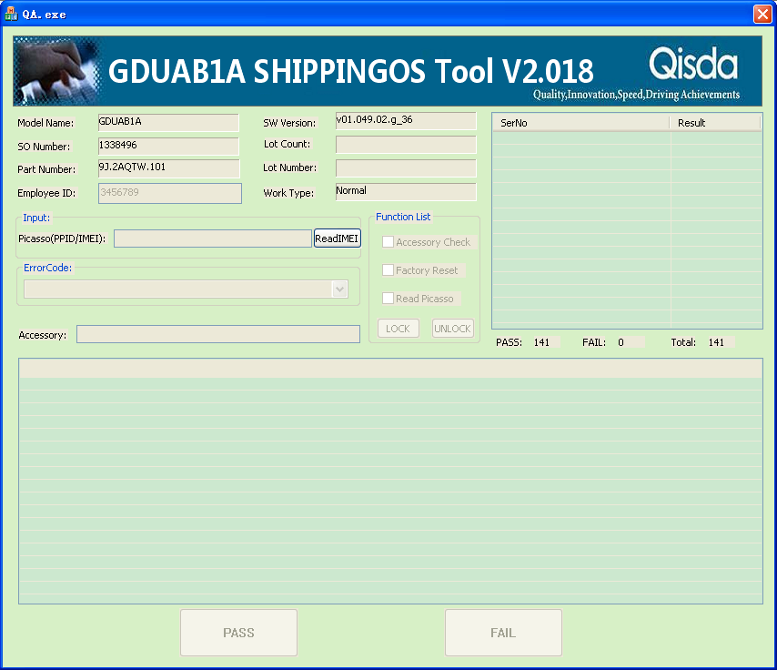
Shipping OS Tool: Switch = Y

Slide 26
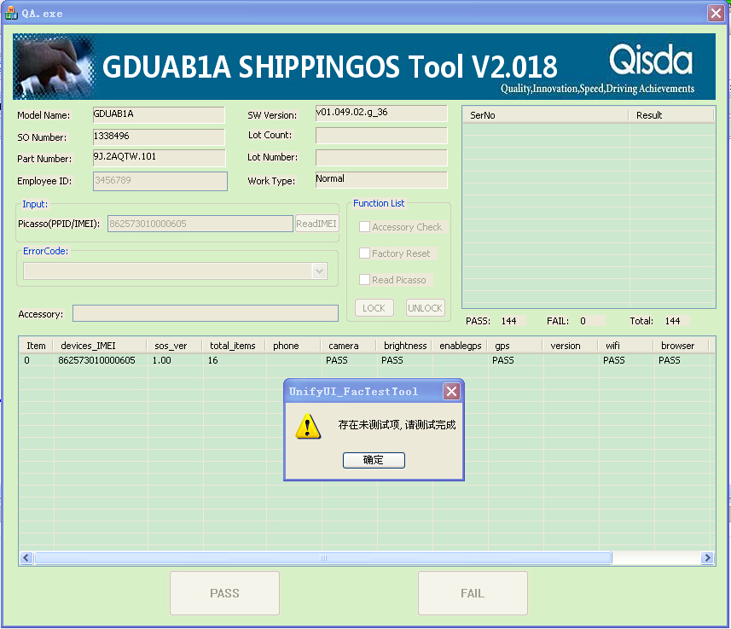
Shipping OS Tool: Switch = Y

Slide 27
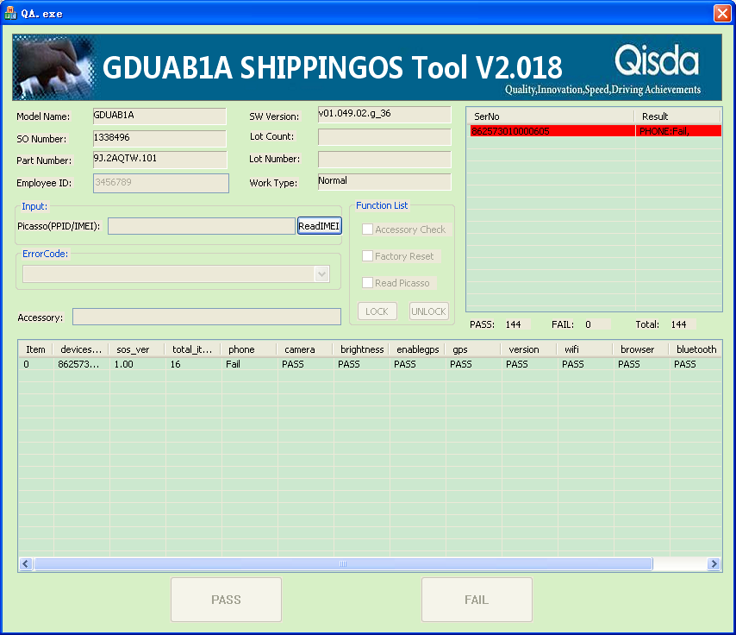
Shipping OS Tool: Switch = Y

Slide 28
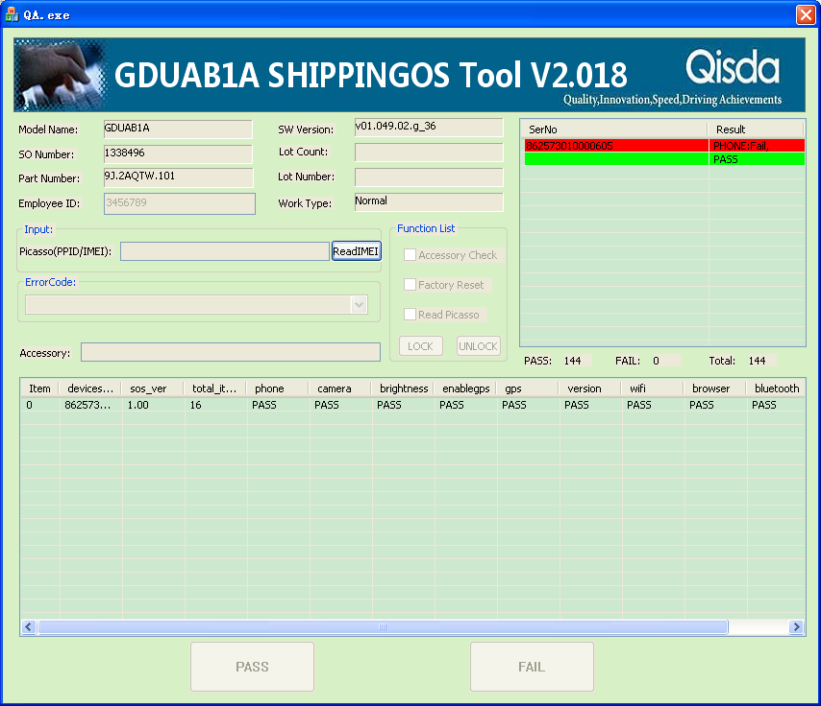
Shipping OS Tool: Switch = Y

Slide 29
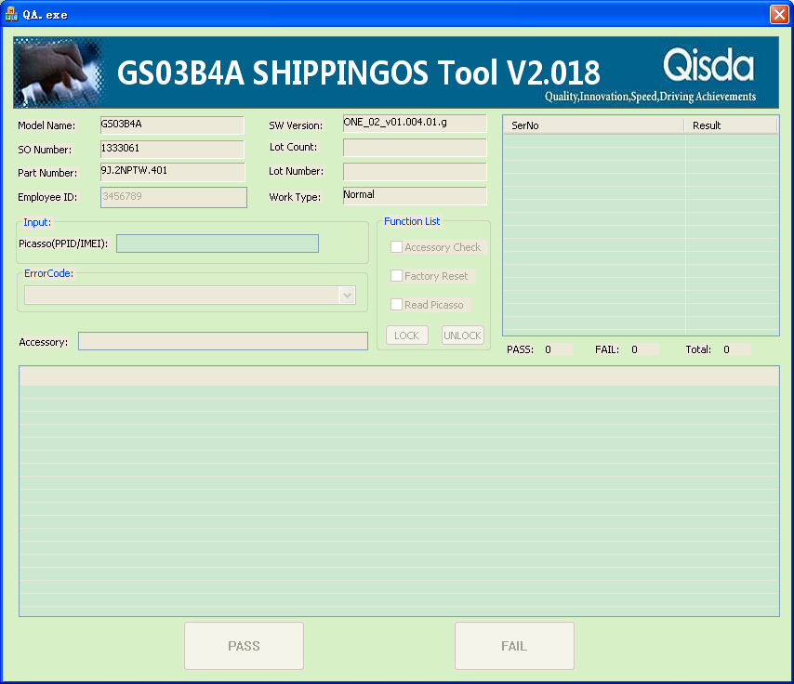
Shipping OS Tool: Switch != Y

Slide 30
FQC/VI/P_VI Tool

Slide 31
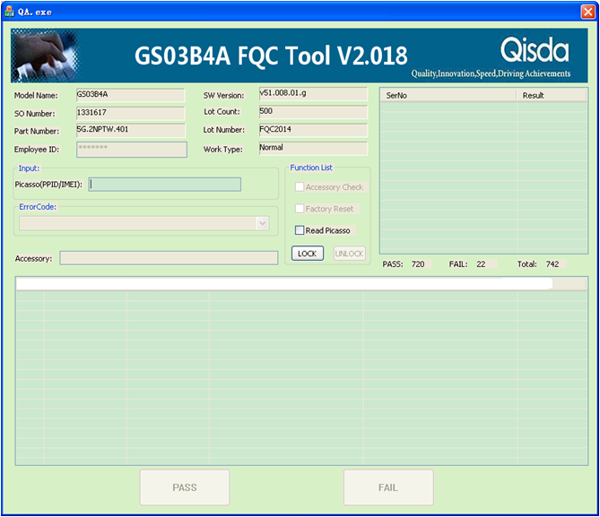
FQC Tool
Support general steps in main function.

Slide 32


FQC Tool
The button ‘Read Picasso’ is enable for choose.
Click it and lock your choose, it will get picasso from phone.
Or don’t do any check, Get picasso by scanning.

Slide 33
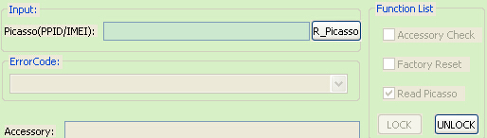
FQC Tool : Read Picasso From Phone
Click ‘R_Picasso’, It will launch C:\Tool\PicassoTool\Picasso.exe.
After the program execution, there will be a file named PICASSO.txt exist in C:\Tool\PicassoTool\
Read PICASSO.txt to get picasso and display it on UI

Slide 34
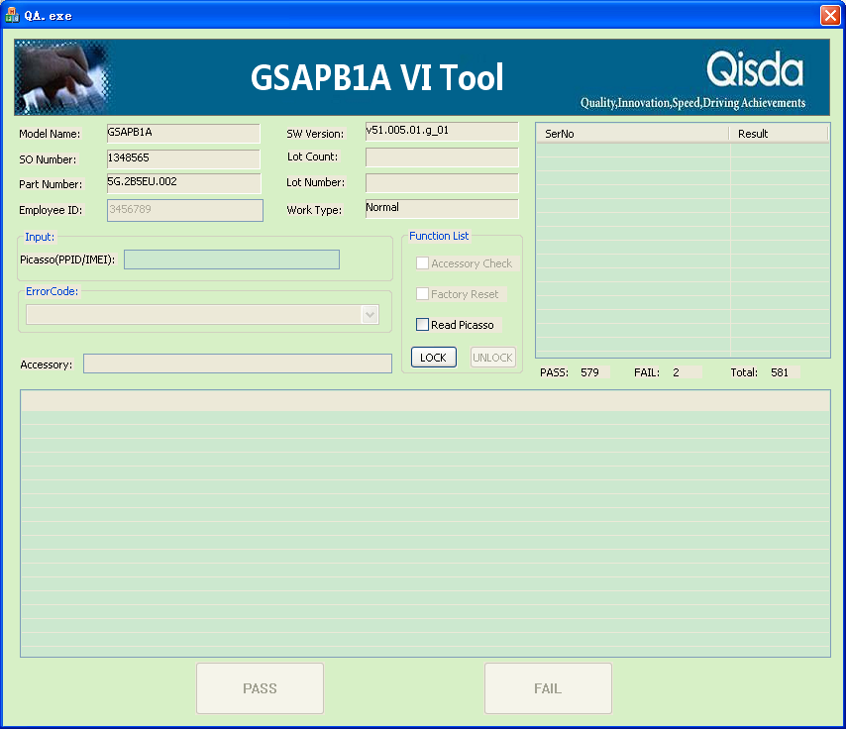
VI Tool
Support general steps in main function.
Read Picasso refer to FQC tool.

Slide 35
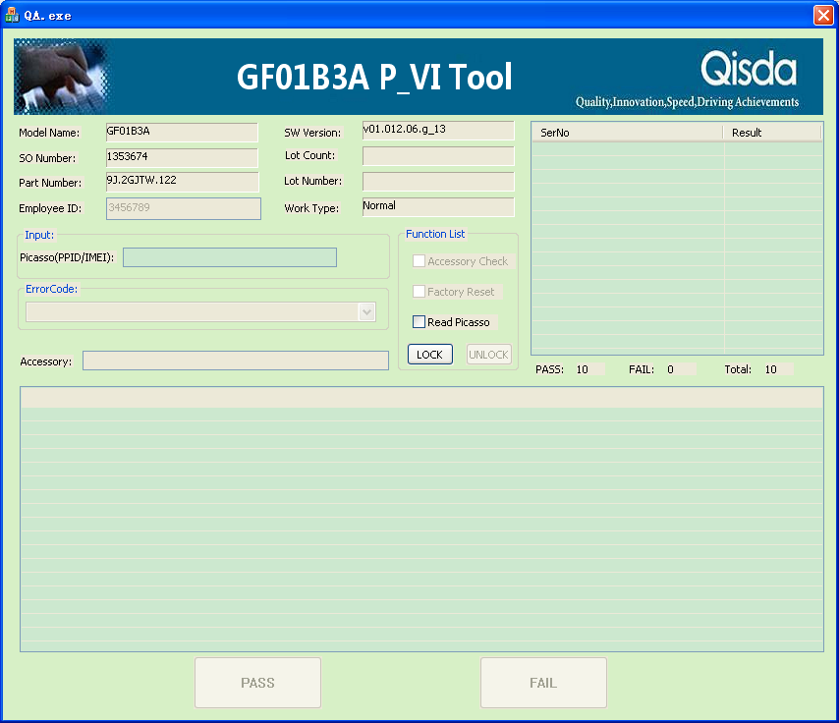
P_VI Tool
Support general steps in main function.
Read Picasso refer to FQC tool.

Slide 36
Q & A

Slide 37


