Slide 1
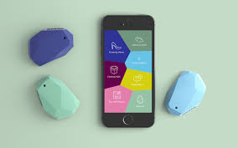
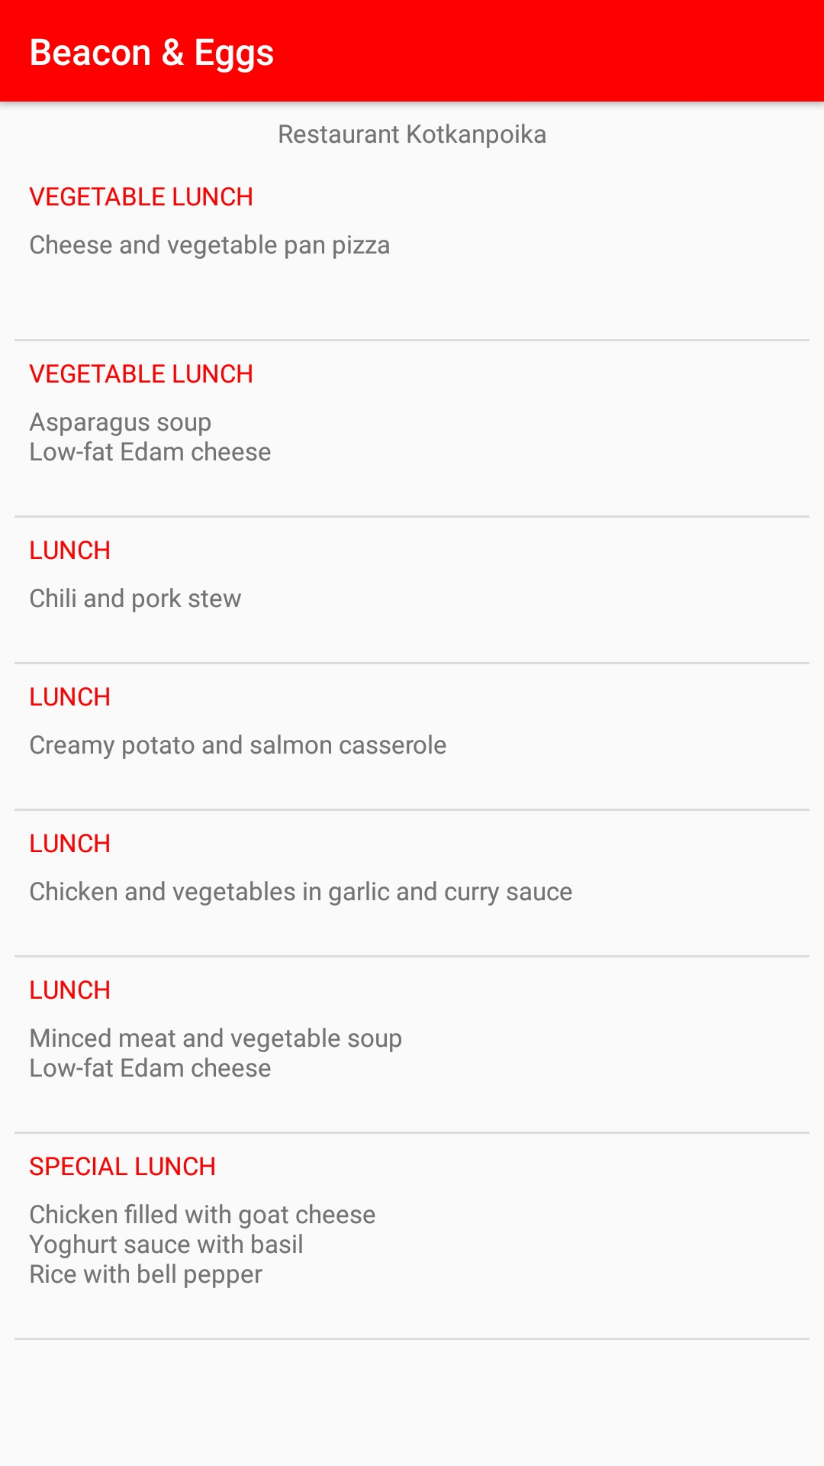
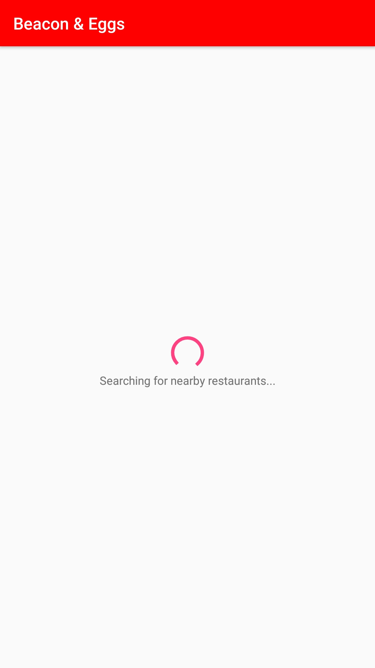
Beacon & Eggs Embedded Systems Development Pproject
Teemu Kolu, Jere Luomajoki
Oulu University of Applied Sciences, Software Engineering
Introduction
The objective of the project was to create an application for a device called “Estimote Beacon”. We decided on making a beacon-based menu for restaurants, which uses the proximity from the beacon and public menus. The Application was made for Android.
FIGURE 1. Estimote Beacon and the base configuration app
Android application
The application is called Beacon & Eggs, features include a loading screen while searching for nearby restaurants, loading today’s menu, highlighting user’s favorite foods and push notifications when user comes near a restaurant with beacons.
FIGURE 2.
Loading screen of the application
Methods
For the base android application, we used Java. We get the food lists by parsing the URL by the restaurants ID and the current date, and parsing the returned data from JSON.
For networking we use Volley-library, which means we don’t need to worry about threading etc. JSON parsing is done by android’s built-in libraries.
Estimote Beacon searching is done by Estimote’s easy to use libraries
FIGURE 3 Food menu
Results
The use cases for Estimote beacon are quite limited, and usually could be replaced by much simpler options.
The application itself is usable, stable and fetches the food menu as quickly as a beacon is found.
Volley library for networking saved a lot of time versus doing networking threads etc. by hand.
Conclusions
Using location services would have been easier and more useful for this project, but in the end we managed to make usable and working application for android.
Beacons are also somewhat unreliable, as in they might close and open the connection whenever, meaning that notifications will get quite irritating, and they should be used with great caution.
References
https://estimote.com/
https://developer.android.com/training/volley/index.html
Project
Date of publication: 16.11.2017
Supervisor Jukka Jauhiainen

Slide 2
Loading screen

Slide 3
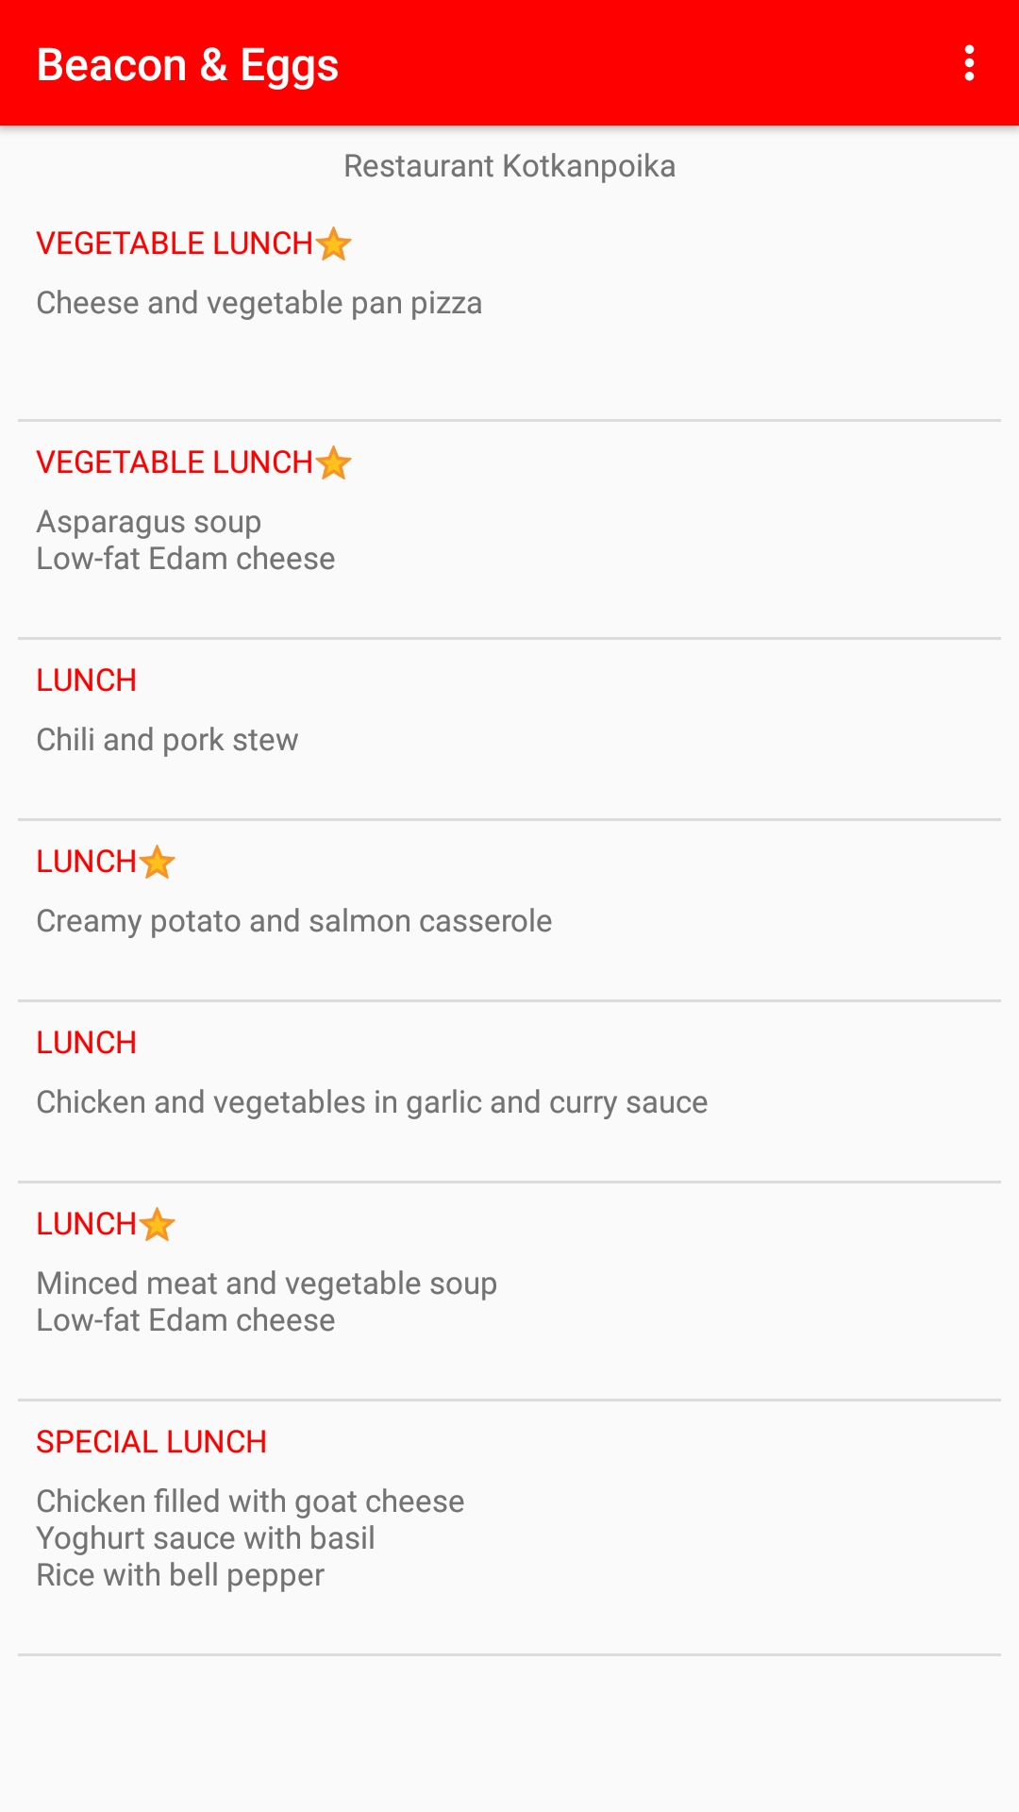
Restaurant loaded

Slide 4
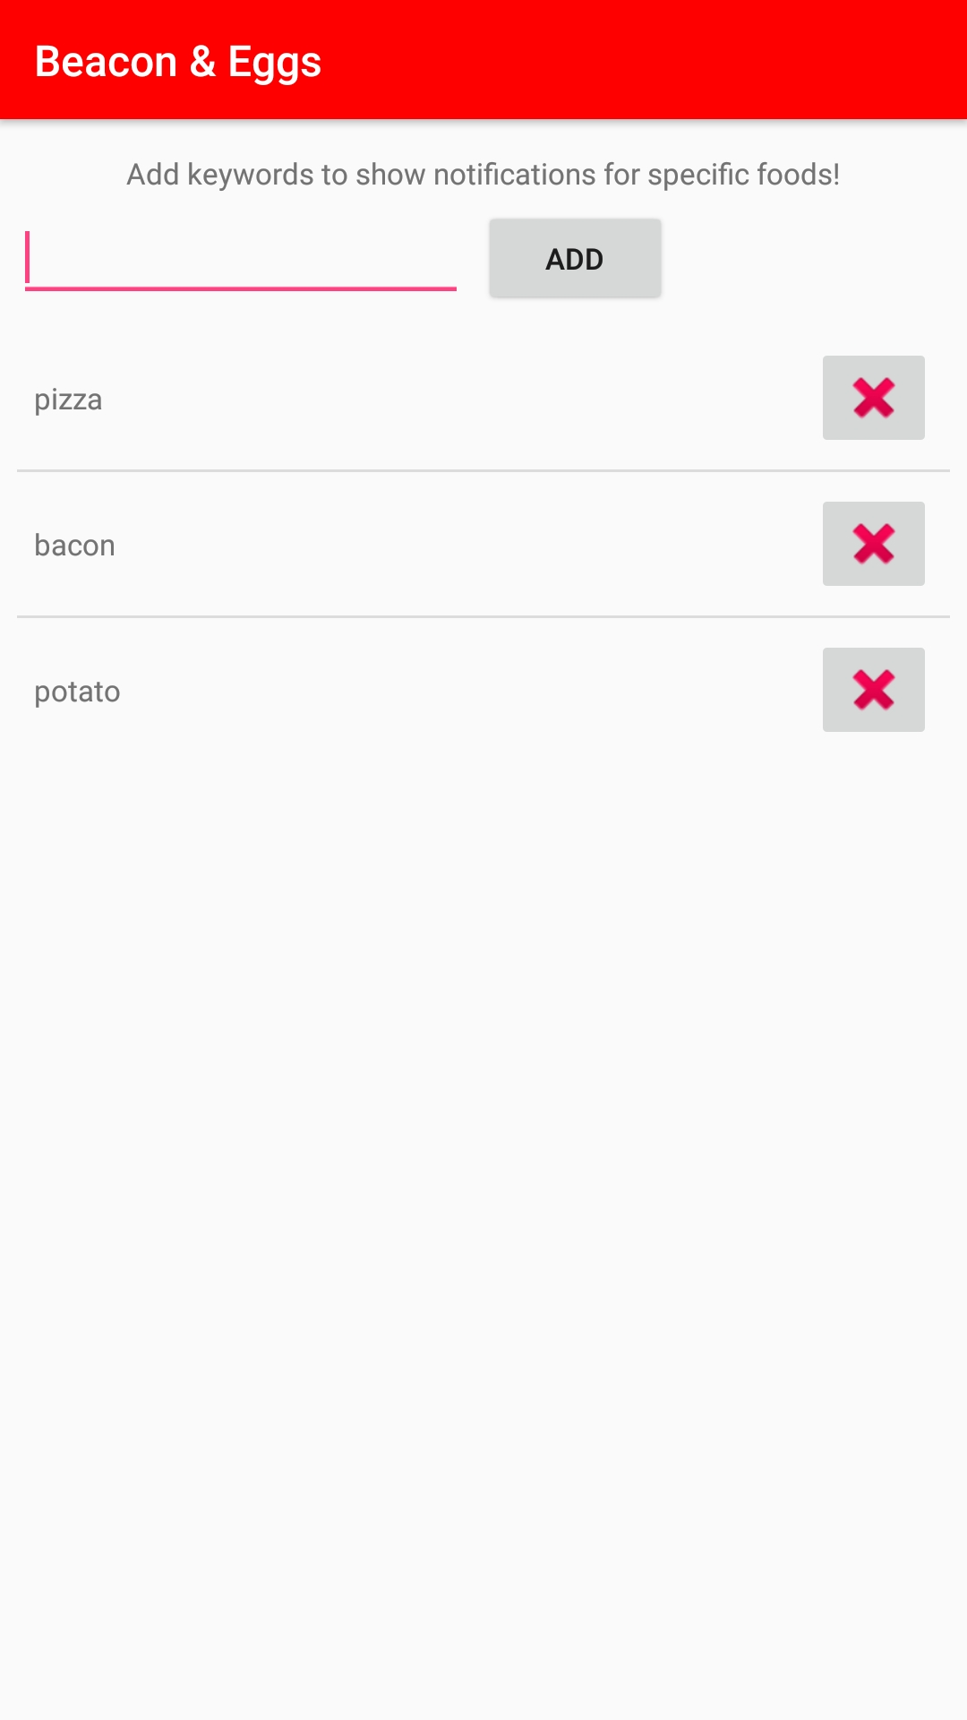
Favorite foods

Slide 5
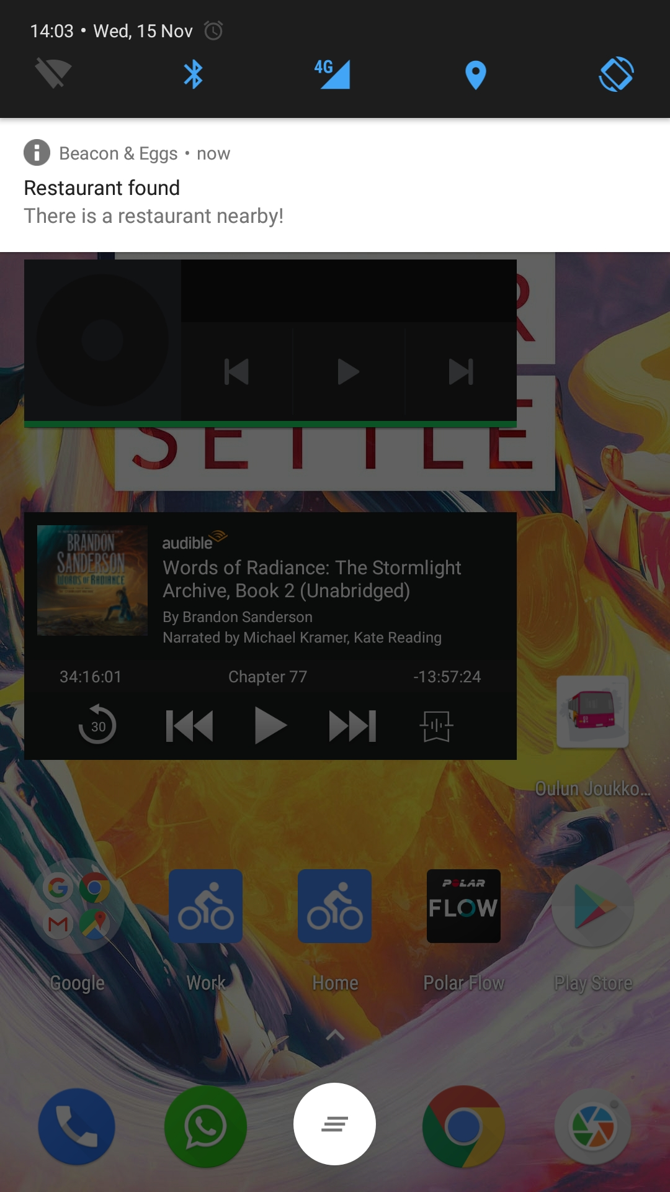
Notification

