Slide 1

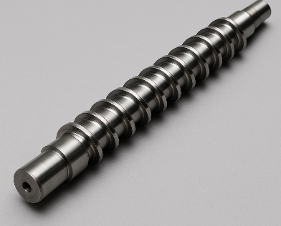
Quadrat
T1
0 | 1 | 2
Text box Added in slide…
In a group
Text box Added in slide…

