Slide 1
Bootstrap Components
Components Based on CSS -Day 2

Slide 2
Bootstrap Form Layouts
(Moat Academy)
Your form can have any of 3 layouts below:
  Vertical form (this is default)
  Inline form
  Horizontal form
Its good to use label to lay out the form elements to help screen readers. To hide label except screen readers. Add the class= “visually-hidden” to your label

Slide 3
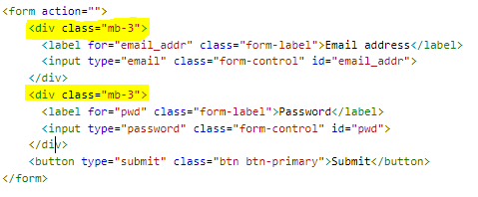
Default Form - Vertical
Each form label and its input field combination must be within a div with the margin bottom or margin top class “mb-3 mt-3”
<div class=“mb-3 mt-3”>
label and input
</div>
All textual input fields should each have class ‘form-control’.
Check the note for source code
Notes:
<div class='row'>
<div class='col'>
<form action="">
<div class="mb-3">
<label for="email_addr" class="form-label">Email address</label>
<input type="email" class="form-control" id="email_addr">
</div>
<div class="mb-3">
<label for="pwd" class="form-label">Password</label>
<input type="password" class="form-control" id="pwd">
</div>
<button type="submit" class="btn btn-primary">Submit</button>
</form> </div>
</div>

Slide 4
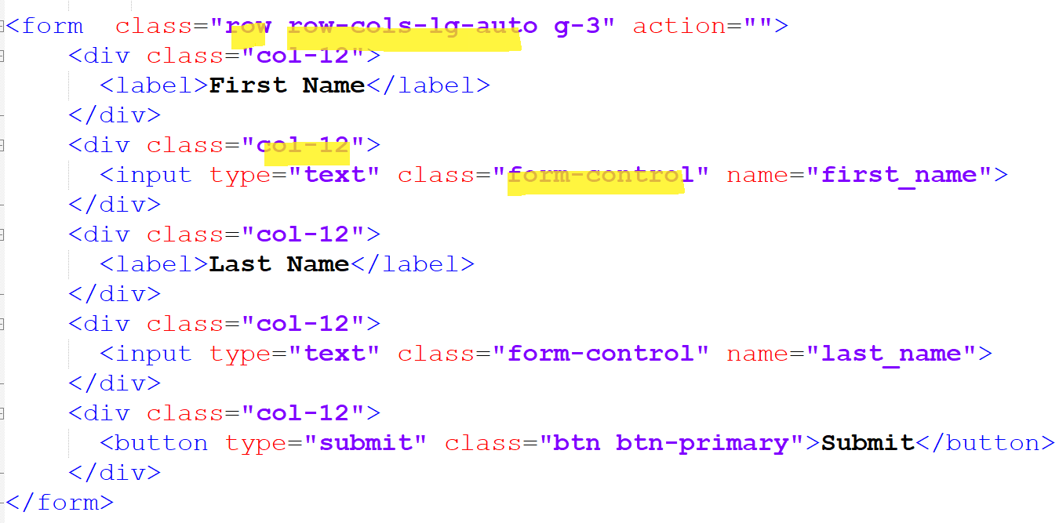
Inline form, class=‘row row-cols-lg-auto’
Place the classes row and row-cols-*-auto within the form tag
Each form label must be within a div with the class col-12
Each form input field must be within a div with the class col-12
The Bootstrap's .row-cols-* classes will create responsive horizontal layouts. Using .col-12 helps stack the form controls on narrow viewports.
All textual input fields should each have class form-control as usual
Notes:
<form class="row row-cols-lg-auto g-3" action="">
<div class="col-12">
<label for="first_name">First Name</label>
</div>
<div class="col-12">
<input type="text" class="form-control" id="first_name" name="first_name">
</div>
<div class="col-12">
<label for="last_name">Last Name</label>
</div>
<div class="col-12">
<input type="text" class="form-control" id="last_name" name="last_name">
</div>
<div class="col-12">
<button type="submit" class="btn btn-primary">Submit</button>
</div>
</form>

Slide 5
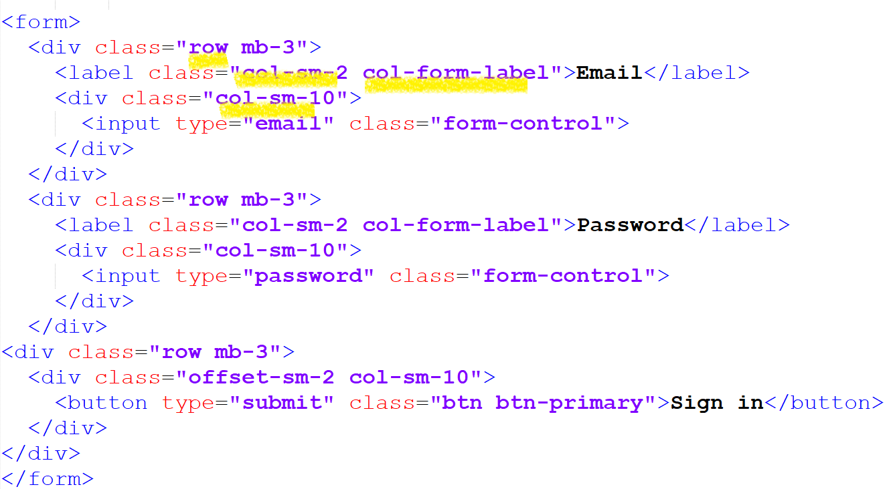
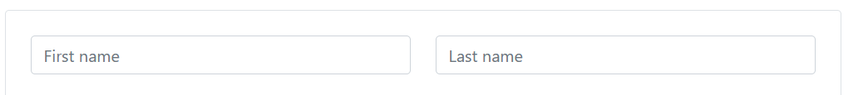
Horizontal form – form that require multiple columns
This type of layout uses the bootstrap grid system to lay out the form especially used when the form has multiple layouts
The label/input elements should be within a single div that has class row.
Use class col-*-* to specify the width of your labels and controls.
Add .col-form-label to your <label> to make the vertically centered with their associated form controls.
All textual input fields should each have class ‘form-control’ as usual
Notes:
<form>
<div class="row mb-3">
<label for="inputEmail3" class="col-sm-2 col-form-label">Email</label>
<div class="col-sm-10">
<input type="email" class="form-control" id="inputEmail3">
</div>
</div>
<div class="row mb-3">
<label for="inputPassword3" class="col-sm-2 col-form-label">Password</label>
<div class="col-sm-10">
<input type="password" class="form-control" id="inputPassword3">
</div>
</div>
<div class="row mb-3">
<div class="offset-sm-2 col-sm-10">
<button type="submit" class="btn btn-primary">Sign in</button>
</div>
</div>
</form>
</div>

Slide 6
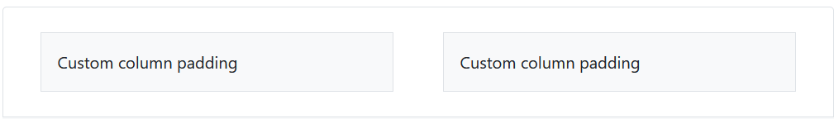
Form Layout: controlling the gap
You can have control over the gutter width (the space between two col(umn) divs especially within an inline form by using the gutters utilities)
See syntax: Apply the class on the row div
  g-1 represents 1 gutter starts from 1.5em
  gy-1: represents 1 vertical gutter
  gx-1 represents 1 horizontal gutter

Slide 7
Responsive Table
Avoid setting fixed width in px!

Slide 8
Bootstrap Table (found under contents)
Your table should contain thead, tbody to sectionalize the various table sections
Add class table to the table tag to add the necessary padding to an usual html table to make it responsive
You can further extend the look of the table with more classes:
<table class="table">
<thead>
<tr>
<th scope="col">#</th>
<th scope="col">First</th>
</tr>
</thead>
<tbody>
---
</tbody>
</table>

Slide 9
Bootstrap Table (found under contents)
In addition to the table class, use .table-dark, .table-striped to add zebra-striping, .table-bordered for borders on all sides of the table and cells, .table-hover to enable a hover state on table rows .table-borderless for borderless table
You can also add .table-striped-columns on the table to add zebra-striping to the table columns.
Non-conflicting classes can be combined
table-bordered can be combined with the border color variants of border-primary etc
Add .table-sm to make any .table more compact by cutting all cell padding in half
Similar to tables and dark tables, use the modifier classes on thead .table-light or .table-dark to make <thead>s appear light or dark gray.

Slide 10
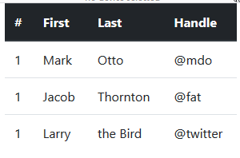
Bootstrap Table (found under Contents)

Slide 11
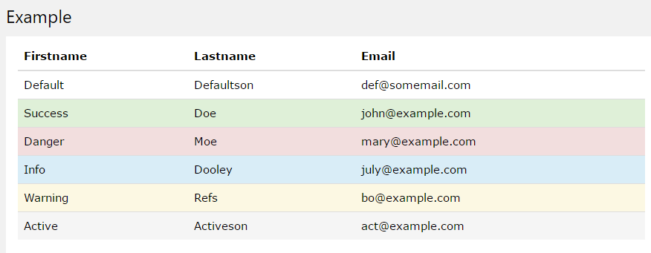
Bootstrap Table (found under Contents)
Contextual classes can be used to color table rows (<tr>) or table cells (<td>):
<tr class=‘table-primary’><td>content</td></tr>
These can be combined with .table-striped to make achieve zebra-design

Slide 12
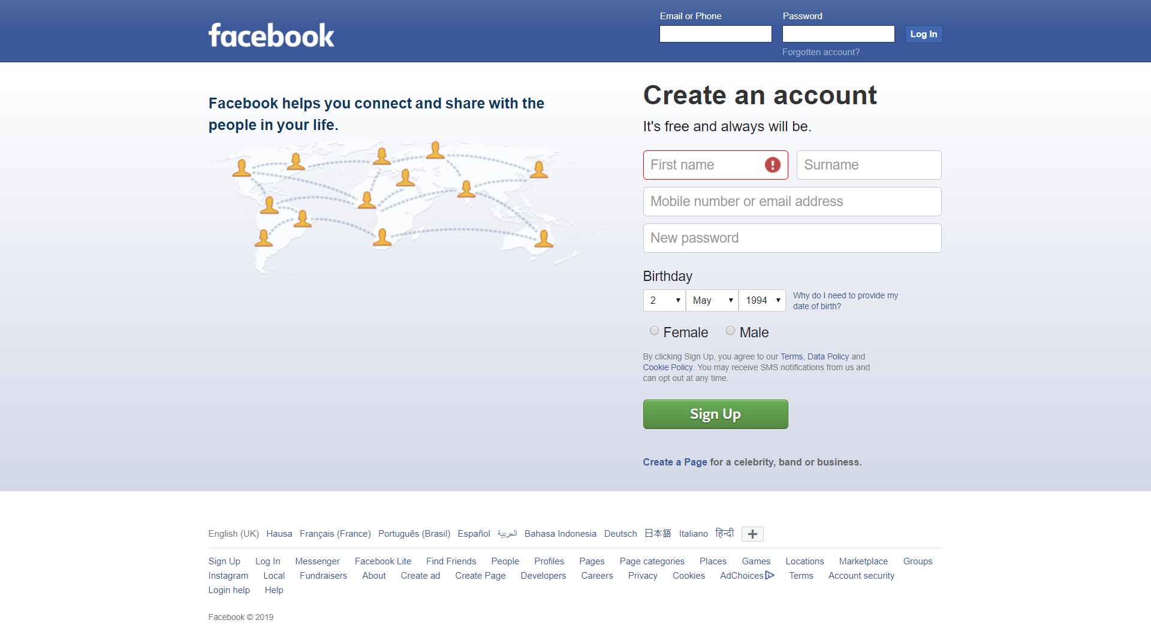
Challenge Accepted?
Make old Facebook responsive

Slide 13
Bootstrap Components
Components Based on Java Script - Day 3

Slide 14
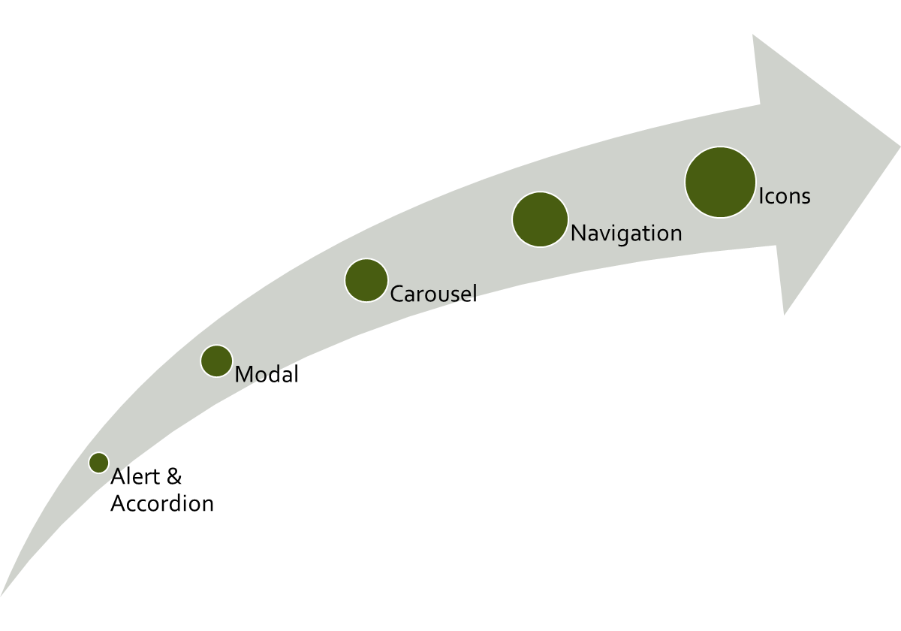
CLASS
OUTLINE

Slide 15
Including Javascript components on your HTML page
Bootstrap may also be used to include elements that have a movement effect. Such website components will require BS javascript files
The Javascript components can be placed via cdn (content delivery network)
Javascript for the moving parts
  JS at the bottom is a good practice as js loads slower than css
  Since JS is for interactivity, it is safe to allow our layout loads completely before the JS.
  Can be included from the server or CDN
  Note that bootstrap.bundle.js and bootstrap.bundle.min.js include Popper (popper.min.js before bootstrap.js if you are not using bootstrap.bundle)
  Use the script tag to include javascript:
  <script src="js/bootstrap.bundle.min.js"></script>
Notes:
<script src="https://cdn.jsdelivr.net/npm/@popperjs/core@2.10.2/dist/umd/popper.min.js" integrity="sha384-7+zCNj/IqJ95wo16oMtfsKbZ9ccEh31eOz1HGyDuCQ6wgnyJNSYdrPa03rtR1zdB" crossorigin="anonymous"></script> <script src="https://cdn.jsdelivr.net/npm/bootstrap@5.1.3/dist/js/bootstrap.min.js" integrity="sha384-QJHtvGhmr9XOIpI6YVutG+2QOK9T+ZnN4kzFN1RtK3zEFEIsxhlmWl5/YESvpZ13" crossorigin="anonymous"></script>

Slide 16
Dismissible Alerts
(found under Components)
Dismissible alerts can be created by adding the class alert-dismissible to the alert class, then create a button that can be clicked to close the alert message. On the button, add the data-bs-dismiss="alert" attribute, which triggers the JavaScript functionality and the class=‘btn-close‘ in a button that triggers the close
<div class="alert alert-info alert-dismissible" role='alert'>
  <p>Thank you for joining</p>
  <button class="btn-close" data-bs-dismiss='alert'></button>
</div>
You can add the classes fade show (together) to make the alert box fade in as it disappears

Slide 17
Create a website layout

Slide 18
Carousel (found under components)
Examine the parts
Helps you to make a sliding banner, this component is included where you want it to appear on your page.
The images to be used need not be given any special class to make it responsive, the entire component is reponsive.
Take note that it is recommended that you use images of the same dimension to avoid ‘galloping effect’
The images should ideally be of the same dimension (natural dimension should be the same)

Slide 19
Navigation found under Components
Used for creating a responsive menu
Importantly, it has the ability to toggle and collapse when viewed on a mobile device, it makes use of the class collapse.navbar-collapse for grouping and hiding navbar contents by a parent breakpoint.
It makes use of flexbox, therefore you can apply common flexbox rules such as align-items, justify-content etc
You can also apply your own stylings to change the background and/or font colors.
The classes navbar-light and bg-light are largely responsible for the colors. You can remove the classes while applying your own style
CLASSWORK Customize the navigation bar to suit your favourite color theme

Slide 20
Accordion
Accordion: can be used to save space

Slide 21
KEEP CODING!
Start by doing what’s necessary, then what’s possible, and suddenly you are doing the impossible. ~ Francis of Assisi

