Slide 1
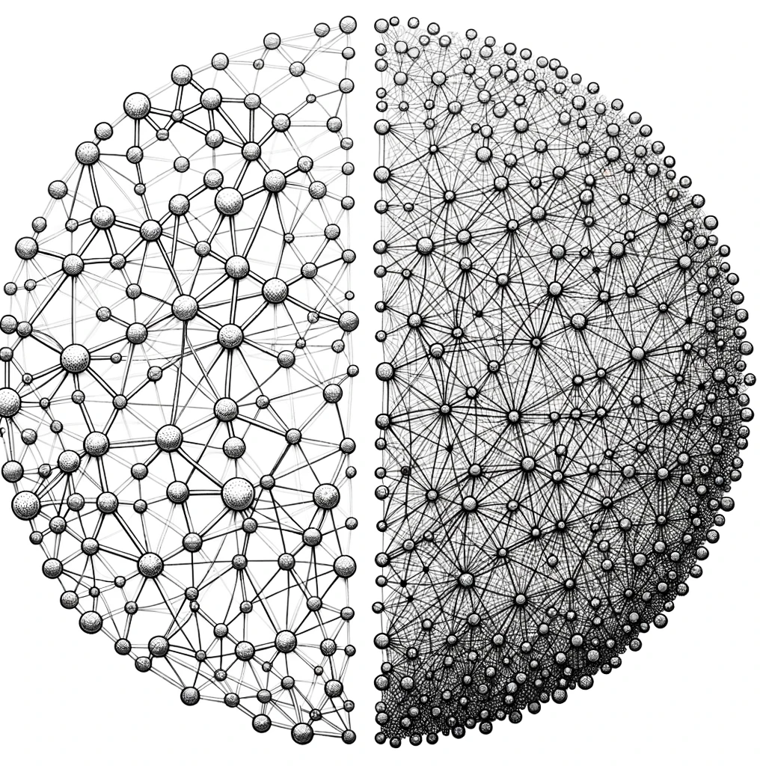
Sparse Coding in Vision
Ariba Khan

Slide 2
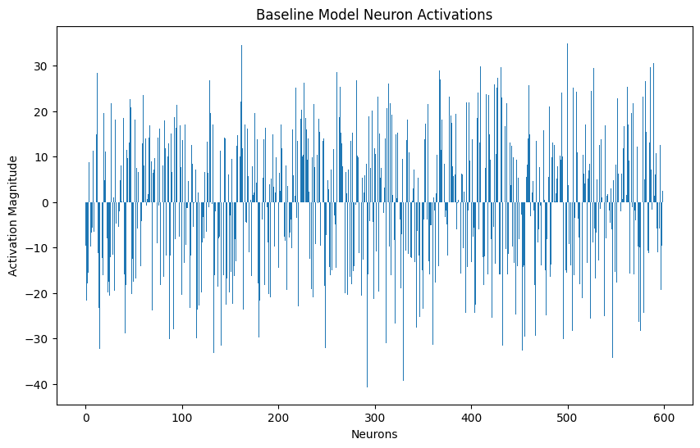
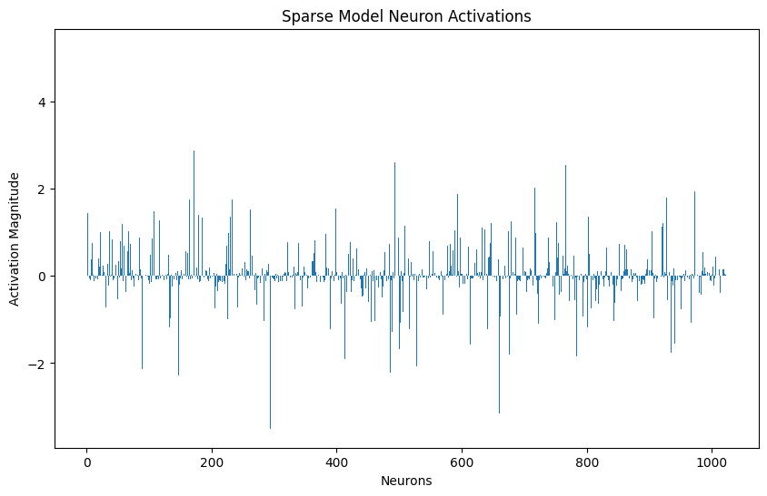
Sparse Overcomplete Representation
Overcomplete neural networks (more hidden neurons than input features) can represent data in diverse ways, but when constrained by sparsity, only a few neurons are actively used, highlighting the system's tendency to optimize resource usage.
Notes:
1. **Sparse Model Neuron Activations**:
- **Sparsity**: The majority of the activations are near zero, which indicates that many neurons are inactive for the given input. In terms of image features, this suggests that the model focuses on specific, distinctive features in the input image. It's capturing only the most salient or unique aspects of the image, effectively ignoring the more common or "background" features.
- **Sharp Activations**: The pronounced spikes in activations suggest that when a neuron does activate, it responds strongly to a particular feature. Each spike could correspond to a specific pattern, edge, texture, or other unique aspect of the image that the model deems important.
2. **Baseline Model Neuron Activations**:
- **Diverse Responses**: The broader range of activations (both positive and negative) implies that this model captures a wider array of features in the image. It seems to be recognizing and encoding a more comprehensive set of patterns and structures.
- **Continuous Activation**: The continuous activations, without a lot of neurons resting at zero, suggest that the model encodes both primary and secondary features of the image. It's not just focusing on the most distinctive aspects but also the subtler details.
In terms of image features:
- **Sparse Model**: Likely captures high-level or abstract features. Given its sparse nature, it might be particularly sensitive to features that are essential for distinguishing between different image classes or categories. For example, if trained on animal images, specific neurons might activate strongly for distinctive features like stripes (for zebras) or a long neck (for giraffes).
- **Baseline Model**: Likely captures both high-level and low-level features. This model might be encoding basic textures, gradients, and color variations in addition to the more distinctive features. In the same animal image analogy, it would pick up on the general textures of fur or scales, the gradients in the sky, and so forth.

Slide 3
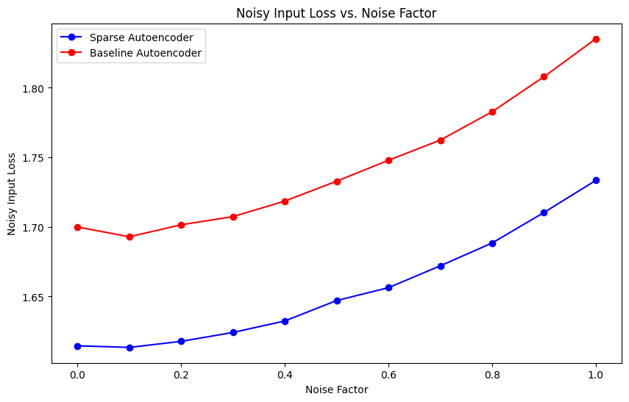
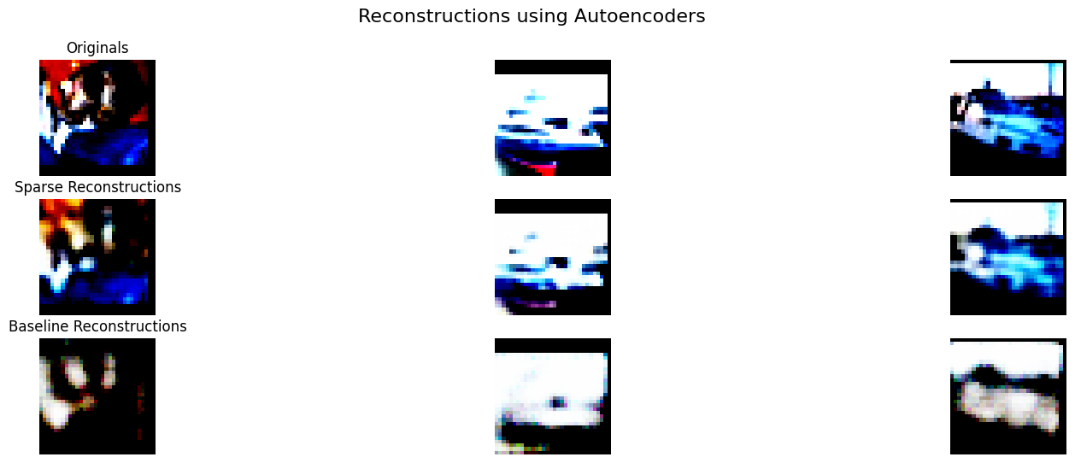
Results
Reconstruction Quality:
Sparse Autoencoder: PSNR is 18.0751, SSIM is 0.7992
Baseline Autoencoder: PSNR is 13.1642, SSIM is 0.5852
Evaluation:
Sparse Autoencoder: Test Loss is 0.5491
Baseline Autoencoder: Test Loss is 0.7102
Notes:
PSNR (Peak Signal-to-Noise Ratio):
PSNR is a metric used to measure the quality of reconstruction of lossy compression (like JPEG) or in this context, reconstructions by an autoencoder. It's often used in image processing to compare the quality of a compressed image to its original.
SIM (Structural Similarity Index Measure):
SSIM is another metric to measure the similarity between two images. It's designed to provide a more intuitive quality metric by comparing local patterns of pixel intensities in images. SSIM considers changes in structural information, luminance, and texture, which are things the human visual system is highly sensitive to.
Sensitivity to Noise:
While both models exhibit an increase in loss as noise factor goes up, the Baseline Autoencoder's loss increases at a steeper rate than the Sparse Autoencoder's loss. This might indicate that the Baseline Autoencoder is more sensitive to increases in noise, whereas the Sparse Autoencoder manages to somewhat mitigate the negative impact of added noise to a better extent.
Sensitivity to Noise:
While both models exhibit an increase in loss as noise factor goes up, the Baseline Autoencoder's loss increases at a steeper rate than the Sparse Autoencoder's loss. This might indicate that the Baseline Autoencoder is more sensitive to increases in noise, whereas the Sparse Autoencoder manages to somewhat mitigate the negative impact of added noise to a better extent.

Slide 4
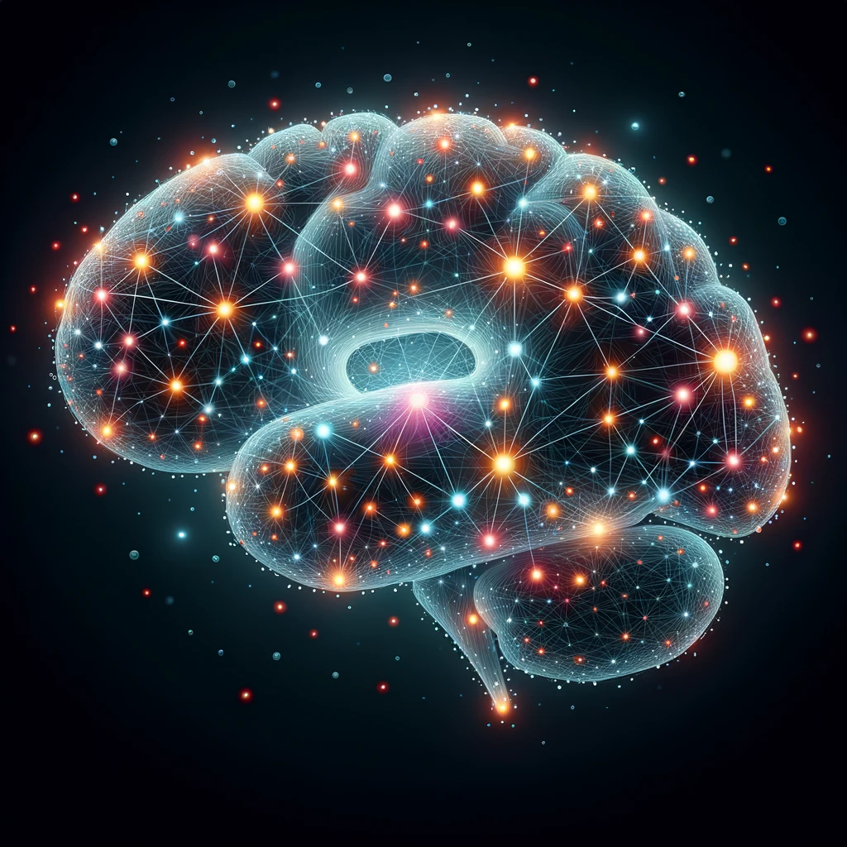
Sparse Coding in Brain
Sparse coding refers to the principle where only a small subset of neurons is actively firing in response to specific stimuli, resulting in efficient and robust information representation.
In the primary visual cortex (V1), sparse coding has been observed to efficiently represent visual information, with fewer neurons firing in response to specific visual stimuli.

Slide 5
Representation: Emulating Sparse Coding in Neural Networks
Artificial neural networks can be trained to have sparse activations by applying techniques like L1 regularization during training.
Sparse representations can potentially reduce computational cost, improve speed, and enhance robustness against noisy inputs.
The Representation view is needed as we are examining how information is encoded differently (and perhaps more efficiently) when sparsity is introduced.

Slide 6
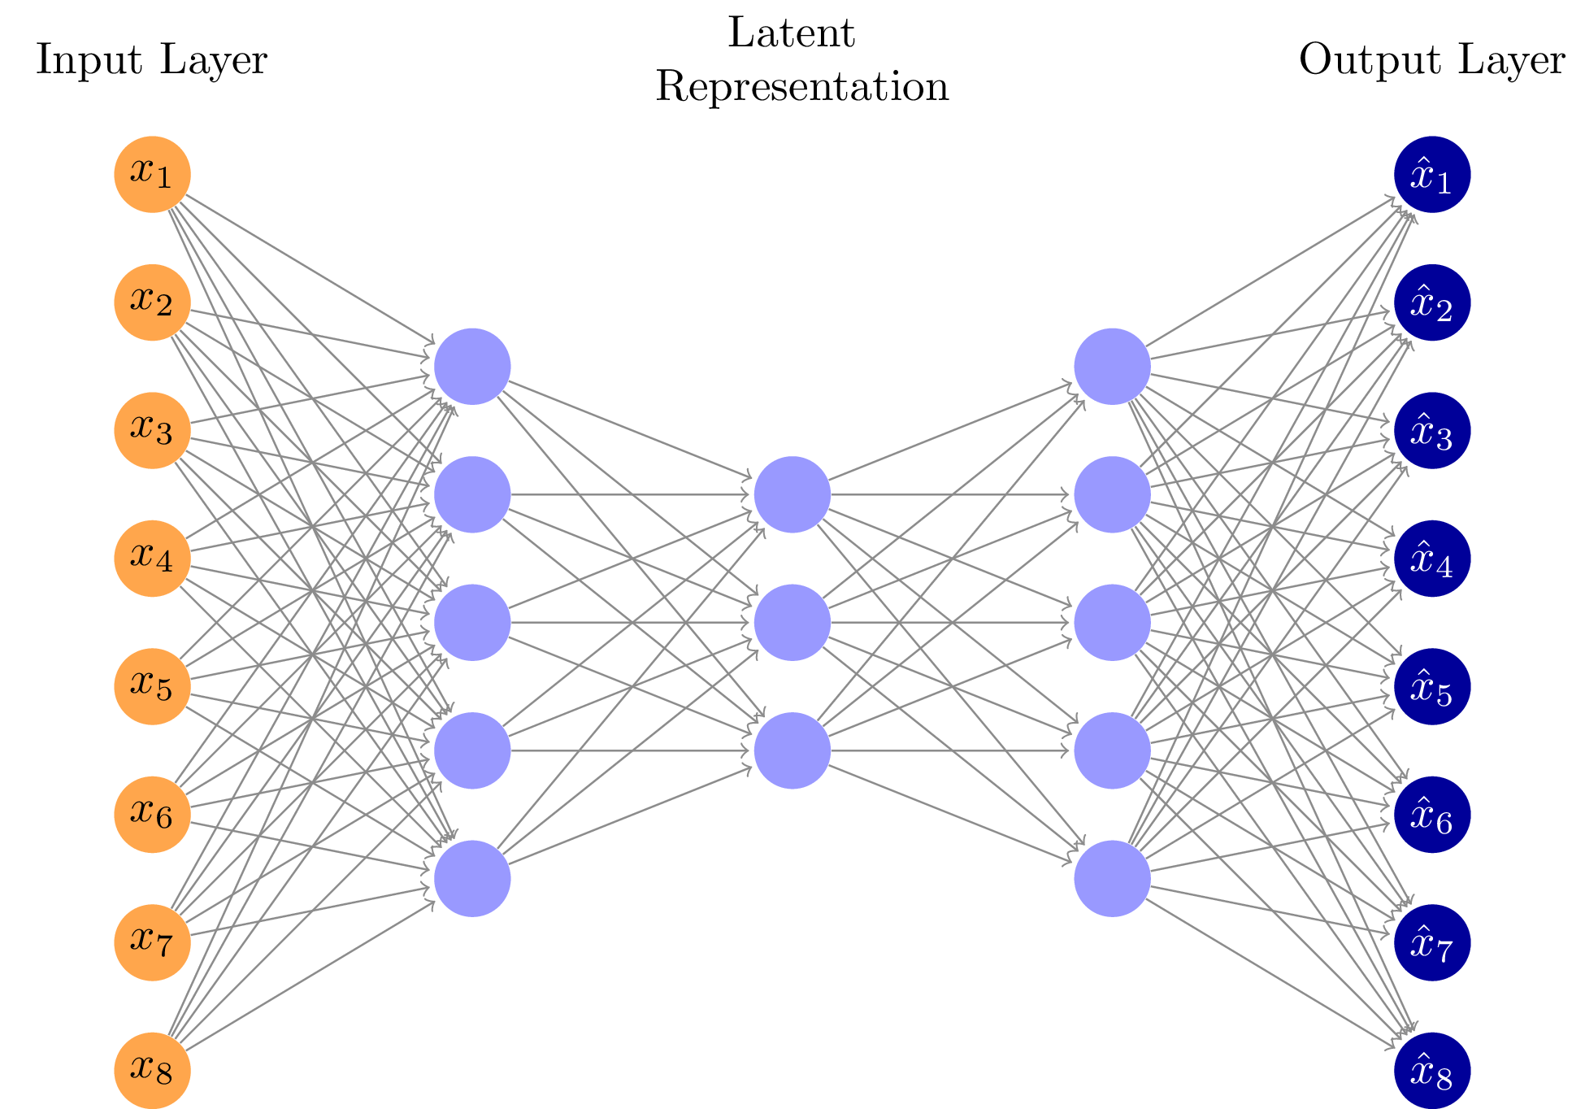
Sparse Autoencoders
Neural networks designed for unsupervised learning that compress input data into a compact form and then reconstruct it, aiming to minimize reconstruction error.
Imposes sparsity constraints on neuron activations to ensure only a few are active at once.
This constraint promotes capturing meaningful patterns, preventing the learning of trivial or redundant features.

Slide 7
Overcomplete Representation
The number of neurons in the hidden layer is greater than the number of input features.
Allows the network to have the capacity to represent the input data in many different ways. With the addition of a sparsity constraint, however, most of these neurons will be driven to zero, with only a few active neurons coding for the input.
Demonstrates that, given redundancy (overcompleteness), the system still tends to utilize only a few of its available resources (neurons) when driven by a sparsity constraint.

Slide 8
Project Objective
Goal: Our aim is to investigate if artificial neural networks, when mimicking the sparse coding observed in the primary visual cortex can improve reconstruction quality and offer advantages in computational robustness and efficiency.

Slide 9
Methodology
1. Data Augmentation and Pre-processing:
To ensure our model generalizes well on unseen data and is robust, data augmentation techniques like random horizontal flipping and random cropping are applied. Additionally, the CIFAR-10 dataset is normalized with its specific mean and standard deviation.
2. Dataset Splitting:
The CIFAR-10 dataset is divided into training (80%) and validation (20%) sets. A separate test dataset, also from CIFAR-10, is retained for evaluating the final model performance.

Slide 10
Methodology (contd.)
3. Model Architecture:
Sparse Autoencoder: Serves as a test model.
Designed with convolutional layers to compress the image and transposed convolutional layers for reconstruction.
Features an overcomplete bottleneck in which only a specific subset of neurons is active, resulting in a sparse representation.
Baseline Autoencoder: Serves as a control model.
Similar convolutional architecture to the Sparse Autoencoder.
The bottleneck is configured with a limited number of neurons and lacks sparsity constraints, so it employs all neurons for representation.

Slide 11
Methodology (contd.)
4. Training:
Both models are trained with the Mean Squared Error loss, where the objective is to minimize the difference between the original and reconstructed images. For the Sparse Autoencoder, an L1 regularization term is added to encourage sparsity in the bottleneck layer.
5. Evaluation:
Loss Curves: Track how well the models are learning over epochs. It's visualized to observe convergence and compare training and validation performance.
Model Testing: Evaluate both models on a separate test set to understand their generalization capabilities.
6. Reconstruction Quality:
Visual evaluations of reconstructions provide insights into quality of the model's outputs.
Quantitative metrics like PSNR (Peak Signal-to-Noise Ratio) and SSIM (Structural Similarity Index) is used to objectively compare reconstructions.

Slide 12
Methodology (contd.)
7. Analyzing Model Properties:
Sparsity: Given our use of an overcomplete sparse autoencoder, analyzing the sparsity levels of the bottleneck can shed light on how data is compactly represented.
Filter Visualizations: By visualizing the convolutional filters of our models, we gain insight into the features the model might be learning.
8. Computational Efficiency and Noisy Inputs:
Computational Efficiency: Time taken for each model to process the test dataset is recorded.
Resilience to Noisy Inputs:
The models are evaluated on their capability to reconstruct images from noisy inputs.
The encoders from the models transform noisy images into feature vectors, which are then used to train and evaluate a classifier's ability to predict original image labels.
Code Link

