Slide 1
How to Flask
June 2017

Slide 2

Install Flask
Today I am following an actual book.
To install flask you can just run
pip install flask
For more about installation see this link: http://flask.pocoo.org/docs/0.12/installation/
Chapter 1 & 2 I already did at home so I am continuing with Chapter 3.

Slide 3
Chapter3: templates
As I am still really new with flask I am still in the hello world face. Last chapter I wrote a script to launch a webserver on the localhost with „Hello World“:
from flask import Flask, request, make_response, redirect
app = Flask(__name__)
@app.route("/")
def index():
user_agent = request.headers.get("User-Agent")
return "<h1> Hello World! </h1> <p><pre> Your browser is %s </pre></p>" % user_agent
if __name__ == "__main__":
app.run(debug=True)

Slide 4
Chapter3: templates
Now instead of squeezing all the html in the „response“ that is returned by the view functions (these functions are apparently called view functions) – it renders the html from an html template.
from flask import Flask, request, make_response, redirect, render_template
app = Flask(__name__)
@app.route("/")
def index():
user_agent = request.headers.get("User-Agent")
return render_template('index.html', user_agent = user_agent)
if __name__ == "__main__":
app.run(debug=True)
I made a folder called templates and created the file index.html:
<img src="https://www.flixbus.com/sites/default/files/flixbus-logo.jpg" alt="Smiley face">
<h1 style="color: #73D300; font-size: 120px">Hello World </h1>
<h1>Hello Flixbus! </h1> <p><pre> Your browser is {{user_agent}} </pre></p>

Slide 5
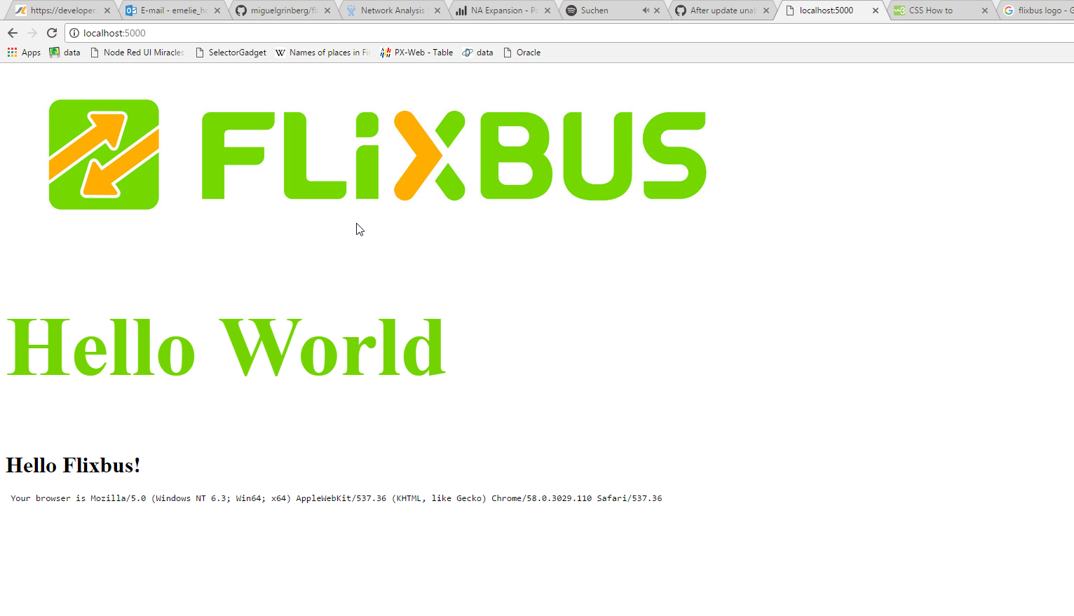
Chapter3: templates
The result:

Slide 6
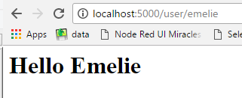
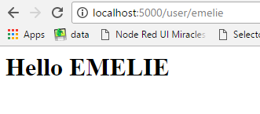
Chapter3: templates
With placeholders like {{name}} in the template you can do a lot of stuff:
# user.html
<h1> Hello {{name|capitalize}} </h1>
# user.html
<h1> Hello {{name|upper}} </h1>

Slide 7
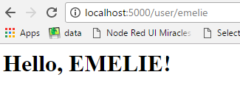
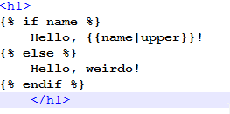
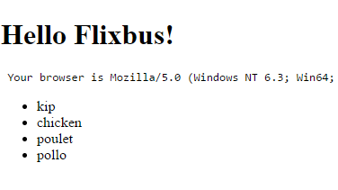
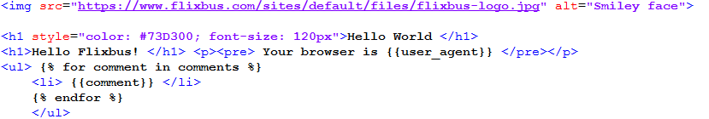
Chapter3: templates
You can also make if statements and for loops:
# user.html
# index.html

Slide 8
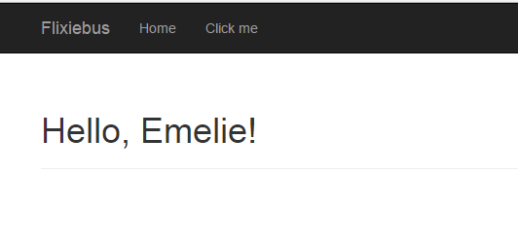
Chapter3: templates
Using CSS bootstraps:
pip install flask-bootstrap
Now the user.html script became slightly more complex – I am not going to post the full script here. However, after that, the page started to look more like a real website:

Slide 9
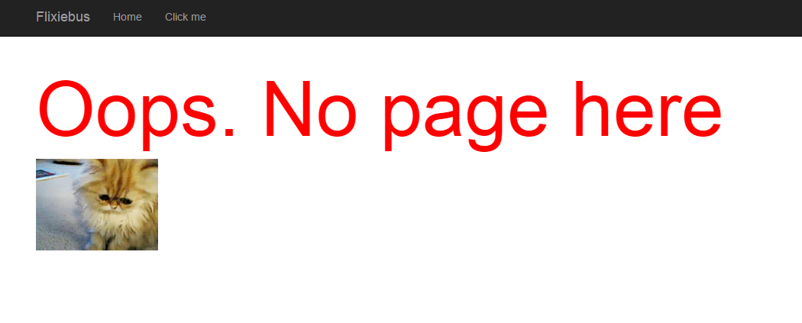
Chapter3: templates
Using error handlers:
In the same style you can make a custom 404-page not found page. Mine looks like this:

Slide 10
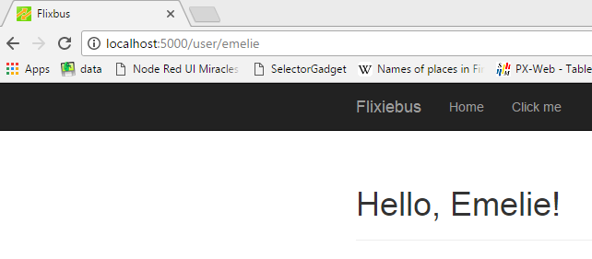
Chapter3: templates
Adding an icon in the page tab:
{% block head %}
{{ super() }}
<link rel="shortcut icon" href="{{url_for('static', filename = 'flixbus.ico')}}" type="image/x-icon">
<link rel="icon" href="{{url_for('static', filename = 'flixbus.ico')}}" type="image/x-icon">
{% endblock %}

Slide 11

Chapter3: localization
Apparently it is possible to adjust the time in the web app to the users local time – there is a special library for this:
pip install flask-moment
Then the base.html & the index.html file needs to be adjusted. Also, in the main script the utc time needs to be assigned to the variable current_time.

Slide 12
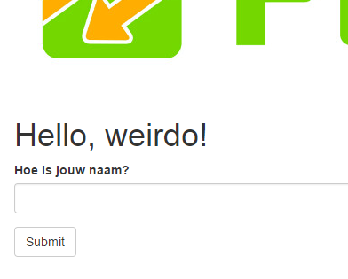
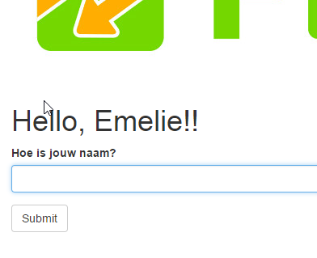
Chapter4: webforms
There is also an extension for webforms (called WTF)
pip install flask-wtf
Now – after adjusting once again the index() function in the main python script, and adding this line to the index.html:
{% import "bootstrap/wtf.html" as wtf %}
{{ wtf.quick_form(form) }}

Slide 13
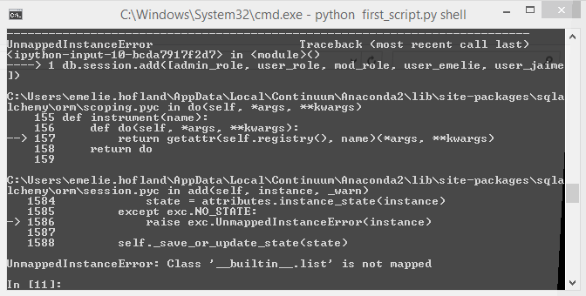
Chapter5: DataBases
pip install flask-sqlalchemy
Now – let‘s make an sqlite database! – Adjusted the script and now…
Okay – no, first install flask-script
pip install flask-script
And add the lines as explained here. Trouble in paradise (https://stackoverflow.com/questions/21196824/sqlalchemy-orm-exc-unmappedinstanceerror-in-flask)
I put the wrong code -> should be:
db.session.add_all(…) (I forgot the all).
Changed to manager app – now run by: hello.py runserver

