Slide 1
Ask My Documents
Transparent RAG for Uploaded Documents
Presentation focus
• Why the project matters
A document Q&A prototype that retrieves evidence first, answers from the uploaded files, and shows sources for verification.
• How the RAG system works
• Evaluation results and lessons
• Recommendations for next steps
Student: Emem Usoh
Supervisor: Professor Dongyu Qiu
ENGR 6971: Project and Report
Notes:
My project is called Ask My Documents. The problem I wanted to investigate is simple: when an AI gives you an answer about an uploaded document, how do you know that answer actually came from the document?
I built and evaluated a transparent Retrieval-Augmented Generation system designed to make that process visible.”

Slide 2
Roadmap for the presentation
A 15-minute overview of the problem, build, evaluation, and recommendations.
1
2
3
4
5
Context
Build
Evaluation
Results
Lessons
Why normal chatbots are risky for private document Q&A
What I implemented and how the RAG pipeline works
How I tested chunking, retrieval depth, citations, and abstention
What worked, what was noisy, and what the numbers mean
Skills developed, limitations, and next steps
Presentation outcome
By the end, you’ll see why this project focuses on making AI answers from documents transparent, traceable, and easy to verify.
Notes:
I’ll start with the motivation for the project and the problem I wanted to solve.
Then I’ll explain the system I built and how the RAG workflow works.
After that, I’ll go through the evaluation design and the main results.
I’ll finish with the limitations, what I learned from the project, and my recommendations for future work.

Slide 3
The main reason for the project
Regular chatbots can sound confident without using the user’s actual documents.
The core problem
Uploaded documents
Black-box answer risk
Transparent RAG
Private, recent, policy-heavy, or only available inside files
Fluent answer
≠
verified answer
Search first, answer from evidence, show citations
Project purpose
Build and evaluate a small configurable system where chunking, retrieval ranking, relevance thresholds, and citations are visible and measurable.
Notes:
The main motivation for this project is trust.
Large language models can generate very convincing answers, but a confident answer does not necessarily mean the answer came from the document the user uploaded.
For example, if someone uploads a company policy and asks a question about it, I want the system to answer from that policy rather than rely on general model knowledge.
That is where RAG becomes useful.
The system first searches the uploaded documents, retrieves the most relevant passages, and then gives those passages to the language model.
So the main idea here is that a fluent answer is not the same as a verified answer.

Slide 4
Objectives and research questions
The project measured the design choices that make RAG answers trustworthy.
RQ1
Chunking strategy
Project aim
Does fixed-size or paragraph-aware chunking improve retrieval and answer quality?
Design, implement, and evaluate a document question-answering system that answers only from retrieved uploaded-document evidence.
RQ2
Retrieval depth
Does top-3 or top-5 retrieval produce better answers with less noise?
• Working prototype
• Source-grounded answers
Abstention
RQ3
• Citations for checking
Can the system refuse unsupported questions when documents do not contain the answer?
• Evaluation evidence
Notes:
The overall goal was to design, implement, and evaluate a transparent document question-answering system.
I focused on three research questions.
how chunking affects retrieval, whether top-3 or top-5 retrieval works better, and whether the system can refuse to answer when there is not enough evidence.

Slide 5
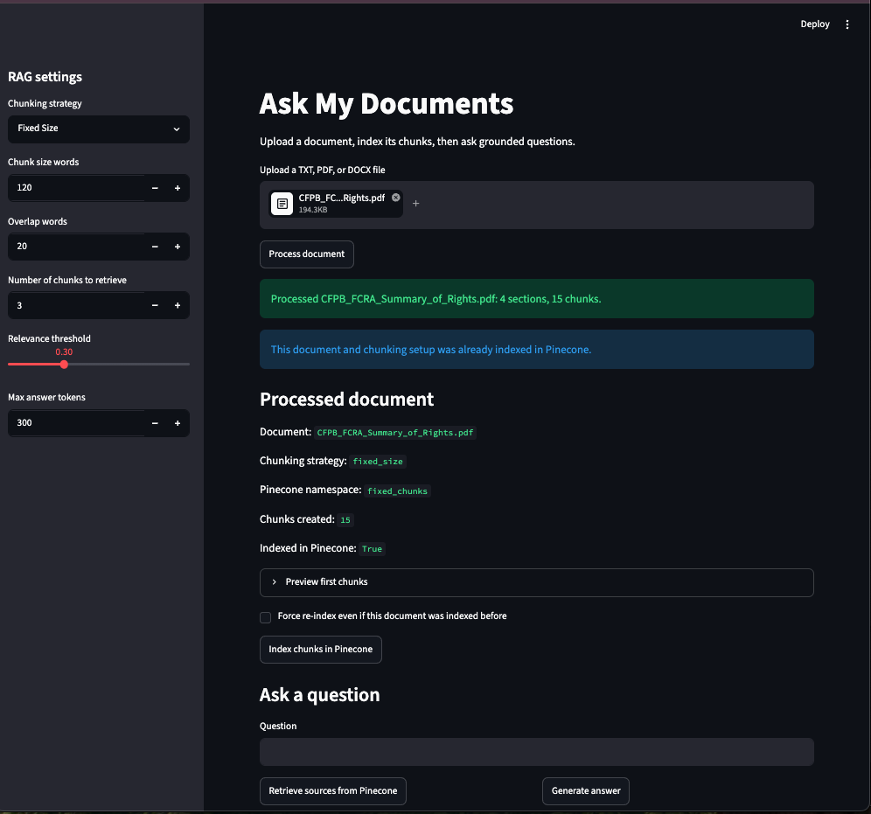
What I built
A local, inspectable RAG prototype and evaluation workflow.
Streamlit app
Upload documents, process chunks, ask questions, view evidence.
Document processing
TXT, PDF, DOCX extraction with source metadata.
Retrieval logic
Embeddings, vector search, top-k ranking, threshold filtering.
Grounded generation
Prompt forces answers to use retrieved passages and citations.
Evaluation harness
Runs test questions across configurations and writes audit CSVs.
prototype UI
My contribution
I reused appropriate tools for document parsing, embeddings, vector storage, and generation, while implementing the project-specific workflow: chunking, metadata, retrieval filtering, citation display, and evaluation.
Notes:
I built a local Streamlit-based RAG prototype that supports PDF, DOCX, and TXT files.
I reused existing services for embeddings, vector search, and generation, while my contribution focused on the workflow around chunking, metadata, retrieval filtering, citations, prompting, and evaluation.

Slide 6
System workflow
A question goes through retrieval before the language model generates an answer.
Upload
Extract
Chunk
Embed & index
Retrieve
Generate
PDF / DOCX / TXT
Text + source metadata
Fixed or paragraph-aware
Vector search in Pinecone
Top-k + threshold filter
Grounded answer + citations
Trust layer: citations + visible retrieved passages
The user can inspect which document section supported the answer.
Notes:
This slide shows the complete workflow.
First, the user uploads a PDF, DOCX, or TXT file.
The system extracts the text and preserves source information such as the document name and location.
The text is then divided into either fixed-size or paragraph-aware chunks.
Those chunks are embedded and indexed so they can be searched using vector similarity.
When the user asks a question, the system retrieves the most relevant chunks and applies a relevance threshold.
The selected passages are then passed to the language model, which is instructed to answer using that evidence and include source labels.
So the main principle behind the system is very simple:
evidence first, answer second.

Slide 7
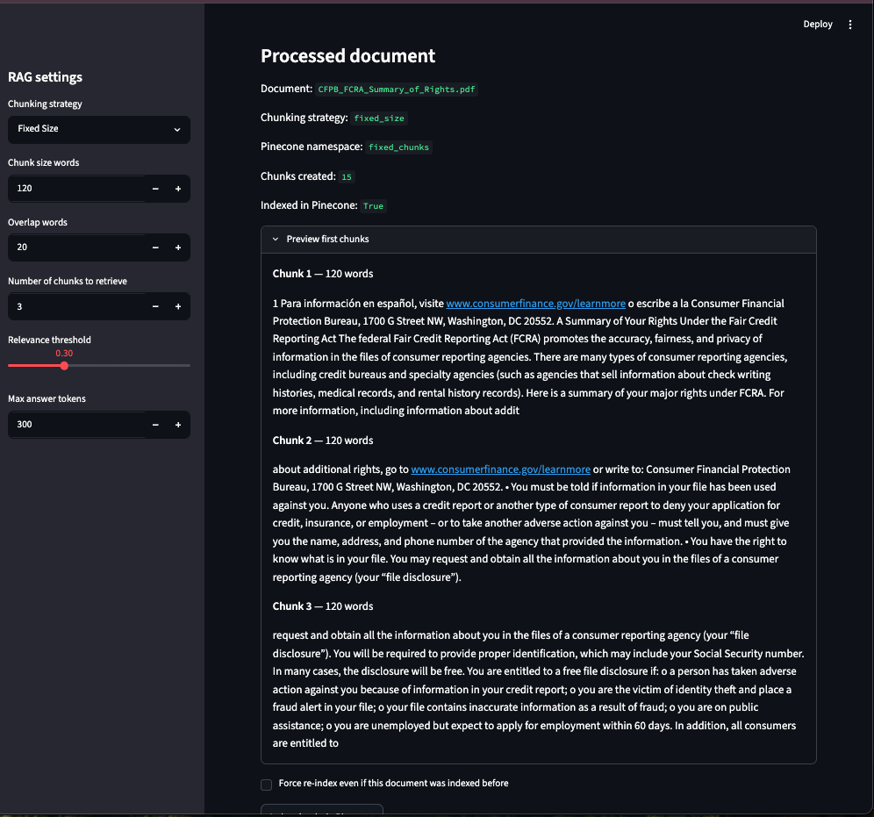
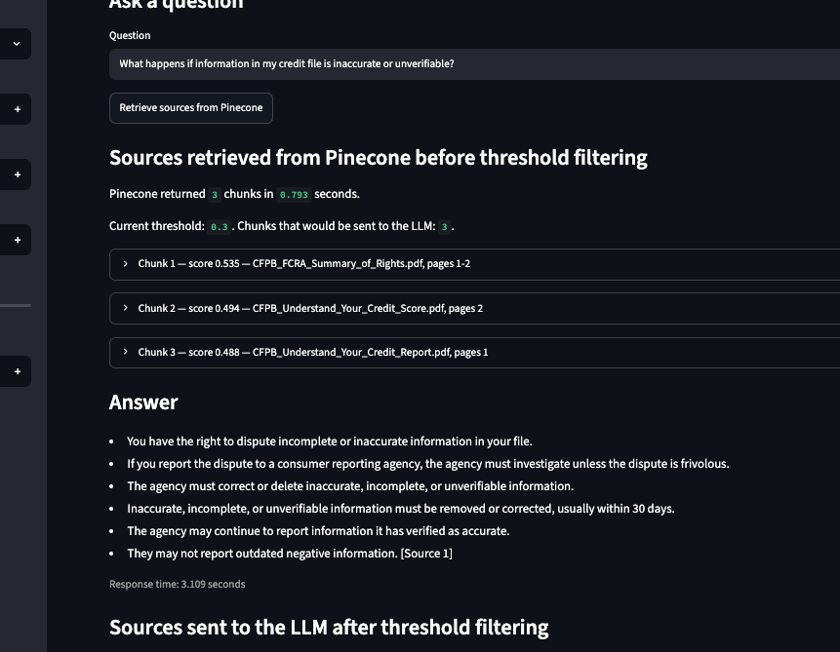
Interface: transparency in practice
The prototype shows both the answer and the evidence that produced it.
Chunk preview
Answer + displayed sources
What the audience should notice
The app is designed to make retrieval visible: users can review chunks, similarity scores, source labels, and passages sent to the LLM.
Notes:
The interface makes the RAG process visible.
Users can inspect the chunks, similarity scores, retrieved evidence, and the final answer, which also makes the system easier to debug.

Slide 8
Evaluation design
The evaluation compared chunking and retrieval-depth settings across a prepared question set.
9
30
4
120
480
corpus documents
evaluation questions
configurations
main result rows
retrieved chunk rows
Experiment matrix
Core metrics
Chunking
Top-k
Configuration
• Retrieval hit: expected source sent to the model
Fixed-size
3
fixed_top_3
• Citation correctness: answer cites displayed source labels
Fixed-size
5
fixed_top_5
Paragraph-aware
3
paragraph_top_3
• Abstention: refuses unsupported questions
Paragraph-aware
5
paragraph_top_5
• Context noise: non-gold chunks sent to LLM
Notes:
For the evaluation, I tested the system using 9 documents and 30 questions, including 6 deliberately unanswerable questions. I compared four configurations using fixed-size and paragraph-aware chunking with top-3 and top-5 retrieval.
Because every question was tested under all four configurations, I collected 120 main result rows, along with 480 retrieved-chunk audit rows.
I measured retrieval, source ranking, answer coverage, citations, abstention, response time, and the amount of extra context sent to the model.

Slide 9
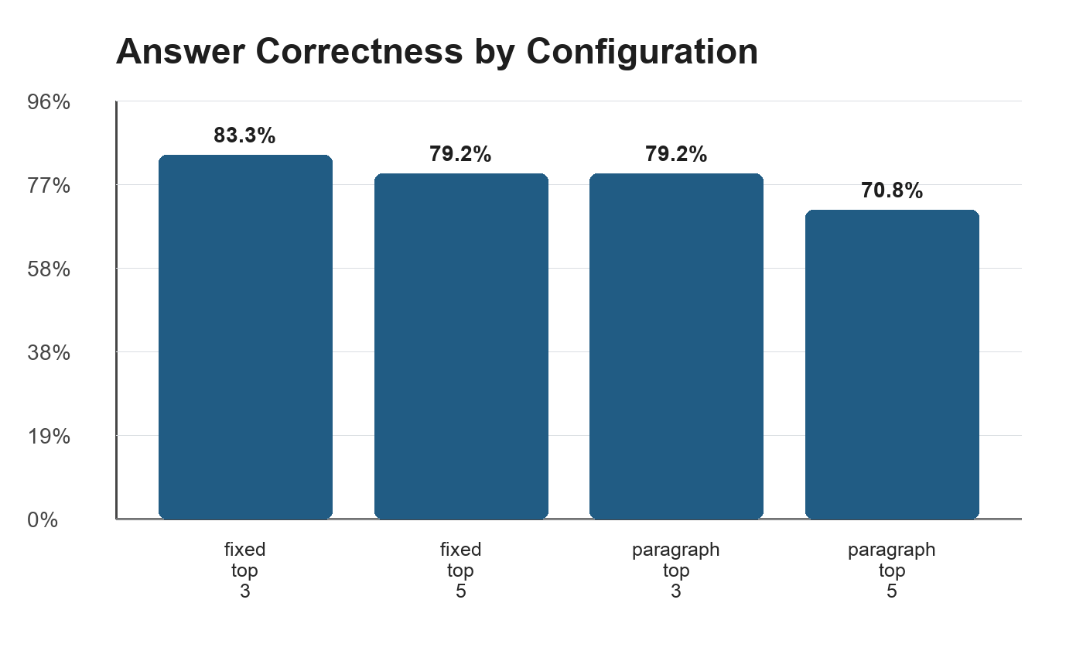
Result 1: the core RAG loop worked
Retrieval, citations, and abstention were strong across every configuration.
100%
100%
100%
expected-source retrieval on answerable questions
citation correctness on answerable questions
correct abstention on unsupported questions
Interpretation
• All configurations found the right evidence.
• The answer score gap came mainly from strict keyword grading.
• The safest practical choice is top-3 retrieval with citation checking.
Important: answer correctness here is an exact-phrase metric, not a full human semantic grade.
Notes:
“The first major result is that the core RAG pipeline performed consistently. In this test set, all configurations achieved 100% retrieval hit, citation-label inclusion, and correct abstention.
The chart below shows more variation in the automated answer score. Fixed top-3 had the highest score at 83.3%, while paragraph top-5 had the lowest at 70.8%.
However, this metric was based on strict phrase matching. During manual review, I found that several answers were correct in meaning but used different wording. So I treat this as keyword coverage rather than complete semantic correctness.
The main takeaway from this slide is that retrieval and grounding were strong; the larger issue was how answer quality was being measured.”

Slide 10
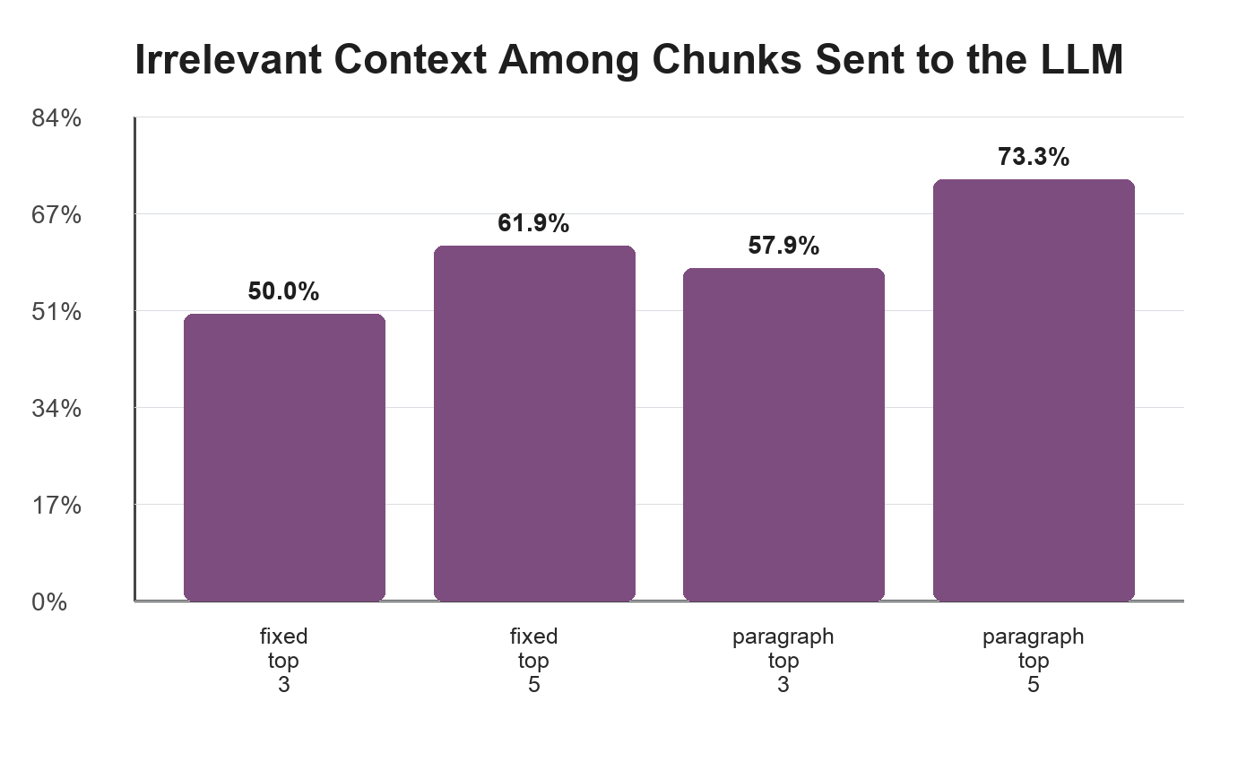
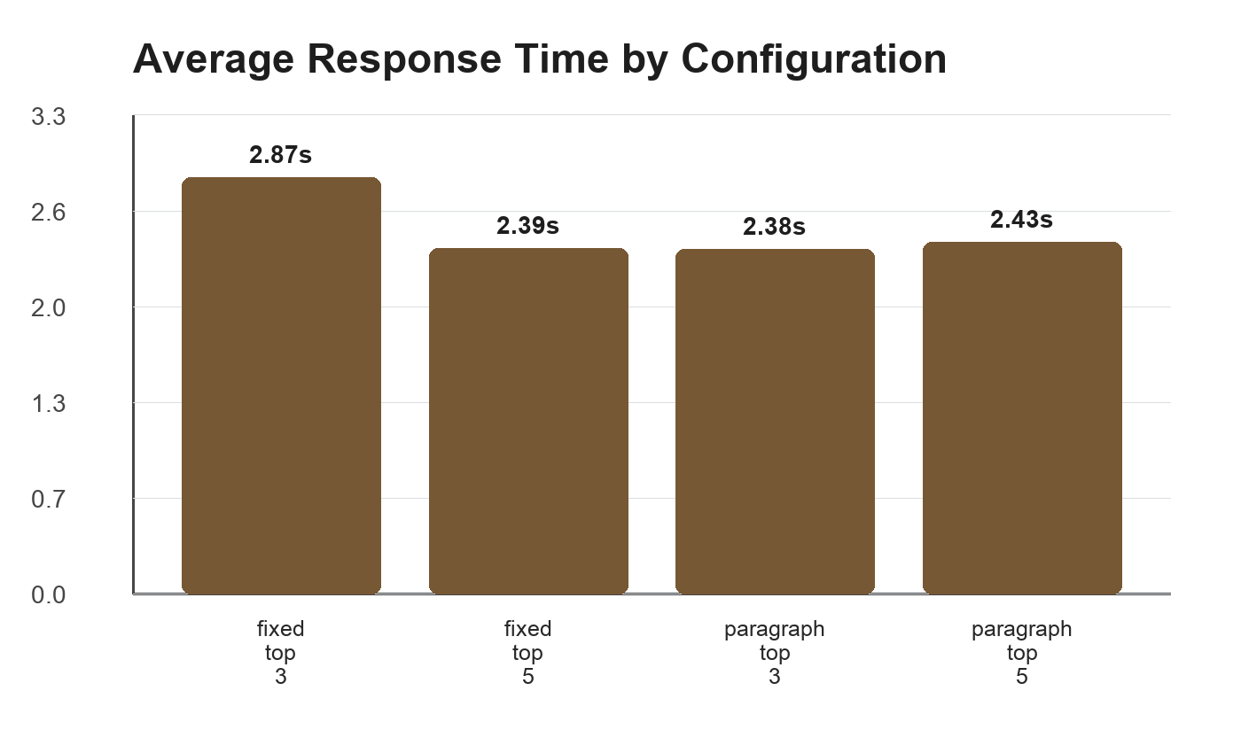
Result 2: more chunks did not mean better answers
Top-5 retrieval added context, but mostly added noise.
Practical lesson:
When top-3 already retrieves the expected source, top-5 often increases irrelevant context without improving the final answer.
Recommendation: keep top_k = 3
Notes:
The second result looks at retrieval depth
One of the clearest findings was that retrieving more chunks did not improve retrieval. Top-3 already found the expected evidence, while top-5 mainly added more unnecessary
For example, with fixed-size chunking, irrelevant context increased from 50% to about 62%, and with paragraph-aware chunking it increased from about 58% to 73%.
The response-time differences were relatively small and also affected by external API variability, so I don't treat latency as a strong conclusion here.
So my practical recommendation from this experiment is to keep top-k at 3.”

Slide 11
Error analysis: the evaluator was too literal
Several “wrong” answers were semantically acceptable but failed exact-phrase matching.
Expected phrase
Generated answer meaning
Why it failed
“small configurable RAG system”
“small configurable Retrieval-Augmented Generation system”
abbreviation expansion
“safe; healthful; working conditions”
“safe and healthful workplace”
synonym / wording
“file a complaint; on-site inspection”
“file a written complaint with OSHA and ask OSHA to inspect”
word order
“once every 12 months”
“one free report per 12 months”
equivalent phrase
What this means:
The strict answer metric is useful for repeatability, but it undercounts reasonable answers. Future evaluation should use semantic grading plus human review.
Conclusion from the audit
The system’s main failure was not retrieval. The main improvement area is evaluation quality and answer conciseness.
Notes:
The answer evaluation produced another important lesson.
I originally used keyword matching because I needed an automated metric that was transparent, easy to reproduce, and consistent across all configurations. .
However, during manual review, I found that some answers were being marked wrong even though they were correct in meaning.
For example, the expected phrase might contain the abbreviation “RAG,” while the generated answer says “Retrieval-Augmented Generation.”
Semantically, those are the same, but a literal phrase-based evaluator may treat them differently.
The lesson is future evaluation should include semantic or human review.

Slide 12
Challenges and limitations
The prototype is useful, but it is not a production document platform.
Evaluation
Keyword scoring missed semantically correct answers.
Scope
Text-based documents only; no OCR, scanned PDFs, complex tables, or diagrams.
Generalization
30 questions are enough for a prototype, not for broad statistical claims.
Latency
API response times varied, so single-run timing is noisy.
Deployment
No user accounts, access control, monitoring, or production hardening.
These limitations are also the roadmap for future work.
Notes:
This is an academic prototype, so there are some limitations.
The evaluation set is small, document support is mainly text-based, and the system does not yet include production features such as authentication, monitoring, or advanced OCR.
And finally, response-time measurements were also affected by external API latency, so I would not make strong conclusions based on timing

Slide 13
Personal and professional development
The work connected academic concepts to a practical AI system.
NLP + RAG
Software engineering
Applied embeddings, retrieval ranking, chunking, and grounded prompting.
Built modular Python components and a Streamlit interface.
Evaluation mindset
Responsible AI
Designed metrics, test questions, CSV outputs, and error analysis.
Focused on source visibility, abstention, and avoiding unsupported answers.
Notes:
This project helped me apply concepts from AI, NLP, software engineering, and evaluation.
My biggest lesson was that building an AI system is not only about making it work, but also making it explainable and testable.

Slide 14
Recommendations and future work
The prototype is ready for deeper validation and refinement.
1
Use top-3 as the baseline
It retrieved expected evidence while sending less noisy context.
2
Improve grading
Add semantic or human rubric scoring for factual correctness.
3
Tune adaptively
Raise or lower top-k based on confidence and source-score margin.
4
Expand document handling
Add OCR, tables, diagrams, and more varied documents.
5
Prepare for deployment
Add authentication, logging, privacy controls, and monitoring.
Notes:
Based on the results, my first recommendation is to keep top-3 retrieval as the current baseline.
The second is to improve the evaluation method by adding semantic grading and human review instead of relying mainly on exact phrase matching.
Longer term, I would also expand document support and add production-level security and monitoring.

Slide 15
Final takeaway
Ask My Documents shows that a RAG system is most valuable when users can verify the path from document → retrieved evidence → cited answer.
Thank you
One-line message
Questions?
Trustworthy AI needs evidence, not just fluent text.
Notes:
The main takeaway is that a useful RAG system should let users verify the path from the document to the retrieved evidence and finally to the answer.
Trustworthy AI needs evidence, not just fluent text.
Thank you, and
I’m happy to take any questions.

