Slide 1
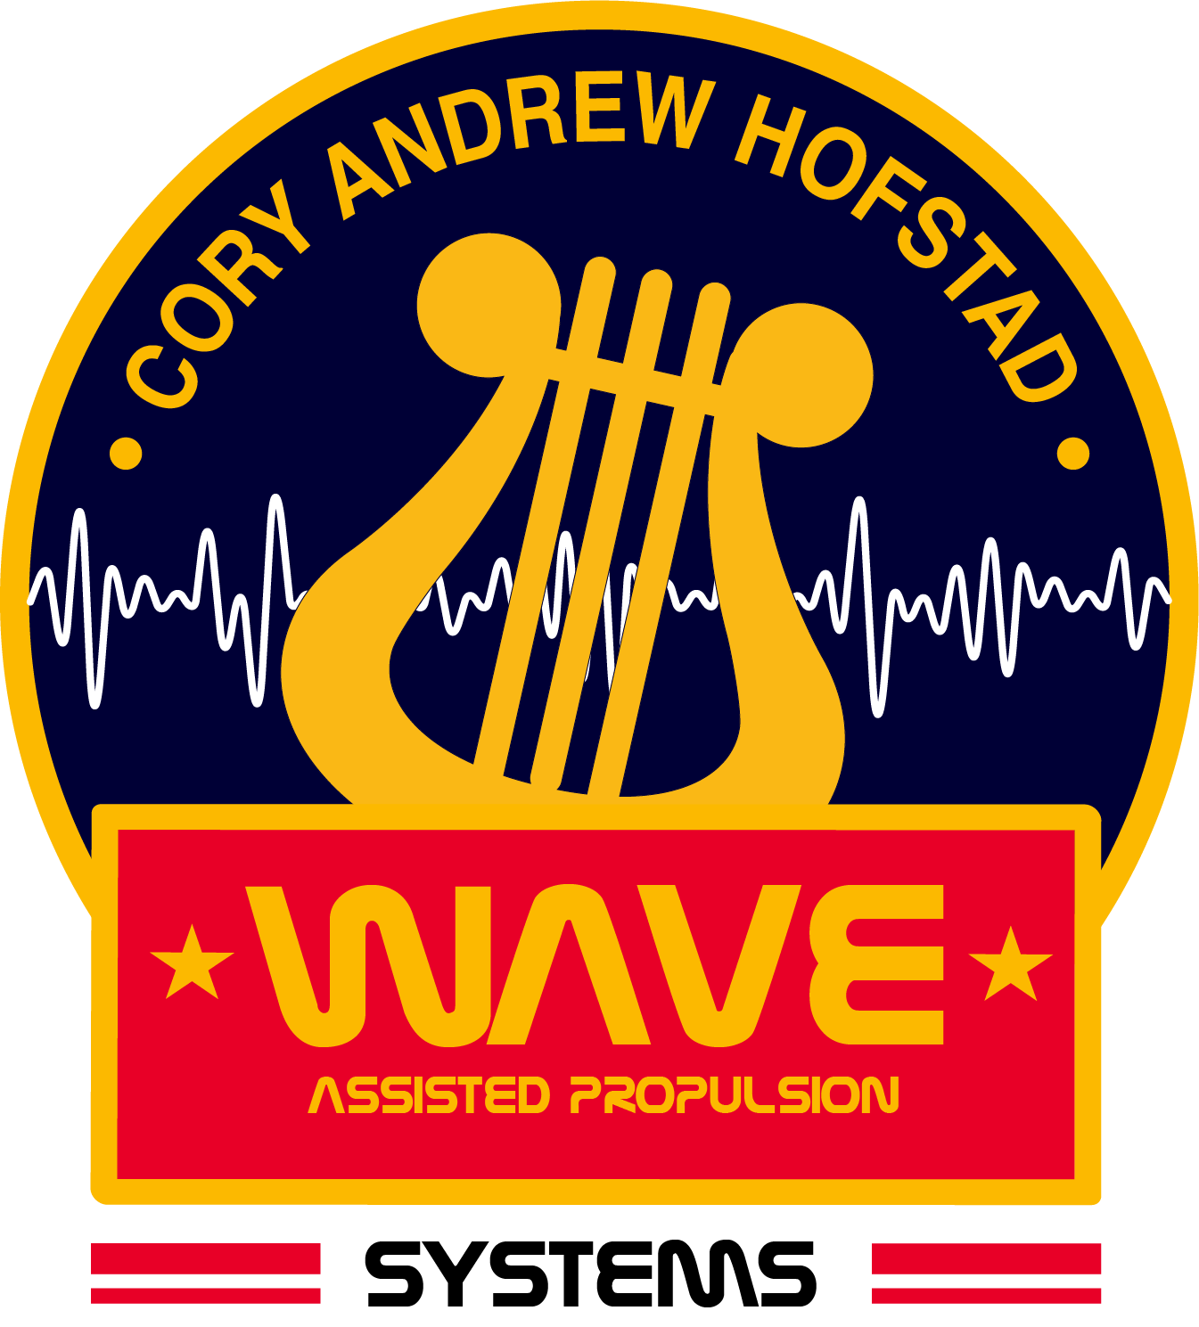

WAVE ASSISTED
PROPULSION SYSTEMS

Slide 2
METHODS
Current Electronic Propulsion Systems
Propulsion System Housing
Noble Gas Propellant Ex: (Xenon)
Magnetic Field to Ionize Propellant
Magnetic Grating or Co-axle Exhaust Nozzle
-
-
Ionized Gas Is Ejected through exhaust nozzle or grating to create thrust
-
+
+
-
+
-
+
+
-
+
-
+
-
Electrothermal devices create thrust by expanding propellant gases with heating elements.
-
-
-
+
-
-
+
-
-
-
_
_
_
-
-
+
+
+
+
+
+

Slide 3
METHODS
W.A.P.S. - MARK I. Electroacoustic Propulsion Thruster
Propulsion System Housing
Noble Gas Propellant Ex: (Xenon)
Embedded Wave Driver
Magnetic Field to Ionize Propellant
Co-axle Exhaust Nozzle
-
-
+
+
-
+
-
Ionized Gas Is Ejected through exhaust column at accelerated velocity creating dense exhaust cloud
-
+
+
-
+
+
-
-
-
-
-
+
-
-
-
Propellant Plasma rotation is ejected along cathode, following Maxwell’s corkscrew rule with accelerated velocity from oscillation of molecular particles.
+
-
-
-
-
+
+
+

Slide 4
How do vortex formations effect particle velocity in Electronic Propulsion Devices?
Traditional electronic propulsion systems accelerate particles from rest through a co-axle system or electromagnetic field which follows the Maxwell’s Corkscrew.
Anode
Cathode
Anode
Wave assisted propulsion systems accelerate particles with rotational velocity, using Maxwell’s corkscrew to create increased thrust velocity from an in-motion particle.
Anode
Cathode
Anode

Slide 5
AIR INTAKE
THEORY
Electroacoustic Helium Turbine Thruster
Propulsion System Housing
Noble Gas Propellant Ex: (Helium)
Electromagnetic Field
Magnetic Grating
-
+
+
-
Embedded Wave Driver
+
+
+
-
+
+
-
+
_
+
Helium Vortex Formation acts as a rotating turbine, providing exhaust power in the form of air pressure. Thrusters can be used in synchronous formations allowing for large volumes of thruster over great areas.
-
+
-
TURBINE EXHAUST

Slide 6
How could helium vortex formations work as turbine propulsion systems?
VORTEX IN
VORTEX OUT

