Slide 1
ORION MODULE TACTICS
METHODS USED BY TERRORISTS INVOLVING THE ORION MODULE / DAMASCUS DEVICE.
HOW TO FIGHT SHAPESHIFTING TERRORISTS
HOW TO PERMENANTLY ELIMINATE TERRORISTS.
A DEFENSE PRESENTATION BY: GUNDAM. SEATTLE, WA.

Slide 2





































1. HOW TERRORISTS USE THE ORION MODULE / DAMASCUS DEVICE TO COMMIT CRIME
What a beautiful day it is today!
I love life so much!
Free Organs!!!

Slide 3






























2. HOW TO FIGHT TERRORISTS WHO USE THE ORION MODULE / DAMASCUS DEVICE
I think he saw something. I better use the Bright
Strike on him…

Slide 4


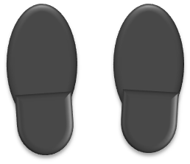












3. HOW TO ELIMINATE TERRORISTS SO ORION / DAMASCUS MODULE WILL NOT WORK
Burn Terrorist’s completely into ash, so that they cannot shift into a new identity
INCINERATOR

Slide 5



