Slide 1


Emerald City
Programming Group

Slide 2
Agenda
Create a demo application
Create two models
define a validator
define a relationship between models
deploy Application

Slide 3
Create Application
$ rails new demo_app

Slide 4
Create User Model
$ rails generate scaffold User name:string email:string

Slide 5

REST URLs

Slide 6
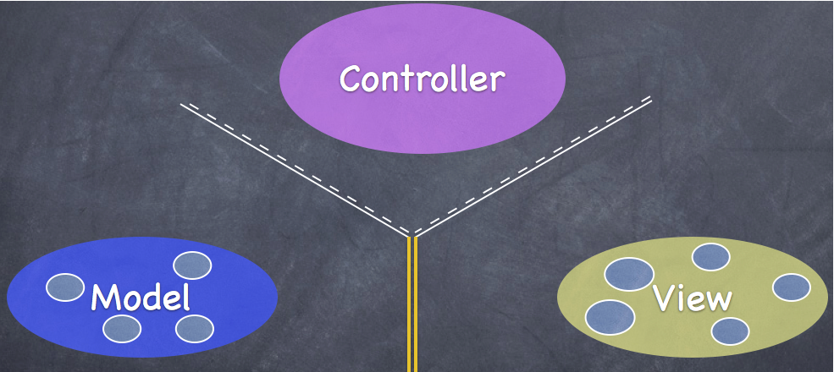
Model View Controller

Slide 7
Create Microposts Model
$ rails generate scaffold Micropost content:string user_id:integer

Slide 8
Limit the length of the posts
class Micropost < ActiveRecord::Base
validates :content, :length => {:maximum => 140}
end

Slide 9
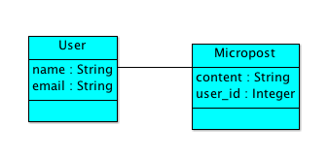
Creating Relationships

Slide 10
Has Many
class User < ActiveRecord::Base
has_many :microposts
end

Slide 11
Belongs To
class Micropost < ActiveRecord::Base
belongs_to :user
validates :content, :length => {:maximum => 140}
end

Slide 12
Deploy Application
$ gem install heroku
$ heroku create
$ git push heroku master
$ heroku rake db:migrate

