Slide 1
Ruby on Rails Tutorial
Chapter 3
Mostly Static Pages
Alan Hecht

Slide 2
Agenda
  Start the ongoing project used throughout the book
  Introduction to RSpec
  Introduction to TDD
  Dynamic Rails pages

Slide 3
Create Application
  rails new sample_app --skip-test-unit
  --skip-test-unit option says not to use the Test::Unit framework for testing
  Add Rails, Sqlite, and RSpec gems to the Gemfile

Slide 4
Initialize RSpec
  rails generate rspec:install
  Creates:
    .rspec options file
    ‘spec’ directory
    spec_helper.rb for RSpec configuration

Slide 5
Server-Side JavaScript
  Used to build CoffeeScript, a Ruby-like language the compiles to JavaScript
  Two primary options:
    Node.js
    Add therubyracer gem to your project

Slide 6
Commit & Deploy Application
  Create improved README file
  Create GitHub repository
  Push commited changes to GitHub
  Deploy to Heroku

Slide 7
Static Pages
  HTML files served from the public directory
    Rails is not involved in handling those files
  public/index.html is the home page by default

Slide 8
Static Pages with Rails
  Create a Git branch to work on the feature
  Generate a StaticPages controller for home & help actions
    Files named by convention using lower case and underscores between words

Slide 9

Static Pages with Rails
  Routes generated for the home & contact actions
  Methods generated for the StaticPages controller actions that do not use REST
  Views containing static HTML generated for the corresponding controller actions

Slide 10
Test Driven Development
  Is about design as well as testing
  Design the code from the perspective of someone who uses it “outside in”

Slide 11
Test Driven Development
  Write a failing test
    Helps ensure that the test is useful
  Write code to make the test pass
    Only write enough code to make the test pass
  Refactor
    Tests ensure the code still works
  Repeat

Slide 12
When not (gasp) to use TDD
  When not sure how to solve a problem
    In XP, this is a “spike”
  When using it means that nothing will get done
    Easy to get overwhelmed, especially when learning Ruby & Rails
    At least write tests after the fact

Slide 13
RSpec Tests
  Integration tests simulate users interacting with the application
  Unit tests test pieces of the application like the model or the controller

Slide 14
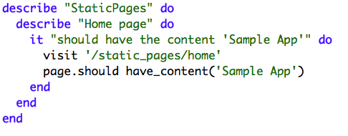
RSpec Tests
  Good advice not to test views & helpers
    Integration tests for views
  Run with ‘bundle exec rspec spec/requests/static_pages_spec.rb’

Slide 15
Add ‘about’ Page
  Write a failing integration test
  Add a route
  Add a controller method
  Add the view

Slide 16
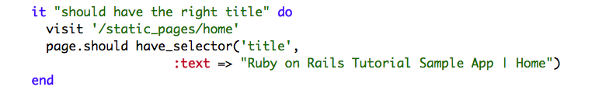
Slightly Dynamic Pages - Red
  Add a title test
    ‘have_selector’ checks for an HTML element in the response
    Do not have to search for complete element text

Slide 17
Slightly Dynamic Pages - Green
  Add HTML to about.html.erb, contact.html.erb, and home.html.erb to make the tests pass

Slide 18
Slightly Dynamic Pages
Refactor
  HTML pages contain a lot of duplication
    Don’t Repeat Yourself (DRY)
  Bind the title string to a label
  Add a layout to define title and page structure
    HTML from the view inserted at “yield” statement

Slide 19
Embedded Ruby
  <%= %> used for inserting the results of the Ruby code on the page
  <% %> used for loops, conditionals, and assignments
  Alternative templates are available
    Haml & Slim

Slide 20
Eliminating ‘bundle exec’
  Can use ‘bundle install --binstubs’ to create executables in bin directory
  rvm integrated with bundler as of version 1.11

Slide 21
Guard
  Gem which monitors changes in your files.
  Used to run tests as files are added/modified

Slide 22
Spork
  Test server that has the Rails environment preloaded
  Tests run faster because everything has already been initialized

Slide 23
Conclusion
  All the tests still pass
  Merge the code back into the ‘master’ branch
    Delete the branch
  Push to GitHub

