Slide 1
Ruby on Rails Tutorial
Chapter 6
Modeling and Viewing Users
Part 1
Alan Hecht

Slide 2
Create a User Model
  Generate the model
    rails generate model User name:string email:string
  By convention, model names are singular, table names are plural

Slide 3
Active Record
  Pattern used to map objects to relational databases
  Database table is represented by a class
  Row in the table is represented by an object instance of the class
  In Rails 3.0 and above, can specify something other than Active Record for persistance

Slide 4
Active Record Migration
  Used to incrementally create and/or update the database
  Created automatically when doing model generation
    Can create an empty migration for editing
  Migration files kept in db/migrate
  Database keeps track of the last migration executed

Slide 5
Run the Active Record Migration
  bundle exec rake db:migrate
  Firefox plugin SQLite Manager also good for viewing SQLite databases
    https://addons.mozilla.org/en-US/firefox/addon/sqlite-manager/

Slide 6
User Model File
  Doesn’t contain the attributes by default
  Can use the ‘annotate’ gem to add database field comments to the model file
  Can look at db/schema.rb to see the Ruby schema definition
  Add name & email accessors
    Should always be done to avoid security issues
    http://railspikes.com/2008/9/22/is-your-rails-application-safe-from-mass-assignment

Slide 7
Experimenting with User Model
  rails console –sandbox
  User.create combines new & save
  User.destroy removes the record from the database but not memory
  Can search by specific attributes (i.e. find_by_email)

Slide 8
Validating the User Model
  ‘validates’ class method used for checking attributes
    validates <field name>, <option hash>
  ‘errors’ property contains a list of errors if a validation fails

Slide 9
Create the Failing
Validation Test
  ‘pending’ indicates the test is yet to be written
    Also done with just having the ‘it’ part of the test
  ‘before’ contains statements to run before the first test or before all tests
  User.create! throws an exception if it fails, but User.create returns false if it fails

Slide 10
Validating with Regular Expressions
  validates <field>, :format => { :with => regex }
  Most common regular expressions are available online
  www.rubular.com good for validating Ruby regular expressions

Slide 11
Validating Uniqueness
  Submitting the same save request twice very quickly can cause a “race condition”
    Second validation starts after the first validation finishes but before the first save occurs
  Add a database index which enforces uniqueness
  Better solution would be to disable the submit button via JavaScript until the user create has been processed

Slide 12
Viewing Users
  Rails.env contains the environment name
    Can test for different types of environments
    Can specify the environment name when starting Rails
  Create a sample user in the database using the Rails console
  Create a minimalist view to show the user

Slide 13
Viewing Users - Controller
  Add a ‘show’ method to the Users controller
  ‘params’ is a hash containing parameters passed into the controller

Slide 14
Viewing Users - Routing
  Add ‘resources :users’ to routes.rb
  ‘resources’ is used to specify routes conforming to a REST architecture

Slide 15
Representational State Transfer
(REST)
  Data is represented as resources with a name and unique identifier
  Using HTTP to execute CRUD operations on resources
  In contrast to passing operation information in URL parameters or the body of the message
  Like all successful buzzwords, it’s lost some meaning

Slide 16
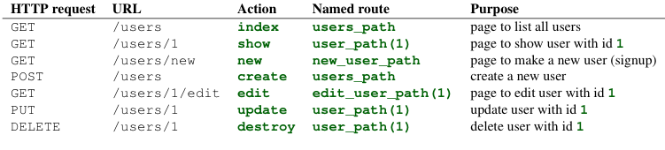
REST Resource Routing

Slide 17
REST Controller Actions
  Generating RESTful resources with ‘rails generate’ can produce a lot of boilerplate code
  ‘inherited_resources’ gem helps alleviate this issue
Notes:
rails generate scaffold Controller name:string description:string

Slide 18
REST Advantages
  Simple
  Easy for search engines to index

Slide 19
REST Disadvantages
  Some things don’t conform to REST
  Don’t try to shoehorn something into a REST style

Slide 20
Conclusion
  Halfway done with creating a working User model
  Created a Users resource based on REST

