Slide 1
"Ruby on Rails Tutorial" by Michael Hartl
RailsTutorial.org
50% off code pdf and/or videos: scholarship01
Google Group: http://groups.google.com/group/atlrug-emeraldcity

Slide 2
Ruby on Rails Tutorial
Chapter 7
Sign Up
Alan Hecht

Slide 3
Book Agenda
  Add a User View
  Create Signup Form
  Handle Sign Up Failure
  Handle Sign Up Success

Slide 4
Rails Environments
  By default, Rails has development, test, and production environments
  Can add more environments like acceptance
  Environment specific configuration in config/environments/

Slide 5
Add a User View
  Add user resource for RESTful routing
  Use a factory to generate a test user
  Add a gravatar image and user sidebar

Slide 6
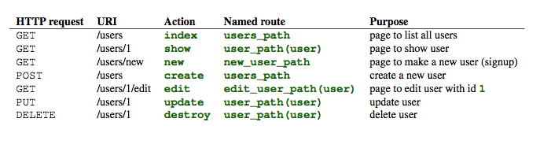
RESTful Routes for User
  resource :users

Slide 7
Testing with factory_girl
  Factories are used to generate objects for testing
  Fixtures, which come with Rails, must use pre-defined data
  Factories can also generate objects based on defined sequences
  No consensus on which method is better

Slide 8
Add a Gravatar Image
  Gravatars associate an image with an email address
  http://en.gravatar.com
  Gravatar returns an image based on the MD5 hashed e-mail address

Slide 9
Add a User Sidebar
  aside & section tags introduced in HTML 5
  SCSS ampersand references the parent selector

Slide 10

Rspec Expect
  ‘expect’ executes a code block and tests the before & after status of calling a method on an object

Slide 11
RSpec with Capybara
  RSpec alone can test controller responses
  Capybara used to test output of controller and provide user input
  Can test JavaScript by using Selenium
    Good for testing AJAX calls

Slide 12
Capybara
  ‘visit <url path>’ to navigate to test page
  ‘fill_in <field>, with: <value>’ to fill in a text field
  Can use field name, id, or label text for fill_in & click_button

Slide 13
form_for
  Form statements executed as a block passed to form_for
  Input elements passed as hash of model attributes (i.e. name = “user[password]”)
  Hidden “authenticity token” to help ensure the form is coming from your web site (Cross Site Request Forgery)
  Form issues an HTTP POST to /users

Slide 14
Form Submission
  “params” contains the form parameters
  params[:user] contains a hash of user attributes from the input form
  On invalid save, form fields are populated with values from model object

Slide 15
Flash Storage
  Flash contains a Ruby Hash instance.
  Only available for the next request
  Often used to display messages but any object can be stored in flash
    Would NOT recommend ActiveRecord objects

Slide 16
SSL
  Force the use of SSL with ‘config.force_ssl=true’
  Designed to help prevent “man-in-the-middle” attacks
  Need SSL certificate when using your own domain

