Slide 1
Ruby on Rails Tutorial
Chapter 1
From Zero to Deploy
Part Two
Alan Hecht

Slide 2
"Ruby on Rails Tutorial" by Michael Hartl
RailsTutorial.org
50% off code pdf and/or videos: scholarship01

Slide 3
Chapter Agenda - Part Two
  Create sample Rails application
  Install dependent Gems
  Run the application
  Commit to source control
  Deploy to Heroku

Slide 4
Create Rails Application
    mkdir rails_projects
  cd rails_projects
  rails new first_app
  Gems are installed in addition to creating the application

Slide 5
Bundler
  Used to install gems specified in Gemfile
  Creates Gemfile.lock which tracks gem dependencies
  Use ‘bundle exec’ to execute a command in the context of a Gemfile

Slide 6
Gemfile
  List of gems used by the application
  Good idea to specify version numbers
    Newer versions can break your application
    Can run ‘bundle install’ and grab version numbers from Gemfile.lock
  Broken out into groups for different environments

Slide 7
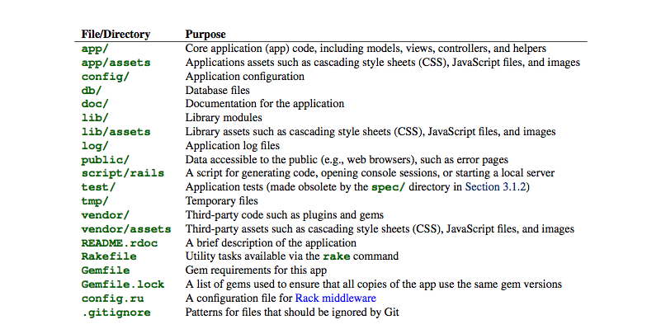
Application Architecture

Slide 8
Run the Application
  rails server
  Make sure you are in the application directory first
  Navigate to http://localhost:3000

Slide 9
Setup Git
  Global Setup:
  git config --global user.name “Your Name”
  git config –global user.email youremail@email.com
  Project Repository Setup:
  git init

Slide 10
Add Application to Git
  git add .
  git commit -m
  Further explanation in the Git session

Slide 11
GitHub
  GitHub provides Git hosting services
  Store, view, and share your Git repositories
  Free storage up to 300 mb – a lot for text files

Slide 12
GitHub – Signup & Setup
  Sign up at https://github.com/signup/free
  Set up instructions at https://help.github.com/articles/set-up-git
  SSH key instructions at https://help.github.com/articles/generating-ssh-keys

Slide 13
Push to GitHub
    git remote add origin git@github.com:<username>/first_app.git
    git push origin master

Slide 14
What is Heroku?
  Service for hosting Rails applications (PaaS)
  Built on top of Amazon EC2
  Free for applications that need limited resources
  Also supports Java, Node.js, Python, and other languages

Slide 15
Heroku Sign Up
  Sign up at https://api.heroku.com/signup
  Getting started with Rails on Heroku – http://devcenter.heroku.com/articles/rails3

Slide 16
Heroku Database
  Heroku uses PostgreSQL
  Easier to use Sqlite for development & test and PostgreSQL for production

Slide 17
Heroku Set Up
  Add heroku gem to Gemfile
  Create Gemfile group for development & test and another for production
    Add sqlite3 gem to development & test
    Add pg gem to production
  bundle install --without production
  heroku keys:add

Slide 18
Create Heroku Application
  Cedar is the default stack
  heroku create

Slide 19
Push to Heroku
  git push heroku master
  heroku open

