Slide 1
Ruby on Rails Tutorial
Chapter 4
Rails Flavored Ruby
Alan Hecht

Slide 2
Agenda
  Common Ruby-isms
  Ruby gotchas
  Introduction to Pry

Slide 3
Single vs. Double Quoted
Strings
  Double quoted strings interpret #{…} and backslashes (i.e. \n is newline)
  Single quoted strings are for literals

Slide 4
Boolean Methods
  By convention, methods ending in ‘?’ return a boolean value
  Method should only check something and not do anything else
    i.e. valid? should not write to the database

Slide 5
Bang Methods
  If two versions of a method exist, one of which modifies the object, then the method that modifies the object will end in ‘!’
    i.e. String#capitalize vs String#capitalize!
  If only one version of the method exists, it won’t be appended with ‘!’ even if it modifies the object.
    String#prepend modifies the string in place

Slide 6

Method Arguments
  When the last argument to a method is a hash, the curly braces are optional
  Hash values as method arguments are more self-documenting and can be in any order

Slide 7

Method Calls
  When calling a method, parenthesis are optional
  This is sometimes done to make the code look like a “domain specific language”

Slide 8
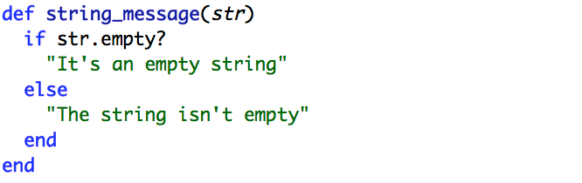
Method Return
  Ruby functions return the result of the last statement executed

Slide 9
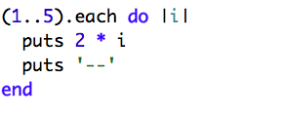
Blocks
  A set of statements or expressions between curly braces or do/end
  Code is executed once for each value
  Blocks are called by ‘yield’

Slide 10
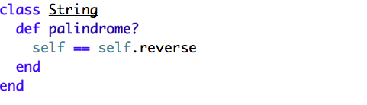
Monkey Patching
  Existing Ruby classes can have methods added to them
  Not a bad thing, but should be done with good reason

Slide 11
For More Information
  “The Well Grounded Rubyist” by David Black
  “The Ruby Way” by Hal Fulton

Slide 12
Pry
  An enhanced version of IRB which for examining and executing Ruby code
  Plugins available for integrating with Rails and for debugging
    Not quite a full-scale debugger

Slide 13
Pry - Installation
  Install pry gem
  Add ‘binding.pry’ to Ruby code to halt execution and start Pry

Slide 14
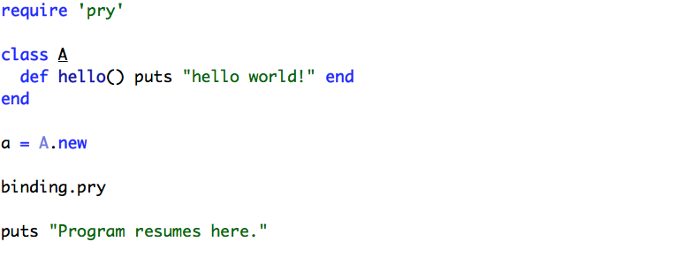
Pry - Example
Notes:
a.hello
show-method A
show-source A

Slide 15
Pry with Rails
  Add pry-rails gem
  Can view routes with show-routes
  Can view models with show-models

Slide 16
Debugging with Pry
  Add pry-debugger gem
  Add ‘binding.pry’ to code to set breakpoint
  Use step & continue to move ahead in code

Slide 17
Debugging with Pry
  View the running call stack with pry-stack_explorer
  Commands include show-stack, up, down, and frame

Slide 18
For More Information
  https://github.com/pry/pry/wiki
  http://pryrepl.org

