Slide 1
"Ruby on Rails Tutorial" by Michael Hartl
RailsTutorial.org
50% off code pdf and/or videos: scholarship01
Google Group: http://groups.google.com/group/atlrug-emeraldcity

Slide 2
Sending Emails with Rails
Alan Hecht

Slide 3
Action Mailer
  Enables you to send e-mail using a mailer model and views
  Don’t need your own mail server to send mail
  Can test e-mails without sending them

Slide 4
Create the Mailer
  rails generate mailer UserMailer
  Creates a derived class from ActionMailer::Base
  No view code and only a skeleton test file created

Slide 5
Edit the Mailer
  Create a method that will send an e-mail
    ‘mail’ is the method that sends the e-mail
  Set the default parameters such as ‘subject’ or ‘from’

Slide 6
Create a Mailer View
  View contains same file name as the method to send e-mail
  E-mail views can be in HTML or plain text format
  As with regular views, can create instance variables for use in the mailer view
  Mailer views can also use layouts

Slide 7
Sending the Email
  UserMail.welcome_mail(@user).deliver
  Call the ‘mail’ method to create the e-mail
  Call the ‘deliver’ method to send it

Slide 8
Testing & Debugging Emails
  In the test environment, e-mails are added to the ActionMailer::Base.deliveries array
  Can install the ‘letter_opener’ gem to have e-mail go to browser.

Slide 9
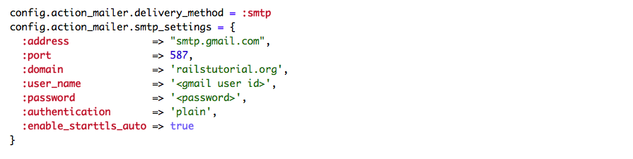
Using Gmail for a Mail Server
  ‘

