Slide 1
Ruby on Rails Tutorial
Chapter 9
Sign In, Sign Out
Alan Hecht

Slide 2
"Ruby on Rails Tutorial" by Michael Hartl
RailsTutorial.org
50% off code pdf and/or videos: scholarship01

Slide 3
Book Agenda
  Add Sessions controller
  Create sign in form
  Handle sign in failure
  Handle sign in success
  Handle signing out

Slide 4
Rails Routes
  Path match maps to named route
    Path ‘/signup’ maps to signup_path
  REST resources can have restricted actions
    :only => [:new, :create, :destroy]

Slide 5
Ruby Hashes
  Can be nested, the value of a hash may be another hash
  Don’t need curly braces when passed into a method

Slide 6
Flash.now
  Regular flash variable set before a redirect
  If only rendering the page, then the flash variable contents will be available after a redirect
  If not redirecting to another page, then use flash.now so contents won’t be available after a redirect

Slide 7
Rails Sessions
  Rails sessions contain a Hash and a session id
  May also be stored in memcached or database
  Specify session type in config/initializers/session_store.rb

Slide 8
Rails Session Storage
  Stored in browser cookies by default
  May also be stored in memcached or database
  Specify session type in config/initializers/session_store.rb

Slide 9
Session Security
  Session information in browser cookie is signed so that it’s tamper-resistant
    Signed with value in config/initializers/secret_token.rb
  For added security, expire the session after a short period of inactivity to prevent “replay attacks”
  Don’t put confidential information in cookie session store

Slide 10
Rails Helpers
  Usually contains code for views – “Presenters”
  Automatically included in its associated view
    May optionally be included in controllers

Slide 11
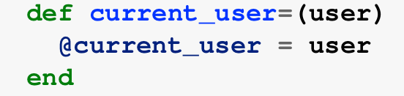
Ruby Assignment Functions
  Defined by:
  Could also use ‘attr_writer :current_user’

Slide 12
Ruby ||=
  Sort of like x = x || y
  Used to initialize a variable when it’s nil, otherwise the variable is unchanged
  See http://www.rubyinside.com/what-rubys-double-pipe-or-equals-really-does-5488.html for what’s really happening.

Slide 13
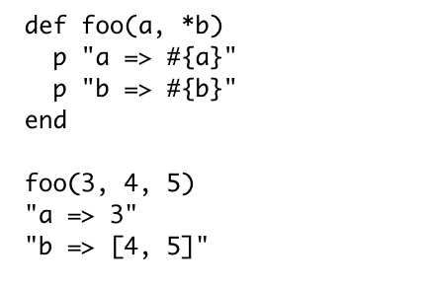
Ruby Method Arguments
  If one of the arguments starts with an asterisk, any excess parameters are converted into an array and assigned to the argument

Slide 14

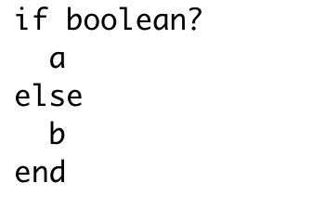
Ruby Ternary Operator ?:
  is equivalent to

Slide 15
HTTP Delete
  Browsers do not natively support HTTP Delete
  Rails uses JavaScript to simulate HTTP Delete

