Slide 1
Ruby on Rails Tutorial
Chapter 10
Updating, Showing, & Deleting Users
Alan Hecht

Slide 2
Book Agenda
  Handle Updating Users
  Add Page Security
  Show All Users
  Handle Deleting Users

Slide 3
Partial View Parameters
  Partials have a local variable with the same name as the partial (without the underscore)
    can be set with the :object parameter
  Other partial local variables can be set with:
    :locals => { :variable => “value” }
  Can pass a collection to the partial to render once for each element
    :collection => @models

Slide 4
Rails Inflector Module
  Manipulating strings for display
  ActiveSupport::Inflector
  Methods include:
    ‘pluralize’
    ‘humanize’
    ‘constantize’
    ‘singularize’

Slide 5
Rails HTTP PUT Requests
  Browsers don’t natively support HTTP PUT
  Rails uses HTTP POST with a hidden input field specifying a PUT request

Slide 6
Rails Filters
  Pre- or post-processing for controller actions
  Filter applies to controller and all sub-classes of the controller
  Filters can access request & response objects
  Filters run in random order unless added using something like ‘append_before_filter’ or ‘append_after_filter’

Slide 7
Flash Messages
  Can be “success”, “error”, or “notice” styles
  Can specify flash message as an argument to ‘redirect_to’
    redirect_to login_path, :error => “Login failed”

Slide 8
Rails Session Storage
  ‘session’ is a Ruby Hash that is stored in a session cookie
  once again, be careful about storing Rails objects that can change between requests

Slide 9
Faker Gem
  Can be used with just Ruby as well as Rails
  Can generate names, addresses, phone numbers, and email addresses
  Unlike Factory Girl Gem, doesn’t need a template in order to generate fields
  Some consider Faker to be a Factory Girl alternative

Slide 10
Rake Tasks
  Rake tasks usually consist of a namespace, description, and a task block containing code to execute
  Can invoke another Rake task by executing:
    Rake::Task[‘<task name>’].invoke
  List all available Rake tasks with ‘rake –T’

Slide 11
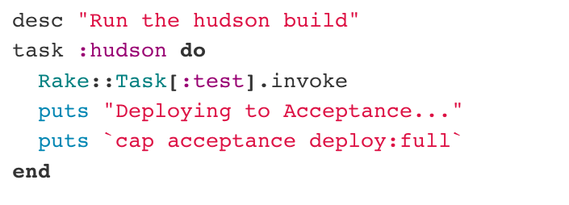
Rake Tasks – External Commands
  On Linux & OS/X, can use backticks to execute a command and Ruby ‘puts’ to capture output

Slide 12
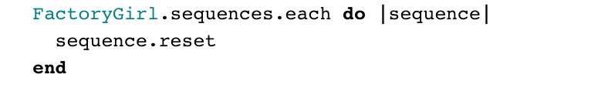
Factory Girl Sequences
  Specified by using ‘sequence’ in the definition:
    f.sequence(:username) { |n| “User#{n}” }
  Sequences can be reset

Slide 13
ActiveRecord
  ‘toggle’ method flips the value of a boolean,
    ‘toggle!’ method flips the value and saves the record
  Only attributes exposed through attr_accessible can be set through mass assignment

Slide 14
Rails HTTP DELETE Requests
  Browsers don’t natively support HTTP DELETE
  Rails fakes the DELETE request using JavaScript
  Need to include Rails JavaScript libraries to issue DELETE requests

