Slide 1
Ruby on Rails Tutorial
Chapter 5
Filling in the Layout
Alan Hecht

Slide 2
Agenda
  Update application layout using Bootstrap
  Clean up code using partials
  Add home page routes
  Begin user signup

Slide 3
Update Application Layout
  Rails 3 uses HTML 5 by default
    HTML 5 tutorial at http://diveintohtml5.info/index.html
  Stub URL ’#’ also used when JavaScript handles the click event
  Rails doesn’t obviate the need for HTML & CSS knowledge.

Slide 4
Ruby Hashes
  Pre-Ruby 1.9 used the “hashrocket” syntax
    :foo => “test”
  Ruby 1.9 uses the syntax present in JavaScript
    foo: “test”

Slide 5
HTML & CSS Debugging Tips
  No need to restart application for HTML & CSS changes
  Chrome is very aggressive about caching
    If something doesn’t look right in Chrome, try clearing the cache

Slide 6
Partials
  Used to organize and/or reuse view files
  Path to included file starts from the ‘views’ directory
  Partial file starts with an underscore, but the underscore is not referenced in the code
  Partials used across different views usually put in the layouts or a shared directory

Slide 7
Asset Pipeline
  Precompile, concatenate, and minify CSS, JavaScript, and image files
  Helps reduce the number of requests and improve transfer speed
  Use is optional

Slide 8
Asset Pipeline - Use
  Original files go in app/assets/ subdirectories
  Manifest contains a list of files to process
  Assets for production are pre-compiled to public/assets/ directory

Slide 9
Asset Pipeline – WTF?
  Referencing an image from a sass file
    Good luck, and tell me how you did it

Slide 10
Asset Pipeline
More Information
  Asset Pipeline for Dummies
    http://coderberry.me/blog/2012/04/24/asset-pipeline-for-dummies/
  Understanding the Rails Asset Pipeline
    http://wekeroad.com/2012/01/12/understanding-the-rails-asset-pipeline/
  RailsGuide – Asset Pipeline
    http://guides.rubyonrails.org/asset_pipeline.html

Slide 11
CoffeeScript
  Python/Ruby like language which compiles to JavaScript
  Takes care of JavaScript warts

Slide 12
Sass
  Sass adds variables, nesting, mixins, and selector inheritance to CSS
  Sass has two syntaxes: SCSS & Sass
    Valid CSS3 is valid SCSS
    Sass uses indentation like Haml

Slide 13
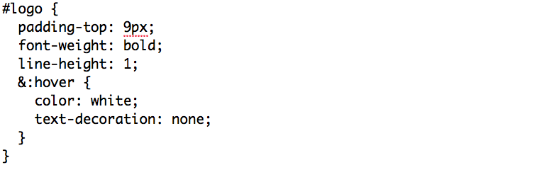
Sass - Nesting
  Parent element referenced by ‘&’

Slide 14
Sass - Variables
  Sass variables can be manipulated by built-in functions, which mostly deal with color manipulation
  Sass function reference at http://sass-lang.com/docs/yardoc/Sass/Script/Functions.html

Slide 15
Named Routes
  named routes are an alias for the routing action
  match ‘/action’, to: ‘controller#method’

Slide 16
Named Routes - Helpers
  named routes generate url & path helpers
  url helpers specify the domain name
    about_url = ‘http://example.com/about’
  path helpers show the path from the root
    about_path = ‘/about’

Slide 17
Root Route
  root to: “<controller>#<action>”
    Default page when navigating to site
  root_path & root_url helpers are generated
    root_path = ‘/’
    root_url = ‘http://localhost:3000/’
  Need to remove the ‘public/index.html’ file

Slide 18
RSpec
  Using Ruby blocks to make the code more readable
    subject { page }
    it { should have_selector(‘h1’, text: ‘Sample App’) }
  Ruby files under <app>/spec automatically loaded

Slide 19
User Signup
  Add a controller with just a ‘new’ action
  Add integration test for the signup page
  Add route for signup page

Slide 20
Conclusion
  All the tests still pass
  Next few chapters focus on functionality instead of layout

