Slide 1
Ruby on Rails Tutorial
Chapter 7
Modeling and Viewing Users
Part 2
Alan Hecht

Slide 2
Agenda
  Add an insecure password
  Make the password secure
  Improve the user view

Slide 3
Add an Insecure Password
  Add a attributes for password & password validation
  Create an encryption function which, at first, just returns what is entered
  Add a migration for the encrypted password

Slide 4
Add Password Attributes
  Add ‘password’ and ‘password_confirmation’ non-persistent attributes
    By convention, ‘password_confirmation’ will be used with confirmation validation
  In TDD, good practice to avoid tests which cause cascading failures
    Avoids looking at a bunch of failed tests to figure out what went wrong

Slide 5
Add Password Migration
  Migration name add_<field>_to_<table> will, by convention, add a column to a table
  Entire migration will be created if fields are specified

Slide 6
Make the Password Secure
  Add a function which creates a one-way secure hash
  Password will be encrypted after validation but before being saved

Slide 7
Create Encrypted Password
  Add a ‘before_save’ Active Record callback to compute the encrypted password
  ‘encrypted_password’ attribute must be prepended with ‘self.’ when assigned inside a method
    ‘self.’ not needed when only referencing the attribute

Slide 8
Active Record Callbacks
  Hooks into the life cycle of an Active Record object
  Callbacks are registered with class methods that specify a method to call
  Common callbacks include:
    after initialization
    before & after validation
    before & after save
    before & after update
    before & after destroy
    after commit

Slide 9
Public, Private, & Protected Methods
  Different from Java & C#
  Private methods accessible by an object from a derived class
  Protected methods accessible by other objects of same class & objects from derived classes
  Inheritance doesn’t determine method visibility
    Private & protected methods visible from subclasses

Slide 10
Securing Passwords
  Needs to be stored as an irreversible hash
  SHA-2 is the strongest cryptographic hash function
  Don’t try to come up with your own encryption scheme

Slide 11
Securing Passwords – Needs Salt
  A ‘rainbow table’ stores the hashed values of common passwords using the cryptographic hashing function
    Can compare hashed password values to what’s in the rainbow table
  A ‘salt’ value is added to the password before encryption
    Now need to create a rainbow table for each salt value
  Only create the salt value once

Slide 12
Improve the User View
  Use factories to generate test users
  Add a gravatar
  Add a user sidebar

Slide 13
Testing with factory_girl
  Factories are used to generate objects for testing
  Fixtures, which come with Rails, must use pre-defined data
  Factories can also generate objects based on defined sequences
  No consensus on which method is better

Slide 14
Verifying Models During Testing
  Can use ‘assigns’ to retrieve the controller instance variable when testing
    Validates that the model objects are correct
  Can use mock objects to isolate controller testing from model testing
    Controller tests won’t rely on models working correctly

Slide 15
Should You Use Mock Objects?
  TDD purists say yes
  Others say it isn’t worth the trouble
  Need integration testing when using mock objects
    “You can mock your way out of any test”

Slide 16
Add a Gravatar
  Gravatars associate an image with an email address
  http://en.gravatar.com
  Gravatar gem returns an image tag based on the email address

Slide 17
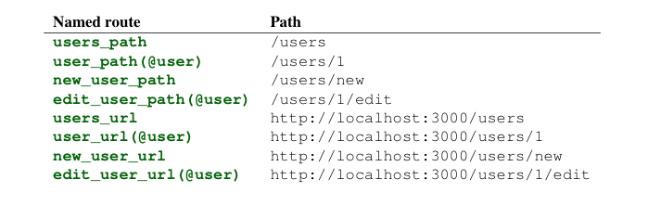
Named Routes for User

