Slide 1
Ruby on Rails Tutorial Chapter 8
Sign in, Sign out
Anjan Das

Slide 2
Agenda
Signin process
How to use sessions
Signout process

Slide 3
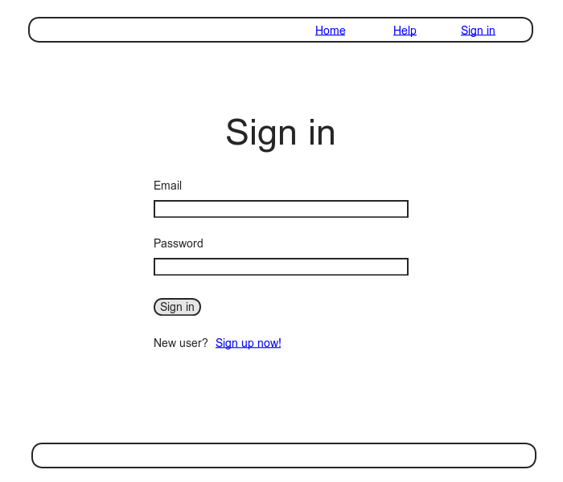
Sessions and Signin Failure

Slide 4
Session
What is it?
A Semi permanent connection between computers.
Between computer running client we browser
and computer server running rails

Slide 5
How we will implement session
Will remember user’s signin status till user explicitly signs out
Use session as a RESTful resource
Signin will create a session
Signout will destroy a session
No model behind – will use a cookie to persist data

Slide 6
Components to implement Session
Sessions Controller
Signin Form
Relevant controller actions
Cookie-manipulation code

Slide 7
Implementing Session
Session Controller
rails generate controller Sessions –no-test-framework
rails generate integration_test authentication_pages

Slide 8
Creating routes for the session
Need routes only for new, create and destroy
Update config/route.rb with
resources :sessions, only: [:new, :create, :destroy]
- Check routes with rake routes

Slide 9
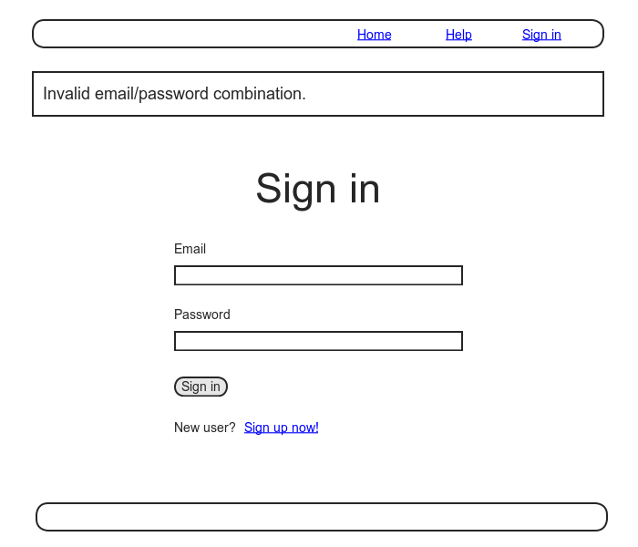
Signin Failure

Slide 10
Signin Failure
Check for error message for failed login
<div class=“alert alert-error”>Invalid …</div>

Slide 11
Check for sign in failure
user = User.find_by(email: params[:session][:email].downcase)
If user && user.authenticate(params[:session][:password])
#success
else
#failure
end

Slide 12
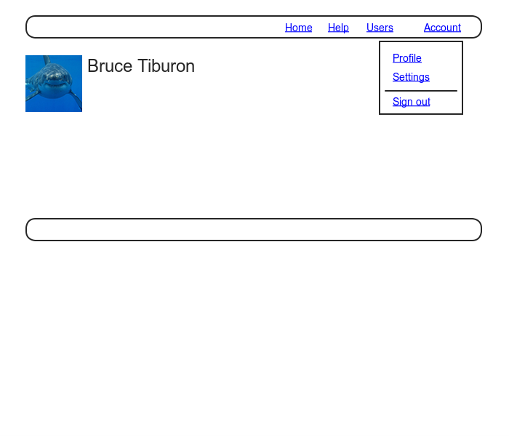
User Profile after successful signin

Slide 13
Testing successful sign-in
Look for existence of
Profile link
Sign out link
Look for disappearance of
Disappearance of sign in link

