Slide 1
Ruby on Rails Tutorial Chapter 7
User Sign Up
Anjan Das

Slide 2
Agenda
Showing Users (Profile Page)
Debug and Rails Environments
Signup Form
Handling Signup Failure and Success

Slide 3
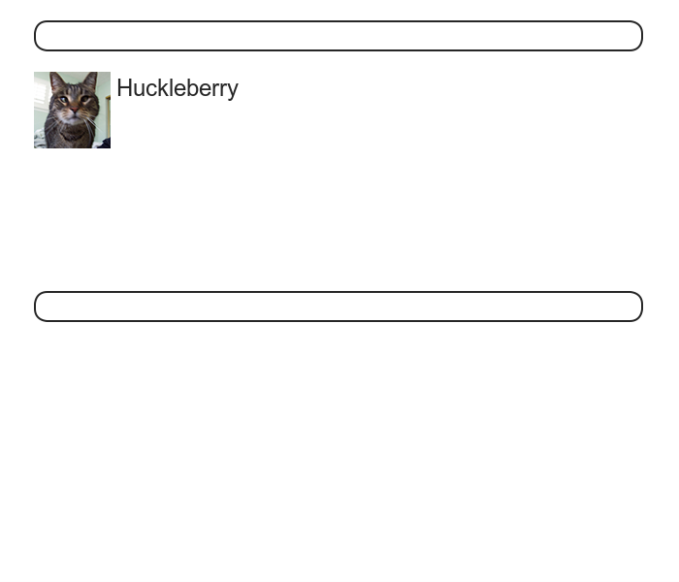
Showing Users (Profile Page)
Initial Mockup

Slide 4
Rails Environments
Comes with three environments
Development
Test
Production
Default Environment is Development
$ rails console
>> Rails.env
=> “development”

Slide 5
Invoking Environments
Console
rails console test
Server
rails server --environment production
Rake Task
bundle exec rake db:migrate RAILS_ENV=production

Slide 6
Creating a user resource
Put in routes File
resources :users
config/routes.rb
SampleApp::Application.routes.draw do
resources :users
root 'static_pages#home'
match '/signup', to: 'users#new', via: 'get’
.
.
End

Slide 7
Creating user resource
Edit app/views/users/show.html.erb
Add show action in app/controllers/users_controller.rb

Slide 8
Testing User Page (with Factories)
Add factory_girl_rails gem
group :test do
.
.
.
gem 'factory_girl_rails', '4.2.1’
end

Slide 9
Define a Factory
FactoryGirl.define do
factory :user do
name "Michael Hartl"
email "michael@example.com"
password "foobar"
password_confirmation "foobar"
end
End
Creating a User Factory
let(:user) { FactoryGirl.create(:user) }

Slide 10
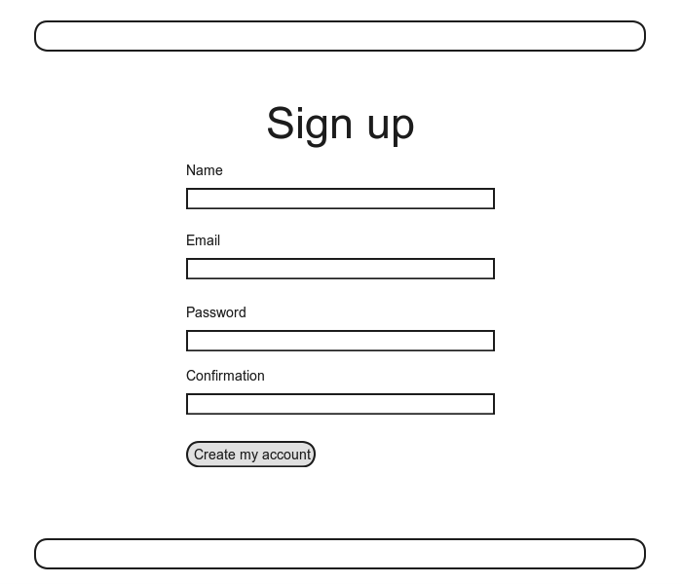
Signup form

Slide 11
Using TDD (user signup)
Let’s Do It

Slide 12
Using form_for
<% provide(:title, 'Sign up') %>
<h1>Sign up</h1>
<div class="row">
<div class="span6 offset3">
<%= form_for(@user) do |f| %>
<%= f.label :name %>
<%= f.text_field :name %>
<%= f.label :email %>
<%= f.text_field :email %>
<%= f.label :password %>
<%= f.password_field :password %>
<%= f.label :password_confirmation, "Confirmation" %>
<%= f.password_field :password_confirmation %>
<%= f.submit "Create my account", class: "btn btn-large btn-primary" %>
<% end %>
</div>
</div>

Slide 13
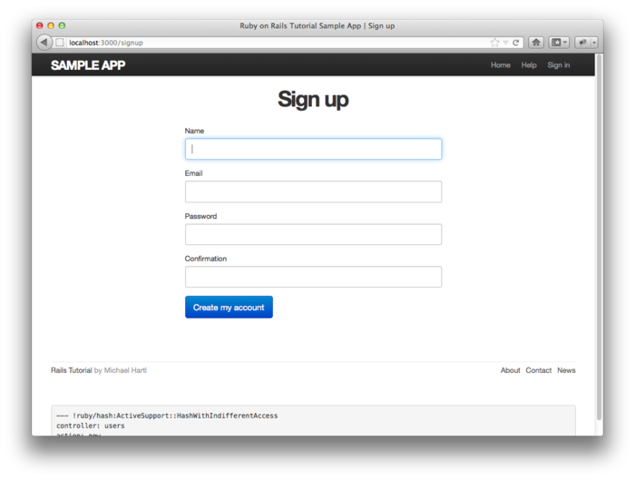
Generated Form

Slide 14
HTML
<form accept-charset="UTF-8" action="/users" class="new_user" id="new_user" method="post">
<label for="user_name">Name</label>
<input id="user_name" name="user[name]" type="text" />
<label for="user_email">Email</label>
<input id="user_email" name="user[email]" type="text" />
<label for="user_password">Password</label>
<input id="user_password" name="user[password]" type="password" />
<label for="user_password_confirmation">Confirmation</label>
<input id="user_password_confirmation" name="user[password_confirmation]" type="password" />
<input class="btn btn-large btn-primary" name="commit" type="submit" value="Create my account" />
</form>

Slide 15
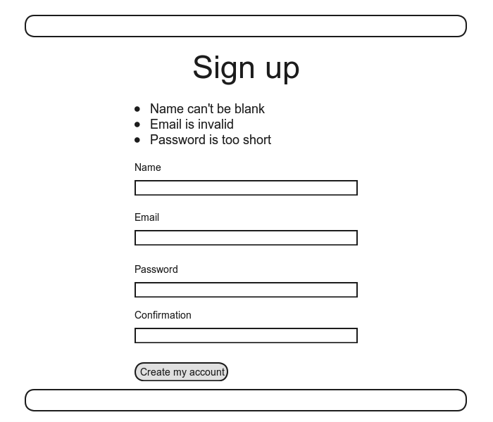
Signup Failure

Slide 16
Problems with Parameters
@user = User.new(params[:user])
equivalent to
@user = User.new(name: "Foo Bar", email: "foo@invalid", password: "foo", password_confirmation: "bar")
Also possible to pass more parameters

Slide 17
Protect with Strong Parameters
params.require(:user).permit(:name, :email, :password, :password_confirmation)

Slide 18
Error Messages
Let’s look at them

Slide 19
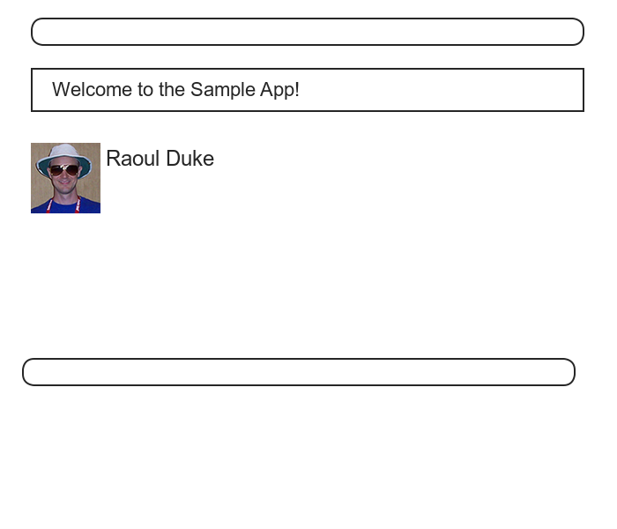
Signup Success

