Slide 1
Ruby on Rails Tutorial
Chapter 2
A Demo App
Anjan Das

Slide 2
Agenda
  Create Demo Application
  Create Data Model
  Implement Users Resource
  Implement Microposts Resource

Slide 3
Create Demo Application
  Create gemset & .rvmrc file if using rvm
  Need to install rails gem
  Always specify a version in the Gemfile
  Use ‘bundle exec’ to execute commands dependent on what’s in Gemfile

Slide 4
Create Data Model
  Rails treats the database like a “black box” which holds data
  Object model almost always drives the database schema
  Table names and foreign keys are named by convention

Slide 5
Scaffolding
  Scaffolding adds model, view, controller, and route
  Can build upon the code & tests that have been added

Slide 6
Rake
  Use “rake -T” to see the list of rake tasks
  Use “--dry-run” option to see the steps that will be executed
    i.e. bundle exec rake --dry-run db:setup

Slide 7
(RE)presentational (S)tate
(T)ransfer
  Web application is built in terms of HTTP request methods instead of on top of it (i.e. SOAP)
  A “resource”, according to Wikipedia, is “any coherent and meaningful concept that may be addressed”

Slide 8
New Project
cd ~/rails_projects
rails new demo_app
cd demo_app

Slide 9
Modify Gemfile
group :development do
# Use sqlite3 as the database for Active Record
gem 'sqlite3’
end
group :production do
gem 'pg', '0.15.1'
gem 'rails_12factor', '0.0.2'
end

Slide 10
Install Gems and First commit
bundle install –without production
bundle update
Modify .gitignore (if needed)
git init
git add .
git commit –m “Initial commit”

Slide 11
Create Repository
Create new repository in github
git remote add origin https://github.com/<username>/demo_app.git
git push -u origin master

Slide 12

User model

Slide 13
Generate Scaffold
rails generate scaffold User name:string email:string
Creates model, views, controller and routes
rake db:migrate
Look at routes
rake routes

Slide 14
Rake routes
Prefix Verb URI Pattern Controller#Action
users GET /users(.:format) users#index
POST /users(.:format) users#create
new_user GET /users/new(.:format) users#new
edit_user GET /users/:id/edit(.:format) users#edit
user GET /users/:id(.:format) users#show
PATCH /users/:id(.:format) users#update
PUT /users/:id(.:format) users#update
DELETE /users/:id(.:format) users#destroy

Slide 15
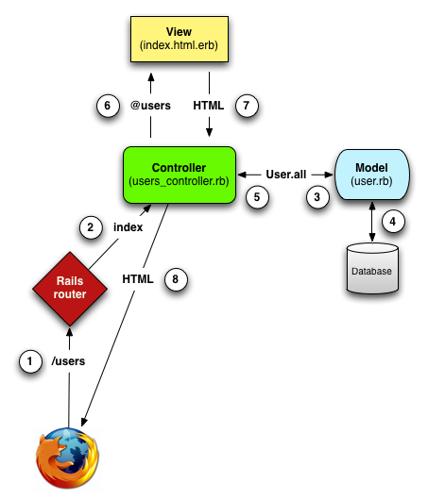
MVC in action

Slide 16

Model
Micropost model

Slide 17
Scaffold
rails generate scaffold Micropost content:string user_id:integer
rake db:migrate

Slide 18
Models/Associations
app/models/user.rb
class User < ActiveRecord::Base
has_many :microposts
end
app/models/micropost.rb
class Micropost < ActiveRecord::Base
belongs_to :user
validates :content, length: { maximum: 140 }
end

Slide 19
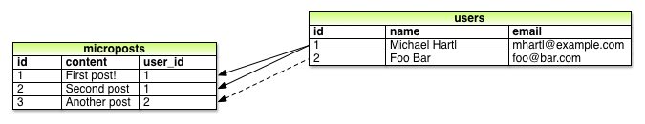
Associations

Slide 20
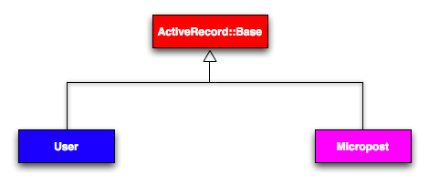
Inheritance (models)

Slide 21
Controllers
class UsersController < ApplicationController
.
.
.
end
class MicropostsController < ApplicationController
.
.
end

Slide 22

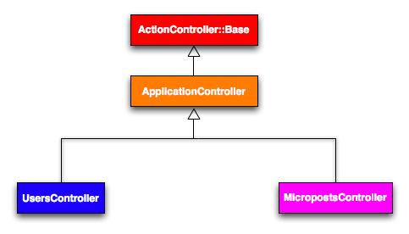
Inheritance (controller)

Slide 23
Routes
DemoApp::Application.routes.draw do
resources :microposts
resources :users
.
.
.
end

Slide 24
Finishing Up
git add .
git commit –m “Finish Demo App”
git push
heroku create
git push heroku master
heroku run rake db:migrate
heroku open

Slide 25
Thank You
Questions?

