Slide 1
Ruby on Rails Tutorial
Chapter 2
A Toy App
Alan Hecht

Slide 2
Book Agenda
  Create Application
  Create Data Model
  Implement Users
  Implement Microposts

Slide 3
Create Demo Application
  Cloud9
  Use Rubygems.org to find package versions
  Stackoverflow.com is your friend

Slide 4
Create Data Model
  Rails treats the database like a “black box” which holds data
  Object model almost always drives the database schema
  Table names and foreign keys are named by convention

Slide 5
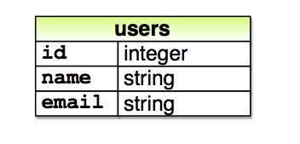
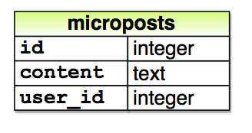
Create Data Model

Slide 6
Scaffolding
  Scaffolding adds everything needed to implement a resource with a basic UI (model, view, controller, and route)
  Can build upon the code & tests that have been added
  inherited_resources gem allows code to inherit from “boilerplate resources”

Slide 7
What’s a Resource
  They are the nouns of your web application
    Verbs are the actions you can do with a resource
  Best place to start is mapping nouns to resources
  Probably will have additional resources to help implement your solution

Slide 8
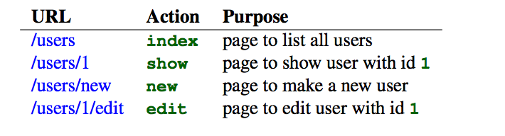
What Can You Do with a Resource?

Slide 9
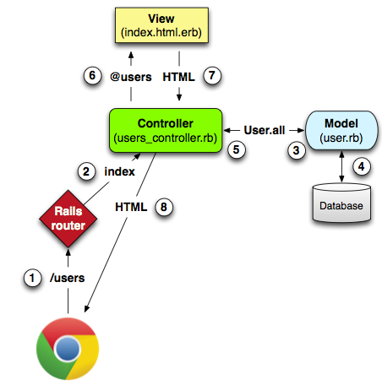
MVC in Rails
(and many other web apps)

Slide 10
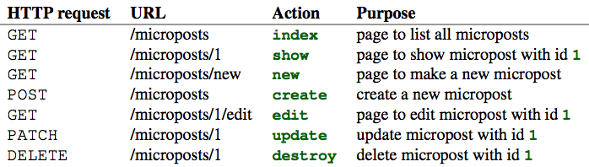
Routes Provided by a Resource

Slide 11
Associations Between Models
  Association must be done in the database as well as in the code
  Declarations must be done on both sides of the association in code

Slide 12
Associations Between Models
  User has_many Microposts
  Microposts belongs_to User
  Model with the ‘belongs_to’ has the database key

Slide 13
Rails Console
  Can try out code
  Has full access to the application
  Demo
Notes:
User = User.first
user.microposts
user.microposts.first

