Slide 1
Ruby on Rails Tutorial
Chapter 1
From Zero to Deploy
Part Two
Alan Hecht
http://groups.google.com/group/atlrug-emeraldcity

Slide 2
"Ruby on Rails Tutorial" by Michael Hartl
Draft.RailsTutorial.org

Slide 3
Chapter Agenda - Part Two
  Create sample Rails application
  Run the application
  Add the home page
  Commit to source control
  Deploy to Heroku

Slide 4
Create Rails Application
    cd ~/workspace
  rails _4.2.0.beta2_ new hello_app
  Gems are installed in addition to creating the application

Slide 5
Common Unix Commands
  List directory contents ls
  Make directory mkdir
  Change directory cd
  Move file mv
  Copy file cp
  Remove file rm
  Remove directory rmdir
  Display file less

Slide 6
RubyGems
  Package manager for Ruby
  Similar to Java JAR file or C# Assembly
  Community host at http://rubygems.org

Slide 7
Gemfile
  List of gems used by the application
  Good idea to specify version numbers
    Newer versions can break your application
    Can run ‘bundle install’ and grab version numbers from Gemfile.lock
  Broken out into groups for different environments

Slide 8
Bundler
  Used to install gems specified in Gemfile
  Creates Gemfile.lock which tracks gem dependencies

Slide 9
Cloud 9 IDE
  Tour

Slide 10
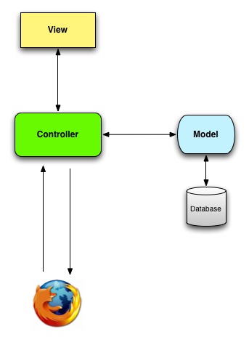
Model-View-Controller (MVC)

Slide 11
Run the Application
  rails server –b $IP –p $PORT
  If local:
  rails server
  Make sure you are in the application directory first

Slide 12
Add a controller
  Modify config/routes.rb
  Add an action to ApplicationController

Slide 13
Setup Git
  Global Setup:
  git config --global user.name “Your Name”
  git config –global user.email youremail@email.com
  Project Repository Setup:
  git init

Slide 14
Add Application to Git
  git add -A
  git commit –m ‘comment’
  Further explanation in the Git session

Slide 15
Push to GitHub
    git remote add origin git@github.com:<username>/hello_app.git
    git push origin --all

Slide 16
What is Heroku?
  Service for hosting Rails applications (PaaS)
  Built on top of Amazon EC2
  Free for applications that need limited resources
  Also supports Java, Node.js, Python, and other languages

Slide 17
Heroku Database
  Heroku uses PostgreSQL
  Easier to use Sqlite for development & test and PostgreSQL for production

Slide 18
Heroku Set Up
  If local, install Heroku toolbelt
  Create Gemfile group for development & test and another for production
    Add sqlite3 gem to development & test
    Add pg gem to production
  bundle install --without production
  heroku login
  heroku keys:add

Slide 19
Create Heroku Application
  heroku create

Slide 20
Push to Heroku
  git push heroku master
  If local:
  heroku open

