Slide 1
Ruby on Rails Tutorial
Chapter 3
Mostly Static Pages
Alan Hecht

Slide 2
Create Application
  rails _4.2.0.beta2_ new sample_app
  Add Ruby gems

Slide 3
HTTP
  How a web browser talks to a web server
  Four operations: GET (read), POST (write/create), PUT (update), DELETE (delete)
  Browsers support GET & POST
  JavaScript used to support PATCH & DELETE

Slide 4
Static Pages with Rails
  Create a Git branch to work on the feature
  Generate a StaticPages controller for home & help actions
    Files named by convention using lower case and underscores between words

Slide 5
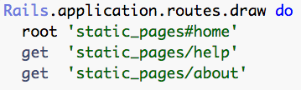
Static Pages with Rails
  Routes generated for the home & help actions
  Methods generated for the StaticPages controller actions are not standard
  Views containing static HTML generated for the corresponding controller actions

Slide 6
Test Driven Development
  Write a failing test
    Helps ensure that the test is useful
  Write code to make the test pass
    Only write enough code to make the test pass
  Refactor
    Change the code, and the tests ensure the code still works
  Repeat

Slide 7
Test Driven Development
  Is about designing code as well as testing code
  Design the code from the perspective of someone who uses it - “outside in”

Slide 8
Should I use Test Driven Development?
  If you’re learning something new, like Ruby & Rails, then no
  Easy to get overwhelmed
  Try writing tests after the code is written

Slide 9
Add ‘about’ Page
  Write a failing test
  Add a route
  Add a controller method
  Add the HTML view

Slide 10
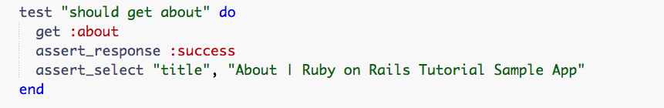
Slightly Dynamic Pages
  Adding a test
  Tests read like pseudo-English (domain specific language)

Slide 11
Don’t Repeat Yourself (DRY)
  If code or HTML is repeated, then it will have to be updated more than once
  Similar code or HTML should be consolidated

Slide 12
Layout Pages
  Provide a template for the parts of the page that get reused
  Contents of a specific page go where the ‘yield’ is located

Slide 13
Embedded Ruby
  <%= %> used for inserting the results of the Ruby code on the page
  <% %> used for loops, conditionals, and assignments

Slide 14
Conclusion
  All the tests still pass
  Merge the code back into the ‘master’ branch
    Delete the branch
  Push to GitHub

