Slide 1

Git and GitHub.com

Slide 2
What is Git?
Git is a distributed version control system
Git stores snapshots of your files
There is no central version control database.
  Each machine has entire source history

Slide 3
Centralized Version Control
Source Control Server
Computer
Files
Version
Database
Computer
Files
Computer
Files

Slide 4
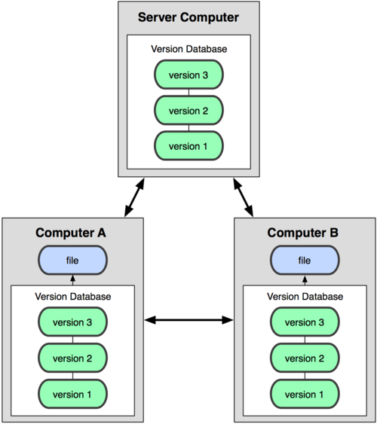
Distributed Version Control
Source: http://progit.org/book/ch1-1.html

Slide 5
Git Workflow
Edit the file in your project (working)directory
Add your file to a staging area
Take a snapshot of the project directory
Repeat

Slide 6
Git Workflow
Modify Files
Commit Files
Stage Files

Slide 7
Installation
(Not needed on Cloud 9)
Windows: Part of Rails Installer
Linux: sudo apt-get install git-core
OS/X: Install Xcode 6 or
  brew install git

Slide 8
Initial Setup
git config --global user.name “John Doe”
git config --global user.email john@example.com
git config --list
  Shows your git settings
See http://progit.org/book/ch1-5.html for more

Slide 9
Lab – Create a repository
mkdir my_project
cd my_project
git init
echo “Hello” >> README
git status
git add README
git status
git commit –m ‘Initial commit’
git status

Slide 10
Lab – Revert changes
echo “Another line” >> README
git status
git diff
git checkout README
cat README

Slide 11
Lab – Revert staged changes
echo “More text.” >> README
git add README
git reset HEAD README
git status
git checkout README
git status

Slide 12
Git History
git log
git log -- <file name>

Slide 13
Git Tagging
Mark specific checkpoints as a release
Tag contains date, version, message, and author information

Slide 14
Lab – Tagging
git tag –a v1.0 –m ‘First release’ # annotated tag
git tag
git show v1.0
echo “print ‘hello’” > test.rb
git add test.rb
git commit –m ‘Add a file’
git tag –a v2.0 –m ‘Second release’
git tag
git checkout v1.0
ls
git checkout v2.0
ls

Slide 15
Git Branching
Allows parallel development to take place
  Bug fixes
  Features
Much easier to maintain branches than with traditional version control systems
  Merging is far simpler
Each branch keeps track of snapshots

Slide 16
Git Master Branch
master is the main branch
Every Git repository created with a master branch by default
Nothing stopping you from deleting the master branch

Slide 17
Git Merging
A snapshot is created which contains the result of merging two branches
Conflicts must be resolved before a commit
  No add is performed, just a straight commit

Slide 18
Branching and Merging
branch commit
branch commit
master branch
master commit
merge commit

Slide 19
Lab – Branching and merging
git checkout –b testbranch
echo “print ‘good bye’” >> test.rb
echo “print ‘another file’” > results.rb
git add .
git commit –m ‘More changes’
git checkout master
git merge testbranch
git branch –d testbranch
git branch -l

Slide 20
Remote Repositories
A copy of your project hosted in another place
  Any repository can be configured for remote access
Each repository has a complete project history
Changes may be requested from or pushed to a remote repository

Slide 21
Working with Remote Repositories
Git Repository:
Located on a remote server
git push
git pull
Git Repository:
Located on your local machine

Slide 22
Remote Repository Push
Git Repository:
Located on a remote server
git push
Git Repository:
Located on your local machine
git commit -m ‘…’
git add filename
edit filename
Commit Changes
Stage Changes
Make file changes
Notes:
The bottom commit loop happens frequently.
Pushing the the remote happens “occasionally”

Slide 23
Remote Repository Pull
Git Repository:
Located on a remote server
git pull
Git Repository:
Located on your local machine
git commit -m ‘…’
edit filename
Commit Changes
Resolve merge
conflicts
Notes:
The bottom commit loop happens frequently.
Pushing the the remote happens “occasionally”

Slide 24
Git is simpler than you think
http://nfarina.com/post/9868516270/git-is-simpler
Git is a collection of command line utilities around an “object database” stored in .git
Git’s terminology and syntax is inscrutable

Slide 25
Git Resources
http://nfarina.com/post/9868516270/git-is-simpler
http://www.youtube.com/watch?v=bwQqz3cb1Jc

Slide 26
What is GitHub?
GitHub is a hosting service for Git repositories
Several hosting services freely available, but GitHub is the most popular

Slide 27
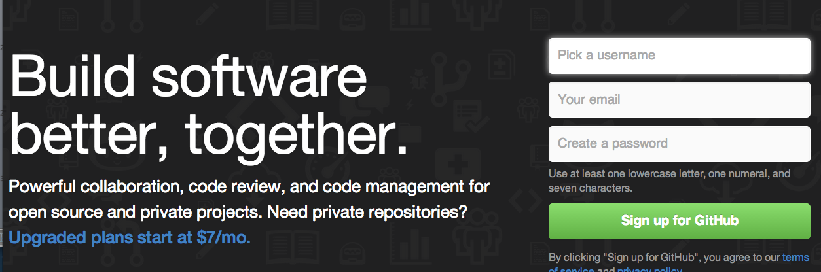
Signup with Github
https://github.com/
Notes:
We’ll be using GitHub as a remote repository for our project. Go to this URL to sign up for an account.

Slide 28
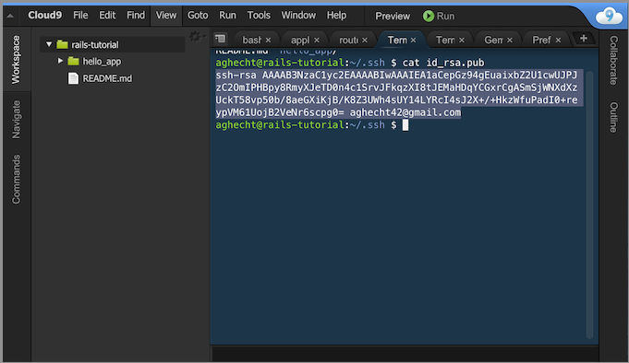
Setup SSH Keys
Notes:
Generate a local SSH key for use with Github.
You can use the default file provided, or give your own path to a key file.

Slide 29
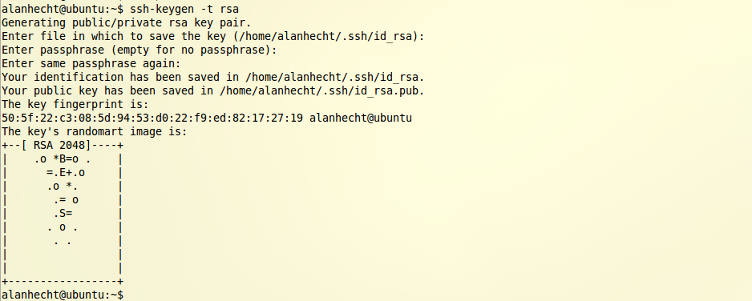
Setup SSH Keys
ssh-keygen –t rsa (if starting from scratch)
Notes:
Generate a local SSH key for use with Github.
You can use the default file provided, or give your own path to a key file.

Slide 30
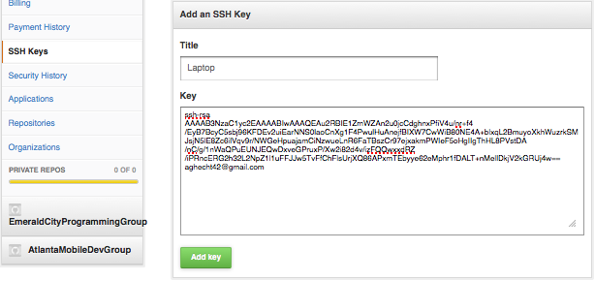
Add SSH Key to GitHub
https://github.com/settings/profile
Add contents of $HOME/.ssh/id_rsa.pub
Notes:
Copy and paste the contents of ~/.ssh/your-key.pub into the Key box

Slide 31
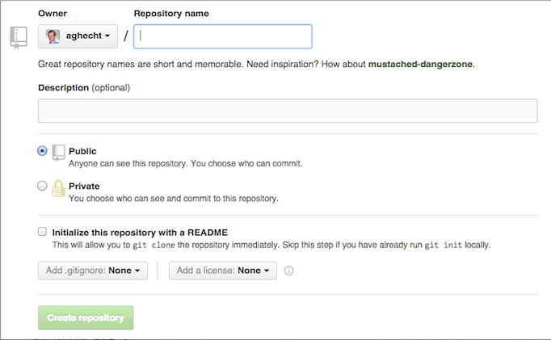
Lab - Create my_project repo
(on Github.com)

Slide 32
Lab - Add remote repository to project
cd my_project
git remote add origin
git@github.com:<user-name>/my_project.git
git push origin master
  “origin” is a configurable name
  “origin” is a convention for GitHub
  Does not push up tags
git push origin –tags
  Can combine commands: git push origin master –tags
View changes at http://github.com/<user-name>/my_project

Slide 33
Lab - Commit changes and push to remote repository
cd my_project
echo “bye” >> README
git add README
git commit -m ‘Added bye to README’
git push origin master
View changes at http://github.com/<user-name>/my_project

Slide 34
For More Information
“Pro Git” by Scott Chacon
Can read online at http://progit.org/book
  Git cheat sheet: http://www.git-tower.com/files/cheatsheet/Git_Cheat_Sheet_grey.pdf
Recommend reading at least the first three chapters

