Slide 1
Log - in
E-mail:
Password:
Login

Slide 2
Enter Pivotal Account
E-mail:
Password:
Only Done if no api
key found on user

Slide 3
Select a project
Project 1
Project 2
Project 3

Slide 4
Select room
Create Room
Join Room

Slide 5
Select room
Create Room
Join Room

Slide 6
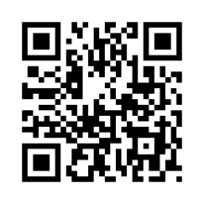
Room # 123455

Slide 7
Room #123455
In Room:
Unestimated Story Title
Unestimated Story Title
Unestimated Story Title
Unestimated Story Title

Slide 8
Story #
Join Room
In Room: 123455
Unestimated Story Title
Unestimated Story Title
Unestimated Story Title
Unestimated Story Title
Vote Now

Slide 9
Story View
Vote Now

Slide 10
Vote results
Waiting For Result
Allan 13
Michael 8
John 8
Points for Story = 8
Next Story

Slide 11
Vote results
Allan 13
Michael 8
Sorting of points
To quickly see highest
And lowest
John 8
Points for Story = 8
After Hitting next story
Points should be written
Next Story

