Slide 1
Feeding, Watering, and Caring for GIS Servers
Mark Welsh
August 7, 2019

Slide 2
Overview
Intro
Launch a server
Server configuration
Managing server software
Install and configure

Slide 3
Intro
Why?
  Quickly share content
  Reliable
  Industry standard – widely deployed
  You love the command line!

Slide 4
Intro
Caveats:
  Security considerations
  Configuration
  Updates
  You hate the command line!

Slide 5
Intro
Good news:
  Ubuntu widely supported
  Cloud providers make it easier
  Great learning opportunity
  You want to be a command line guru!

Slide 6
Launch a Server
Cloud service provider
Microsoft Azure, Amazon Web Service, Digital Ocean...
They all provide FOSS server instances
Pay by hour, capped bandwidth
Great laboratory

Slide 7
Launch a Server
Create a private/public key pair (for secure login)
Open command prompt (console)
cd ~/.ssh
If no directory exists: mkdir ~/.ssh
~/.ssh is where the private/public keys will be stored
cd ~/.ssh

Slide 8
Launch a Server
Create key pair
cd ~/.ssh
ssh-keygen -t rsa -b 4096
It will prompt you to define key name (enter or type in key name)
Prompt for password (enter means no password)
Creates public-private keys
ls -l

Slide 9
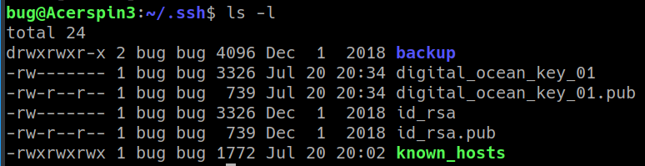
Launch a Server
keys in ~/.ssh:

Slide 10
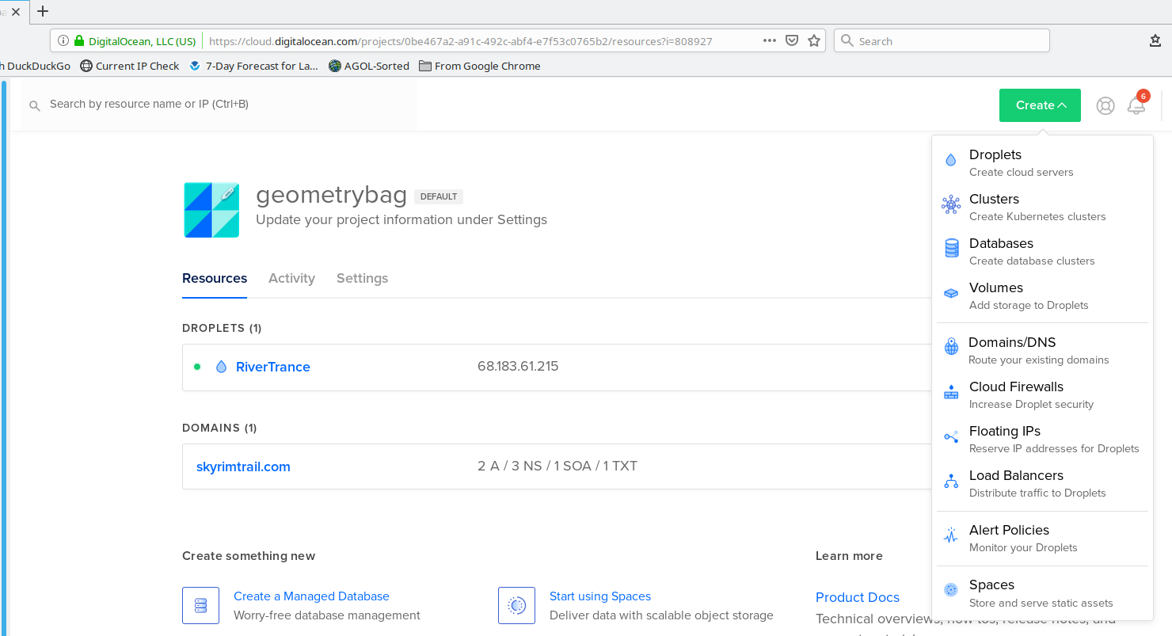
Launch a Server
Login to cloud server provider (Digital Ocean):

Slide 11
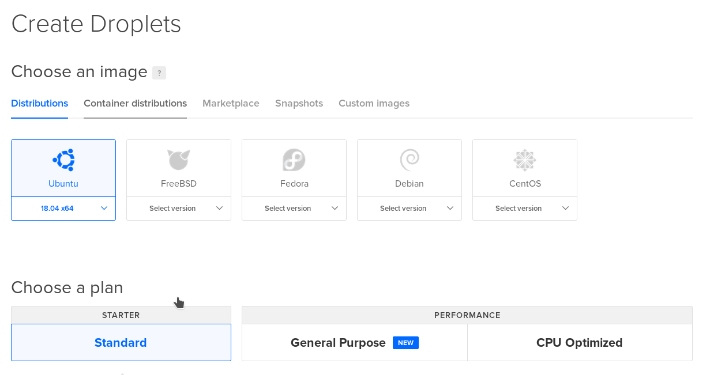
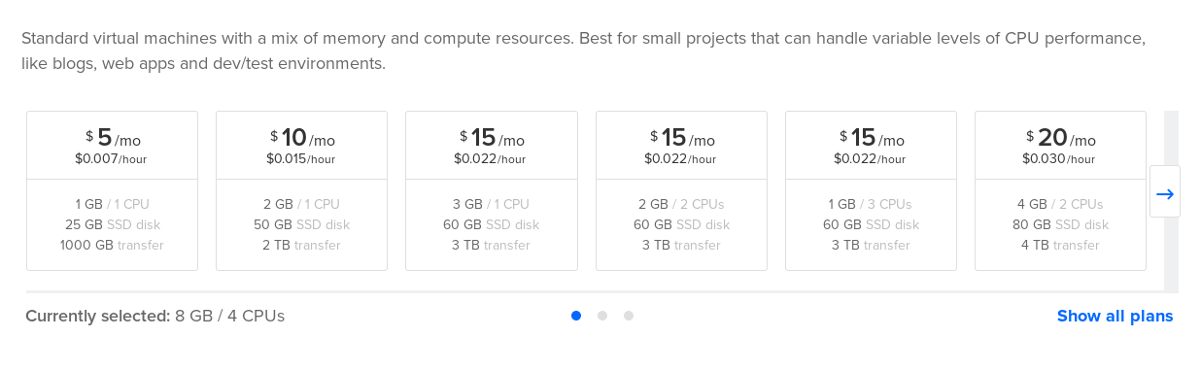
Launch a Server
Select configuration:

Slide 12
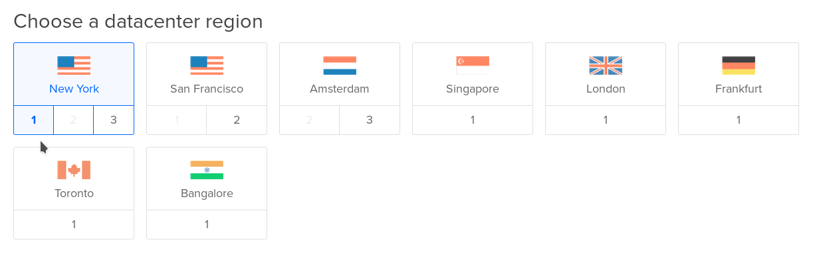
Launch a Server
Configuration:

Slide 13
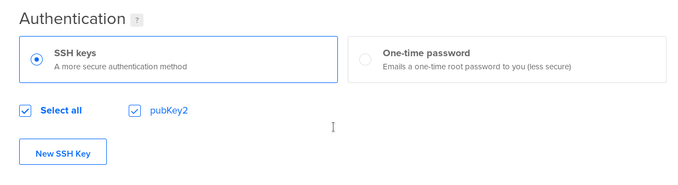
Launch a Server
Configuration:

Slide 14
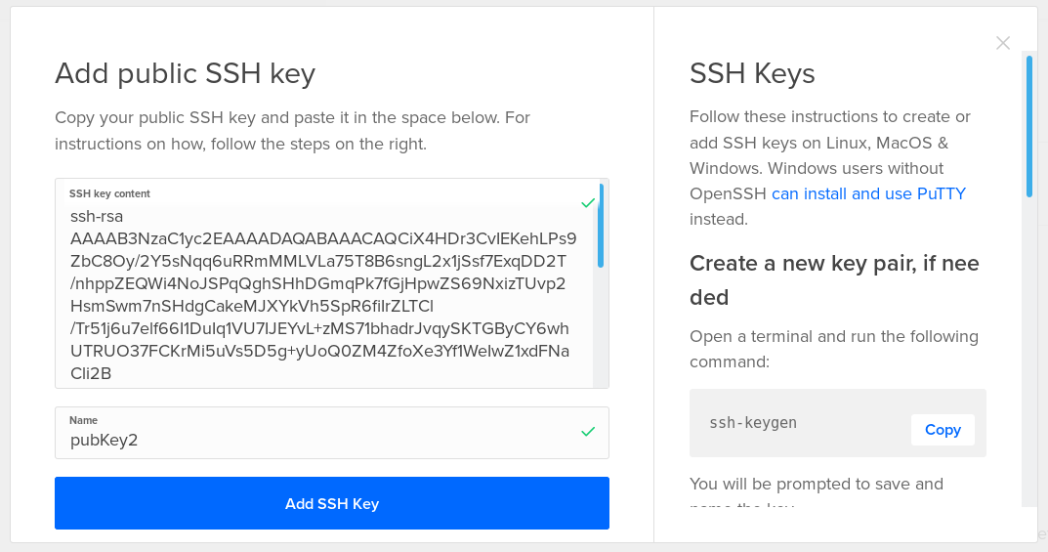
Launch a Server
Configuration (new key):
cat id_rsa.pub
select output from the command to paste the public key contents:
Paste public key contents here

Slide 15
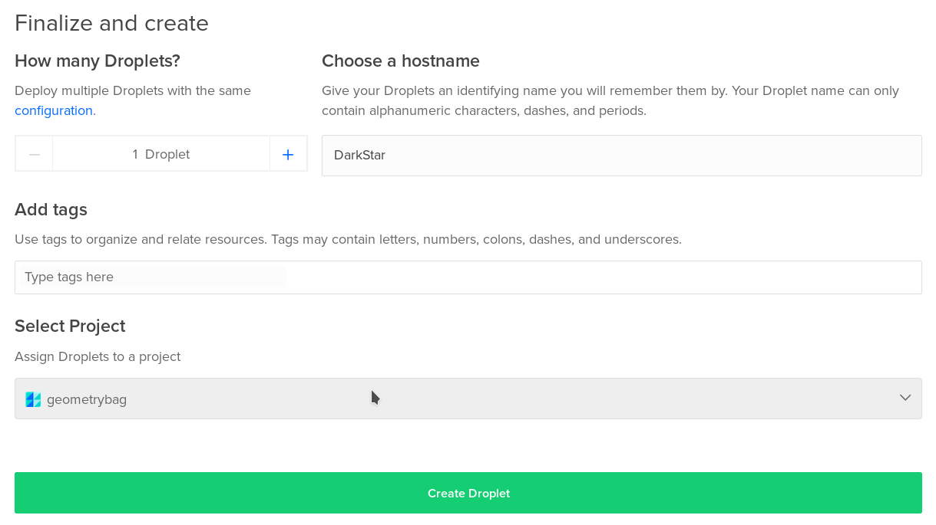
Launch a Server
Configuration (final settings):

Slide 16
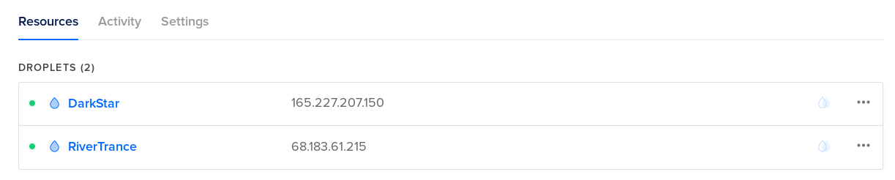
Launch a Server
Server is launched:
Write down that IP address!

Slide 17
Launch a Server
Connect to server (command prompt)
ssh root@XXX.XXX.XXX.XXX (your server IP)
ssh root@165.227.207.150
ignore warning about identity
Type password for key file (if applicable)

Slide 18
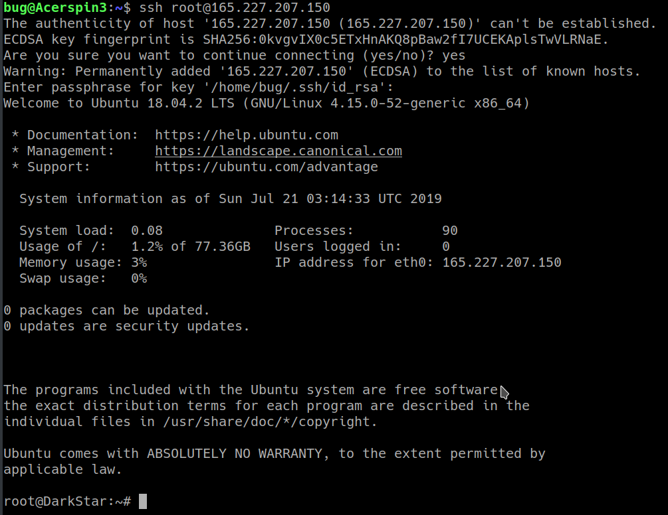

Launch a Server
You’re in!

Slide 19
Launch a Server
but you’re logged in as root!
In server, create a new user:
adduser althea (replace althea)
Enter user password (write down!)
Enter other info as prompted

Slide 20
Launch a Server
Add the account to sudo group
usermod -aG sudo althea (replace with your account name)
rsync --archive --chown=althea:althea ~/.ssh /home/althea
logout
ssh using this new account (don’t log in with root!)
ssh althea@165.227.207.150

Slide 21
Launch a Server
Turn on firewall (ufw)
check if ufw installed (sudo ufw status)
Allow ssh connections:
sudo ufw allow ssh
enable firewall:
sudo ufw enable

Slide 22
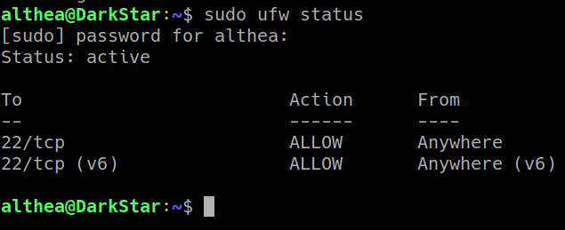
Launch a Server
Firewall on, ssh connections allowed:

Slide 23
Maintaining Server Software
Ubuntu set to install security updates automatically
But installing/updating other software up to you
You get an indication when you log in:

Slide 24
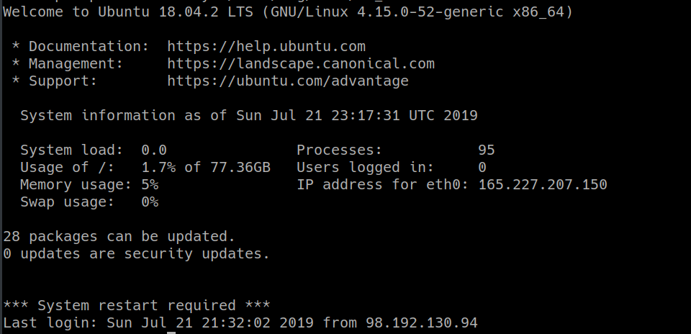
Maintaining Server Software

Slide 25
Maintaining Server Software
apt – Advanced Package Tool
Update, then upgrade
Keeps software up to date
Security

Slide 26
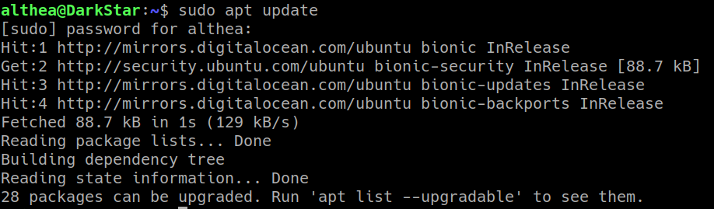
Maintaining Server Software
First, update the package index:
sudo apt update

Slide 27
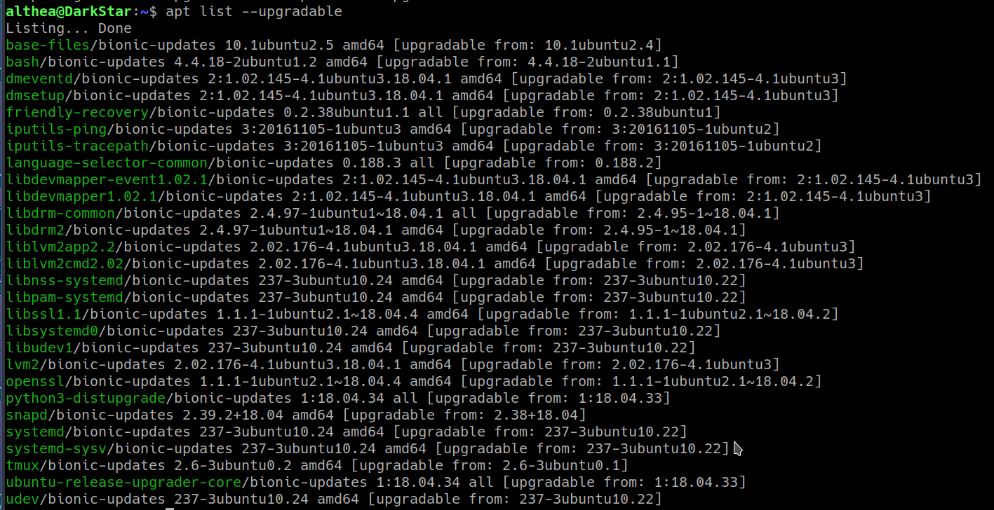
Maintaining Server Software
List packages that will be upgraded:
apt list --upgradable

Slide 28
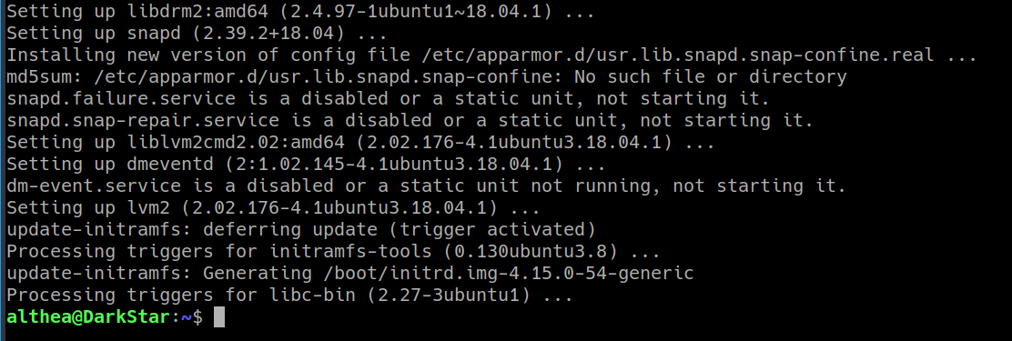
Maintaining Server Software
Upgrade software:
sudo apt upgrade

Slide 29
Installing Server Applications
Apache Web Server
Use apt to install applications

Slide 30
Installing Server Applications
Use apt to install applications
sudo apt update
sudo apt install apache2
sudo ufw allow 'Apache'
sudo ufw status
You can now reach the web server:

Slide 31
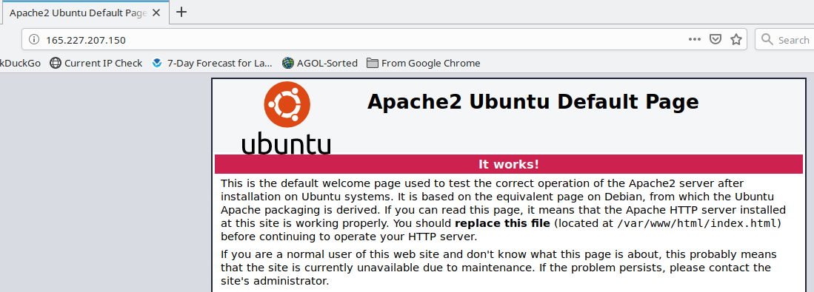
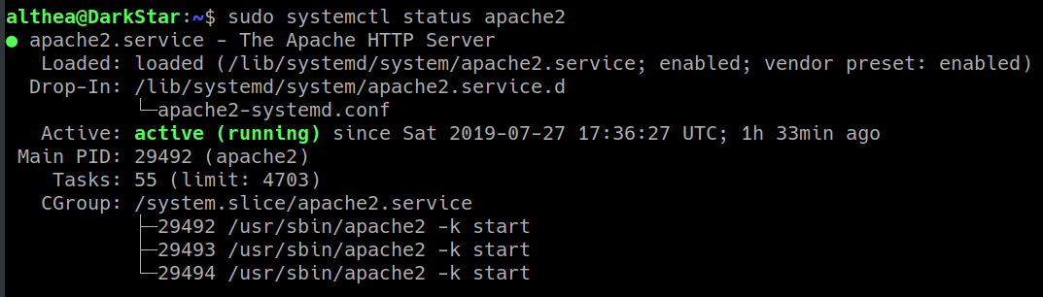
Installing Server Applications
sudo systemctl status apache2

Slide 32
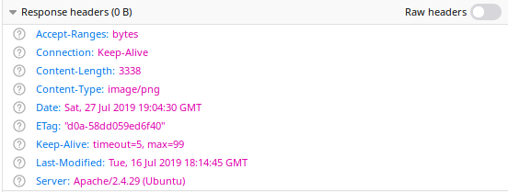
Installing Server Applications
Configure Apache to not show server info:

Slide 33
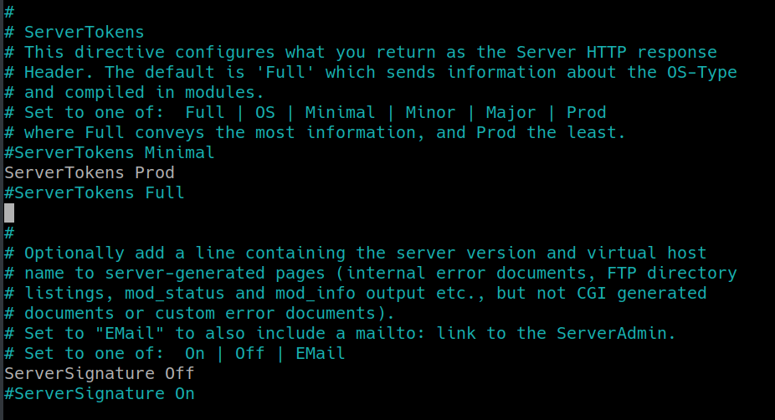
Installing Server Applications
sudo nano /etc/apache2/conf-enabled/security.conf

Slide 34
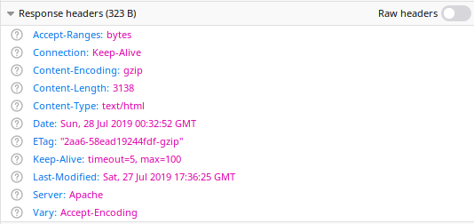
Installing Server Applications
Ctrl-X ends nano text edit, you’ll be prompted to save changes…
Restart Apache to implement changes
sudo systemctl reload apache2

Slide 35
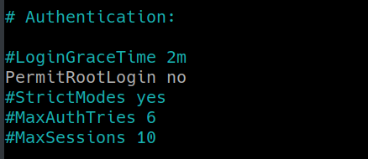
One Last Configuration
Don’t allow root login
sudo nano /etc/ssh/sshd_config
Change PermitRootLogin to no:
sudo systemctl restart ssh

Slide 36
What’s Next?
Additional security configuration
  https://askubuntu.com/questions/151440/important-things-to-do-after-installing-ubuntu-server
  https://hostadvice.com/how-to/how-to-harden-your-ubuntu-18-04-server/
  https://www.nuharborsecurity.com/ubuntu-server-hardening-guide-2/
Domain Name
Certificate
Spatial software (postgresql, mapserver etc)
Logwatch (and other log utilities like GoAccess)

Slide 37
Summary
Server makes your content shareable
Linux community is very helpful
Linux and FOSS is an internet force
How to set up a basic platform to build on
Questions

