Slide 1
Analogue Digital Converter
(ADC)
STEVEN FOONG GHIN YEW

Slide 2

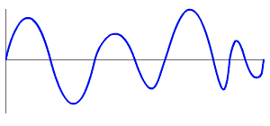
What is ADC ???
ANALOGUE signal input converted into DIGITAL data.

Slide 3
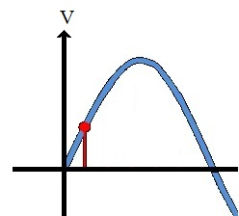
How ADC works???
Different level of voltage measured and stored into register.
RED : Conversion
BLUE : Input Analogue Signal

Slide 4
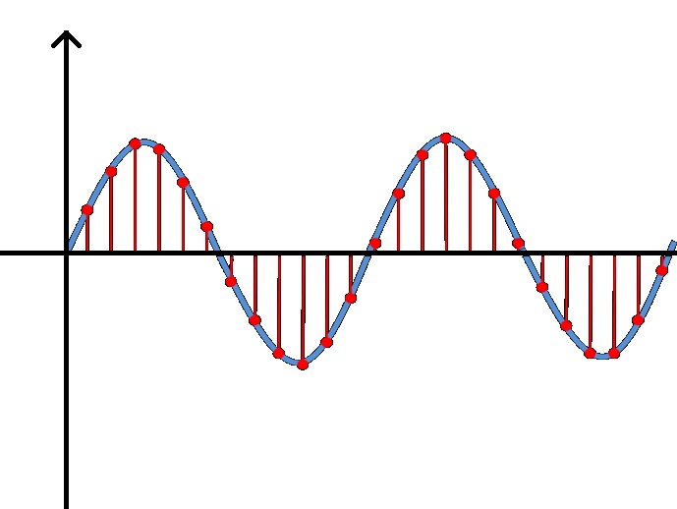
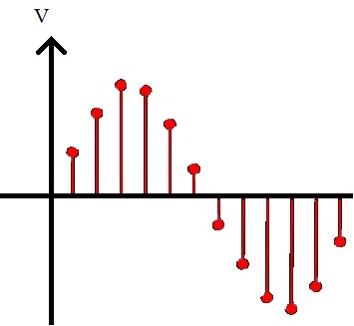
How ADC works???
When the conversion is done frequently, a long analogue signal will be able to be converted and store into registers.

Slide 5
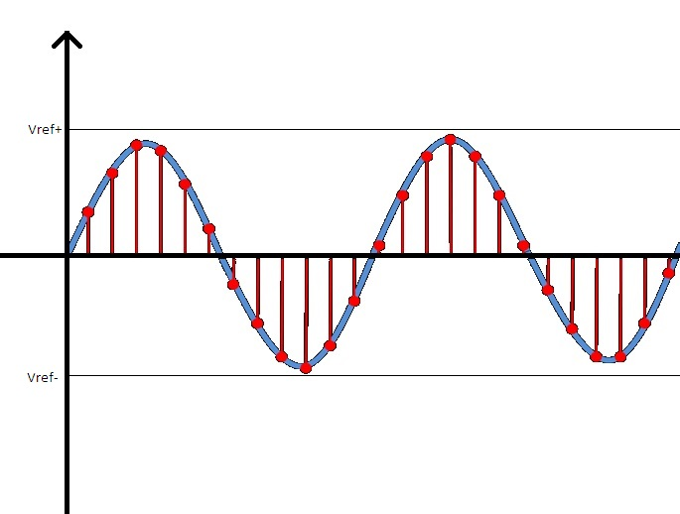
What is required to perform ADC???
Generally, ADC required the following information
Threshold voltage control
Sample time
Resolution of conversion
Interrupt are used to represent the conversion

Slide 6
ADC in STM32F42x (GENERAL)
3 ADC in STM32F42x
There are total of 19 available input channel shared to all three ADC
All 3 ADC have same feature and same number of
Control Register (CR)
Status Register (SR)
Data Register (DR)
NOTE: One ADC is enough to sample all 19 channels

Slide 7
ADC in STM32F42x (Threshold Voltage)
In STM32, threshold voltage is referred as Vref
If the input analogue signal exceeded the threshold voltage range, the process will be halt.
Therefore, the input signals must between Vref- and Vref+,
Vref+ as the highest allowable input voltage
Vref- as the lowest allowable input voltage
The two Vref value will be stored in HTR and LTR register
NOTE: The supplied Vss must be equal to Vref-
NOTE: Vref+ must be higher than 1.8V and lower than Vdd

Slide 8
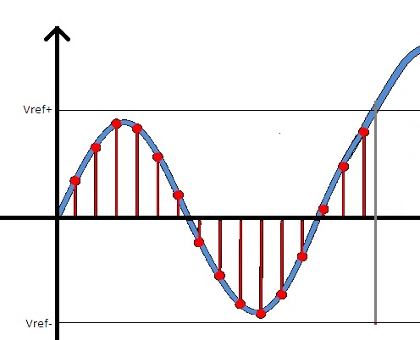
ADC in STM32F42x (Threshold Voltage)
To enable the Watchdog to generate interrupt, CR1.AWDIE must be set
If the input signal exceed the threshold voltage range, an interrupt SR.AWD will be generated. We can then halt the conversion.

Slide 9
ADC in STM32F42x (Resolution)
The resolution can be calculate with (Vref+ - Vref-)/(2^number of bits)
Number of bits allowed: 12, 10, 8, 6
4096
1024
256
64
Eg.
ADC configured with 8 bit resolution and Vref+ = 3.3V, Vref- = -3.3V
The voltage resolution = (3.3V – (-3.3V))/(2^8) = 0.0257812V
This mean there will be a 0.0257812V different at every level

Slide 10
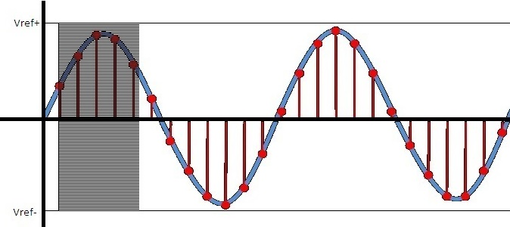
ADC in STM32F42x (Resolution)

Slide 11
ADC in STM32F42x (Resolution)
CR1.RES [1:0] will be used to set the resolution of the ADC

Slide 12
ADC in STM32F42x (SLEEP & AWAKE)
There are two mode for the ADC chip, Sleep Mode and Awake Mode
During Sleep Mode, the chip only consume few micro-A which approximately zero. However, no conversion can be perform during the Sleep Mode
The chip can only perform conversion/conversions during Awake Mode
To wake up the ADC chip from Sleep mode, CR2.ADON bit must be set

Slide 13
ADC in STM32F42x(FAST & SLOW Conv)
There are two conversion mode allowed which is Fast Conversion Mode and Slow Conversion Mode.
To use Fast Conversion Mode, analogue supplied voltage Vdd in the range of 2.4V and 3.6V
To use Slow Conversion Mode, analogue supplied voltage Vdd must in the range of 1.8V and 3.6V

Slide 14
ADC in STM32F42x (CHANNEL)
STM32F42x consist of 19 ADC pin
16 External Input pin
3 Internal Input pin
There are 16 GPIO pins that can be use as ADC input channel which is ADC_IN0, ADC_IN1, … , ADC_IN14 and ADC_IN15.
These channels can be grouped into Regular Group or Injected Group
Regular Group allow 16 conversion
Injected Group allow 4 conversion

Slide 15
ADC in STM32F42x (CHANNEL)
SQR1.L[3:0] is use to select the number of conversion in the sequence. The sequence can be arranged in SQR3, SQR2 and SQR1.
The sequence can have repeated channel
Eg. With L = 0010 (3 conversion), the sequence can be
1st: Convert channel ADC_IN0
2nd: Convert channel ADC_IN1
3rd: Convert channel ADC_IN0 again
Same case to Injected group but JSQR.JL[1:0] can only have maximum 4 conversion. Therefore only one JSQR register is needed.

Slide 16
ADC in STM32F42x (CHANNEL)
No. | Regular Channel sequence | Injected Channel sequence
1 | IN0 | IN16
2 | IN3 | IN15
3 | IN2 | IN14
4 | IN0 | IN13
5 | IN6
6 | IN4
7 | IN0
8 | IN9
9 | IN3
10 | IN0
11 | IN2
12 | IN6
13 | IN0
14 | IN4
15 | IN9
16 | IN0
When CR2.JAUTO is not set
Injected group will have higher priority.
Example
During conversion of a regular group channel, JWSTART is set. The current regular conversion will halt and start the injected channel conversion first.

Slide 17
ADC in STM32F42x (CHANNEL)
The 3 Internal inputs are
Temperature sensor
Is connected to ADC_IN18 in STM32F42x
It can measure the temperature ranging from -40 to 125 ± 1.5 degree celcius
However, I recommend to use 6 bit resolution while using the temperature sensor
This is because (125-(-40))/1.5 = 110 which mean that a resolution with more than 110 level will give an inaccurate result. 8 bit would have a resolution up to 256 already
Vrefint (ACD_IN17)
Vbat

Slide 18
ADC in STM32F42x (CHANNEL)
To ENABLE the internal input channel
Temperature sensor and Vrefint:
CCR.TSVREFE have to be set HIGH
Vbat:
CCR.VBATE have to be set HIGH

Slide 19
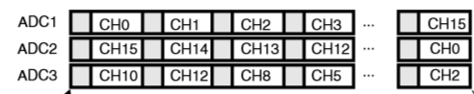
ADC in STM32F42x (CHANNEL)

Slide 20
ADC in STM32F42x (Conversion)
To start conversion of regular group, the CR1.SWSTART have to be set whereas CR1.JSWSTART set to start injected group.
After the conversion, an interrupt SR.EOC will be generated to acknowledge the end of conversion.
Therefore, this interrupt must be enable by setting CR1.EOCIE to 1.
Same case to injected group with SR.JEOC and CR1.JEOCIE as its interrupt flag and interrupt enable.

Slide 21
ADC in STM32F42x (Conversion)
Other than using SWSTART and JSWSTART to start.
ADC can also start a conversion from 16 external triggers
First, set the edge of trigger through the CR2.EXTEN[1:0]
00 No external trigger
01 Rising Edge trigger
10 Falling Edge trigger
11 Both Edge trigger
Second, set the source of trigger through CR2. EXTSEL[3:0]
There are 16 available sources of trigger including TMR1, TMR2 …

Slide 22
ADC in STM32F42x (SAMPLING)
The sampling time can be set to every channel individually with the SMP1 and SMP2 registers
However, the time set is not the actual sampling time because the conversion time have to be include.
12 clock cycle have to be added to obtain the actual time scale.
Eg. A 30MHz clock with sampling time set to 3 cycle (case 000)
The conversion time will be (3 + 12) cycles = 15cycles
The time needed would be 0.5 micro-s between each sample

Slide 23
ADC in STM32F42x (SAMPLING)
It is possible to reduce the actual sampling time with the FAST CONVERSION MODE and the resolution setting.
In FAST CONVERSION MODE and resolution to 12bits. The actual sampling time only have to add extra clock cycle as follow:
12 bits: Sampling time + 12 clock cycle (no change)
10 bits: Sampling time + 10 clock cycle (reduced 2 cycle)
8 bits: Sampling time + 8 clock cycle (reduced 4 cycle)
6 bits: Sampling time + 6 clock cycle (reduced 6 cycle)

Slide 24
ADC in STM32F42x (DATA STORAGE)
After the conversion, regular group will store the data in:
Register DR
Whereas, injected group will store the data in:
Register JDR1
Register JDR2
Register JDR3
Register JDR4

Slide 25
ADC in STM32F42x (DATA STORAGE)
From previous slide, it is clear that the regular group only have 1 data register DR.
Must keep track when there are more than 1 regular channel
Therefore, NOT CONVENIENT
By using DMA, the system allow the converted data to be stored directly to the memory allocated in the software.
DMA can be enabled by setting CR2.DMA to HIGH.
NOTE: This DMA setting only allow for single ADC mode

Slide 26
ADC in STM32F42x (DATA STORAGE)
If DMA is used for multiple ADC, CCR.DMA[1:0] have to be configure.
00: Multi ADC disabled
01: ADC1 → ADC2 → ADC3
10: ADC1 & 2 → ADC3 & 1 → ADC2 & 3 (more than 6 bit)
11: ADC1 & 2 → ADC3 & 1 → ADC2 & 3 (6bit)

Slide 27

ADC in STM32F42x (DATA STORAGE)
If DMA is used for multiple ADC, CCR.DMA[1:0] have to be configure.
00: Multi ADC disabled
01: ADC1 → ADC2 → ADC3
10: ADC1 & 2 → ADC3 & 1 → ADC2 & 3 (more than 6 bit)
11: ADC1 & 2 → ADC3 & 1 → ADC2 & 3 (6bit)

Slide 28
ADC in STM32F42x (MODE)
Single conversion mode, only 1 conversion is done
Temperature sensor only need 1 conversion
CR2.CONT must be cleared
Continuous conversion mode
The ADC will convert that channel again after it finished
Meaning that it will keep on convert the channel
CR2.CONT have to be enabled

Slide 29
ADC in STM32F42x (MODE)
SCAN mode
The ADC convert all the channels listed in the sequence and restart the converting all the channels if CONT bit is set.
CR1.SCAN have to be set in order to be in this mode
if CR2.EOCS == 0
EOC is generated after the whole sequence is finished
Else
EOC is generated after finishing each channel conversion

Slide 30
ADC in STM32F42x (MODE)
No | Channel
1 | IN0
2 | IN1
3 | IN2
4 | IN3
Discontinuous mode
CR1.DISCEN[0:0]
This bit is use to ENABLE the discontinuous mode with set and DISABLE with unset.
CR2.DISCNUM[2:0]
This 3 bits use to separate the sequence listed in SQR
Example.
The setting is DISCNUM = 011 (4 channel) and DISCEN = 1
The sequence then wait for the second trigger / setting of SWSTART 2nd time
NOTE: SWSTART and JSWSTART will auto reset once conversion started
No | Channel
5 | IN4
6 | IN5
7 | IN2
 | -

Slide 31
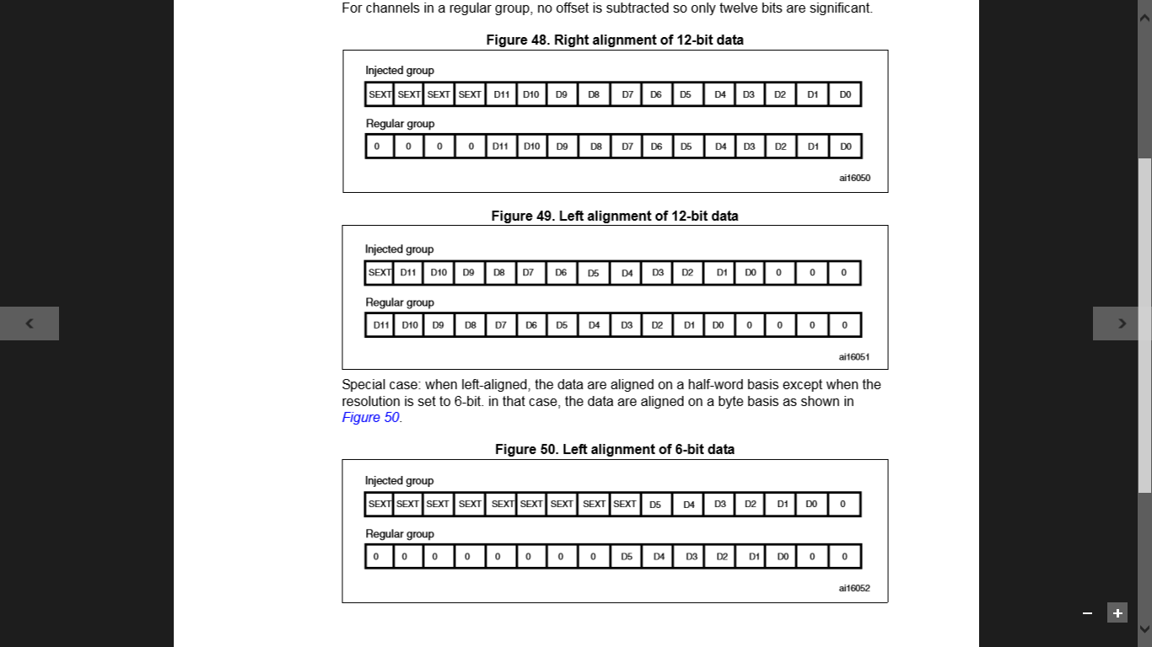
ADC in STM32F42x (ALLIGNMENT)
Generally, there are two alignment
Right Align
Left Align

Slide 32
ADC in STM32F42x (ADC Clock)
After all this, you may found your pin unable to perform ADC as there is no CLOCK.
RCC still have to be configured to allow the ADC feature.
To pre-scale clock (division of clock), CCR.ADCPRE[1:0] have to be configured.
APB2 is the CLOCK for ADC. Therefore, we still have to configure the RCC.APB2ENR to ENABLE APB2
But this is not under ADC because it is under RCC. MUAHAHAHAHAHAHA

Slide 33
THANK YOU

