Slide 1


Airline Safety
An Analytic Overview
Presented by: Rachel Nelson
Assignment: 6.3 Final Presentation

Slide 2
Airline Safety - Overview
Accident and Fatality rates show a decrease trend year over year
Passenger Revenue are showing an upward trend year over year and are forecasted to continue to show a positive increase

Slide 3
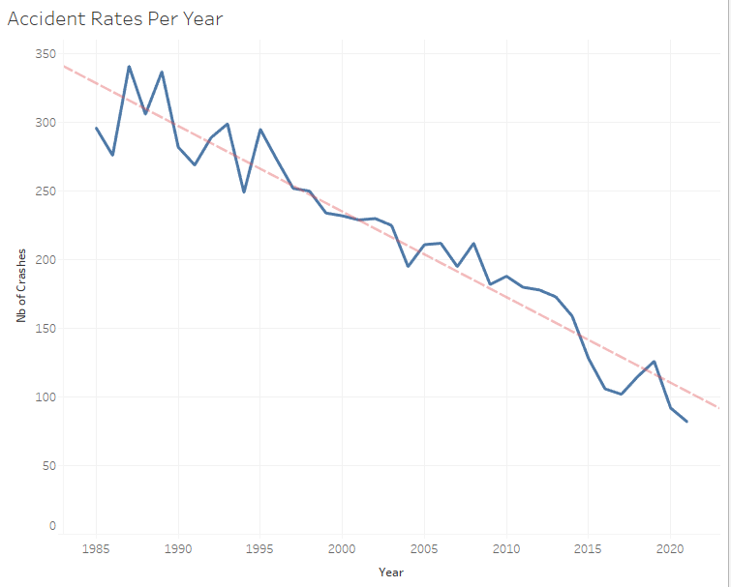
Accident Rates Per Year
Accident Rates have significantly decreased year over year since 1985.

Slide 4
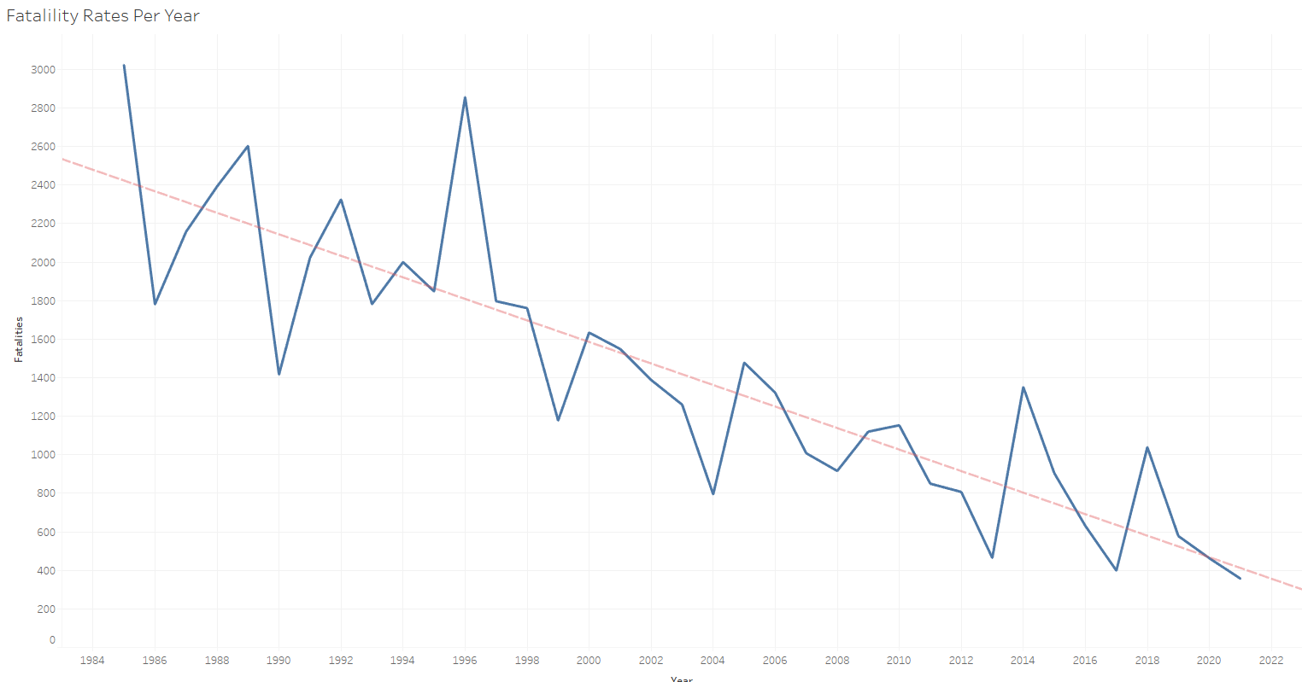
Fatality Rates Per Year
We also see a sharp decline in fatality rates year over year. These indicate that airline safety has increased despite small rises in 2014 and 2018.

Slide 5
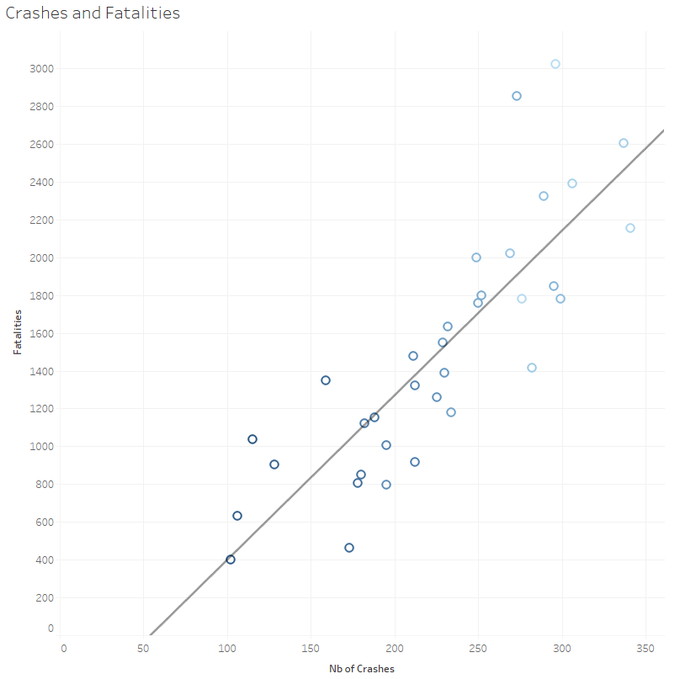
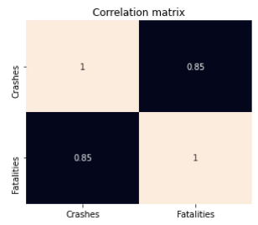
Crashes and Fatality Comparison 1985-2018
7,700 crashes resulting in 51,012 fatalities during the testing period (1985-2018). Crashes are strongly correlated with fatalities.

Slide 6
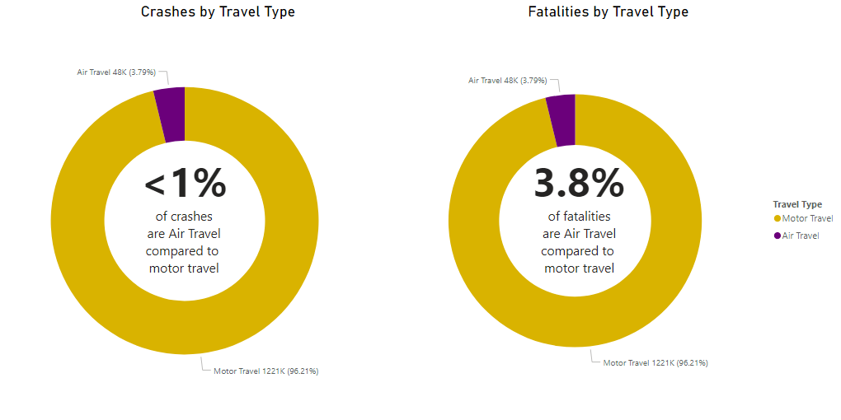
Air vs. Motor Crashes and Fatalities
Looking at pure numbers, air crashes occur far less frequent than motor vehicle crashes

Slide 7
Conclusion
Because airplane accidents are rare, media coverage of such occasions are high. Everyone’s eyes are on the television when these events happen, which may lead to a misperception that airplane travel is less safe. However, data shows that airplane fatalities are less common than motor fatalities

Slide 8
Appendix
Data Source:
airline-safety - Downloaded from: Aviation Safety Network
Supplemental Data Sources:
Motor Crashes - Downloaded from: https://www.iihs.org/topics/fatality-statistics
U.S. Air Carrier Safety Data - Downloaded from: https://www.bts.gov/content/us-air-carrier-safety-dat
Passenger Revenue -- Total System Operations - Downloaded from: MIT
Crashes Per Year/Fatalities Per Year - Downloaded from: Statistics, Bureau of Aircraft Accident Archives
GitHub Repository:
https://github.com/RachelONelson/airline-safety

