Slide 1

https://get.foundation/
Home
Installation
Content
Others
FOUNDATION 6
PLAN
1
INTRODUCTION
2
INSTALLATION
2
SYNTAXE
En savoir plus

Slide 2
https://get.foundation/
Introduction
Installation
Content
Others
Qu’est ce que foundation ?
C’est un framework/outils de développement web, open-source, pour le front-end.
Ces spécificités:
Il est flexible (personnalisable)
Responsive design (automatique)
Possède une bibliothèques d’icones
Propose un ensemble de plugins JavaScript
Focus sur l’expérience utilisateur
Les grilles CSS
Il respecte la norme WCAG
En savoir plus

Slide 3

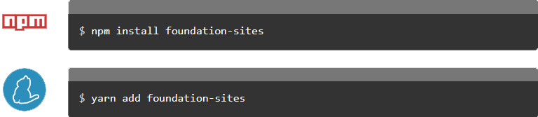
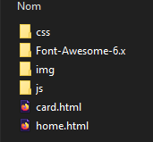
THYNK UNLIMITED
Introduction
Installation
Syntaxe
Others
COMMENT INSTALLER FOUNDATION ?
<link rel="stylesheet" href="https://cdn.jsdelivr.net/npm/foundation-sites@6.9.0/dist/css/foundation.min.css" crossorigin="anonymous">

Slide 4
Content
THYNK UNLIMITED
Syntaxe
https://get.foundation/
Home
Introduction
Others
About
Others
Installation
Les principales classes les plus utilisées dans Foundation
Les principales balises directement mise en forme par de Foundation avec leurs balises
CUTTING-EDGE SPORTS TECHNOLOGY
Grid XY/Row
ul -> menu
Float Grid
div -> grid-x
Flex Grid
div -> cell
Cell/Columns
div -> large/medium/small
Large/medium/small

Slide 5
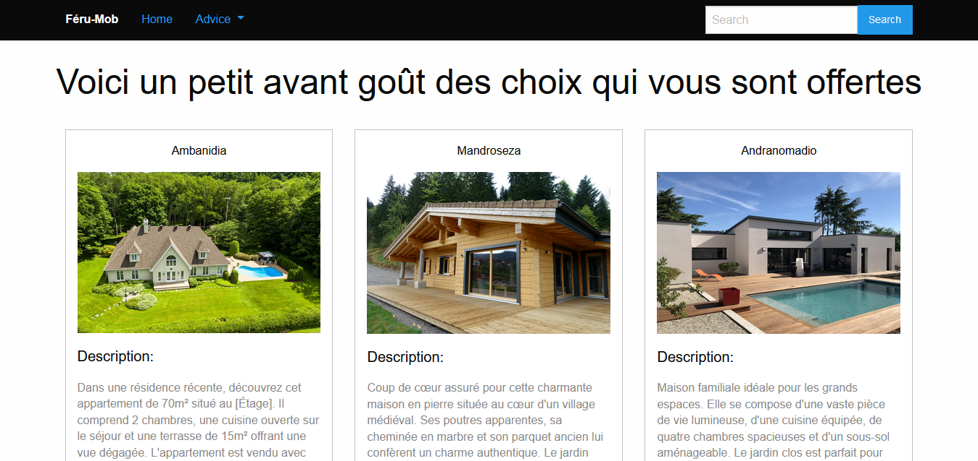
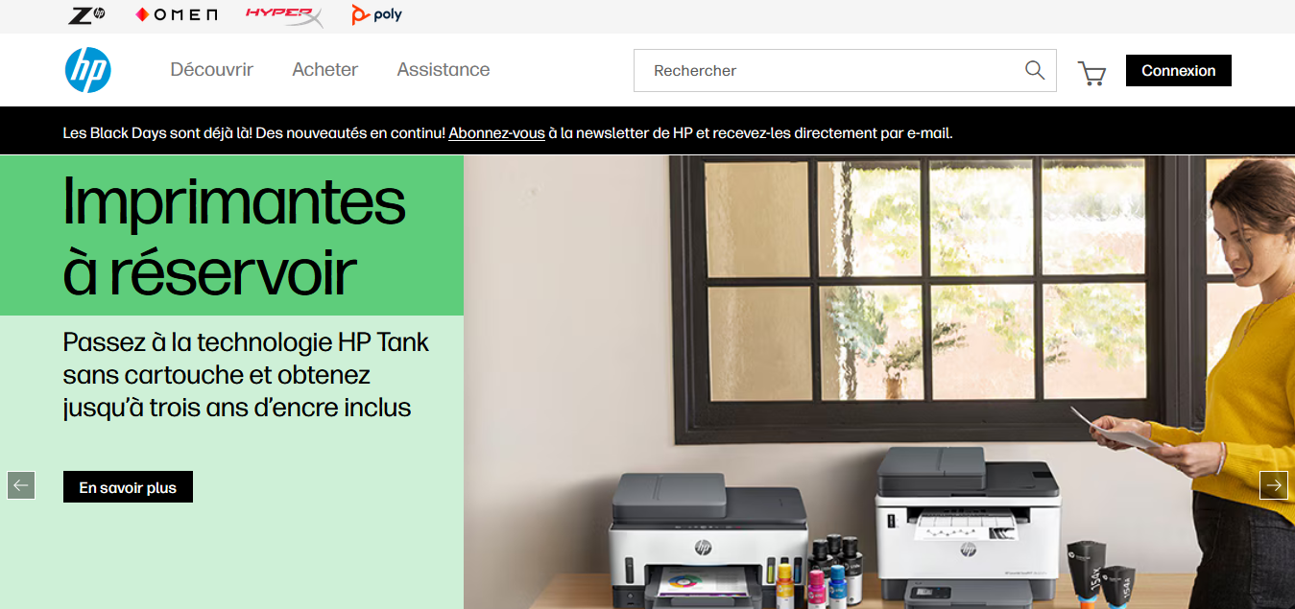
Content
THYNK UNLIMITED
Syntaxe
https://get.foundation/
Home
Introduction
Others
About
Exemple
Installation
CUTTING-EDGE SPORTS TECHNOLOGY
Our sports technology services focus on data analytics, wearable tech, and performance-tracking tools. By providing real-time insights and advanced analytics, Thynk Unlimited enables athletes and coaches to make data-driven decisions that enhance training, strategy, and results.

Slide 6
Content
THYNK UNLIMITED
Syntaxe
https://get.foundation/
Home
Introduction
Others
About
Exemple
Installation
CUTTING-EDGE SPORTS TECHNOLOGY
Merci de votre attention !
Our sports technology services focus on data analytics, wearable tech, and performance-tracking tools. By providing real-time insights and advanced analytics, Thynk Unlimited enables athletes and coaches to make data-driven decisions that enhance training, strategy, and results.
Des questions ?

