Slide 1
Epic Data Sources: Reporting Workbench
Intro to Query Tools for Research
Spring 2021

Slide 2
Epic at a glance
In place at MSH since 2011, MSQ since 2013
In clinics since 2008 (now hundreds)
Documentation from providers, nurses
Visit details, timestamped events
Orders, “flowsheets”
Pulls in data from ADT, Bed Mgmt, Labs, Rads, Muse, Echo, Cath, Path, financials & more

Slide 3
Self Service Tools
Built in Epic Tools
Slicer Dicer
Reporting Workbench
Need to Work with Data Team
Caboodle (not self-service)
Other Sources
Mount Sinai Data Warehouse (MSDW)

Slide 4

Data in Epic
Epic Hyperspace
Epic Clarity
Epic Caboodle
hierarchical database
real time
relational database
30000+ SQL tables
not real time
relational database
“Clarity’s greatest hits”
not real time
Chart Review
Epic Reporting Workbench
+ real time
+ less knowledge required
- slow (smaller searches)
Slicer/Dicer
+ in the EPIC interface
- cumbersome to use
Caboodle/Clarity Searches
+ fast
- requires some set-up
- requires SQL competency
Reporting Teams (MS:DW and Epic Reporting)
+ a lot of data and expertise
- $$$
- slower turnaround

Slide 5
Epic Reporting Workbench
Hierarchical
Slow. And don’t bother pre-filtering
(sometimes a lack of specificity is good)
Identify active/recent patients that match specific criteria
Can return data on 10,000+ fields

Slide 6
Epic Reporting Workbench
ALWAYS PHI
Links to chart
Very precise
Current Uses
Administrative/Operations Reports
Data-gathering before meetings
Abstracts (May require IRB)
Grant proposals (May require IRB)

Slide 7
Epic Reporting Workbench
Admin Use Examples:
Who currently meets sepsis criteria in ED?
Among patients discharged 24+ hours ago, which providers haven’t signed their notes?
What is the turnaround time for nurses on 10C to acknowledge new orders?
Which patients got procedural sedation last week (and was the documentation satisfactory?)

Slide 8
Epic Reporting Workbench
Research Use Examples:
Providers ignoring BEERS criteria upon elderly d/c
Is “10/10” pain more likely to be admitted?
What are patient characteristics in mis-triaged visits?

Slide 9
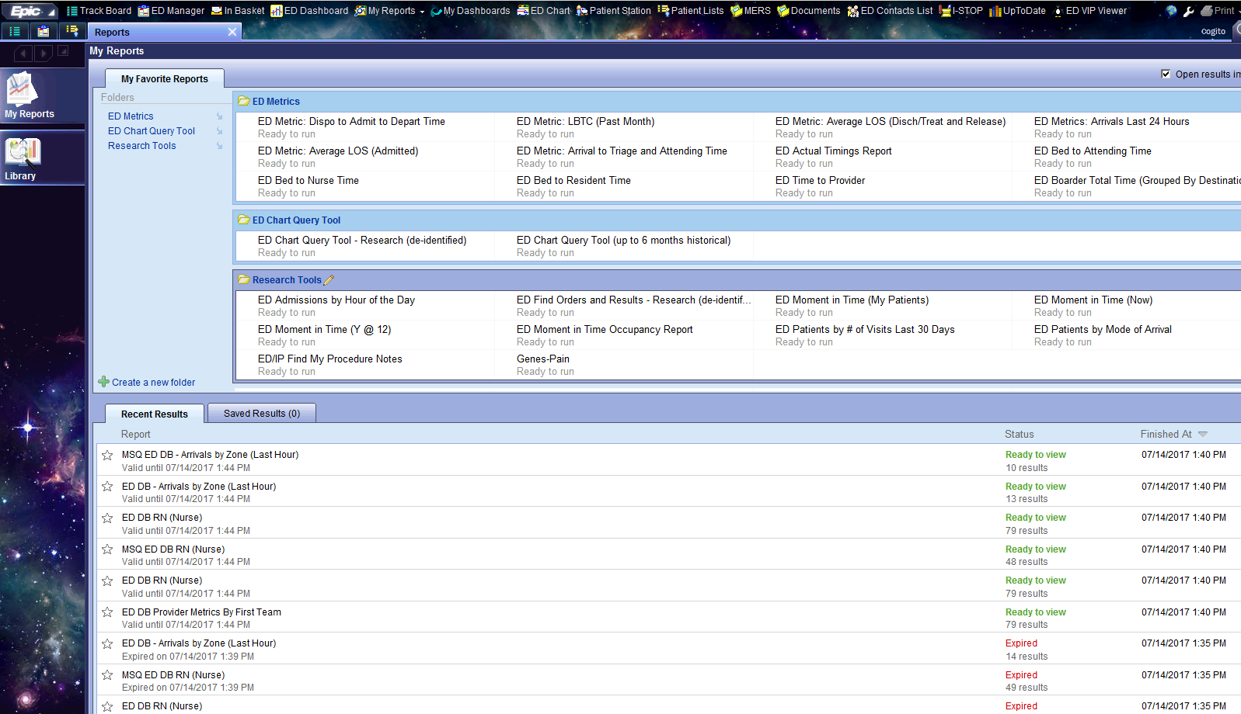
You can find RWB under the Epic main menu. Look for Reports.

Slide 10
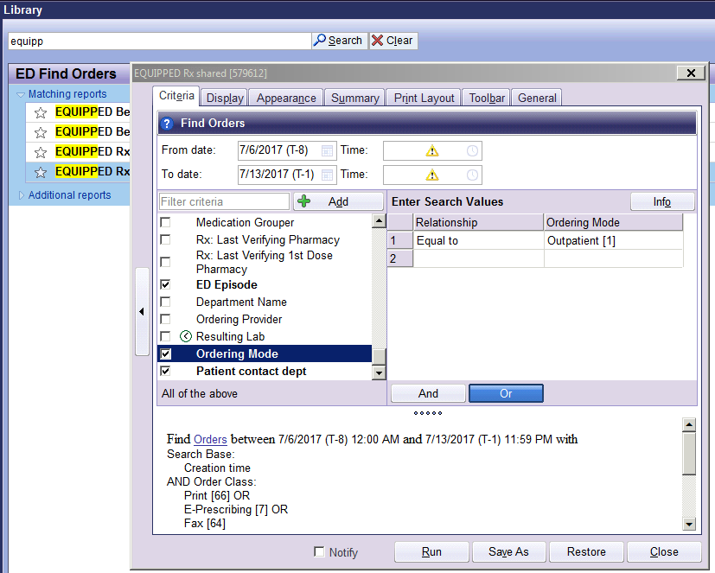
Report criteria can be modified as needed
You can search for existing reports in the Library

Slide 11
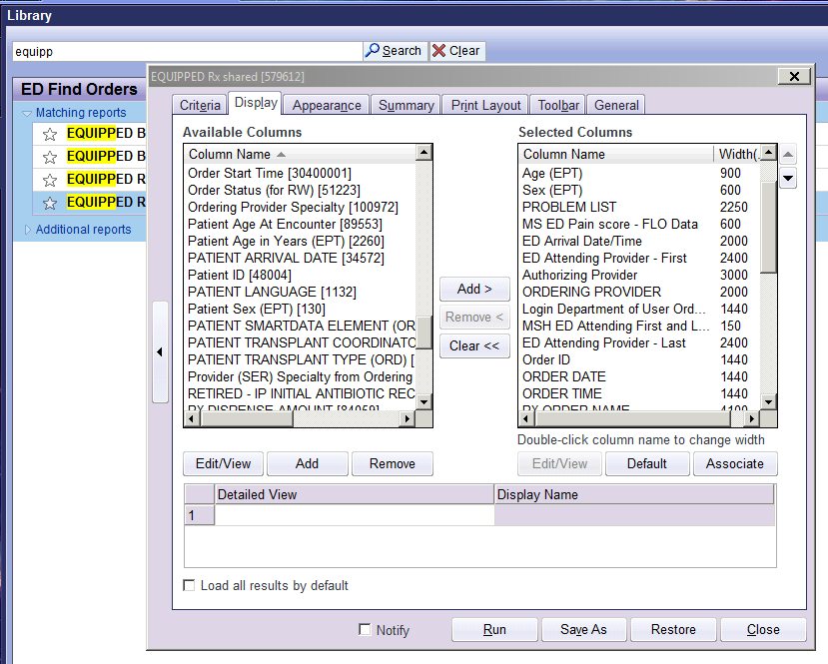
Select the information you want to see in your report

Slide 12
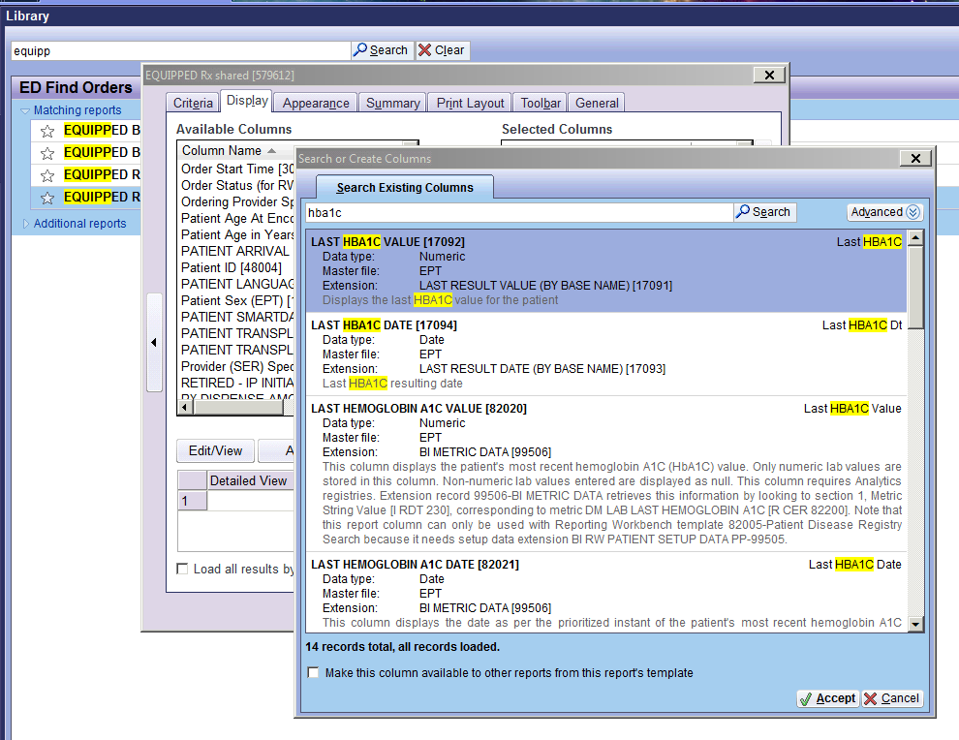
You can search for more information about the available variables

Slide 13
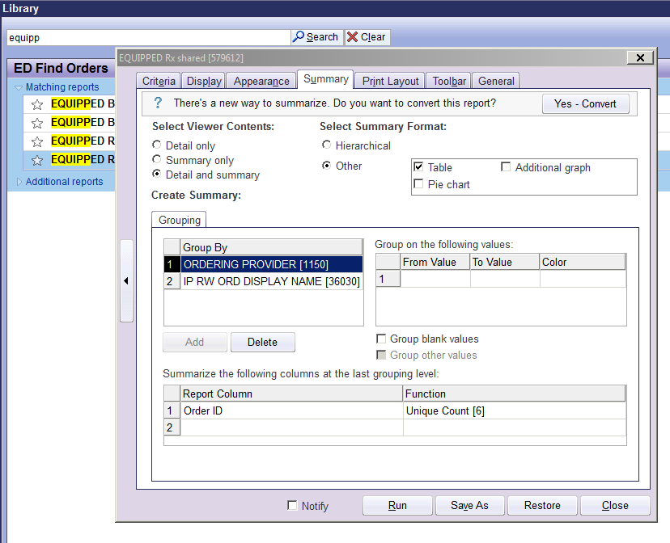
The summary tab allows for you to group your results and sum variables

Slide 14
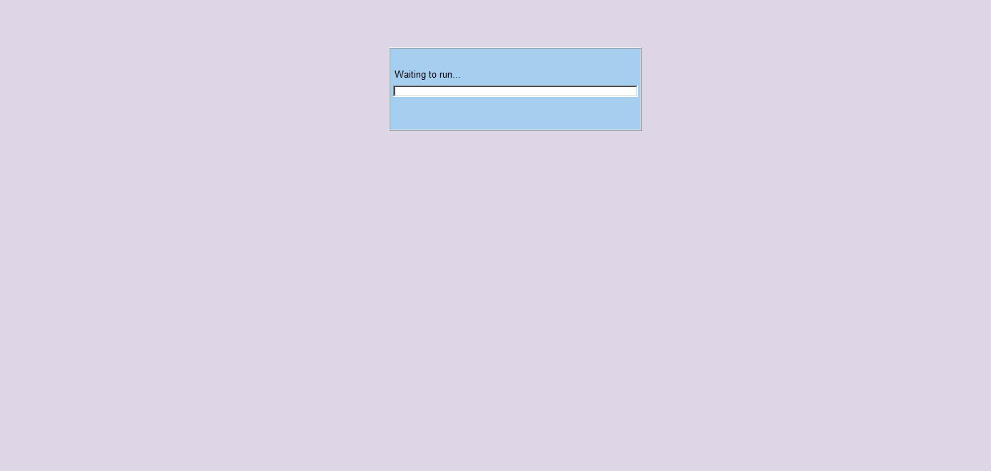
Be Patient! Some reports may take time to run

Slide 15
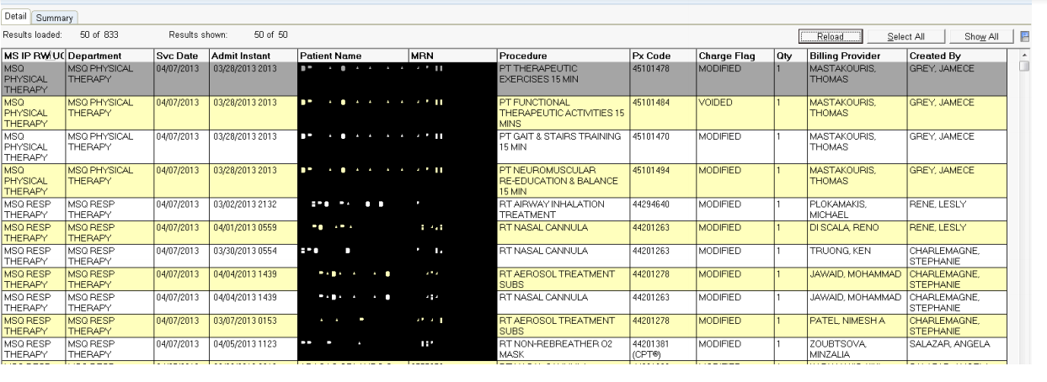
Make sure you load all of your encounters before any sorting. Large reports may be truncated initially.
This is the what your report will look like. Each encounter will be one row of data with each of the columns you selected .

Slide 16
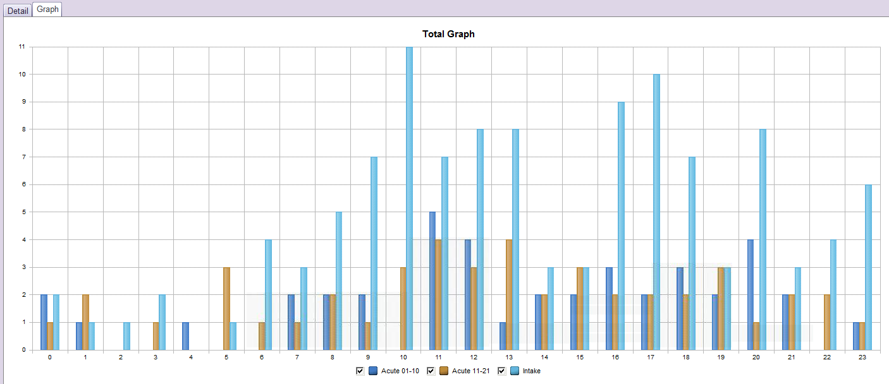
RWB Graphing Capabilities

Slide 17
Epic Reporting Workbench
Pros:
No external costs
Very precise
Can adapt existing reports for your own needs
Can return almost anything related to a visit
Easy to export to Excel or jump into chart
Some reports can be automated/e-mailed
Cons:
Struggles above “visit-level” (patient, department)
Limited within visits information (flowsheets, movements)
Slooooooooowwwww
Requires Epic access (read only is fine)
May require two queries (e.g. orders+notes) and join tables

Slide 18
Important to Remember
How are you using the data:
Research requires an IRB!!!
Speak with research faculty about requirements
IRB determines if study is exempt
Start with least amount of PHI necessary
You are responsible for your data
Keep data secure (computer, email, drives)
Reported data must be aggregated for research purposes

Slide 19
Next Steps
Read and complete the attestation
If you are unsure of how to proceed:
Submit a request to the EM Analytic Core
Review the tutorials
Discuss your project with a research faculty member
Check out the research trainings offered

