Slide 1
Epic Data Sources: SlicerDicer
Intro to Query Tools for Research
Spring 2021

Slide 2
Epic at a glance
In place at MSH since 2011, MSQ since 2013
In clinics since 2008 (now hundreds)
Documentation from providers, nurses
Visit details, timestamped events
Orders, “flowsheets”
Pulls in data from ADT, Bed Mgmt, Labs, Rads, Muse, Echo, Cath, Path, financials & more

Slide 3
Self Service Tools
Built in Epic Tools
Slicer Dicer
Reporting Workbench
Need to Work with Data Team
Caboodle (not self-service)
Other Sources
Mount Sinai Data Warehouse (MSDW)

Slide 4

Data in Epic
Epic Hyperspace
Epic Clarity
Epic Caboodle
hierarchical database
real time
relational database
30000+ SQL tables
not real time
relational database
“Clarity’s greatest hits”
not real time
Chart Review
Epic Reporting Workbench
+ real time
+ less knowledge required
- slow (smaller searches)
Slicer/Dicer
+ in the EPIC interface
- cumbersome to use
Caboodle/Clarity Searches
+ fast
- requires some set-up
- requires SQL competency
Reporting Teams (MS:DW and Epic Reporting)
+ a lot of data and expertise
- $$$
- slower turnaround

Slide 5
Epic SlicerDicer
Visualization tool for quickly estimating patients meeting criteria
Patient-level data
Diagnoses
Demographics
Medications
Tests
Limited information
Facilities
Encounters
Procedures
Uses SQL tables to pull data from Epic
Can be aggregated and exported using additional Epic tools

Slide 6
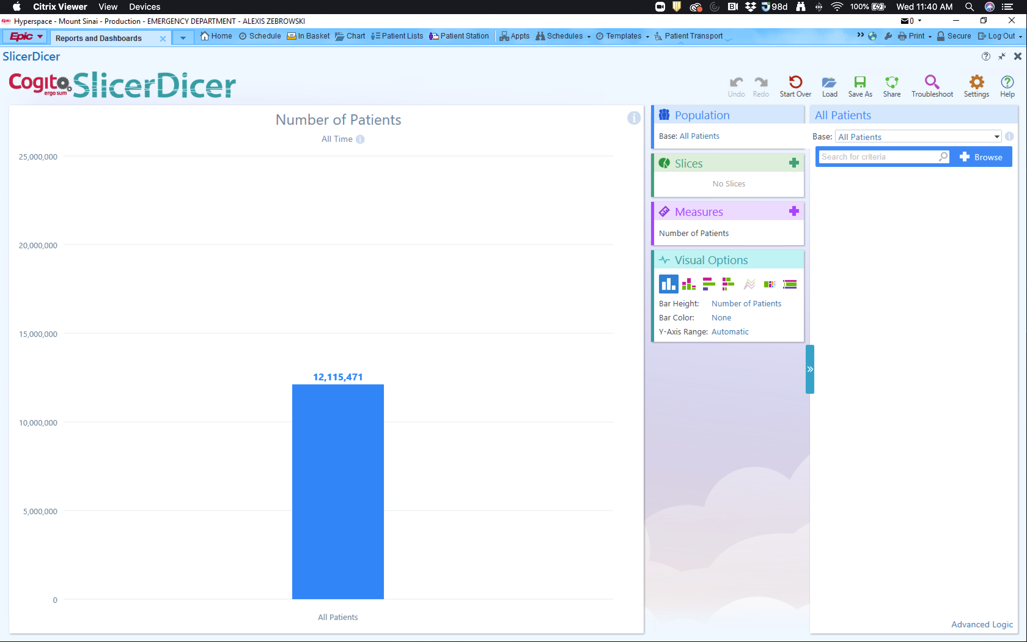
SlicerDicer is located in the Epic main menu under Reports.

Slide 7
You can identify population and ”slice” the data using these filters

Slide 8
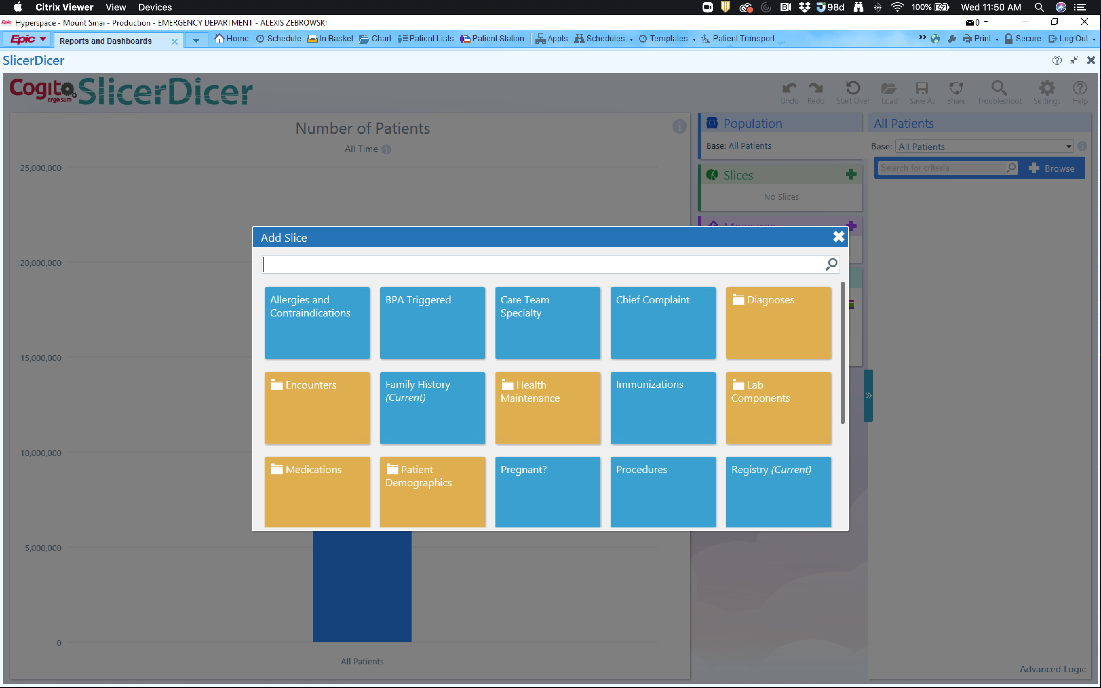
Options for ”slicing” the data

Slide 9
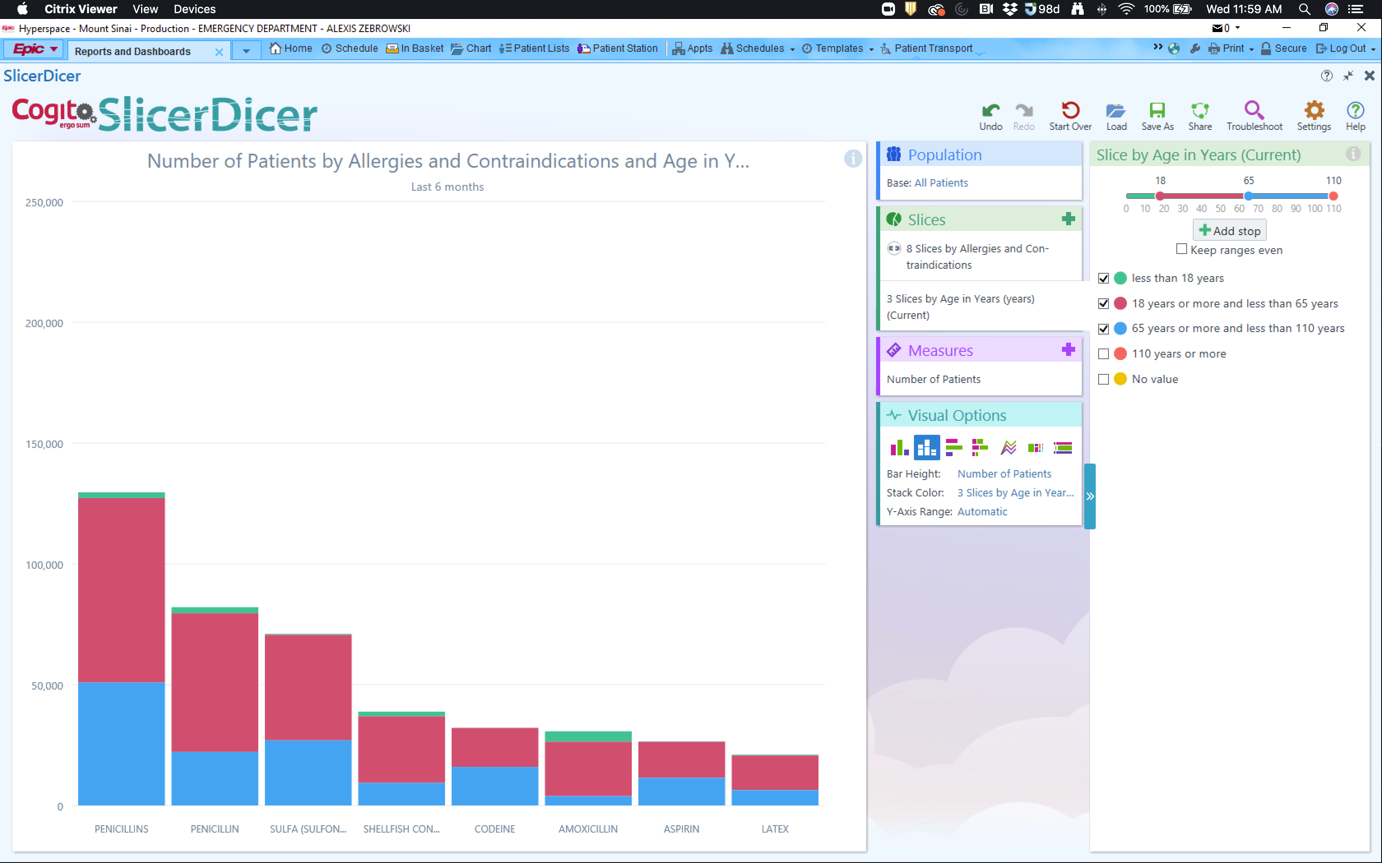
You can modify how you see your data

Slide 10
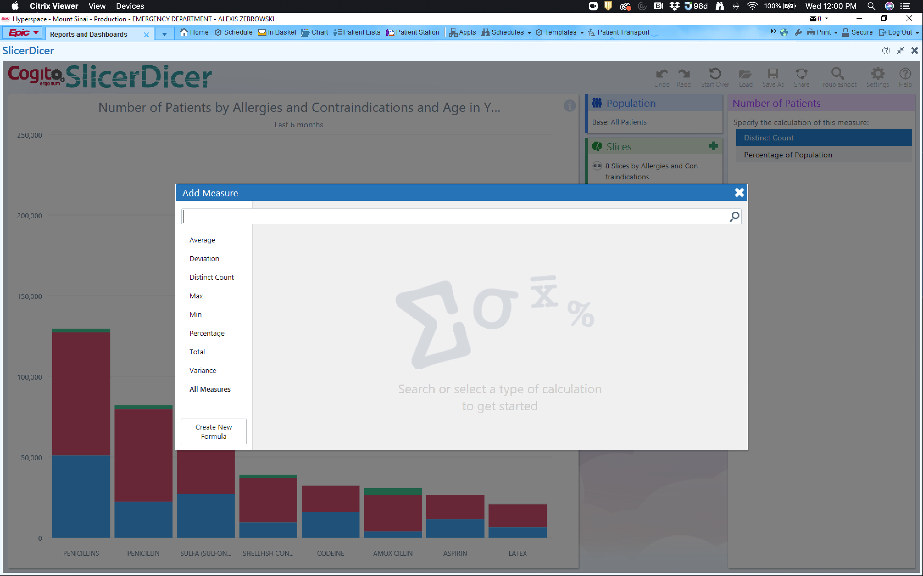
Various descriptive statistics can also be calculated via the “Measures” tab

Slide 11
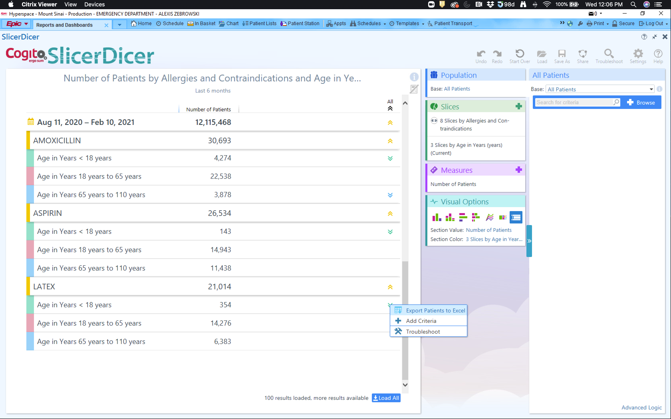
From the ”Number of Patients” option, you can export your data to RWB, look up charts, etc. for further investigation

Slide 12
Epic SlicerDicer
Pros:
No external costs
Easy to use
Quick
Great for first pass/feasibility
Can easily see how changing criteria impacts numbers
Cons:
Limited ways to “slice” data
Accuracy may be reduced depending on question
Requires Epic access (read only is fine)
Best for small number of “slices” with specific inclusion/exclusion criteria

Slide 13
Important to Remember
How are you using the data:
Research requires an IRB!!!
Speak with research faculty about requirements
IRB determines if study is exempt
Start with least amount of PHI necessary
You are responsible for your data
Keep data secure (computer, email, drives)
Reported data must be aggregated for research purposes

Slide 14
Next Steps
Read and complete the attestation
If you are unsure of how to proceed:
Submit a request to the EM Analytic Core
Review the tutorials
Discuss your project with a research faculty member
Check out the research trainings offered

